Slide 1

Machine Learning Homework
Loan Dataset
Macoveiciuc Teodor-Mihai
1241B

Slide 2
Introduction
Problem Definition:
Classifying loan statuses (approved/rejected) using machine learning.
Objectives:
Explore data insights, pre-process effectively, handle class imbalance, and evaluate model performance.

Slide 3
Dataset description
Number of columns and entries: 28 col, cca. 45k entries
Col: age, loan, credit score etc
Challenges:
  Missing (maybe not that important) information such as marital status
  Standardization of the dataset for model’s stability
  Big dataset (taking some time to train certain models

Slide 4
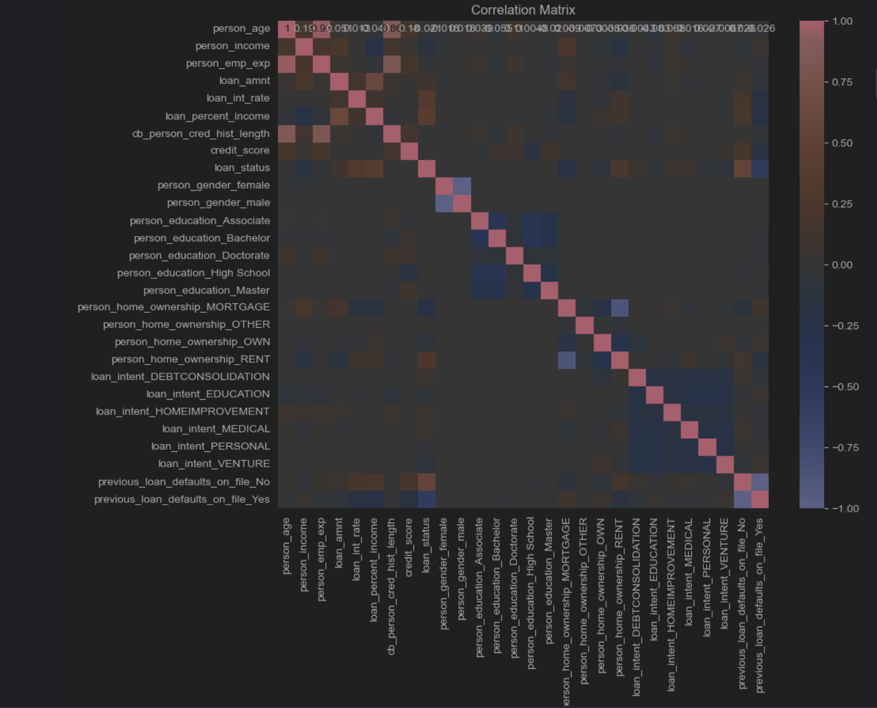
Exploratory data analys

Slide 5
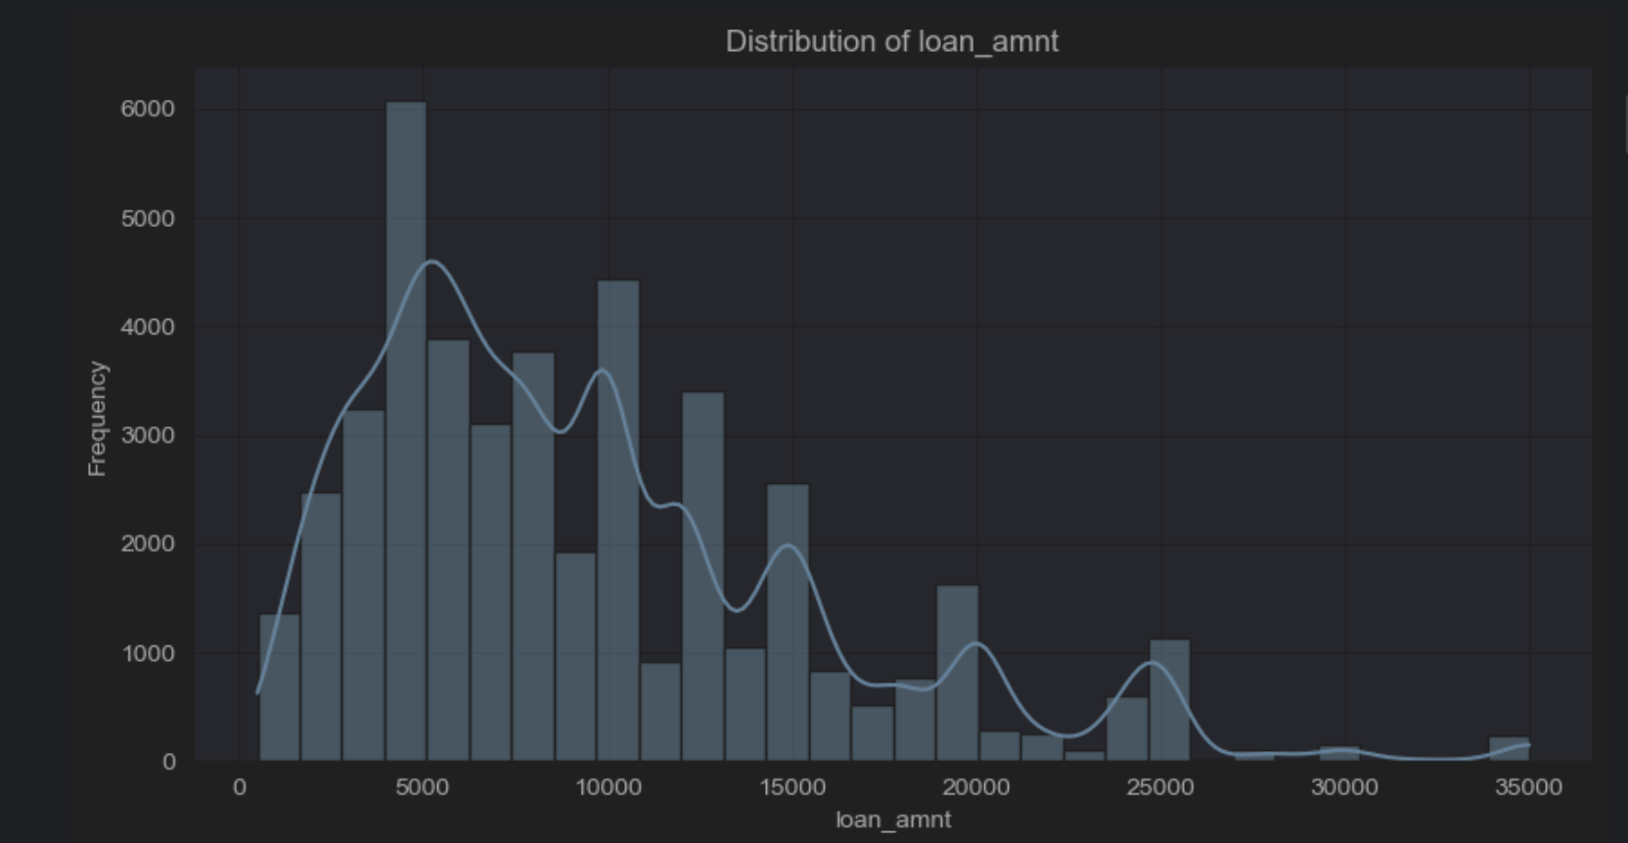
Distribution

Slide 6
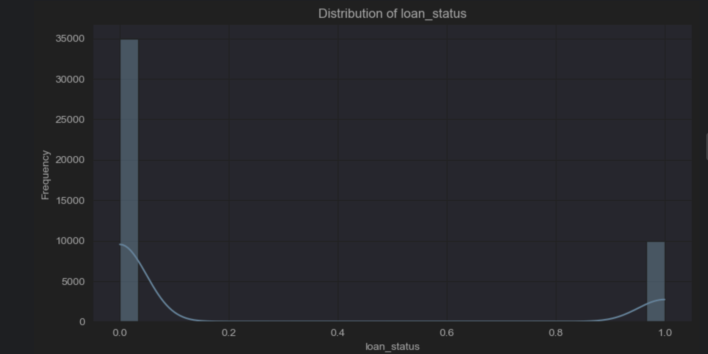
Low data graph

Slide 7
Data preprocessing
Steps Taken:
Outliers: Detected and addressed using winsorization.
Missing Values: Filled using mean and mode imputation.
Encoding: Applied one-hot encoding for categorical variables.
Scaling: Standardized numerical data with StandardScaler.
Dimensionality Reduction: Used PCA to reduce multicollinearity.

Slide 8
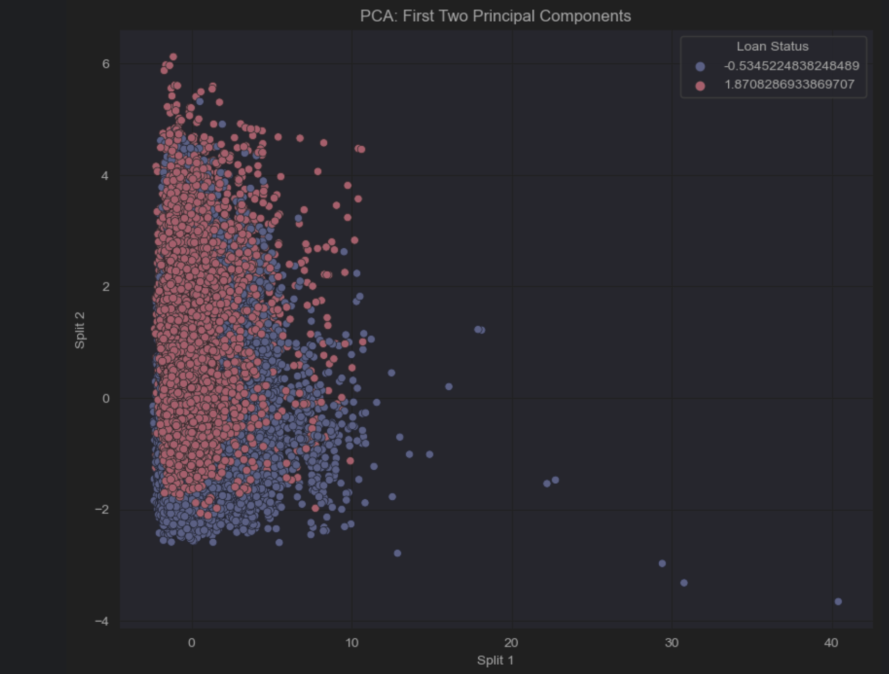
Standardization

Slide 9
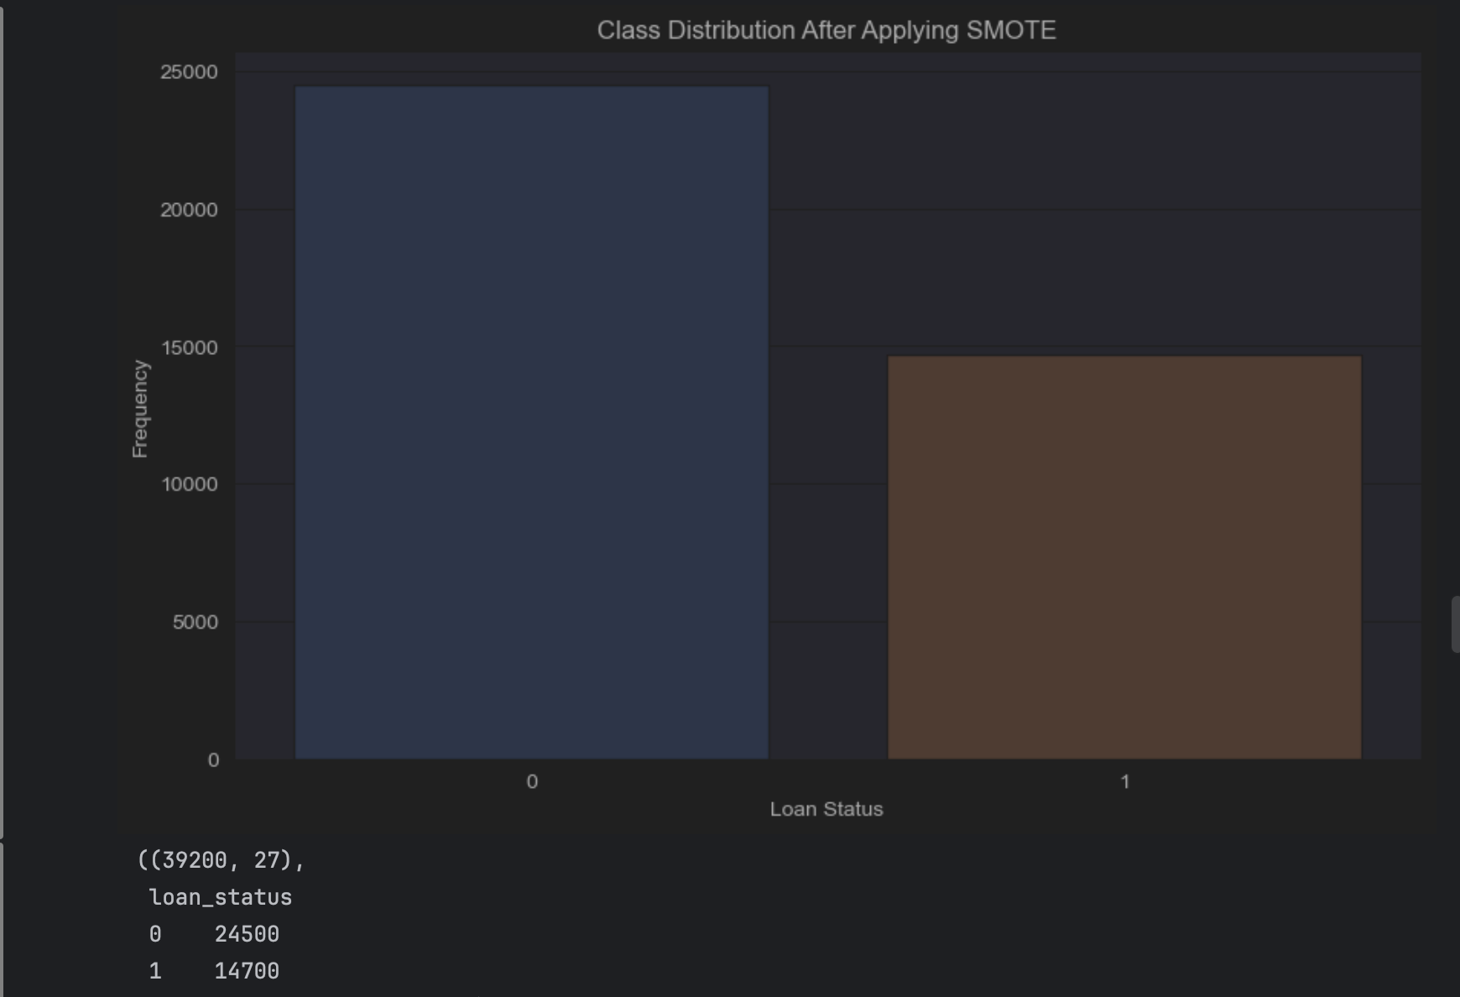
Class distribution after applying SMOTE

Slide 10
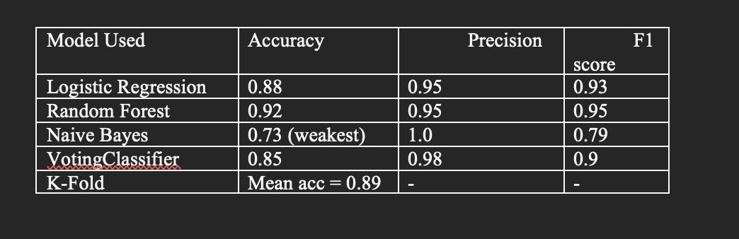
Machine learning Models

Slide 11
Model Comparision
Logistic regression:
Strength: Balanced performance across all metrics, efficient and interpretable.
Weakness: Slightly lower accuracy than Random Forest.
Random forest:
Strength: Best overall performance due to its ensemble nature.
Weakness: Computationally more expensive compared to Logistic Regression.

Slide 12
Model comparison
Naive Bayes:
Strength: High precision.
Weakness: Struggles with recall, leading to a low F1 score. Poor performance in terms of overall accuracy
Voting classifier:
Strength: Combines strengths of multiple models, improving precision.
Weakness: Accuracy slightly lower than Logistic Regression and Random Forest.
K-fold:
Provides a robust measure of model performance across splits.

Slide 13
Conclusion of models
Best Model: Random Forest due to its highest accuracy and F1 score.
Naive Bayes should be avoided as its accuracy is significantly lower.
Voting Classifier can be used for enhanced precision in certain applications.

Slide 14
Conclusionm, challenges and solutions
Challenges: Imbalance in classes (solution with SMOTE)
Computational ineffiency with SVM (replaced with another model)
In conclusion:
Voting Classifier is the best-performing model.
Random Forest was the top individual model.

