Slide 1
GAME2023
Game Engine II
Week 12
Level Streaming

Slide 2
Level Streaming Overview
Sublevels: levels within a level
Load, unload, show, and hide entire maps dynamically at runtime
Break up a very large world into chunks and seamlessly load the parts that are needed during gameplay
Reduce how often players see loading screens
Collaborate with other team members on different parts of the level by separating it into sublevels

Slide 3
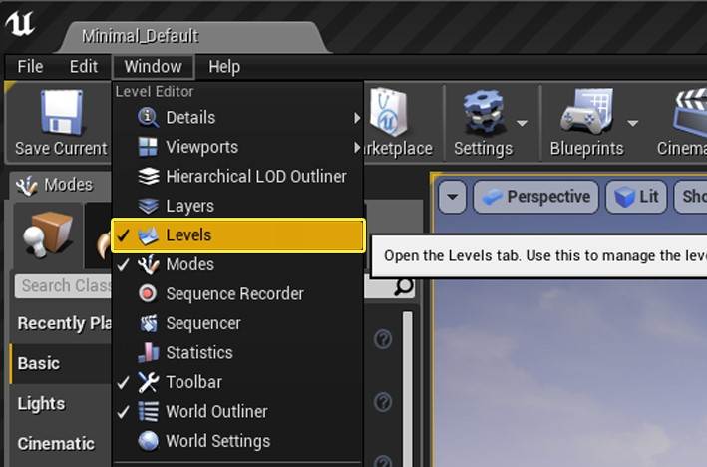
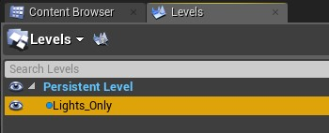
Levels
The Persistent Level
This is the ‘master level’. This is the level that will be responsible for hosting the streaming levels. This is a normal level, nothing special yet.
Streaming Levels
Managed through the ‘Levels’ window
Can be “AlwaysLoaded”, loaded through Blueprints, managed through Streaming Volumes, or World Composition subsystem

Slide 4
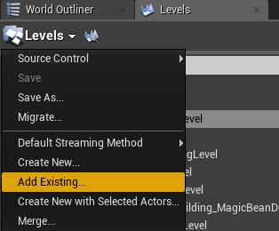
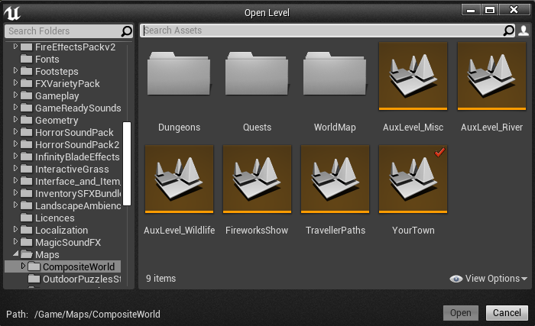
Adding a Streaming Level
Open the Map that will be your PersistentLevel
You can use any existing level:
In the Levels panel, use the “Levels” drop down and select Add Existing
Select the existing level to be a streaming level from the familiar Open Level interface
Or you can create a new level with “Create New...” from the Levels drop down

Slide 5
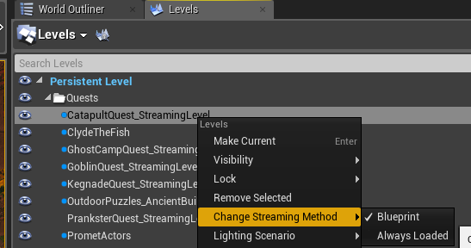
Streaming Method
The streaming method of a sublevel can be “Blueprint” or “Always Loaded”
Right-click on the level in the levels panel to change this under “Change Streaming Method”
Blueprint Method:
Enables dynamic Streaming that can be controlled through Blueprints and other methods (including C++).
Always Loaded Method:
The level will always be loaded and visible, so long as the PersistentLevel is loaded.
Useful for when the level has been broken up into sections for dev management reasons, but should never be unloaded.

Slide 6
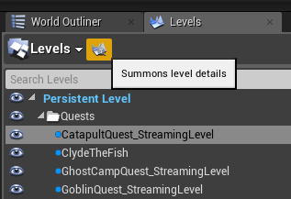
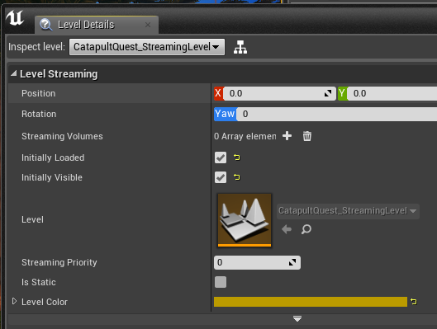
Streaming Level Config
Through the “Level Details” panel you can configure streaming levels
Position and Rotation:
Entire streaming levels and all contained actors can be moved & rotated. The “Viewport Edit” button can be used to show a transform widget to position it.
Initially Loaded & Visible
These options are used for Blueprint Streaming volumes.
Level will be Loaded/Visible on level start if they are enabled.

Slide 7
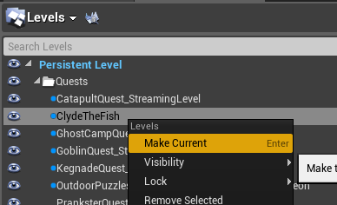

Current Level
The “Current Level” is where newly spawned actors will be placed.
To select the Current Level, open the Levels panel and:
Double click on the level in the list
OR Right-click it and “Make Current”
The currently selected level will be bolded

Slide 8
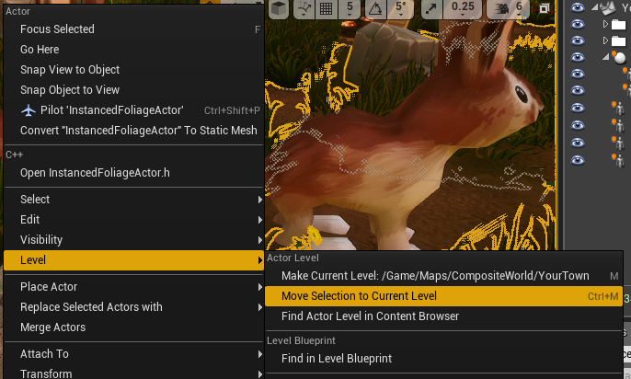
Moving Actors from one level to another
When working with streaming levels, you’ll sometimes want to move an actor from one level to another. This is easy to do:
In the Levels panel, make the level to move the actors to the “Current Level”
In the viewport, select the actors to move and right-click on one of them.
In the Level submenu, choose “Move Selection to Current Level”
Note that there is also a shortcut in this menu to make the selected actors’ level the current level. This has proven a useful shortcut in my experience.

Slide 9
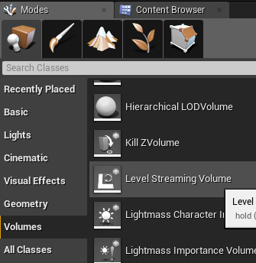
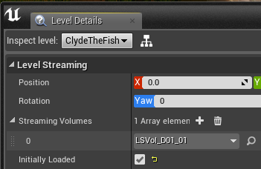
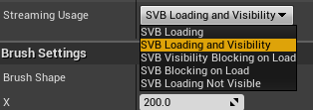
Level Streaming Volumes
Level Streaming Volumes are brushes that are used to manage loading and visibility states of streaming levels
When a viewpoint is inside of a volume associated with a level, a load/unload request is sent to the level
Behaviour based on the Streaming Usage of the volume
Streaming levels are assigned to a level from the Level Details panel. More than one can be assigned
More details: https://docs.unrealengine.com/en-US/Engine/LevelStreaming/StreamingVolumes/index.html

Slide 10
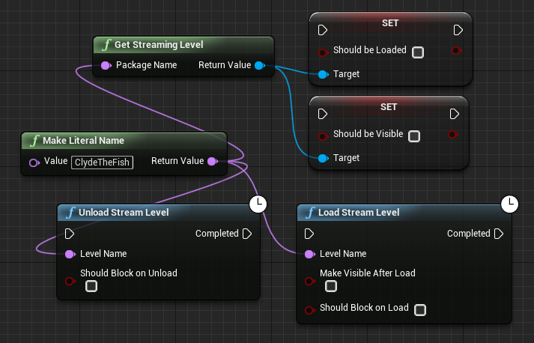
Scripted Level Streaming
Blueprints:
Load and Unload Stream Level latent functions can be used, along with the exact map name.
Alternatively, the Should Be Loaded and Should Be Visible flags can be enabled or disabled. The engine will detect this flag change and will set the level to the desired state when next available (ie. next tick)

Slide 11
Scripted Level Streaming
Similarly in C++:
Load and Unload Stream Level is also available from C++ through UGameplayStatics::
GetStreamingLevel returns ULevelStreaming* which has our bShouldBeLoaded and bShouldBeVisible flags and associated setter/getter functions
/** Stream the level with the LevelName ; Calling again before it finishes has no effect */ static void LoadStreamLevel(const UObject* WorldContextObject, FName LevelName, bool bMakeVisibleAfterLoad, bool bShouldBlockOnLoad, FLatentActionInfo LatentInfo);
static void UnloadStreamLevel(const UObject* WorldContextObject, FName LevelName, FLatentActionInfo LatentInfo, bool bShouldBlockOnUnload);
static class ULevelStreaming* GetStreamingLevel(const UObject* WorldContextObject, FName PackageName); eg: FLatentActionInfo LatentInfo; UGameplayStatics::LoadStreamLevel(this, levelName, true, true, LatentInfo);

Slide 12
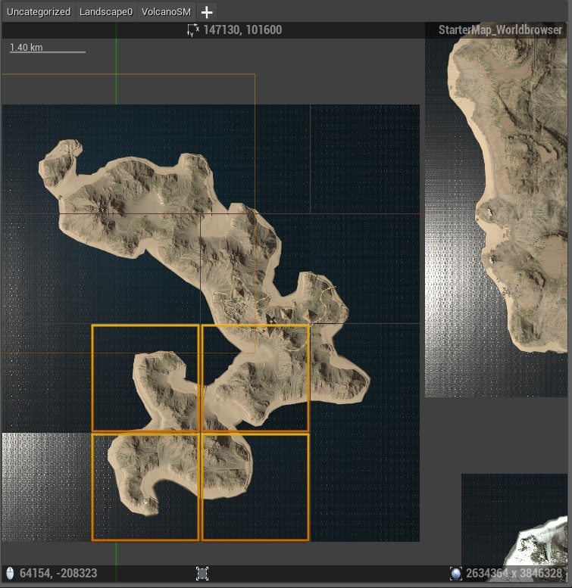
World Composition (Advanced - open worlds)
For sake of completeness, I will mention there is a powerful system that can help manage streaming levels conveniently for large open worlds.
This is an opt-in system that will require a change to the layout of your map project folders to use.
Details can be found here: https://docs.unrealengine.com/en-US/Engine/LevelStreaming/WorldBrowser/index.html

Slide 13
Additional Resources
Collaborating with Sublevels
https://docs.unrealengine.com/en-US/Engine/Levels/CollaborateWithSublevels/index.html
Managing Multiple Levels
https://docs.unrealengine.com/en-US/Engine/Levels/LevelsWindow/index.html
Level Streaming Documentation
https://docs.unrealengine.com/en-US/Engine/LevelStreaming/index.html

