Slide 1
GAME2023
Game Engine II
Week 10
Networking I - Replication

Slide 2
Networking in UE4
Unreal has very robust built-in networking architecture to work from
Developed upon since Unreal Engine 1
Thoroughly tested and reliable
Client & Server Model through Replication

Slide 3
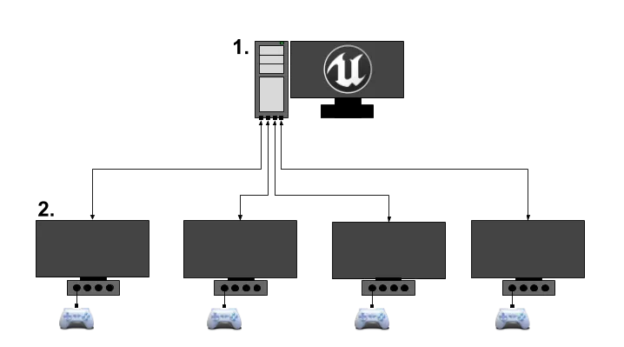
Client-Server Model
Server (Game Host)
Can be standalone command line server OR hosting player computer (a.k.a. Dedicated or Listen Server)
One true Authority on game state
Processes gameplay
Clients (Players)
Processes gameplay as a Remote client
Usually similar logic paths to the server, branching only when authority is required
Gamestate is overwritten by Replicated server data periodically
Displays most up to date game state

Slide 4
Creating a server
As Listen Server (host is also a player)
Command line launch: <game.exe> <map>?listen -game
As Dedicated Server (headless, server is not a player)
Command line launch: <game.exe> <map> -server
Packaged games could also include <game>server.exe
Usage: <game>server.exe <map>
Joining a server
From command line: <game.exe> <Server IP> -game
From the in-game console: open <Server IP>

Slide 5
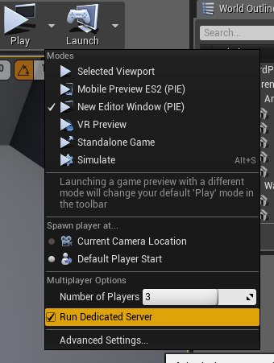
Creating a server (cont.)
With PIE
In the play options, select Number of Players greater than 1.
Launch in New Editor Window.
Multiple instances of the game will launch at the same time, and automatically connect to the hosting instance or server.
As Dedicated Server with PIE
Enable the “Run Dedicated Server” flag to run a separate, headless, instance as the server.

Slide 6
Client-Server Gameplay
Clients should be treated as simple displays for game state and should avoid directly affecting important game data.
Input from the clients should be relayed to the server for processing.
Client can simulate the exact same code as the server, but beware that they may be overridden by the server’s true authority.
Assume Cosmetic changes are the only safe direct changes from clients.
Clients can communicate to other clients through the server only, they do not have a direct connection to other clients (ie. p2p connections).
Data is transmitted through Replication from the Authority to the Remote role connections (according to documentation, this currently only ever occurs from server to client)
Calling Functions over the network is done through RPCs (Remote Procedural Calls)

Slide 7
Role/RemoteRole
All Actors have the properties Role and RemoteRole
These describe important information:
The level of access the local or remote machine has over this actor (who has authority)
If this actor is replicated or not
The mode of replication
If (Role==ROLE_Authority) //or HasAuthority()
The local machine is the owner of the actor (meaning the actor was spawned from this game instance, usually the server). Only this machine should make important decisions about this actor’s data.
If (Role==ROLE_SimulatedProxy)
The local machine is not the owner; this actor is replicated. This is the usual simulation path
This actor will also simulate movement (extrapolating based on last known velocity) to avoid choppy or sporadic movement.
If (Role==ROLE_AutonomousProxy)
The local machine is not the owner; this actor is replicated. Generally only actors possessed by PlayerControllers.
Means that this actor is receiving inputs from players, giving better information for extrapolating simulated movement.

Slide 8
Replication
Actors and Components support replication
Note: Component replication is a bit more involved, and any object can be made to support replication with some effort.
Server data that is marked for replication, and is ‘dirty’ (changed since last update), is packaged up on a special Replication tick, and sent to every connected client.
Replication ticks do not execute every frame. This would be very heavy network usage and would result in many dropped packets, and wasteful network saturation.
Replicating properties C++:
UPROPERTY(Replicated) int32 Health;
DOREPLIFETIME(AMyActor, Health);
From GetLifetimeReplicatedProps function
Actor replication can be enabled/disabled using AActor::SetReplicates(bool)
Replicating properties from Blueprints
Enable: “Replicates” in Class Defaults
Mark properties as “Replicated”
Conditions can be applied to properties to control when it should or shouldn’t replicate.

Slide 9
Additional Resources
Documentation: https://docs.unrealengine.com/en-US/Gameplay/Networking/index.html
Wiki: https://wiki.unrealengine.com/Networking/Replication

