Slide 1
GAME2023
Game Engine II
Week 13
Performance Profiling

Slide 2
Profiling
Slow framerates? Frame hitches?
What is the cause?
Where to start?
Tools available in UE4:
Built-in stat cycle counters
Customizable stat cycle counters
UE4 GPU Profiler
UE4 CPU Profiler

Slide 3

Low FPS
Identify the Bottleneck
What is our framerate? New Command: stat fps Top Number: Frames per Second Bottom Number: Milliseconds per frame
FPS is valuable to as a target (eg. aim for 60+ FPS, never fall below 30 FPS)
MS/F is valuable to measure the value of each optimization. This is because the change in MS is linear. 10ms/f is a lot no matter what your FPS is, while 10 FPS can mean a lot at lower frame rates, but very little at higher frame rates.
Keep these numbers green. Aim for low MS/F and high FPS.

Slide 4

Low FPS
CPU or GPU? New Command: stat unit The first step to knowing where to start is to know if you’re dealing with a CPU or GPU bottleneck. Optimizations and profiling tools can be quite different depending on this factor.
Frame: The total amount of time spent in 1 frame of the game.
Game: Milliseconds spent per frame in the Game thread. (CPU)
Draw: Milliseconds spent per frame in the Rendering thread. (CPU)
GPU: Milliseconds spent per frame on the Video Card, rendering the frame. (GPU)

Slide 5
Low FPS
CPU or GPU? (continued…) How do I read these numbers?
The Game thread and Draw thread sync up before finalizing the thread, so Frame will likely be close to one of these two numbers.
GPU is synched to the frame, and will likely be very close to the Frame time.
If Game time is very close to Frame time, you are Game thread limited.
If Draw tim is very close to Frame time, you are render thread limited
If NEITHER the Game or Draw times are close to the game time, but GPU time is, then the video card work is the bottleneck.

Slide 6
CPU Profiling
CPU Bound on Render Thread (Draw)
Likely cause: too many draw calls
New Command: stat SceneRendering
Look for “Mesh Draw Calls” in this stat list
On High End PCs - Thousands of draw calls are acceptable (eg. 10K)
On Mobile and standalone VR (eg. Oculus Quest) - Hundreds of draw calls are acceptable. (eg. 200)
Reduce how many things are drawn, combine meshes together, use HLoDs, and use InstancedStaticMeshes instead of StaticMeshes
CPU Bound on Game Thread
New Command: stat Game New Command: stat Quick New Command: stat Slow New Command: List of all stat commands
Most of the game code, including blueprint ticks and functions, are run on the single Game thread.
These commands give realtime graphs/charts and are a good start to get a hint of what is causing the slowdowns.

Slide 7
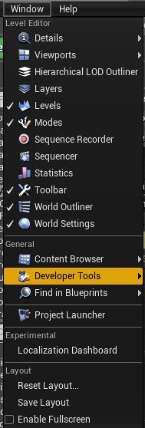
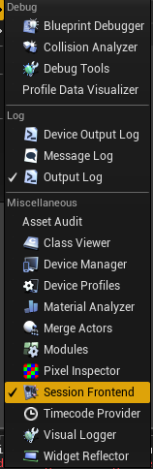
CPU Profiling
Session Frontend Profiler
Stat counters provide a realtime look into the application, but we can track these over a period of time to record a history of activity.
A built-in Profiler can be used to gather this information.
A standalone version can also be found under ‘\Engine\Binaries\Win64\UnrealFrontend.exe’
https://docs.unrealengine.com/en-US/Engine/Performance/Profiler/index.html

Slide 8
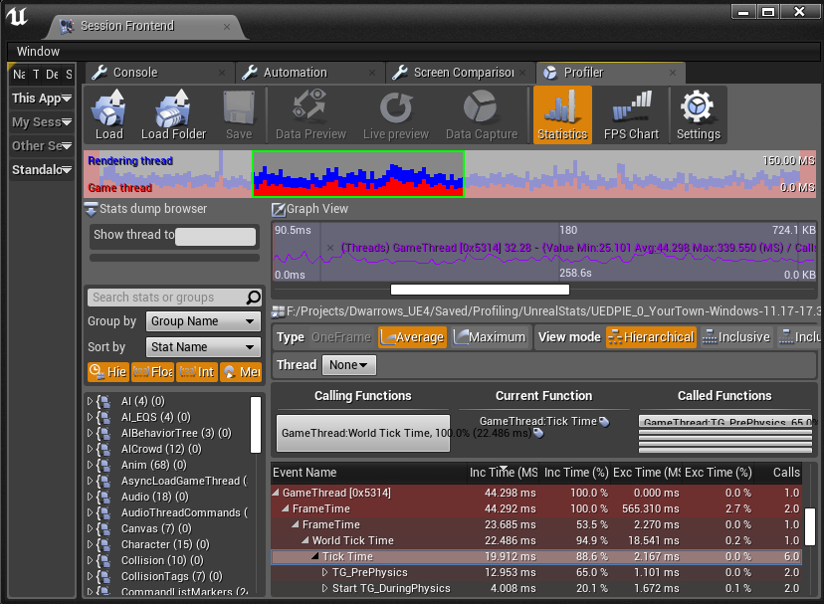
Profiler
This tool captures a snapshot of the scope counters, per frame.
A hierarchy of function calls can be followed to track down the most expensive one.

Slide 9
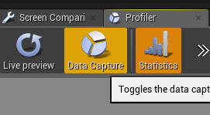
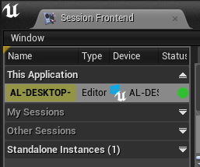
Profiler
If launched from the editor, to begin a capture from a live editor session: Under “This Application” on the left side, select the editor instance.
Once the session has been selected, under the “Profiler” tab, hit “Data Capture” to start and stop capturing data.
The longer the capture, the more accurate an average might be, but the larger and slower the dataset is to work with. 10-20 seconds is a good length for most captures, in my experience.

Slide 10
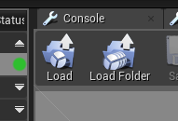
Profiler
In a dev build, you can start recording in two ways:
Launch the executable with the ‘-messaging’ parameter to enable live recording
OR
Once loaded into the game use the following commands to begin and end recording a file which will be output to \Saved\Profiling\UnrealStats\
New Command: stat StartFile
New Command: stat StopFile
You can load this file in the profiler using the ‘Load’ button

Slide 11
Custom stat counters in C++
Stat commands are very helpful to give a quick look into performance metrics of individual native function calls.
By default, they tell you very little about your own code.
You can define your own counters for your functions, and track how often they are called or how much time per frame they occupy
This requires a Stat Group and a Scope Cycle counter.
//Declare a stat group DECLARE_STATS_GROUP(TEXT("MyStatGroup"), STATGROUP_MyStatGroup, STATCAT_Advanced);
//Custom macro to help declare new cycle counters #define MyStatGroup_SCOPE_CYCLE_COUNTER(Stat) \ DECLARE_SCOPE_CYCLE_COUNTER(TEXT(#Stat),Stat,STATGROUP_MyStatGroup)
//Declare your cycle counter - this will track how long it took for this scope to execute for every call void MyFunction { //Will appear in 'stat MyStatGroup' and CPU Profiler MyStatGroup_SCOPE_CYCLE_COUNTER(STAT_MyFunction); }

Slide 12
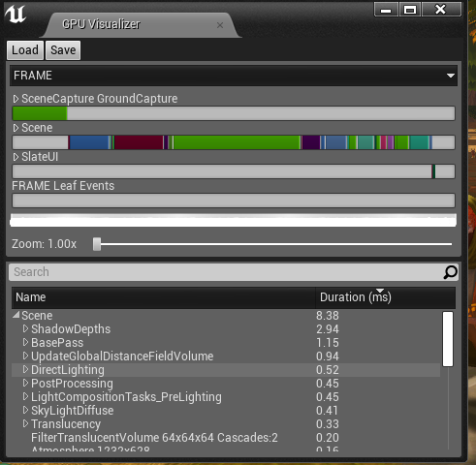
GPU Profiler
When GPU bound, the CPU will often be waiting for the video card to complete before moving on to the next frame.
The CPU profiler will not clearly tell us what is happening on the GPU.
Realtime GPU data (less accurate): New Command: stat GPU
GPU Capture with the GPU Profiler: New Command: ProfileGPU New Command: ProfileGPUHitches Shortcut: CRTL+Shift + ,
https://docs.unrealengine.com/en-US/Engine/Performance/GPU/index.html

Slide 13
Profiling Tips
For quick iterations on a first pass, use the stat commands and the CPU Profiler in a New PIE Window
Minimize the editor while running the profiler. The editor adds plenty of noise and overhead to confuse the actual bottlenecks.
For more accurate profiling sessions (later stages of development), use stat StartFile and stat StopFile commands in a DEVELOPMENT packaged build.
Load this generated into the Frontend Profiler for an accurate representation of bottlenecks
Using commands Pause or Slomo 0.01 can help isolate performance problems
This will slow down or stop the Tick function on all actors
Tick functions are especially expensive, especially on Blueprint actors, even if it barely does anything.
For loops in Blueprints have A LOT more overhead than C++ loops. Move these over whenever necessary.
Tackle the biggest bottlenecks first. If there is 20 ms/f of overhead, 0.5 ms is a droplet in the ocean and should be left for later.

Slide 14
Additional Resources
Performance and Profiling Documentation
https://docs.unrealengine.com/en-US/Engine/Performance/index.html
Profiler Tool Reference
https://docs.unrealengine.com/en-US/Engine/Performance/Profiler/index.html
How to Improve game Thread CPU Performance in Unreal Engine (Blog - 2014 but still relevant)
https://www.unrealengine.com/en-US/blog/how-to-improve-game-thread-cpu-performance
External tools, not covered but worth looking into:
Visual Studio profiler
RenderDoc (OpenSource graphics debugger, with optional plugin)
PIX for Windows

