Slide 1
GAME2023
Game Engine II
Week 1
Splines in Unreal Engine 4

Slide 2
Introduction
Alain Bellemare
alain.bellemare@georgebrown.ca
Course Outline:
See Blackboard

Slide 3
Course Outcomes
Continue exploring more advanced features of UE4
Add Saving and Loading for simple and complex games
Explore Artificial Intelligence sub systems in UE4
Shader programming through UE4’s Material editor
Adding Multiplayer support to your Unreal projects

Slide 4
Evaluation System
Assessment Tool: | Description: | Date / Week: | % of Final Grade:
Labs (8) | Weekly programming tasks | 2-6, 9-13 | 30
Assignment (1) | Practical coding projects | 14 | 20
Midterm Exam | Test on code and theory | 7 | 25
Final Exam | Test on code and theory | 15 | 25
 |  | TOTAL: | 100%

Slide 5
Course Outline
Week | Topic / Task | Content / Activities | Resources
1 | Splines | Lab 1 | Class Notes
2 | Serialization I |  | Class Notes
3 | Serialization II | Lab 2 | Class Notes
4 | Nav Mesh & Path finding | Lab 3 | Class Notes
5 | Behaviour Trees | Lab 4 | Class Notes
6 | Environment Query System | Review Lab 5 | Class Notes
7 | MIDTERM EXAM

Slide 6
Course Outline
Week | Topic / Task | Content / Activities | Resources
9 | Materials | Lab 6 | Class Notes
10 | Networking I - Replication |  | Class Notes
11 | Networking II - RPC | Lab 7 | Class Notes
12 | Level Streaming | Lab 8 | Class Notes
13 | Performance Profiling |  | Class Notes
14 | Data Tables Assignment Due | Review | Class Notes
15 | FINAL EXAM

Slide 7
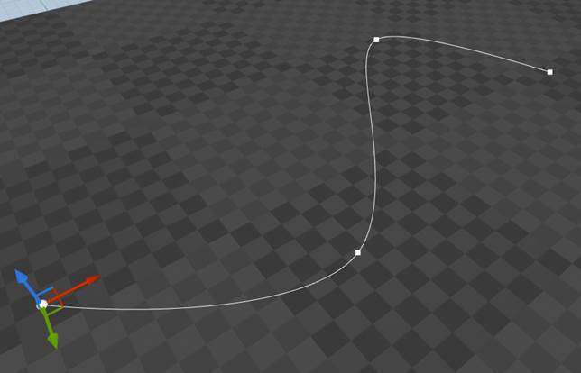
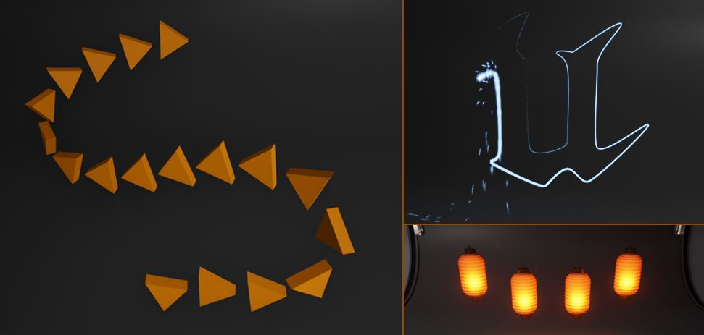
Splines
Splines are Paths or Curved Lines connected together by Spline Points
Can be used to:
Place Actors or components along a curved path (eg. create roads or rivers)
Move Actors or components along a curved path (eg. follow road, or send an electricity particle through cables)

Slide 8
Types of Slines
Spline Components
Add an editor modifiable spline to any actor
Many functions exist to extract information about locations and tangents of a spline at a given ‘time’ or ‘relative distance’ on a spline
Example uses: Strict path for ai to follow, ‘lit fuses’, a swaying rope bridge, imperfectly positioned fence posts, etc...
https://docs.unrealengine.com/en-US/Engine/BlueprintSplines/index.html
Landscape Splines
Can be used to place and deform meshes on the terrain
Deforms the terrain to fit the placed mesh
Example uses: Chasm, rivers, roads https://docs.unrealengine.com/en-US/Engine/Landscape/Editing/Splines/index.html

Slide 9
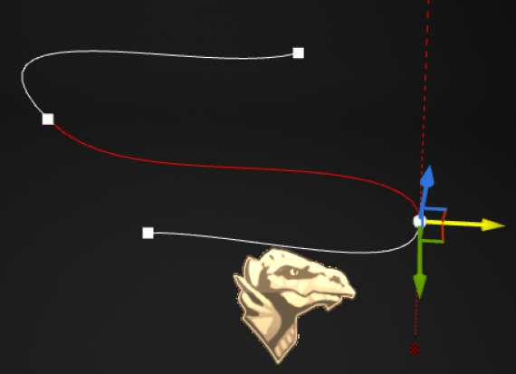
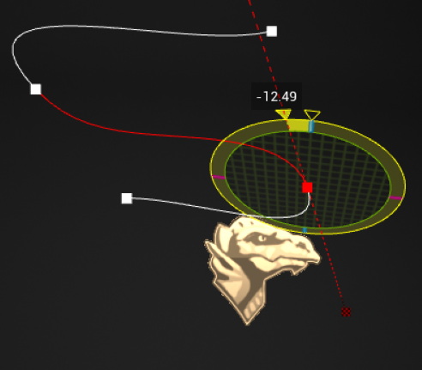
Manipulating Spline Points
Splines utilize Cubic Bézier curves internally to calculate the curves from each point.
The Rotator tool can be used to affect the angle of the curve at each point
The Move tool can be used to … move each spline point in 3 dimensions

Slide 10
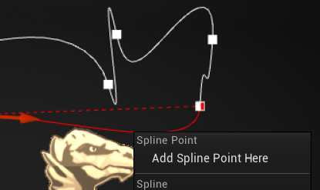
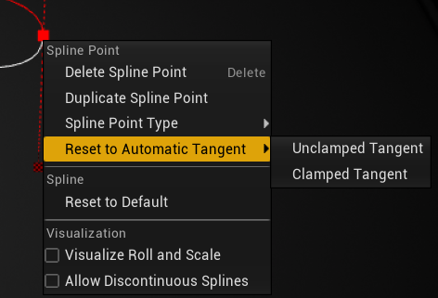
Manipulating Spline Points
Hold CTRL and then Click on spline points to select multiple at a time if you want to change multiple at once
Right click a spline point for some advanced options (resetting tangents to cleanup messy curves, or change their curve type)
Add more spline points by ALT+Dragging an existing spline point
OR right click somewhere on the spline and hit “Add Spline Point Here”

Slide 11
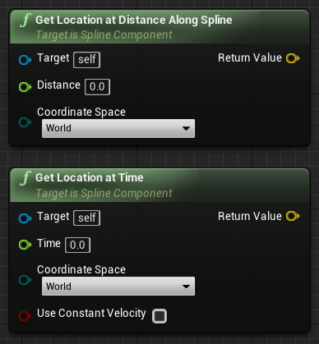
Programmatically Using Splines
The World or Local (relative) Location along a spline can be retrieved using these two functions.
Distance in GetLocationAtDistance is in CM
Time in GetLocationAtTime is from 0 to spline::Duration (which is in ‘seconds’ according to the comments - ignore this, it isn’t related to spatial relativity). This is useful for use as a percentage, from 0-duration.

Slide 12
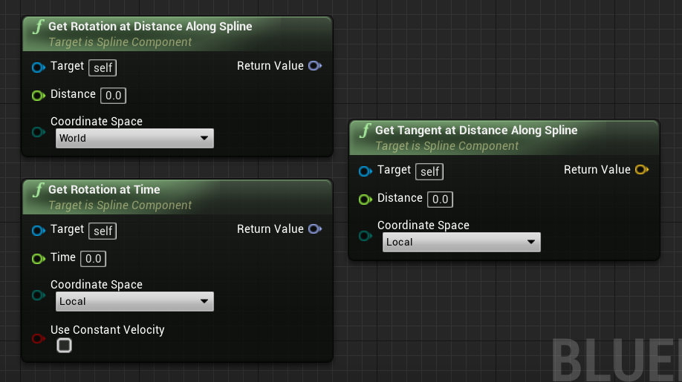
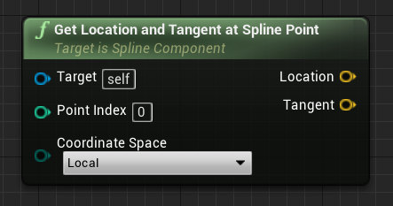
Programmatically Using Splines
Similarly, the Rotation and Tangent can be retrieved by distance or time
Spline point index can also be used:

Slide 13
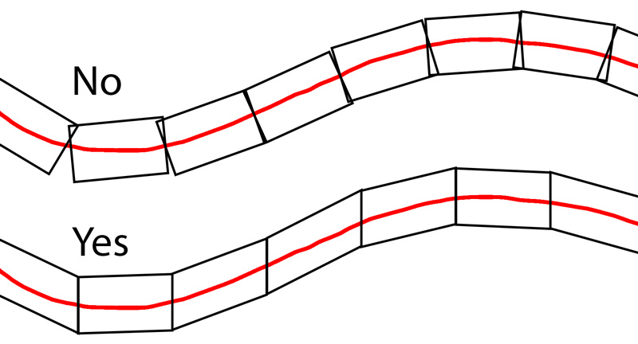
Spline Mesh Components
Roads and tracks can bend
Static meshes can only rotate, not bend
Enter: Spline Mesh Components.
With a start and end location and tangent, spline mesh vertices will be morphed along with your spline!
Add multiple meshes together using this method to create roads, tracks, or pipes
Notes: Collision vertices and mesh vertices composition is important to allow for clean bends.

Slide 14
Additional Resources
See the Blueprint_Splines map in the free ContentExamples project:
https://docs.unrealengine.com/latest/INT/Resources/ContentExamples/Blueprint_Splines/
This Live Training video to build a road with guardrails (old but still relevant - although with some minor function name changes):
https://www.youtube.com/watch?v=wR0fH6O9jD8

