Slide 1
GAME2023
Game Engine II
Week 4
NavMeshes and Pathfinding

Slide 2
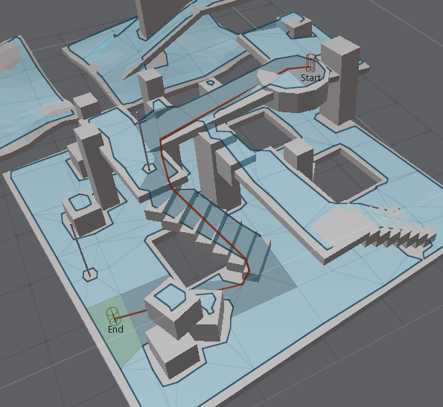
NavMesh
A NavMesh is a type of graph used for open area path finding.
Made up of actual polygons (vertices and faces)
Automatic Mesh generation with configurable agent dimensions and step height (how high off of the ground they can step onto)
Avoids obstacles and otherwise invalid terrain
Can optionally update dynamically at runtime through modifiers & invokers

Slide 3

NavMesh and Pathfinding
In UE4
Uses the OpenSource “Recast” system for generating the NavMesh
Uses the associated OpenSource “Detour” pathfinding system
Also supports “DetourCrowd”, which is more limited in some ways but better simulates crowd agent movements
Recast/Detour GitHub: http://masagroup.github.io/recastdetour/index.html

Slide 4
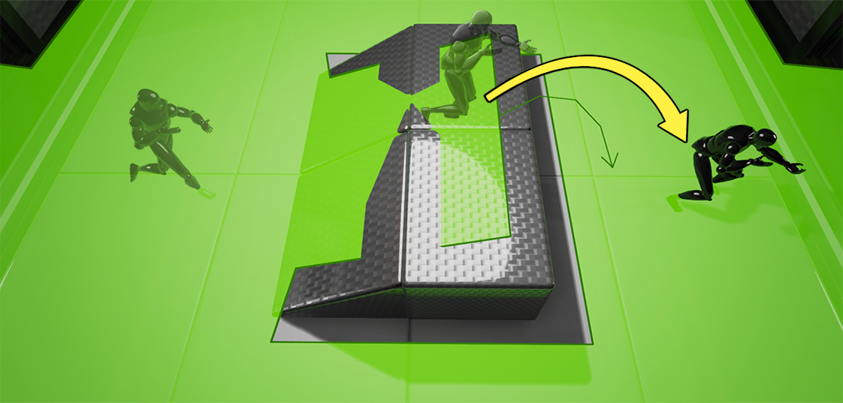
NavMesh and Pathfinding
In UE4
Engine Source implementation for these systems can be found in:
Engine\Source\Runtime\Navmesh\
Engine\Source\Runtime\AIModule\Classes\Navigation\
Supports fast Baked version and Runtime built NavMeshes
Also supports Jump Points (NavLinkProxy)

Slide 5
Navigation Important Classes
ANavMeshBoundsVolume
Defines an area where a navigation mesh will be generated
ARecastNavMesh
The actual generated NavMesh actor, which holds the navigation data
UNavModifierComponent
Nav modifier can affect specific areas of the NavMesh by changing the pathfinding ‘cost’ to either prefer or avoid an area, or changing the ‘type’ of area
ANavModifierVolume
A built in drop-in actor that can apply NavModifier components
UNavigationInvokerComponent
Used in Dynamic runtime generation
A specified radius around the hosting actor will trigger dynamic NavMesh generation at runtime
ANavLink & UNavLinkComponent
Informs AI about gaps to jump over
Specifies a jump start and end point as a guide for the AI to jump

Slide 6
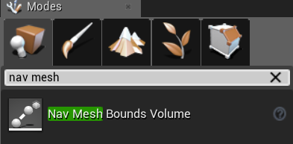
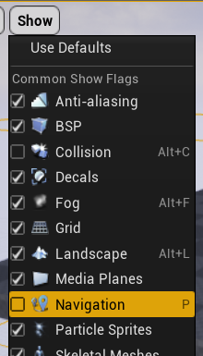
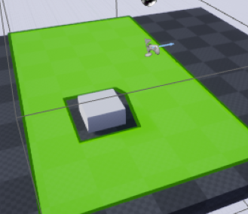
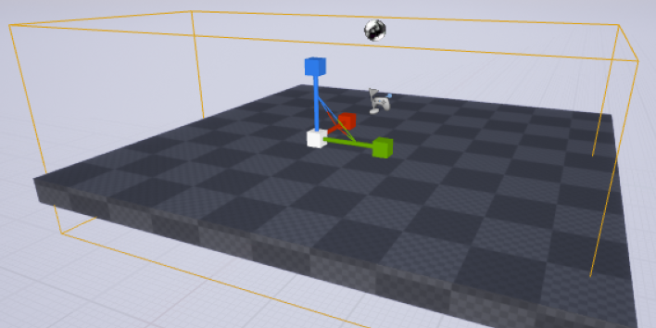
Creating NavMeshes (Static generation default)
Blocking obstacle
Spawn a NavMesh Bounds Volume into your scene:
Scale to fit the area where the AI can walk:
Enable “Show Navigation” to see the automatically generated navigation mesh. Intersecting geometry will be used to generate the mesh.

Slide 7
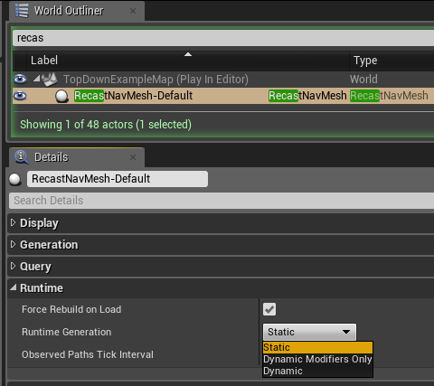
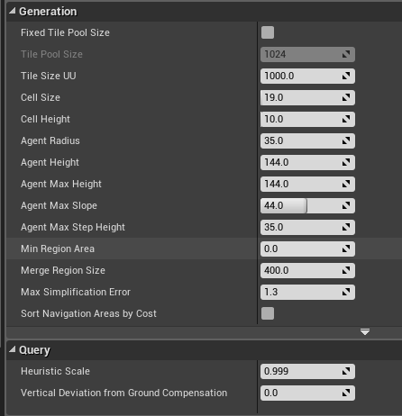
Configuring the nav mesh
The generated Recast NavMesh actor can be configured to run statically or dynamically
Some generation properties can be configured [advanced]

Slide 8
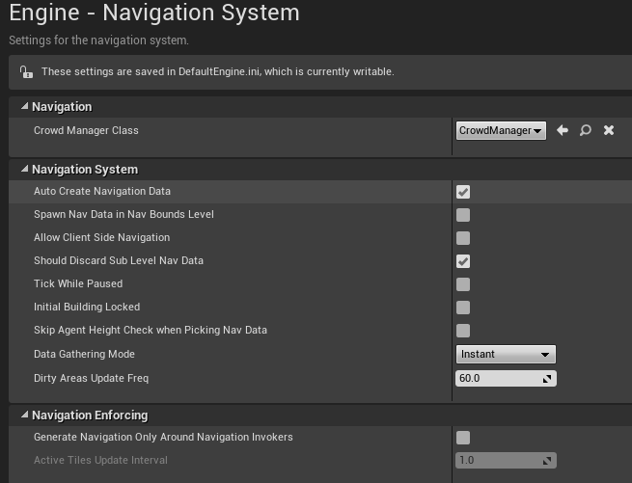
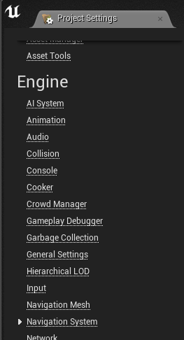
Pathfinding on NavMesh
Navigation system settings can be accessed from the Project Settings

Slide 9
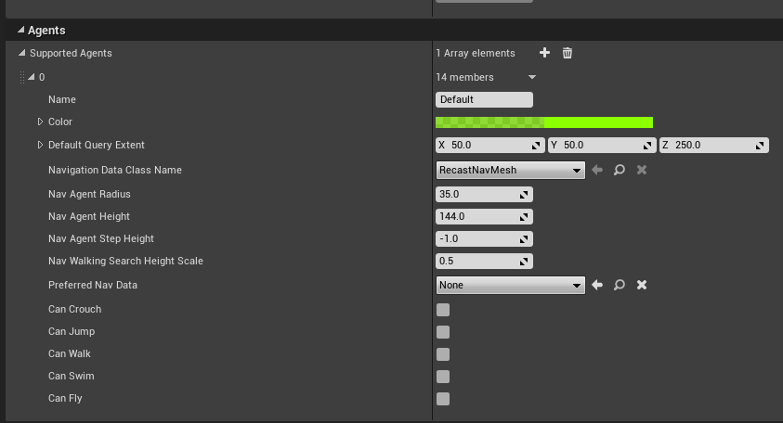
Pathfinding Agents
Agents are the AI actors who will be using the navigation subsystems
Agent configurations are automatically selected based on your character’s bounds Height and Radius (ie. Characters will use the Agent settings that they fit in physically)
Nav Radius is used to calculate how far away from obstacles the NavMesh edges will be generated.
Each Agent spawns a unique generation of the Recast NavMesh Actor

Slide 10
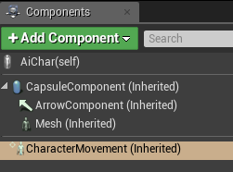
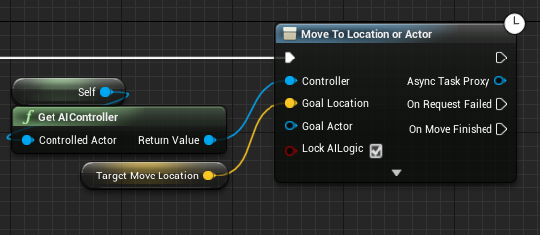
Pathfinding Characters
The simplest way to move a character is to have a built-in Character Movement Component on the actor ...
… and then call the Move To Location or Actor latent function

Slide 11
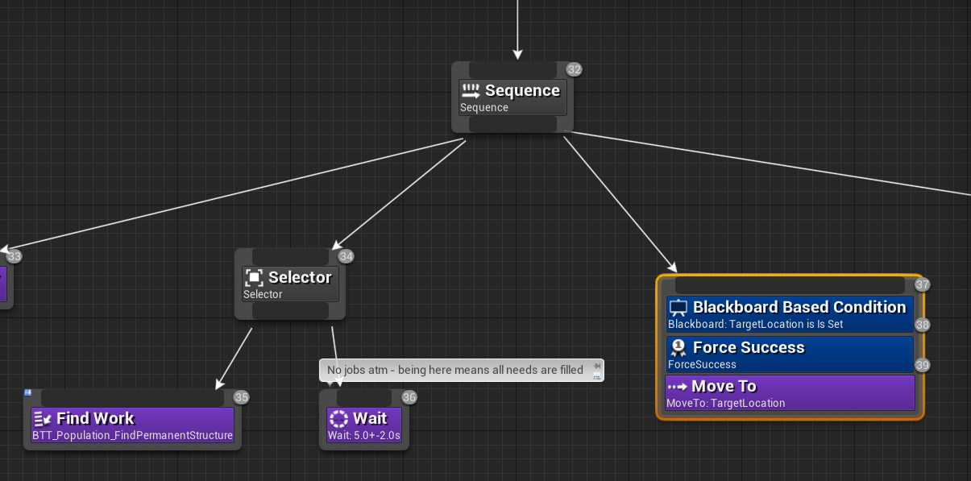
Pathfinding Characters
UBTTask_MoveTo - a.k.a. “MoveTo” can be used in BehaviorTrees to search for and follow a path, in conjunction with the NavMesh

Slide 12
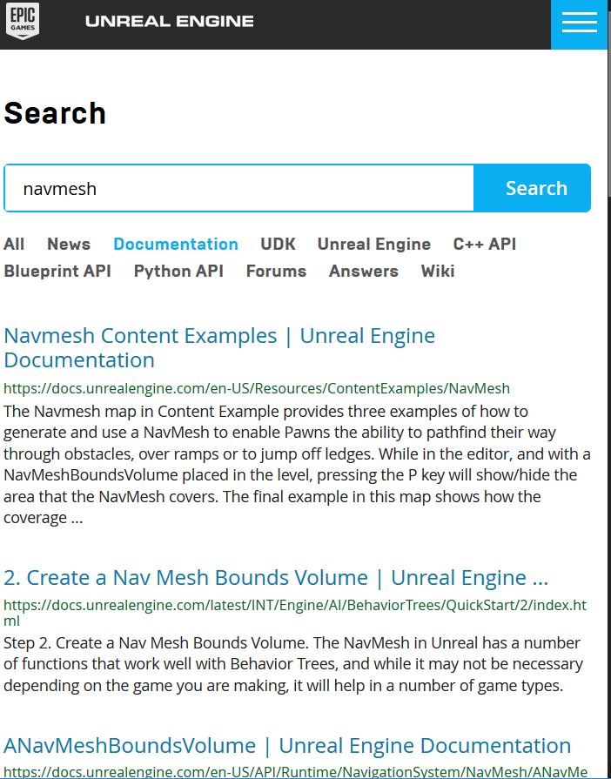
Additional Information
Content Examples - NavMesh level
https://docs.unrealengine.com/en-US/Resources/ContentExamples/NavMesh/index.html
Navigation Subsystem API
https://docs.unrealengine.com/en-US/API/Runtime/NavigationSystem/index.html

