Slide 1
GAME2023
Game Engine II
Week 5
Behavior Trees

Slide 2
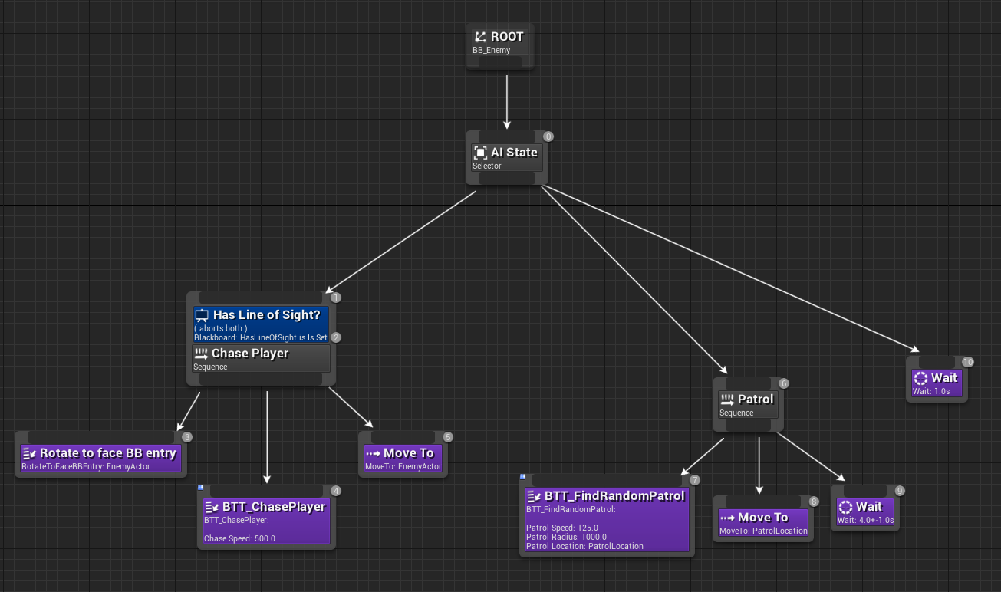
Behavior Tree
Common modern ai tool
Used in many fields of ai (comp sci, robotics, control systems, games, etc...)
Allows ai decisions by switching between a conditional and finite set of possible tasks
Similar to hierarchical state machines, but puts emphasis on “tasks” instead of “state”
Program complex ai decision trees, visually, with abstracted components (eg. ‘find target’ -> ‘walk’)
Easy to read and understand at a glance)

Slide 3
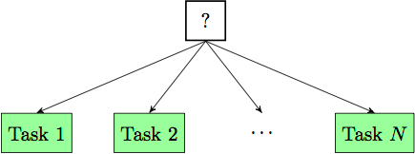
Behavior Tree
The classic model is a directed tree formed by a root node, control flow nodes (aka Composite nodes), conditionals (aka Decorators) and task nodes.
Unreal adds Service nodes and SimpleParallel nodes.
Task nodes are the leaf nodes, have no children, and return a success or failure result
Control Flow Nodes:
Selector (aka fallback)
Sequence
SimpleParallel
Nodes are prioritized from left to right

Slide 4
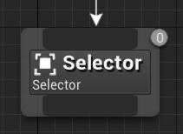
Composite Nodes - Selector
Executes children from left to right
Stops executing when a child returns ‘successful’
Selector returns as a failure if all children fail
Note: The logic to this node seems similar to a ‘switch’, ‘branch’, or ‘if’ statement, but this can be a dangerous assumption since child nodes are likely executed with delayed behaviour and can be aborted, possibly changing the results of any conditionals that allowed it to enter the node.

Slide 5
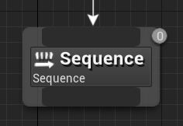
Composite Nodes - Sequence
Executes children from left to right
Fails and stops executing when one of the children nodes fail
Succeeds when all children succeed

Slide 6
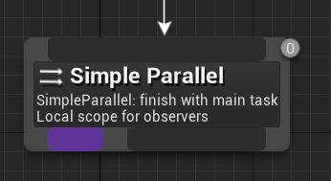
Composite Node - Simple Parallel
Allows a task node to execute alongside a full tree.
Finish Mode:
Immediate: Background tree aborts as soon as the main Task ends
Delayed: Background tree will be allowed to finish when the main Task ends.
This node is not as commonly used as other composite nodes.
Note: This is not truly asynchronous. Code is executed on the Game thread.
Documentation

Slide 7
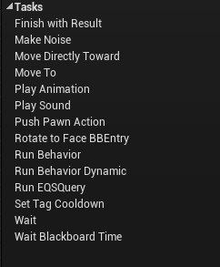
Task Nodes
Tasks are nodes that execute some action(s)
Eg. MoveTo; PlaySound; Wait; etc…
Execution can take more than one frame
Code can be written in C++ or Blueprints
Must return finish succeed/fail unless aborted. Composite nodes will wait for this before moving on.
Built-in Tasks documentation
Built-In Tasks

Slide 8
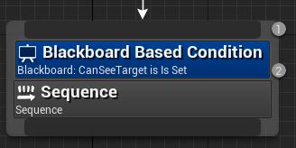
Decorators
A.k.a. Conditionals
These components attach to Composite nodes and Task nodes
Decides whether or not a branch or node can be executed
Can be a simple check against a Blackboard variable (eg. bSomeBool == true)
Can also be a more complex and custom C++ or Blueprint class (eg. Is within range of x)
Documentation

Slide 9
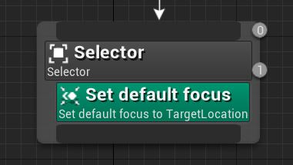
Service Nodes
Attached to Composite or Task nodes.
Executes at its own specified rate, while their branch is executing.
Useful for updating Behavior Tree information (eg. cached Blackboard variables)
Documentation

Slide 10
Data storage on BT Nodes
All agents using the same Behavior Tree share a single set of node instances
This means that data can NOT be stored on the nodes themselves
Storing data on the BT’s owning actor is possible, but would only be usable by custom decorators and tasks, and would tie the nodes specifically to that actor.
This is sometimes a valid option
One solution is to store data in a special class called a Blackboard. Accessible to BP and C++. Hosting BT data is the class’ sole purpose.
C++ Only options:
Nodes can opt-in to being instanced per agent instead by setting the bCreateNodeInstance variable to true.
This incurs a performance and memory cost
Nodes can also store custom struct data in the node’s memory.
Not part of UE4’s ecosystem or garbage collection and does not support UPROPERTY
See FBTMoveToTaskMemory in BTTask_MoveTo.h for an example
More info at the bottom of this page

Slide 11
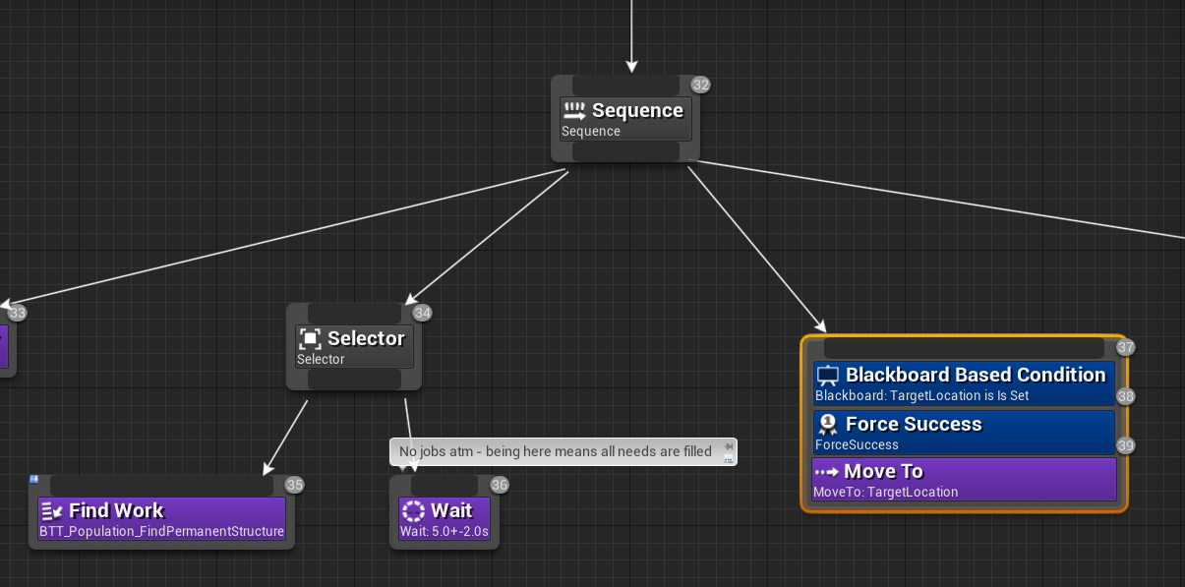
Pathfinding Characters
UBTTask_MoveTo - a.k.a. “MoveTo” can be used in BehaviorTrees to search for and follow a path, in conjunction with the NavMesh

Slide 12
Additional Info
Step by Step creation of a Behavior Tree and BT elements:
https://docs.unrealengine.com/en-US/Engine/ArtificialIntelligence/BehaviorTrees/BehaviorTreeUserGuide/index.html
Behavior Trees in Artificial Intelligence:
https://en.wikipedia.org/wiki/Behavior_tree_(artificial_intelligence,_robotics_and_control)

