Slide 1
GAME2023
Game Engine II
Week 6
EQS - Environment Query System

Slide 2
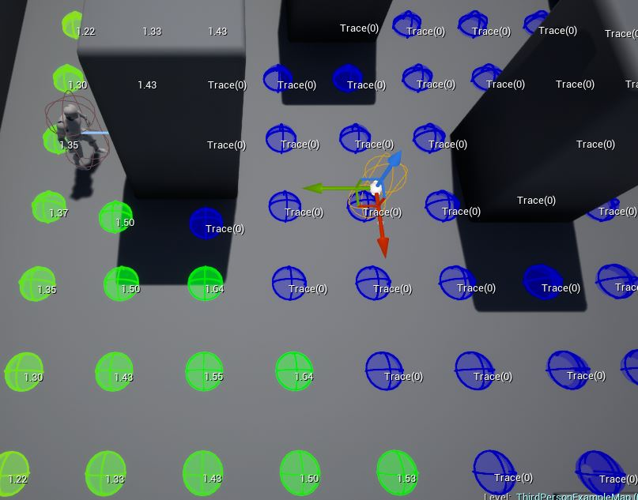
Environment Query System (EQS)
Artificial Intelligence subsystem
Gathers information about the environment
Environment data can then be tested to make intelligent decisions, especially positional
https://docs.unrealengine.com/en-US/Engine/ArtificialIntelligence/EQS/index.html

Slide 3
EQS
Can be called from Behavior Trees with the “Run EQS Query” Node
Made up of “Generators”, “Tests”, and “Contexts”
Generators are used to produce the list of Locations or Actors (referred to as Items) that will be tested
Eg. Points in a Grid
Eg. Characters in a radius
Tests can be performed on the Generated items
Can eliminate items with boolean “Valid/Invalid” tests
Can score and sort items with scoring functions
Contexts provide a frame of reference to generate from and test against
Eg. Querier (the actor performing the test)
Eg. All Actors of Type

Slide 4
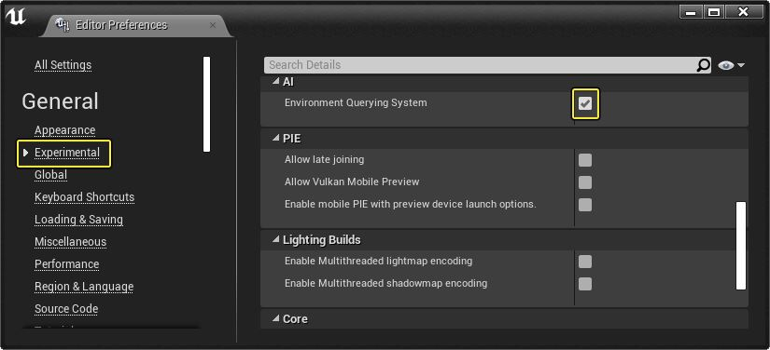
Creating an EQS Query
Must be enabled in Editor preferences
“Experimental”, although stable enough for uses

Slide 5
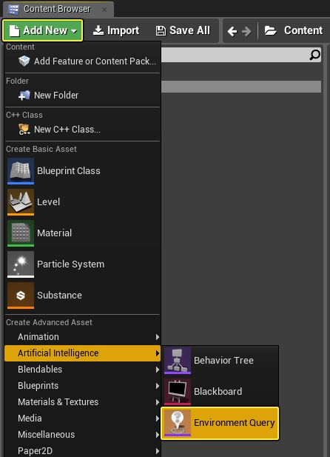
Creating an EQS Query
Once enabled, a new item appears in the Artificial Intelligence context menu
Custom contexts can be created in Blueprints (EnvQueryContext_BlueprintBase) or C++
Custom Generators can also be created in Blueprints (EnvQueryGenerator_BlueprintBase) or C++
Custom Tests can only be created from C++ (UEnvQueryTest)

Slide 6
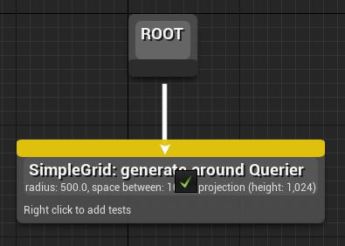
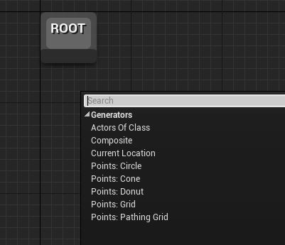
Creating an EQS Query
The first step is to Generate a list of things to test using a Generator
Right-click in the EQS graph and select the Generator of choice
Connect the root to the generator

Slide 7
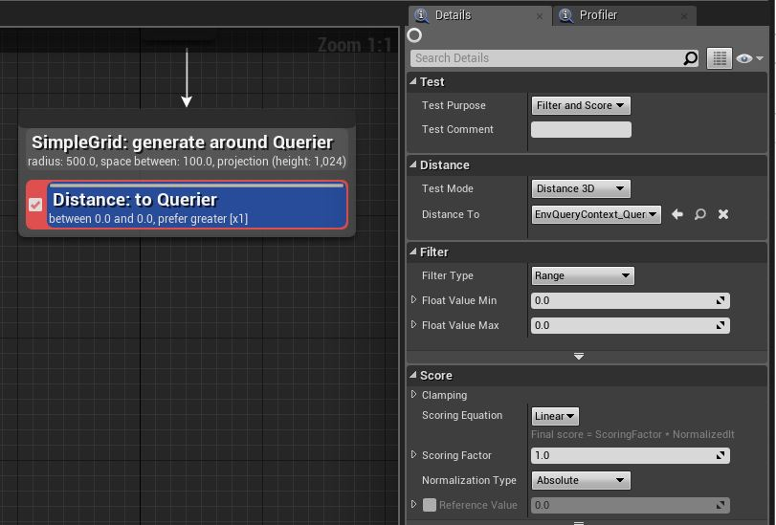
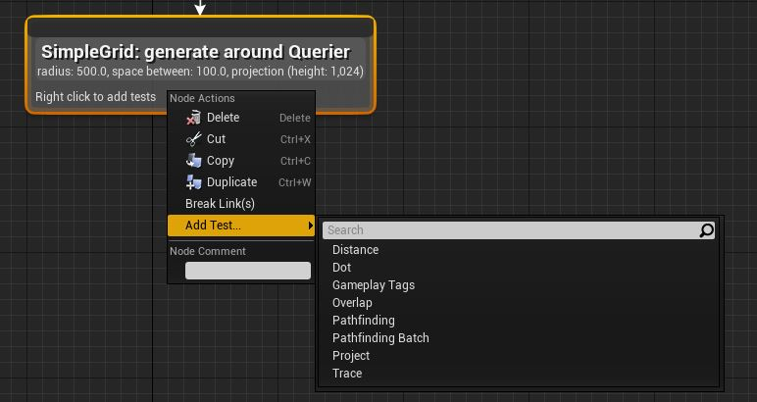
Creating an EQS Query
The generator will create items to test
To add tests: Right-click on a Generator and select a test under “Add Test”

Slide 8
EQS Generators
Actors of Class
The Actors of Class Generator finds all of the Actors of a given class within the specified Search Radius around the Search Center. The Actors returned can be used as Items in your tests.
Composite
Combine multiple Generators
Current Location
The Current Location Generator can be used to get the location of the specified Query Context for the purposes of validating Tests.
Custom Generators
Create your own in C++ or Blueprints
Points
Generates point locations within an area in a given shape, given a set of rules
Circle
Cone
Donut
Grid
Pathing Grid
https://docs.unrealengine.com/en-US/Engine/ArtificialIntelligence/EQS/EQSNodeReference/EQSNodeReferenceGenerators/index.html

Slide 9
EQS Tests
Distance
The Distance Test will return the direct distance between the Item and the chosen Distance To property. If Distance To is more than one location, it averages the results of each distance check.
Dot
The Dot Test calculates the Dot Product of two vectors. These can be Context rotations, or the vector from one point to another. This Test is useful for determining if something is facing something else.
Gameplay Tags
The Gameplay Tags Test enables you to specify a Tag to query and attempt to match in your Test.
Overlap
The Overlap Test can be used to determine if an Item (or Items) are within the bounds defined in the properties.
Pathfinding
The Pathfinding Test can be used to determine if a path exists to (or from) the Context, how expensive the path to (or from) the Context is, or how long the path is.
Pathfinding Batch
Project
Trace
https://docs.unrealengine.com/en-US/Engine/ArtificialIntelligence/EQS/EQSNodeReference/EQSNodeReferenceTests/index.html

Slide 10
EQS Tests
Pathfinding Batch
The Pathfinding Test can be used to determine if a path exists to (or from) the Context, how expensive the path to (or from) the Context is, or how long the path is. Every processed Context (paths) will be scored depending on the defined Test Mode.
Project
The Project Test can be used to project the resulting Items onto the NavMesh (and which NavMesh data set to use).
This will move Items that may be inside walls or blocked, back onto the NavMesh, which can create bunching if a grid line happens to be just beyond the edge of the NavMesh.
Trace
The Trace Test will trace to (or from) an Item or Context and return if it hit it or not something. You can invert the result using the Filter option, Bool Match. One typical use-case for this type of test is to determine if an enemy can (or cannot) see a Player in the Level.
https://docs.unrealengine.com/en-US/Engine/ArtificialIntelligence/EQS/EQSNodeReference/EQSNodeReferenceTests/index.html

