Slide 1
GAME2023
Game Engine II
Week 9
Materials

Slide 2
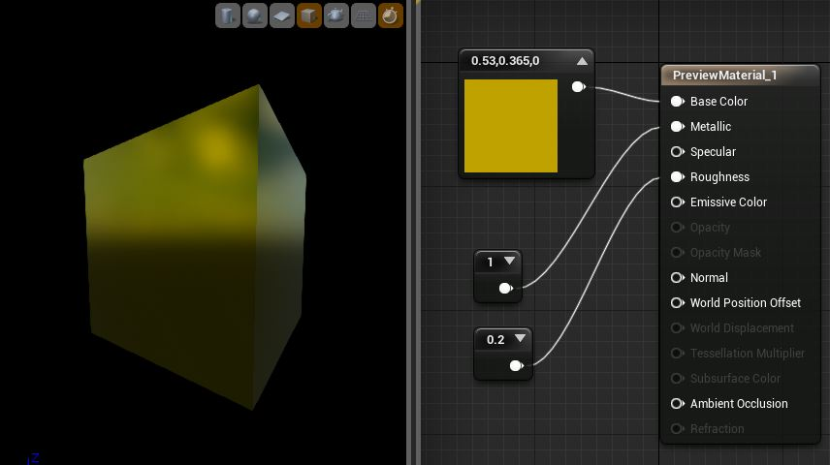
Materials
UE4 Materials define the look and feel of an object or post process programmatically.
Asset that can be applied to:
Static/Skeletal/Instanced Meshes
Decals
UI & Fonts
Post Processing stack
Material Editor is a visual scripting node network, like Blueprints...but different.
These are called Material Expressions

Slide 3
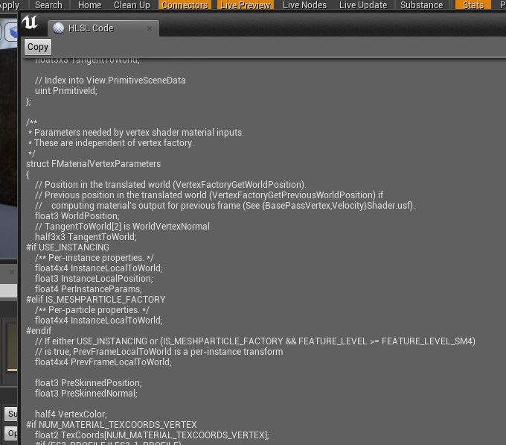
Shaders vs Materials
Materials kinda ARE shaders
Note: Core shader files can be found in <engineInstallPath>\Engine\Shaders\Private\*.usf
You’re never really expected to change these, but you can if you need to.
High-level: Material expressions compile into optimized, platform specific, shaders.
Fun fact: You can see this generated HLSL code in the Material Editor -> Window -> SourceCode -> HLSL

Slide 4
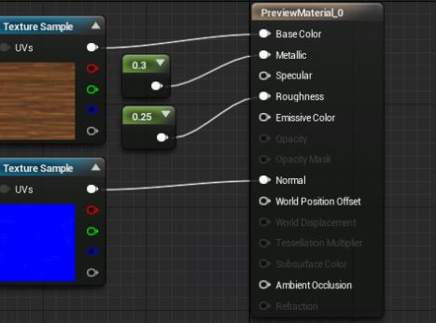
Material Return Parameters
Commonly, materials will return a set of properties per pixel and/or per vertex
BaseColour (vec3)
Metallic (float 0-1)
Specular (float 0-1)
Roughness (float 0-1)
Opacity (float 0-1)
Opacity Mask (float 0-1)
Normal (vec3)
Etc… (more advanced things)

Slide 5
Basic Components
Commonly, materials will return a set of properties per pixel and/or per vertex
BaseColour (vec3 [RGB])
Metallic (float 0-1)
Specular (float 0-1)
Roughness (float 0-1)
Opacity (float 0-1 [A])
Opacity Mask (float 0-1 [A])
Normal (vec3)
Etc… (more advanced things)
Common Nodes/Operations:
Texture Sample (t + Click)
Vector Constant (1, 2, 3, or 4 + Click)
Vector Param (v + Click)
Scalar Param (s + Click)
Multiply (m + click)
Add (a + click)
TexCoord (u + click)
If (i + click)
1-x (o + click)
Lerp (l + click)

Slide 6
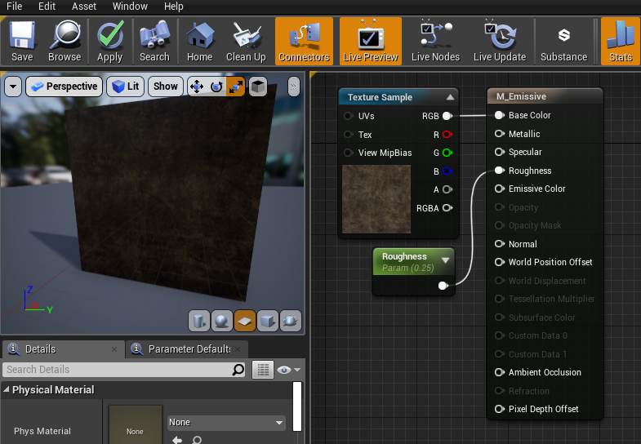
Simple Surface Material Example
Texture Sample node: Returns the texture colour per pixel, based on the UV coordinates of the mesh’s UV unwrap
Roughness: Scalar parameter that can be changed dynamically at runtime per instance.

Slide 7
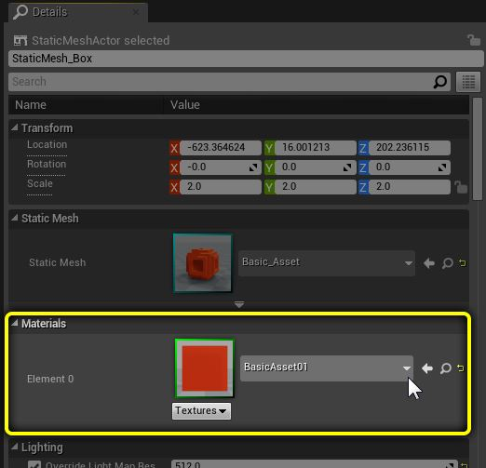
Applying Material to a Surface
Select the mesh to apply the material to
In the Details Panel, find the material slot and select your material

Slide 8
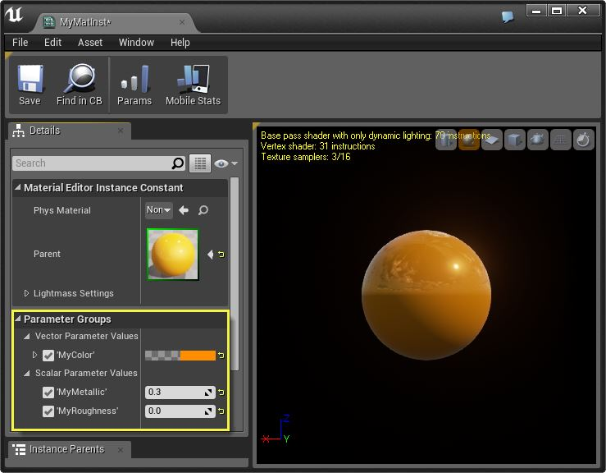
Material Instances
Many materials share effectively the same code but have slightly different components (eg. Textures, or parameter configurations)
Re-use them to avoid unnecessary and expensive material recompilation
Parameters are configurable without re-creating the same material again.

Slide 9
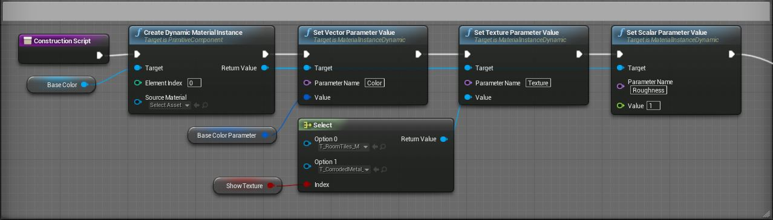
Material Instance Dynamic
A Material Instance Dynamic (MID) is an instanced Material that can be calculated during gameplay (at runtime).
Material Parameters can be changed through C++ or Blueprints.
Must be created dynamically with CreateDynamicMaterialInstance
This function replaces the Material Instance applied to the mesh with a MID

Slide 10
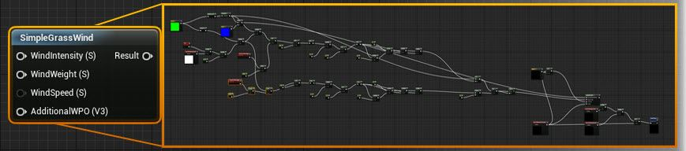
Material Functions
Snippets of shared and reusable Material graphs
Can be embedded into Materials and nested into other Material Functions
Stored as a standalone material function asset
https://docs.unrealengine.com/en-US/Engine/Rendering/Materials/Functions/index.html

Slide 11
Custom Postprocessing stack
Post Processing effects can be applied by way of Materials
The Scene is drawn to a quad surface (or texture) before being displayed on the screen.
We can apply a material on this surface to affect the final result
Using the “Post Processing” Material domain configures the Material for this purpose

Slide 12
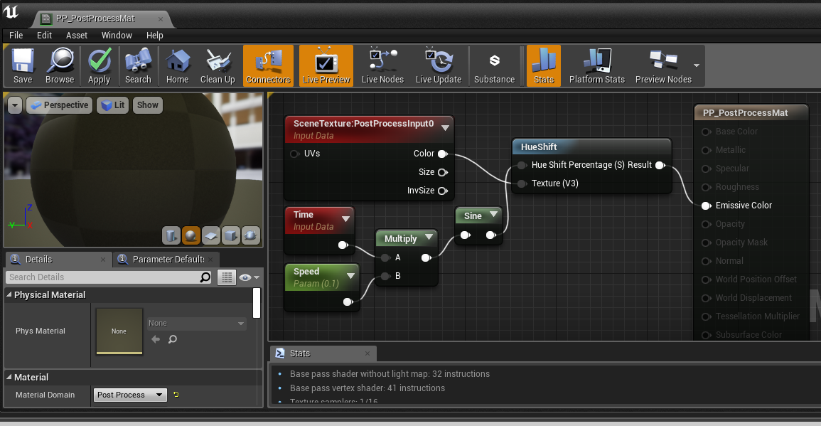
Simple Post Processing Material

Slide 13
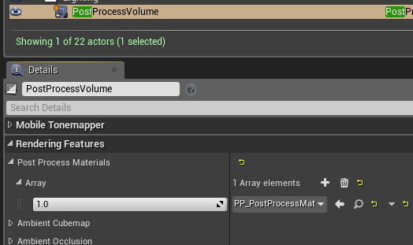
Apply Post Process Material
Add to Array of post process materials found on the Post Process Volume

