Slide 1
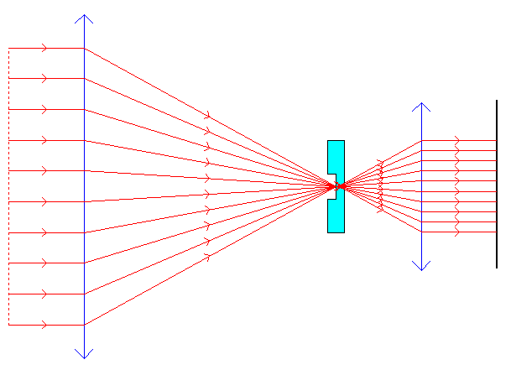
Detector
Phase contrast mask
Segmented pupil

Slide 2
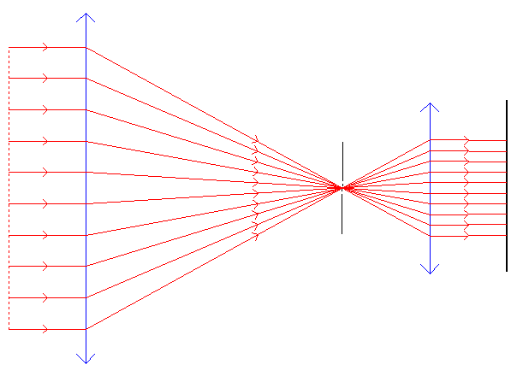
Detector
Pin hole
Segmented pupil

