Slide 1
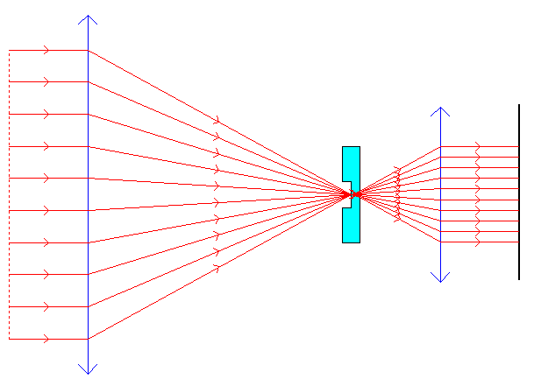
exit pupil
Detector
Phase contrast mask
Segmented entrance pupil

Slide 2
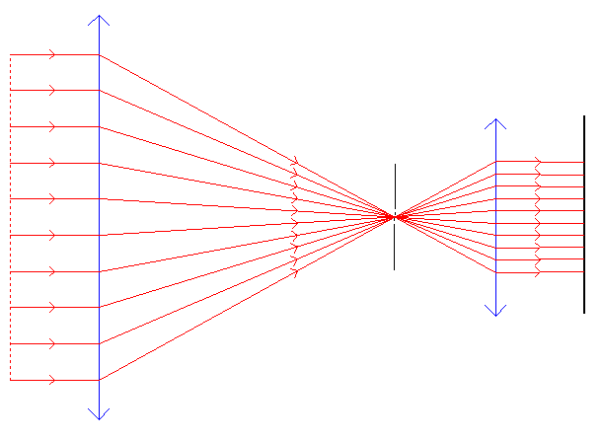
exit pupil
Detector
Pin hole
Segmented entrance pupil

Slide 3
