Slide 1
Modelling and Simulation Project
Single component Vaporizer(Liquid and Vapor Dynamics)
Vishesh Mangla 2017B2A10548P
Ritik Gupta 2017A1PS0837P

Slide 2
Objective:
Model Assumptions:
Liquefied petroleum gas (LPG) is fed into a pressurized tank to hold the liquid level in the tank. Our objective is to perform simulations to generate profiles for VL, Fo, T, P, HL, UL, Uv, Vv, rho_v, Tv, Pv, Hv, Q, Wv.
We will assume that LPG is a pure component: propane.
The liquid in the tank is assumed perfectly mixed.
Heat is added at a rate Q to hold the desired pressure in the tank by vaporizing the liquid at a rate W,(mass per time).
Heat losses and the mass of the tank walls are assumed negligible.
Gas is drawn off the top of the tank at a volumetric flow rate F_{v} . F_{v} is the forcing function or load disturbance.
Cp is assumed to be constant.Cv is assumed to be constant even for the gas phase and equal to Cp.
The liquid is assumed incompressible so that Cv= Cp

Slide 3
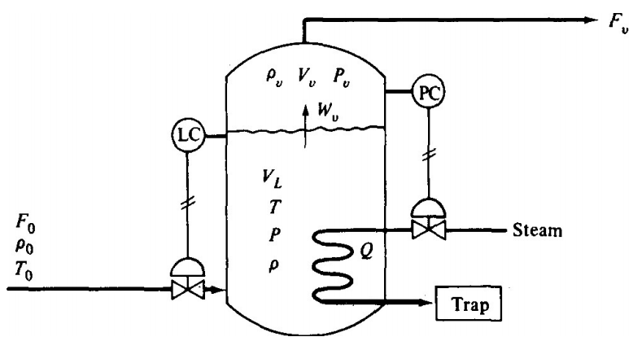
System Diagram

Slide 4
Symbols:
VL | Liquid propane volume in the tank
Vv | Volume of propane gas in the chamber
Fo | Inlet flow rate of propane
Fv | Outlet flow rate of propane
Wv | Rate of vaporization of propane
VL_frac | Fraction of vessel occupied by liquid at t=0
rho_o | Density of liquid(const)
rho_v | Density of vapour
Q | Heat output
P | Pressure inside chamber
T | Temperature of liquid phase
Tv | Temperature of vapour phase
V_chamber | Volume of vessel

Slide 5
Symbols:
Method | ‘RK45’ or ‘LSODA’
t_bound | The solver would run from t=0 to t=’t_bound’
Fo_steady | Steady state value of Fo
Q_steady | Steady state value of Q
To | Inlet temperature of liquid

Slide 6
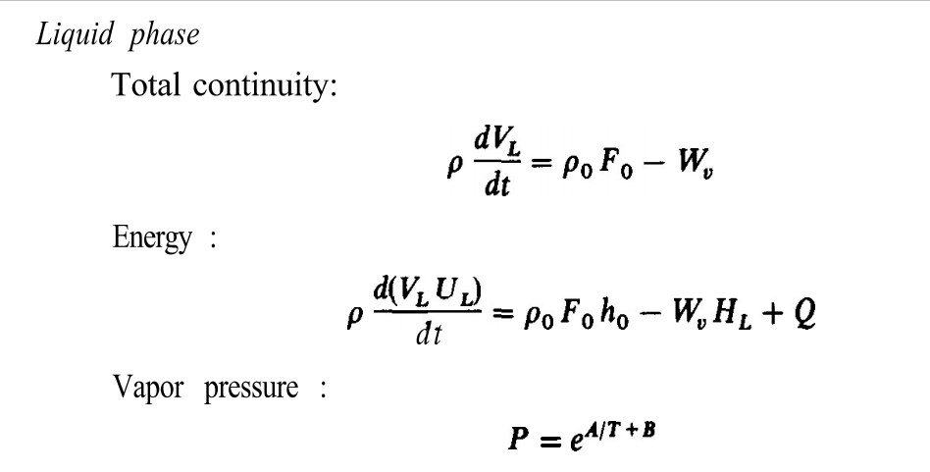
Modelling Equations :
Modelling Equations

Slide 7
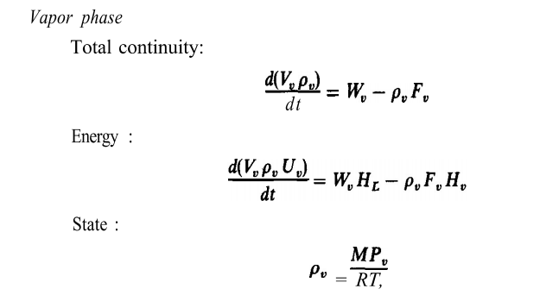


Modelling Equations :
Modelling Equations

Slide 8
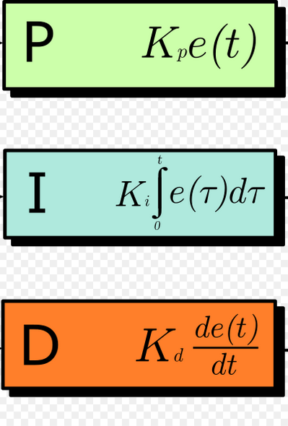
Controller Equations
We used 2 controllers:
Level Controller
By manipulating the inlet flow rate of propane.
Pressure Controller
By manipulating the heat in the system

Slide 9
Methodology:
The properties of propane are put inside the Python file(.py) . The parameters which we have to set other than those for simulations are to be put in the form of a JSON file(.json). There should be a file named “input_data.json” in the same directory as the Python file where the parameters are to be put. On running the code we get a (.html) file with simulation data and the plots.
In the JSON:
Methods can be either of “RK45” or “LSODA”.
There are two types of controllers, “level” and “pressure”.
Any of “P” , “I”, or “D” action objects can be put for each of the controllers. The actions are made additive. Each action has two properties namely “prop_constant” which is the proportionality constant and the “delay_time” which is the time from which an action should start taking place.

Slide 10
JSON Structure
{ "0": { "method": "RK45", "t_bound": 0.01, "Fo_steady": 2.1111, "Qo_steady": 100990, "Fv": 2, "V_chamber": 3, "rho_o": 493, "To": 233.15, "Km": 1.71, "VL_frac": 0.2, | "controllers": { "level": { "set_point": 0.4, "actions": { "P": { "prop_constant": 2500, "delay_time": 0 } } }, "pressure": { "set_point": 1000000, "actions": { "P": { "prop_constant": 20, "delay_time": 0 } } } } }}
To get (.html)s for various objects just put the same object with different set of values inside the list.

Slide 11
Methodology:
Compound properties:
Cp = 1.68 * 1000 J / kg / K
M = 44.1 / 1000 kg / mol
latent_heat = 428 * 1000 J / kg
Antoine Equation
A = 9.10
B = 1872 K
C = -25.16 K
The code contains 4 python classes : 1 “Controller” and 3 Actions namely “PAction”, “IAction”, and “DAction”.
The level controller are “Controller” type of objects.
We find out the plots for VL, Fo, T, P, HL, UL, Uv, Vv, rho_v, Tv, Pv, Hv, Q, Wv.

Slide 12
Results :
All results will be presented in the form of (.html) files in “datas” directory.
https://drive.google.com/drive/folders/1zVfEMfVXrI4_VWtlkTgWWIa-1gSDFaPU?usp=sharing

