Slide 1
CS427 Multicore Architecture and Parallel Computing
Lecture 3 Multicore Systems
Li Jiang
2014/9/24

Slide 2

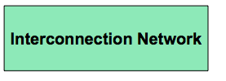

An Abstraction of Multicore System
How is parallelism managed?
Where is the memory physically located?
How the processors work?
What is the connectivity of the network?

Slide 3
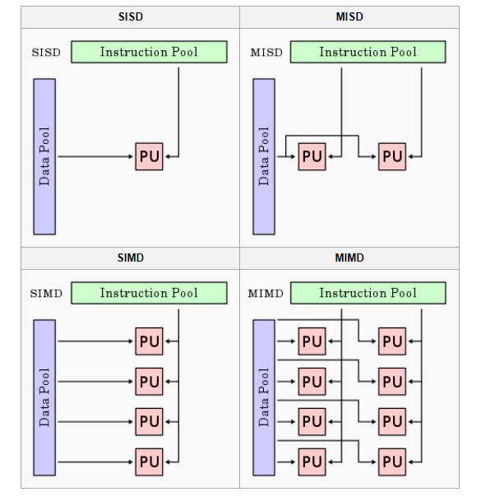
Flynn’s Taxonomy
classic von Neumann
not covered

Slide 4
MIMD Subdivision
SPMD
Single Program Multiple Data: Multiple autonomous processors simultaneously executing the same program (but at independent points, rather than in the lockstep that SIMD imposes) on different data.
MPMD
Multiple Program Multiple Data: Multiple autonomous processors simultaneously operating at least 2 independent programs. The "host" runs one program that farms out data to all the other nodes which all run a second program.

Slide 5
Two Major Classes
Shared memory multiprocessor architectures
A collection of autonomous processors connected to a memory system.
Supports a global address space where each processor can access each memory location.
Distributed memory architectures
A collection of autonomous systems connected by an interconnect.
Each system has its own distinct address space, and processors must explicitly communicate to share data.
Clusters of PCs connected by commodity interconnect is the most common example.

Slide 6
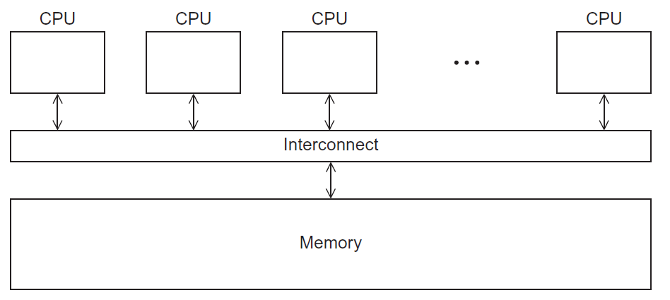
Shared Memory System

Slide 7
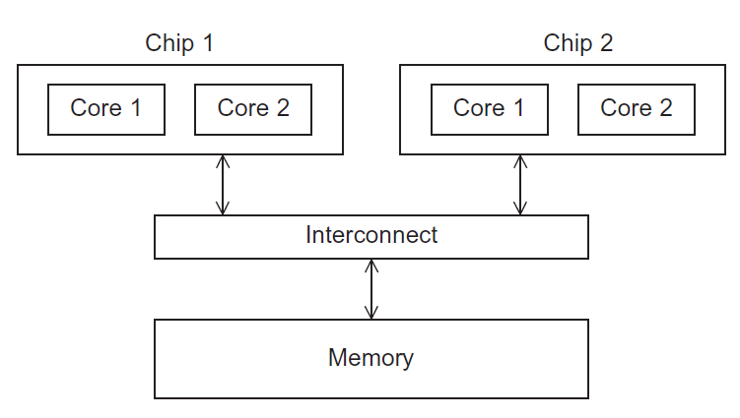
UMA Multicore System
Uniform Memory Access: Time to access all the memory locations will be the same for all the cores.

Slide 8
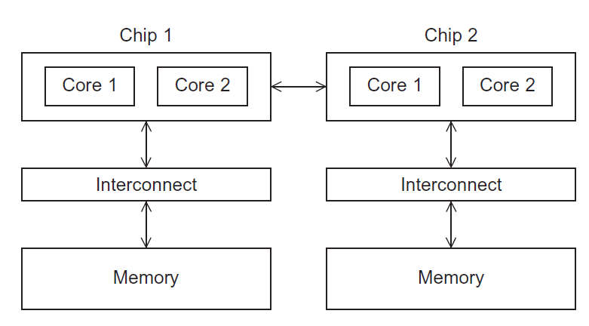
NUMA Multicore System
Non-Uniform Memory Access: A memory location a core is directly connected to can be accessed faster than a memory location that must be accessed through another chip.

Slide 9
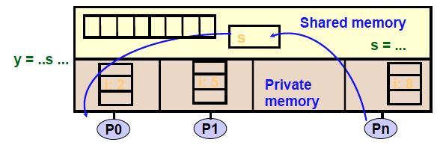
Programming Abstraction
A shared-memory program is a collection of threads of control.
Each thread has private variables, e.g., local stack variables
Also a set of shared variables, e.g., static variables, shared
common blocks, or global heap.
Threads communicate implicitly by writing and reading shared variables.
Threads coordinate through locks and barriers implemented using shared variables.

Slide 10
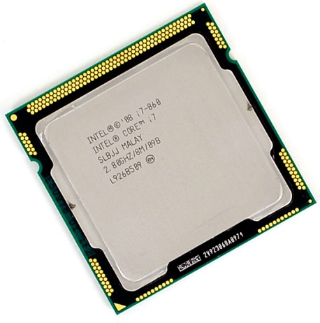
Case Study
Intel i7-860 Nehalem
32KB L1
Data Cache
32KB L1
Data Cache
32KB L1
Data Cache
32KB L1
Data Cache
32KB L1
Instr Cache
32KB L1
Instr Cache
32KB L1
Instr Cache
32KB L1
Instr Cache
Proc
Proc
Proc
Proc
Support for SSE 4.2 SIMD instruction set
8-way hyperthreading (executes two threads per core)
Multiscalar execution (4-way issue per thread)
256KB L2
Unified Cache
256KB L2
Unified Cache
256KB L2
Unified Cache
256KB L2
Unified Cache
Bus (Interconnect)
Shared 8MB L3 Cache
Up to 16 GB Main Memory (DDR3 Interface)

Slide 11
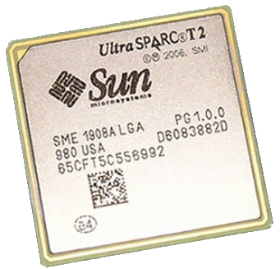
Case Study
Sun UltraSparc T2 Niagara
Memory
Controller
Memory
Controller
Memory
Controller
Memory
Controller
512KB
L2
C$
512KB
L2
C$
512KB
L2
C$
512KB
L2
C$
1
512KB
L2
C$
52KB
L2
C$
512KB
L2
C$
512KB
L2
C$
FPU
Support for VIS 2.0 SIMD instruction set
64-way multithreading (8-way per processor, 8 processors)
Full Cross-Bar (Interconnect)
Proc
Proc
Proc
Proc
Proc
Proc
Proc
Proc
FPU
FPU
FPU
FPU
FPU
FPU
FPU
FPU

Slide 12
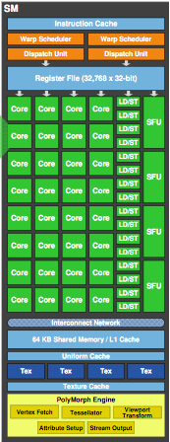
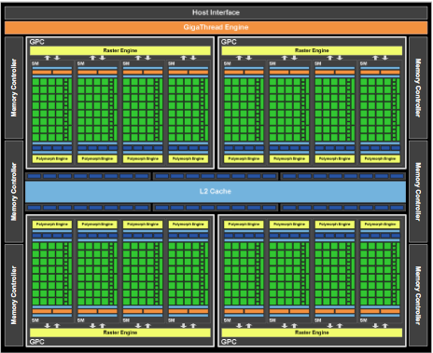
Case Study
Nvidia Fermi GPU

Slide 13
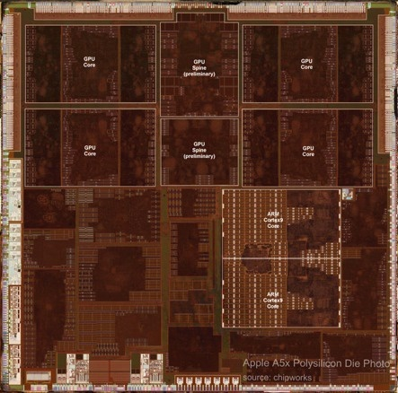
Case Study
Apple A5X SoC
2 ARM cores
4 GPU cores
2 GPU Primitive Engines
Other SoC components: WIFI, Video, Audio, DDR controller, etc.

Slide 14
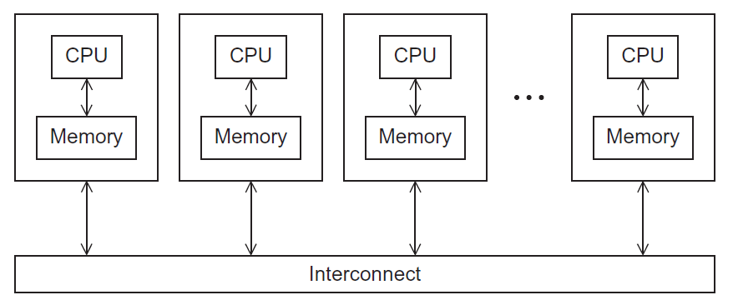
Distributed Memory System

Slide 15
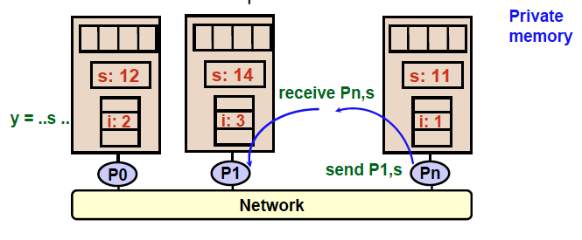
Programming Abstraction
Distributed-memory program consists of named processes.
• Process is a thread of control plus local address space -- NO shared data.
• Logically shared data is partitioned over local processes.
• Processes communicate by explicit send/receive pairs
• Coordination is implicit in every communication event.

Slide 16
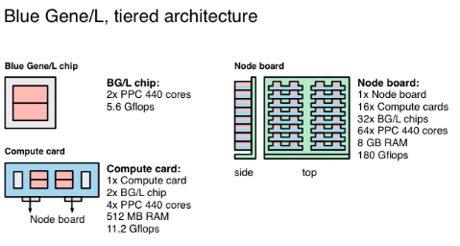
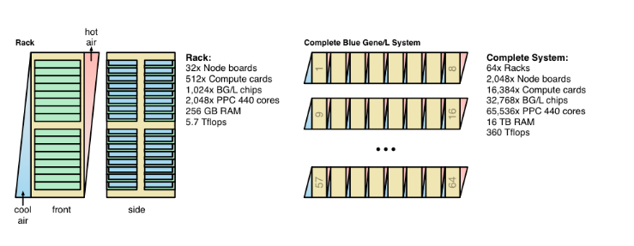
Case Study
Year

Slide 17

Case Study
Jaguar
Oak Ridge National Laboratories
Cray XT5 supercomputer
2.33 Petaflops Peak
1.76 Petaflops Sustain
224256 AMD Opteron cores
3-dimensional toroidal mesh

Slide 18
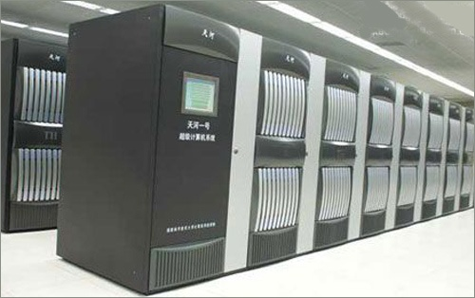
Case Study
Tianhe (TH-1A)
Chinese National University of Defense Technology
4.7 Petaflops Peak
2.5 Petaflops Sustain
14336 Intel X5760 (6-core) CPUs
7168 Nvidia M2050 Fermi GPUs
Tianhe (TH-2A)
54.9 Petaflops Peak

Slide 19
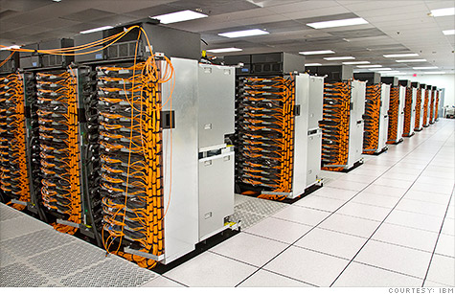
Case Study
IBM Sequoia
IBM+ Lawrence Livermore National Laboratory
20.1 Petaflops Peak
16.32 Petaflops Sustain
1572864 IBM PowerPC cores
6MW of power !!
Huge amount of heat !!!

Slide 20
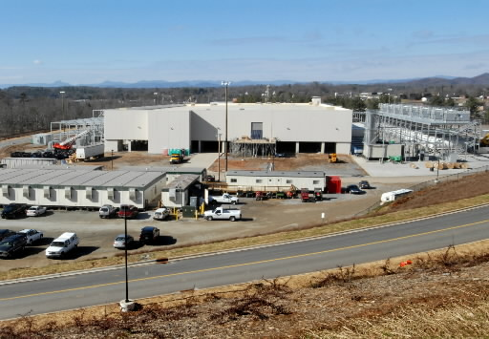

Case Study
Google Data Center
Power: build data center close to power source (Sun, wind, etc.)
Cooling: sea water cooled data center

Slide 21
Interconnects
Affects performance of both distributed and shared memory systems.
Two categories
Shared memory interconnects
Distributed memory interconnects

Slide 22
Shared Memory Interconnects
Bus interconnect
A collection of parallel communication wires together with some hardware that controls access to the bus.
Communication wires are shared by the devices that are connected to it.
As the number of devices connected to the bus increases, contention for use of the bus increases, and performance decreases.
Switched interconnect
Uses switches to control the routing of data among the connected devices.

Slide 23
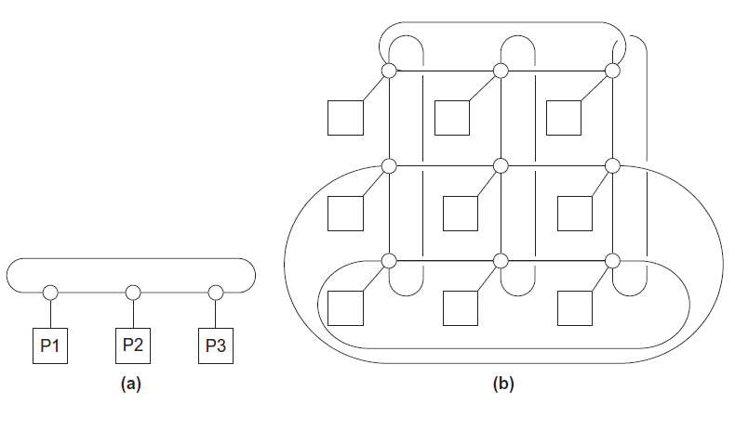
Distributed Memory Interconnects
ring
toroidal mesh
Suppose p processors? How many links?

Slide 24
Distributed Memory Interconnects
How to measure the “connectivity”
ring
toroidal mesh
Suppose p processors? How many links?
(3 – 1)*p/2 + 1*p = 2p
(5 – 1)*p/2 + 1*p = 3p

Slide 25
Distributed Memory Interconnects
How to measure the “connectivity”
ring
toroidal mesh
Suppose p processors? How many links?
(3 – 1)*p/2 + 1*p = 2p
(5 – 1)*p/2 + 1*p = 3p

Slide 26
Distributed Memory Interconnects
How to measure the “connectivity”
Bisection width:
The parallel system divided into 2 halves;
How many simultaneous communications can take Place “across the divide”between halves
ring
toroidal mesh
Suppose p processors? How many links?
(3 – 1)*p/2 + 1*p = 2p
(5 – 1)*p/2 + 1*p = 3p

Slide 27
Distributed Memory Interconnects
How to measure the “connectivity”
Bisection width:
The parallel system divided into 2 halves;
How many simultaneous communications can take Place “across the divide”between halves
ring
toroidal mesh
2*p^{0.5}

Slide 28
Fully Connected Interconnects
Each switch is directly connected to every other switch.
impractical
Bisection width: p/2 * p/2
Links: (p-1)*p/2

Slide 29
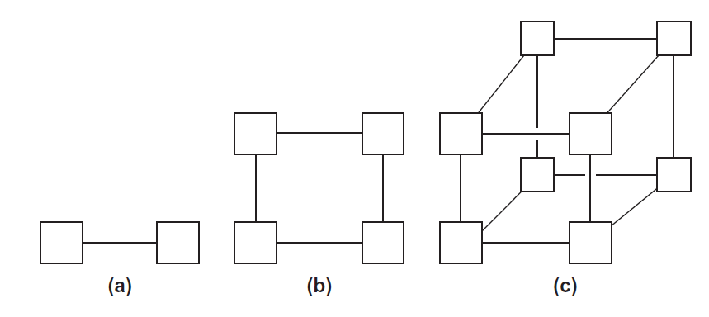
Hypercubes
one-
two-
three-dimensional
Dimension | Node | Bisection | Links
d

Slide 30
Hypercubes
one-
two-
three-dimensional
Dimension | Node | Bisection | Links
d | 2^{d} | p/2 | 1+d=1+log₂(p)

Slide 31
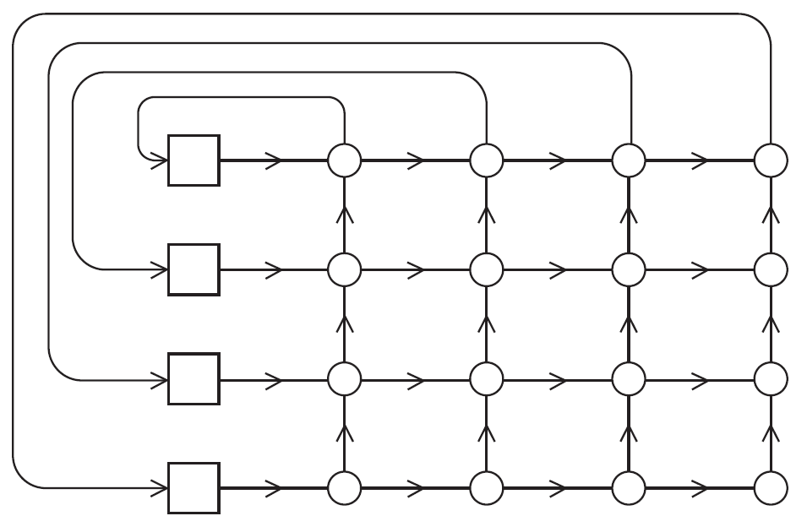
Crossbar Interconnects
Node | Switch | Bisection
P

Slide 32
Crossbar Interconnects
Node | Switch | Bisection
P | P*P | P

Slide 33
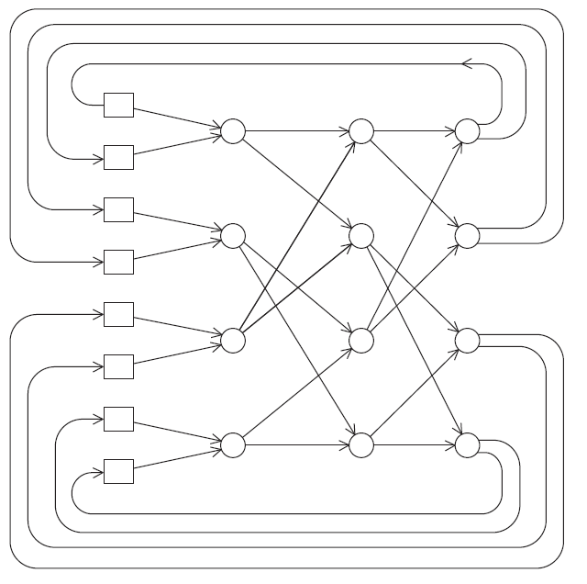
Omega Network
Node | Switch | Bisection
P

Slide 34
Omega Network
Node | Switch | Bisection
P | 1/2*log₂P*(2*2) | P

Slide 35
Network Parameters
Any time data is transmitted, we’re interested in how long it will take for the data to finish transmission.
Latency
The time that elapses between the source’s beginning to transmit the data and the destination’s starting to receive the first byte.
Bandwidth
The rate at which the destination receives data after it has started to receive the first byte.

Slide 36
Data Transmission Time
Message transmission time = l + n / b
latency (seconds)
length of message (bytes)
bandwidth (bytes per second)

Slide 37
Memory Consistency Models
A memory consistency model gives the rules on when a write by one processor can be observed by a read on another, across different addresses.
Strict Consistency: demand write operations are seen in order in which they were actually issued, which is essentially impossible to secure in distributed system as deciding global time is impossible.
Sequential Consistency: every node of the system sees the write operations on the same memory part in the same order, although the order may be different from the real time issuing the operations.
Casual Consistency: A system provides causal consistency if memory operations that potentially are causally related are seen by every node of the system in the same order.

Slide 38
Memory Consistency Models
Release consistency
Systems of this kind are characterized by the existence of two special synchronization operations, release and acquire.
Before issuing a write to a memory object a node must acquire the object via a special operation, and later release it. Therefore the application that runs within the operation acquire and release constitutes the critical region.
The system is said to provide release consistency, if all write operations by a certain node are seen by the other nodes after the former releases the object and before the latter acquire it.

Slide 39
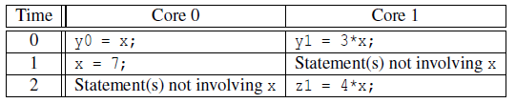
Cache Coherence
Programmers have no control over caches and when they get updated.
CPU-1
CPU-2
A 2
cache-1
A 2
cache-2
CPU-Memory bus
A 2->7
memory

Slide 40
Snooping Cache Coherence
Memory
Bus
M₁
Snoopy
Cache
Physical
Memory
M₂
Snoopy
Cache
M₃
Snoopy
Cache
DMA
DISKS
Use snoopy mechanism to keep all processors’ view of memory coherent

Slide 41
Snooping Cache Coherence
The cores share a bus .
Any signal transmitted on the bus can be “seen” by all cores connected to the bus.
When core 0 updates the copy of x stored in its cache it also broadcasts this information across the bus.
If core 1 is “snooping” the bus, it will see that x has been updated and it can mark its copy of x as invalid.

Slide 42
Snooping Cache Protocols
MSI Protocol
Each cache line has state bits
M: Modified
S: Shared
I: Invalid
Address tag
state
bits
Write miss
(P1 gets line from memory)
P₁ reads
or writes
M
Other processor reads
(P₁ writes back)
Read miss
(P1 gets line from memory)
P₁ intent to write
Other processor
intent to write (P₁ writes back)
S
I
Read by any
processor
Other processor
intent to write
Cache state in processor P₁

Slide 43
Example
P₁ reads
P₁
P₁ reads
or writes
P₂ reads,
P₁ writes back
M
P₁ writes
P₂ reads
Write miss
P₂ writes
P₁ intent to write
P₂ intent to write
P₁ reads
P₁ writes
Read
miss
P₂ writes
S
I
P₁ writes
P₂ intent to write
P₂
P₂ reads
or writes
P₁ reads,
P₂ writes back
M
Write miss
P₂ intent to write
P₁ intent to write
Read
miss
S
I
P₁ intent to write

Slide 44
Memory Update
CPU-1
CPU-2
A 200
cache-1
cache-2
CPU-Memory bus
A 100
memory (stale data)
When a read-miss for A occurs in cache-2,
a read request for A is placed on the bus
Cache-1 needs to supply & change its state to shared
The memory may respond to the request also!
Cache-1 needs to intervene through memory controller to supply correct data to cache-2

Slide 45
False Sharing
state blk addr data0 data1 ... dataN
A cache block contains more than one word
Cache-coherence is done at the block-level and not word-level
Suppose M₁ writes word_{i} and M₂ writes word_{k} and
both words have the same block address.
What can happen?

Slide 46
Directory Cache Coherence
CPU
CPU
CPU
CPU
CPU
CPU
Each line in cache has state field plus tag
Stat.
Tag
Data
C$
C$
C$
C$
C$
C$
Each line in memory has state field plus bit vector directory with one bit per processor
Interconnection Network
Stat.
Directry
Data
Directory Controller
Directory Controller
Directory Controller
Directory Controller
DRAM Bank
DRAM Bank
DRAM Bank
DRAM Bank

Slide 47
Cache States
For each cache line, there are 4 possible states
C-invalid (= Nothing): The accessed data is not resident in the cache.
C-shared (= Sh): The accessed data is resident in the cache, and possibly also cached at other sites. The data in memory is valid.
C-modified (= Ex): The accessed data is exclusively resident in this cache, and has been modified. Memory does not have the most up-to-date data.
C-transient (= Pending): The accessed data is in a transient state (for example, the site has just issued a protocol request, but has not received the corresponding protocol reply).

Slide 48
Directory States
For each memory block, there are 4 possible states
R(dir): The memory block is shared by the sites specified in dir (dir is a set of sites). The data in memory is valid in this state. If dir is empty (i.e., dir = ε), the memory block is not cached by any site.
W(id): The memory block is exclusively cached at site id, and has been modified at that site. Memory does not have the most up-to-date data.
TR(dir): The memory block is in a transient state waiting for the acknowledgements to the invalidation requests that the home site has issued.
TW(id): The memory block is in a transient state waiting for a block exclusively cached at site id (i.e., in C-modified state) to make the memory block at the home site up-to-date.

Slide 49
Protocol Message
There are 10 different protocol messages
Category | Messages
Cache to Memory Requests | ShReq, ExReq
Memory to Cache Requests | WbReq, InvReq, FlushReq
Cache to Memory Responses | WbRep(v), InvRep, FlushRep(v)
Memory to Cache Responses | ShRep(v), ExRep(v)

Slide 50
Example
Write miss, to read shared line
Multiple sharers
CPU
Update cache tag and data, then store data from CPU
CPU
CPU
CPU
Store request at head of CPU->Cache queue.
1
Invalidate cache line. Send InvRep to directory.
12
InvReq arrives at cache.
Store misses in cache.
C$
Cache
2
Cache
ExRep arrives at cache
C$
Send ExReq message to directory.
3
11
8
7
Interconnection Network
ExReq message received at directory controller.
When no more sharers, send ExRep to cache.
10
4
9
Directory Controller
Send one InvReq message to each sharer.
6
InvRep received. Clear down sharer bit.
DRAM Bank
Access state and directory for line. Line’s state is R, with some set of sharers.
5

