Slide 1
CS427 Multicore Architecture and Parallel Computing
Lecture 5 OpenMP, Cont’d
Li Jiang
2014/10/16

Slide 2
Data Distribution
Data distribution describes how global data is partitioned across processors.
This data partitioning is implicit in OpenMP and may not match loop iteration scheduling.
Compiler will try to do the right thing with static scheduling specifications.

Slide 3
Data Locality
Consider a 1-Dimensional array to solve the global sum problem, 16 elements, 4 threads
CYCLIC (chunk = 1):
BLOCK (chunk = 4):
3
6
7
5
3
5
6
2
9
1
2
7
0
9
3
6
3
6
7
5
3
5
6
2
9
1
2
7
0
9
3
6

Slide 4
Data Locality
Consider how data is accessed
Temporal locality
Same or nearby data used multiple times
Intrinsic in computation
Spatial locality
Data nearby to be used and is present in “fast memory”
Same data transfer (same cache line, same DRAM transaction)
What can we do to get locality
Appropriate data placement and layout
Code reordering transformations

Slide 5
Loop Transformation
We will study a few loop transformations that reorder memory accesses to improve locality.
Two key questions:
Safety: Does the transformation preserve dependences?
Profitability: Is the transformation likely to be profitable? Will the gain be greater than the overheads (if any) associated with the transformation?

Slide 6
Permutation
Permute the order of the loops to modify the traversal order
for (i= 0; i<3; i++)
for (j=0; j<6; j++)
A[i][j]=A[i][j]+B[j];
for (j=0; j<6; j++)
for (i= 0; i<3; i++)
A[i][j]=A[i][j]+B[j];
i
i
new traversal order!
j
j
NOTE: C multi-dimensional arrays are stored in row-major order, Fortran in column major

Slide 7
False Sharing
state blk addr data0 data1 ... dataN
A cache block contains more than one word
Cache-coherence is done at the block-level and not word-level
Suppose M₁ writes word_{i} and M₂ writes word_{k} and
both words have the same block address.
What can happen?
For (i = 0; i < N/2){
y[i] = …
}
For (i = N/2+1; i < N){
y[i] = …
}

Slide 8
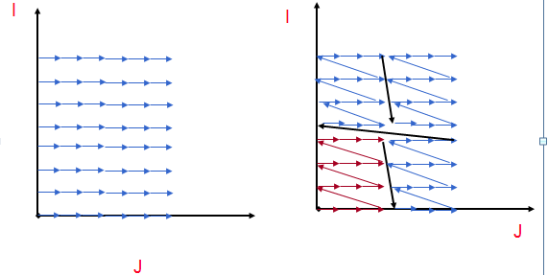
Tiling
Tiling reorders loop iterations to bring iterations that reuse data closer in time
Goal is to retain in cache/register/scratchpad (or other constrained memory structure) between reuse

Slide 9
Tiling
Tiling is very commonly used to manage limited storage
Registers
Caches
Software-managed buffers
Small main memory
Can be applied hierarchically
Also used in context of managing granularity of parallelism

Slide 10
Tiling
for (j=1; j<M; j++)
for (i=1; i<N; i++)
D[i] = D[i] +B[j,i]
Strip
mine
for (j=1; j<M; j++)
for (ii=1; ii<N; ii+=s)
for (i=ii; i<min(ii+s-1,N); i++)
D[i] = D[i] +B[j,i]
for (ii=1; ii<N; ii+=s)
for (j=1; j<M; j++)
for (i=ii; i<min(ii+s-1,N); i++)
D[i] = D[i] +B[j,i]
Permute

Slide 11
Blocking
for (i=0; j<n; j++)
for (j=0; i<m; j++)
b[i][j] = a[j,i]
for (j1=0; j1<n; j1+=nbj)
for (i1=0; i1<n; i1+=nbi)
for (j2=0; j2<min(n-j1,nbj); j2++)
for (i2=0; i2<min(n-i1,nbi); i2++)
b[i1+i2][j1+j2] = a[j1+j2][i1+i2]
Increased cache hit rate and TLB hit rate

Slide 12
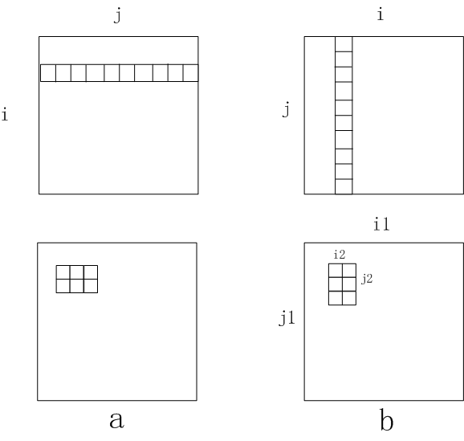
Blocking

Slide 13
Unroll and Jam
Unroll simply replicates the statements in a loop, with the number of copies called the unroll factor
As long as the copies don’t go past the iterations in the original loop, it is always safe
Unroll-and-jam involves unrolling an outer loop and fusing together the copies of the inner loop (not always safe)
One of the most effective optimizations there is, but there is a danger in unrolling too much
Original:
for (i=0; i<4; i++)
for (j=0; j<8; j++)
A[i][j] = B[j+1][i];
Unroll j
for (i=0; i<4; i++)
for (j=0; j<8; j+=2)
A[i][j] = B[j+1][i];
A[i][j+1] = B[j+2][i];
Unroll-and-jam i
for (i= 0; i<4; i+=2)
for (j=0; j<8; j++)
A[i][j] = B[j+1][i];
A[i+1][j] = B[j+1][i+1];

Slide 14
Unroll and Jam
Original:
for (i=0; i<4; i++)
for (j=0; j<8; j++)
A[i][j] = B[j+1][i] + B[j+1][i+1];
Unroll-and-jam i and j loops
for (i=0; i<4; i+=2)
for (j=0; j<8; j+=2) {
A[i][j] = B[j+1][i] + B[j+1][i+1];
A[i+1][j] = B[j+1][i+1] + B[j+1][i+2];
A[i][j+1] = B[j+2][i] + B[j+2][i+1];
A[i+1][j+1] B[j+2][i+1] + B[j+2][i+2];
}
Temporal reuse of B in registers
Less loop control

Slide 15
Unroll and Jam
Tiling = strip-mine + permutation
Strip-mine does not reorder iterations
Permutation must be legal
Unroll-and-jam = tile + unroll
Permutation must be legal

Slide 16
Message Passing
Suppose we have several “producer” threads and several “consumer” threads.
Producer threads might “produce” requests for data.
Consumer threads might “consume” the request by finding or generating the requested data.
Each thread could have a shared message queue, and when one thread wants to “send a message” to another thread, it could enqueue the message in the destination thread’s queue.
A thread could receive a message by dequeuing the message at the head of its message queue.

Slide 17

Barrier
One or more threads may finish allocating their queues before some other threads.
We need an explicit barrier so that when a thread encounters the barrier, it blocks until all the threads in the team have reached the barrier.
After all the threads have reached the barrier all the threads in the team can proceed.

Slide 18
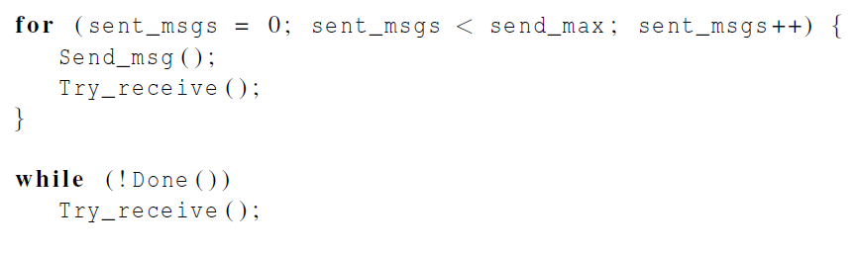
Synchronization

Slide 19
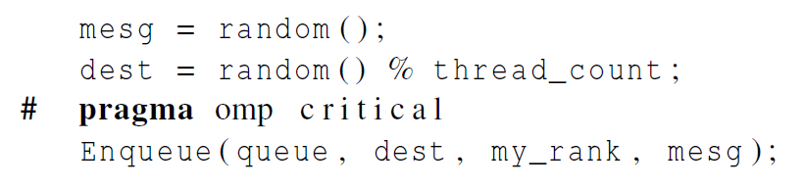
Synchronization-enqueue
Use synchronization mechanisms to update FIFO
What is the implementation of Enqueue?
What happens when two threads try to enqueue simultaneously?

Slide 20
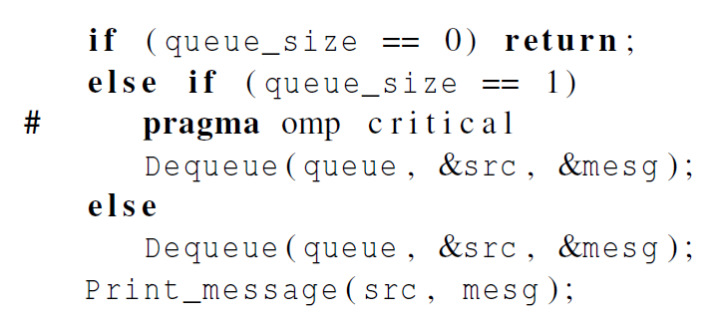
Synchronization-dequeue
This thread is the only one to dequeue its messages. Other threads may only add more messages. Messages added to end and removed from front. Therefore, only if we are on the last entry is synchronization needed.

Slide 21
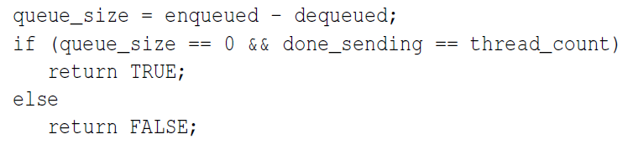
Synchronization-termination
each thread increments this after completing its for loop
More synchronization needed on “done_sending”

Slide 22

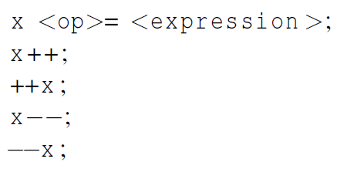
Atomic
“done_sending”is critical
Unlike the critical directive, it can only protect critical sections that consist of a single C assignment statement.
Further, the statement must have one of the following forms:
What is the difference with reduction?
What about: # pragma omp atomic
x += y++;

Slide 23
Atomic
Here <op> can be one of the binary operators
Many processors provide a special load-modify-store instruction.
A critical section that only does a load-modify-store can be protected much more efficiently by using this special instruction rather than the constructs that are used to protect more general critical sections.

Slide 24

Named Critical Sections
Three critical sections:
done_sending
Enqueue
Dequeue
Need to differential critical sections
Using atomic and critical sections
Using Named critical sections

Slide 25

Locks
How to differential in one critical section? (enqueue1, enqueue2… )
A lock consists of a data structure and functions that allow the programmer to explicitly enforce mutual exclusion in a critical section.

Slide 26
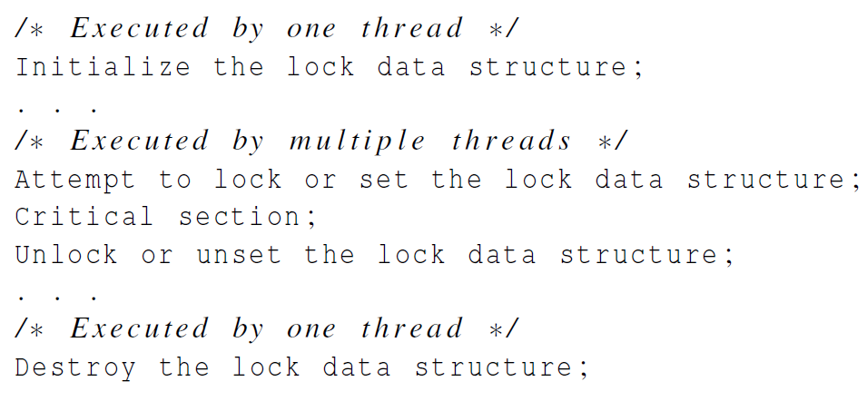
Locks

Slide 27
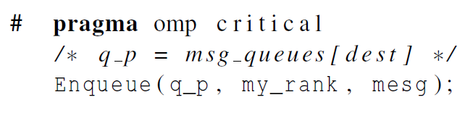
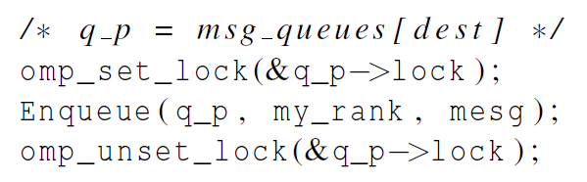
Locks
opm_lock_t

Slide 28
Summary of Mutual Exclusion
“critical”
Blocks of code
Easy to use
Limited named critical section (naming at compiler time)
“atomic”
Single expression
Faster speed
Variable name differentiate different critical sections
“lock”
Locks for data structures
Flexible to use
Dynamically updated
Multiple different critical section
-two protected statement update
the same variables
-… different variables

Slide 29
Caveat
You shouldn’t mix the different types of mutual exclusion for a single critical section.
# pragma omp atomic # pragma omp critical
x += f(y); x = g(x)
There is no guarantee of fairness in mutual exclusion constructs.
While (1) {
…
# pragma omp critical
x = g(my_rank) ;
…}

Slide 30
Caveat
It can be dangerous to “nest” mutual exclusion constructs.
#pragma omp critical
y=f(x)
…
double f(double x) {
pragma omp critical
z=g(x); /* z is shared */
}
Dead Lock!
What can we do to solve?
Named critical section
Naming is not deadlock free!
Thread u | Thread v
In C.S.1 | In C.S.2
-> C.S.2 | ->C.S.1
Block | Block

Slide 31
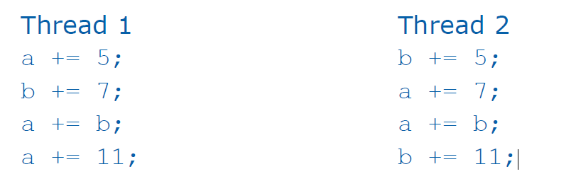
Deadlock

Slide 32
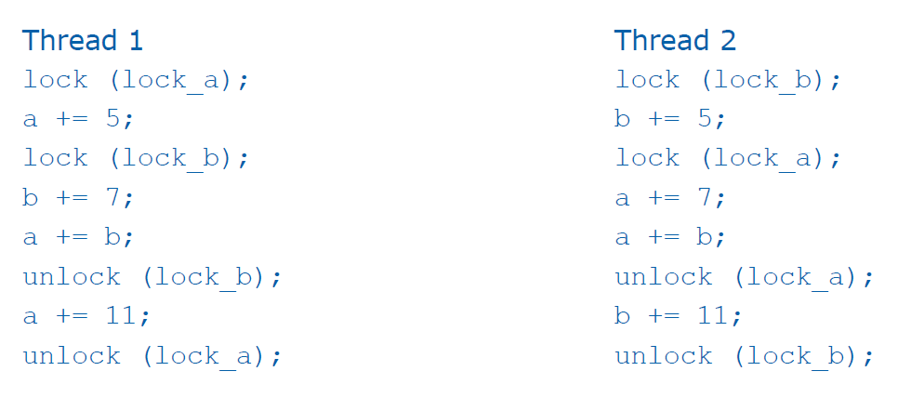
Deadlock
An implementation that can cause deadlock
Deadlock!

Slide 33
Deadlock
A program exhibits a global deadlock if every thread is blocked
A program exhibits local deadlock if only some of the threads in the program are blocked
A deadlock is another example of a nondeterministic behavior exhibited by a parallel program
Change timing can change deadlock occurring

Slide 34
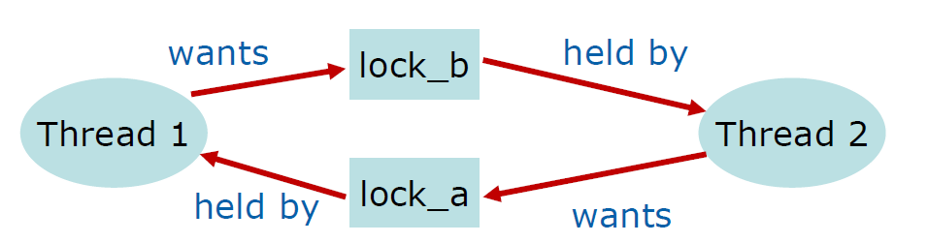
Deadlock
A graph of deadlock contains a cycle

Slide 35
Deadlock
Mutually exclusive access to a resource
Threads hold onto resources they have while they wait for additional resources
Resources cannot be taken away from threads
Cycle in resource allocation graph

Slide 36
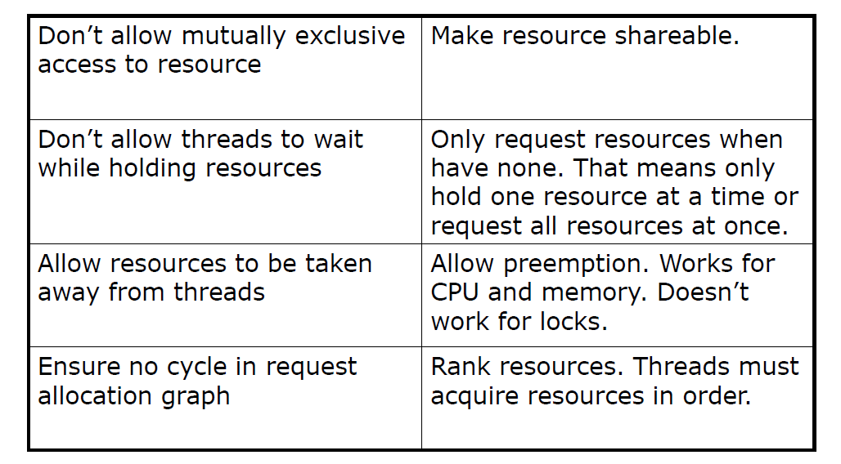
Solving the deadlock

Slide 37
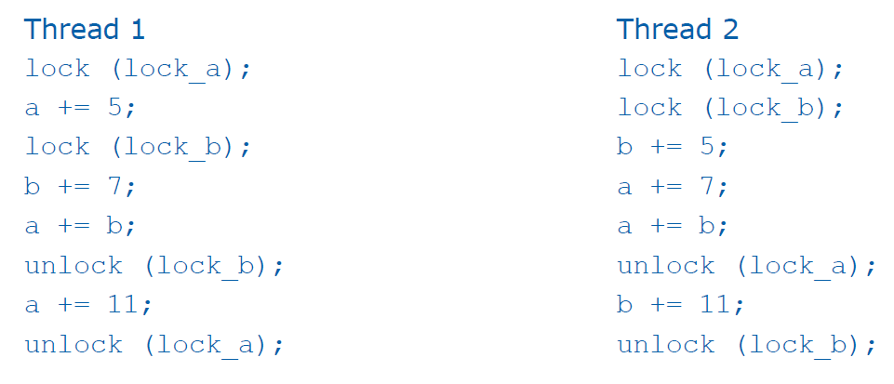
Deadlock
Enforce order for locks to eliminate deadlock

Slide 38
Recovery From Deadlock
So, the deadlock has occurred. Now, how do we get the resources back and gain forward progress?
PROCESS TERMINATION:
Could delete all the processes in the deadlock -- this is expensive.
Delete one at a time until deadlock is broken ( time consuming ).
Select who to terminate based on priority, time executed, time to completion, needs for completion, or depth of rollback
In general, it's easier to preempt the resource, than to terminate the process.
RESOURCE PREEMPTION:
Select a victim - which process and which resource to preempt.
Rollback to previously defined "safe" state.
Prevent one process from always being the one preempted ( starvation ).

Slide 39
Reduce Barriers
#pragma omp parallel default (none) shared (n,a,b,c,d,sum) private(i) {
#pragma omp for nowait
for (i=0;i<n;i++)
a[i]+=b[i];
#pragma omp for nowait
for (i=0;i<n;i++)
c[i]+=d[i];
#pragma omp barrier; explicit barrier
#pragma omp for nowait reduction (+:sum)
for (i=0;i<n;i++)
sum+=a[i]+c[i];
} implicit barrier

Slide 40
Maximize Parallel Region
#pragma omp parallel for
for() {working set 1}
#pragma omp parallel for
for() {working set 2}
#pragma omp paralle for
for() {
working set 1
working set 2
}
#pragma omp parallel {
#pragma omp for
for {working set 1}
#pragma omp for
for {working set 2}
}

Slide 41
Load Balancing
for (i=0;i<n;i++) {
readfromfile(i);
for (j=0;j<m;j++)
processingdata(); /* lots of work here*/
writetofile(i);
}
Readfromfile(0);
for(i=0;i<n;i++) {
#pragma omp single nowait
readfromfile(i+1); one thread is reading the next file, nowait for
finish reading
#pragma omp for schedule(dynamic)
for(j=0;j<m;j++)
processingdata(); multiple threads processing current file,
implicit barrier for all processes finish
#pragma omp single nowait
writetofile(i); write to current file, nowait for next reading
}

Slide 42
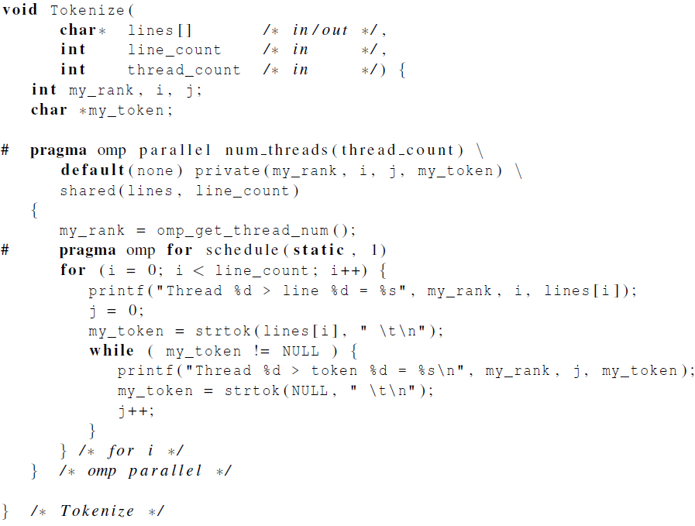
Thread Safety

Slide 43
Thread Safety
Pease porridge hot
Pease porridge cold
Pease porridge in the pot
Nice days old
T0: line0=Pease porridge hot
T0: token0=Pease
T1: line1=Pease porridge cold
T1: token0=Pease
T0: token1=porridge
T1: token1=cold
T0: line2=Pease porridge in the pot
T0: token0=Pease
T1: line3=Nine days old
T1: token0=Nine
T0: token1=days
T1: token1=old
strtok() caches the line and
remember the pointer
Not thread safe !!

Slide 44
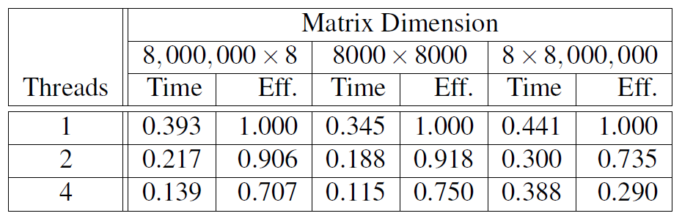
False Sharing
#pragma omp parallel for shared(Nthreads,a) schedule(static,1)
for(i=0;i<Nthreads;i++)
a[i]+=i;
Each thread updates 1 element of the same cache line, causing false sharing
Use private data whenever possible
Reorganize data layout to eliminate false sharing

Slide 45
Data Race
first=1;
#pragma omp parallel for shared(first,a) private(b)
for(i=0;i<n;i++) {
if(first) {
a=10;
first=0;
}
b=i/a;
}
Compiler might interchange the order of the assignment of “a” and “first”
If context switching happens after the assignment of “first”, a is not initialized, other threads might divide an invalid “a”
Initialize “a” before the parallel region

