Slide 1
CS427 Multicore Architecture and Parallel Computing
Lecture 6 Pthreads
Li Jiang
2014/10/23

Slide 2
Roadmap
Problems programming shared memory systems.
Controlling access to a critical section.
Thread synchronization.
Programming with POSIX threads.
Mutexes.
Producer-consumer synchronization and semaphores.
Barriers and condition variables.
Read-write locks.

Slide 3
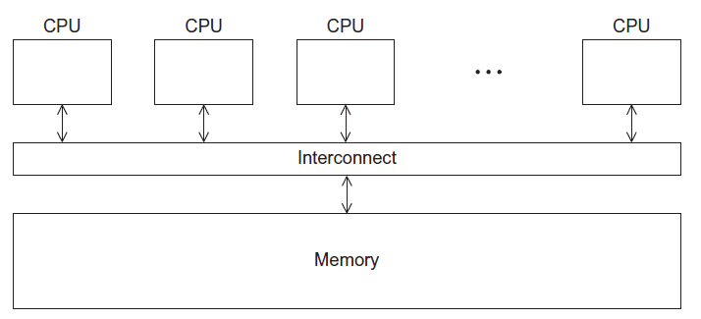
A Shared Memory System

Slide 4
POSIX Threads
Also known as Pthreads.
A standard for Unix-like operating systems.
A library that can be linked with C programs.
Specifies an application programming interface (API) for multi-threaded programming.
The Pthreads API is only available on POSIX systems — Linux, MacOS X, Solaris, HPUX, …

Slide 5
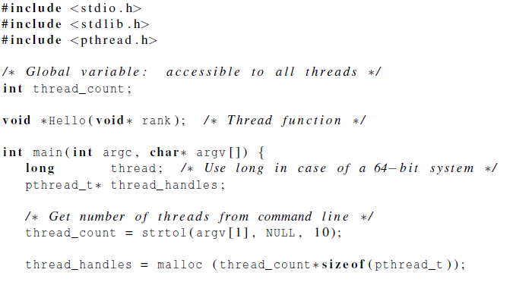
“Hello World !”
declares the various Pthreads
functions, constants, types, etc.
allocate memory space for thread handlers

Slide 6
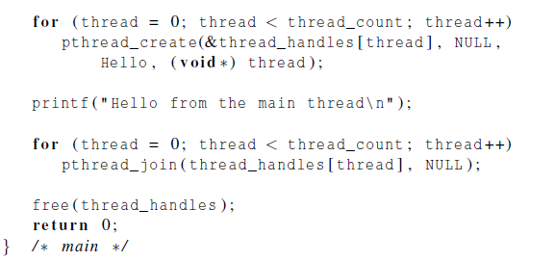
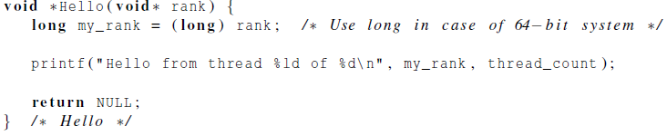
“Hello World !”
What is the variable type?
Carefully use global variable

Slide 7
Running the Program
gcc −g −Wall −o pth_hello pth_hello . c −lpthread
link in the Pthreads library
. / pth_hello 4
Hello from the main thread
Hello from thread 0 of 4
Hello from thread 2 of 4
Hello from thread 1 of 4
Hello from thread 3 of 4

Slide 8
Creating the Threads
pthread.h
One object for each thread.
pthread_t
int pthread_create (
pthread_t* thread_p /* out */ ,
const pthread_attr_t* attr_p /* in */ ,
void* (*start_routine ) ( void ) /* in */ ,
void* arg_p /* in */ ) ;

Slide 9
“pthread_t” Object
Opaque
The actual data that they store is system-specific.
Their data members aren’t directly accessible to user code.
However, the Pthreads standard guarantees that a pthread_t object does store enough information to uniquely identify the thread with which it’s associated.
Allocate object space before using.

Slide 10
Pthreads Function
Prototype: void* thread_function ( void* args_p ) ;
Void* can be cast to any pointer type in C.
So args_p can point to a list containing one or more values needed by thread_function.
Similarly, the return value of thread_function can point to a list of one or more values.

Slide 11
Stopping the Threads
We call the function pthread_join once for each thread.
A single call to pthread_join will wait for the thread associated with the pthread_t object to complete.

Slide 12
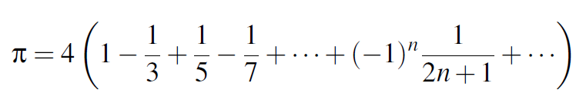
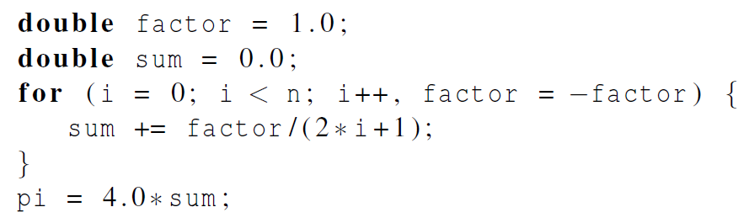
Estimating PI

Slide 13
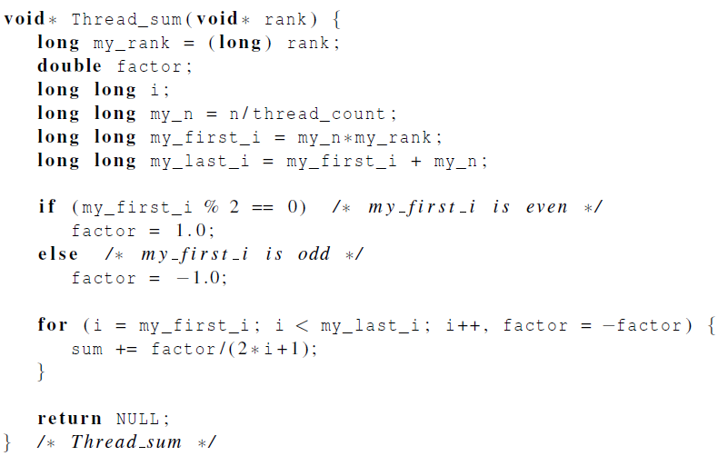
Estimating PI
 | n
 | 10⁵ | 10⁶ | 10⁷ | 10⁸
Pi | 3.14159 | 3.141593 | 3.1415927 | 3.14159265
1 thread | 3.14158 | 3.141592 | 3.1415926 | 3.14159264
2 threads | 3.15158 | 3.141480 | 3.1413692 | 3.14174686

Slide 14
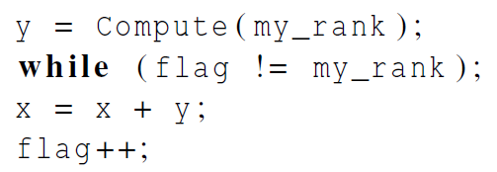
Busying-Waiting
A thread repeatedly tests a condition, but, effectively, does no useful work until the condition has the appropriate value.
flag initialized to 0 by main thread

Slide 15
Busying-Waiting
Beware of optimizing compilers, though!
Disable compiler optimization
Protect variable from optimization
int volatile flag
int volatile x
Compiler can change the program order

Slide 16
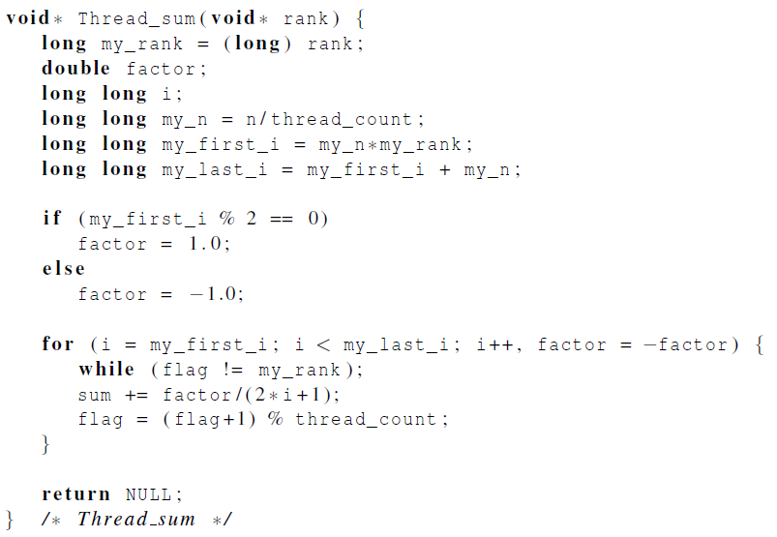
Busy-Waiting
Using % so that last thread reset flag back to 0

Slide 17
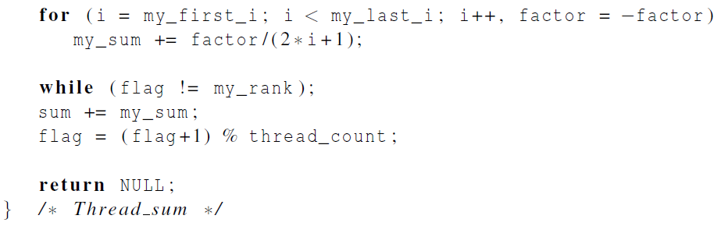
Remove Critical Section in a Loop
19.8 Seconds two threads Vs. 2.5 Seconds one threads
What is the problem??
1.5 after moving the critical section out of the loop

Slide 18
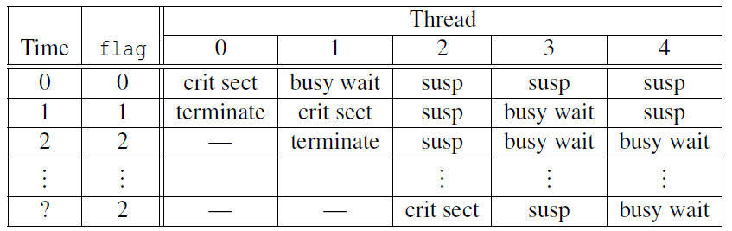
Problems in Busy-Waiting
A thread that is busy-waiting may continually use the CPU accomplishing nothing.
Critical section is executed in thread order, large wait time if thread number exceed core number.
Possible sequence of events with busy-waiting and more threads than cores.

Slide 19
Mutexes
Mutex (mutual exclusion) is a special type of variable that can be used to restrict access to a critical section to a single thread at a time.
Used to guarantee that one thread “excludes” all other threads while it executes the critical section

Slide 20
Mutexes

Slide 21
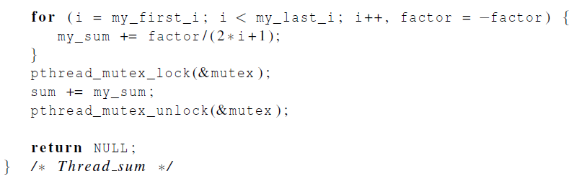
Estimating PI Mutexes

Slide 22
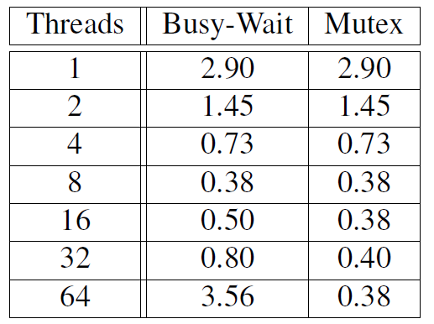
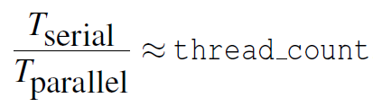
Performance Comparison
Run-times (in seconds) of π programs using n = 108 terms on a system with two four-core processors.

Slide 23
Some Issues
Busy-waiting enforces the order threads access a critical section.
Using mutexes, the order is left to chance and the system.
There are applications where we need to control the order threads access the critical section.

Slide 24
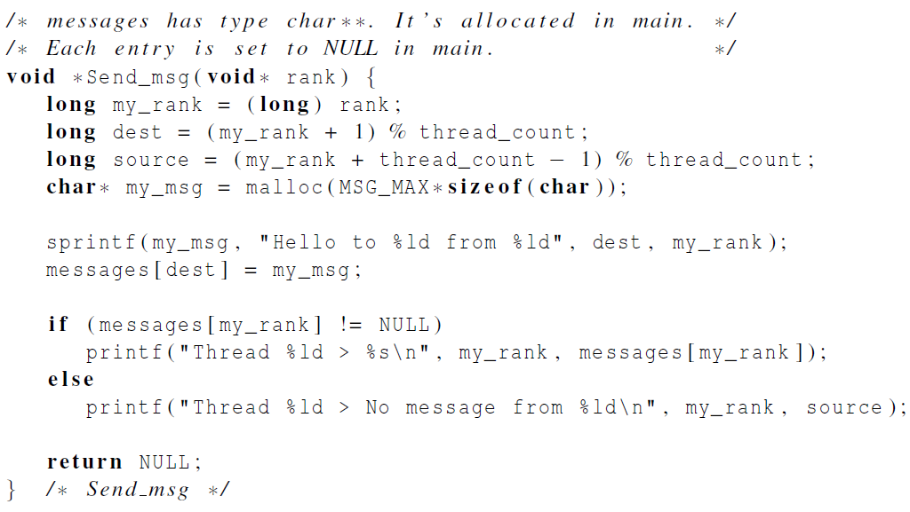
Message Passing Example

Slide 25
Message Passing Example
…
pthread_mutex_lock(mutex[dest]);
…
messages[dest]=my_msg;
pthread_mutex_unlock(mutex[dest]);
…
pthread_mutex_lock(mutex[my_rank]);
printf(“Thread %ld>%s\n”, my_rank, messages[my_rank]);
pthread_mutex_unlock(mutex[my_rank]);
Problem: If one thread goes too far ahead, it might access
to the uninitialized location and crash the program.
Reason: mutex is always initialized as “unlock”

Slide 26

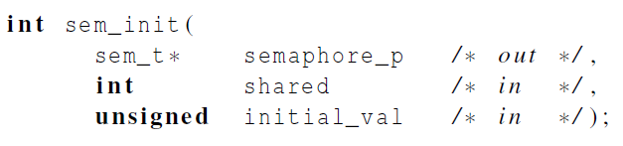
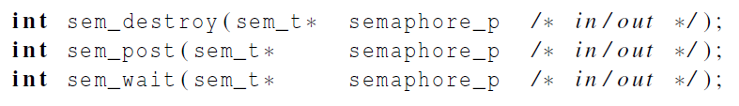
Semaphore
Semaphores are not part of Pthreads;
you need to add this.

Slide 27
Using Semaphore
all semaphores initialized to 0 (locked)
…
messages[dest]=my_msg;
sem_post(&semaphores[dest]); /*unlock the destination semaphore*/
…
sem_wait(&semaphores[my_rank]); /*wait for its own semaphore to be unlocked*/
printf(“Thread %ld>%s\n”, my_rank, messages[my_rank]);
Semaphore is more powerful than mutex
because you can initialize semaphore
to any value

Slide 28
Barriers
Synchronizing the threads to make sure that they all are at the same point in a program is called a barrier.
No thread can cross the barrier until all the threads have reached it.

Slide 29
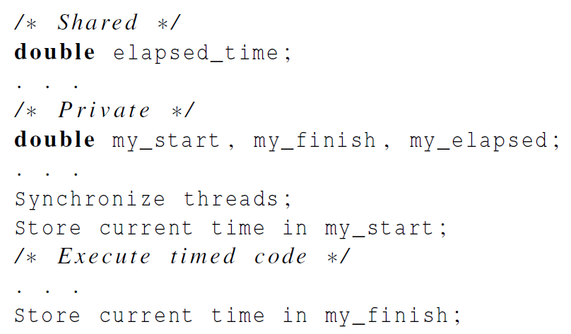
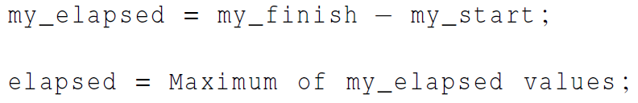
Barriers for Execution Time

Slide 30
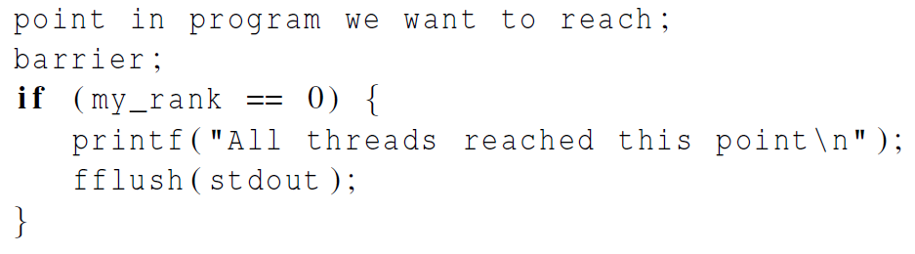

Barriers for Debug

Slide 31
Implementing Barrier
Implementing a barrier using busy-waiting and a mutex is straightforward.
We use a shared counter protected by the mutex.
When the counter indicates that every thread has entered the critical section, threads can leave the critical section.

Slide 32
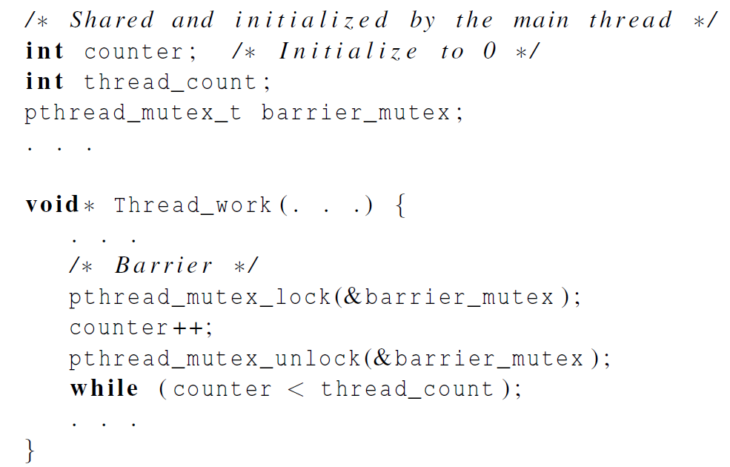
Implementing Barrier
We need one counter
variable for each
instance of the barrier,
otherwise problems are likely to occur.

Slide 33
Caveat
Busy-waiting wastes CPU cycles.
What about we want to implement a second barrier and reuse counter?
If counter is not reset, thread won’t block at the second barrier
If counter is reset by the last thread in the barrier, other threads cannot see it.
If counter is reset by the last thread after the barrier, some thread might have already entered the second barrier, and the incremented counter might get lost.
Need to use different counters for different barriers.

Slide 34
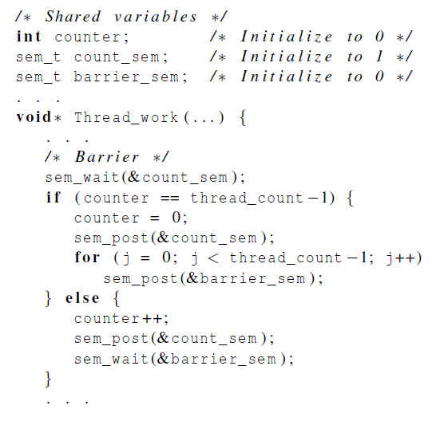
Implementing Barrier

Slide 35
Caveat
No wasting CPU cycles since no busy-waiting
What happens if we need a second barrier?
“counter” can be reused.
“counter_sem” can also be reused.
“barrier_sem” need to be unique, there is potential that a thread proceeds through two barriers but another thread traps at the first barriers if the OS put the thread at idle for a long time.

Slide 36
Pthreads Barrier
Open Group provides Pthreads barrier
pthread_barrier_init();
pthread_barrier_wait();
pthread_barrier_destroy();
Not universally available

Slide 37
Linked List
Let’s look at an example.
Suppose the shared data structure is a sorted linked list of ints, and the operations of interest are Member, Insert, and Delete.

Slide 38
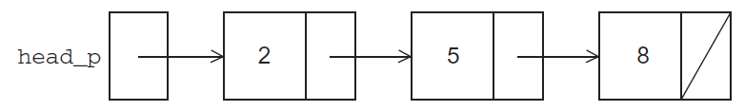
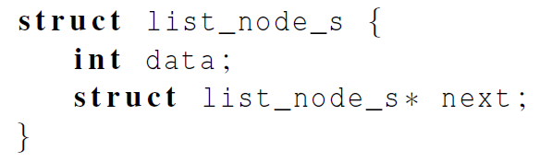
Linked List

Slide 39
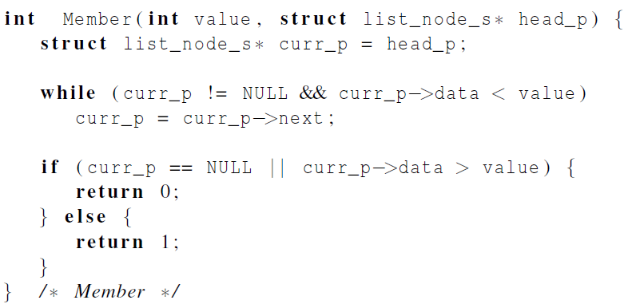
Membership

Slide 40
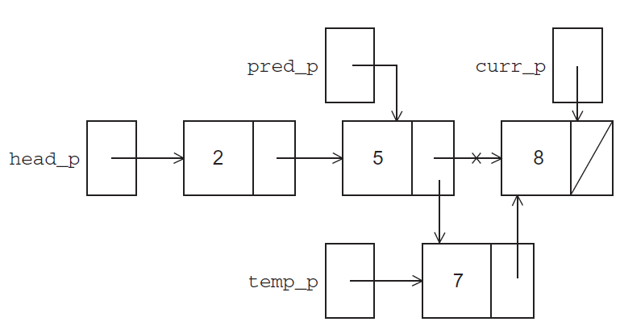
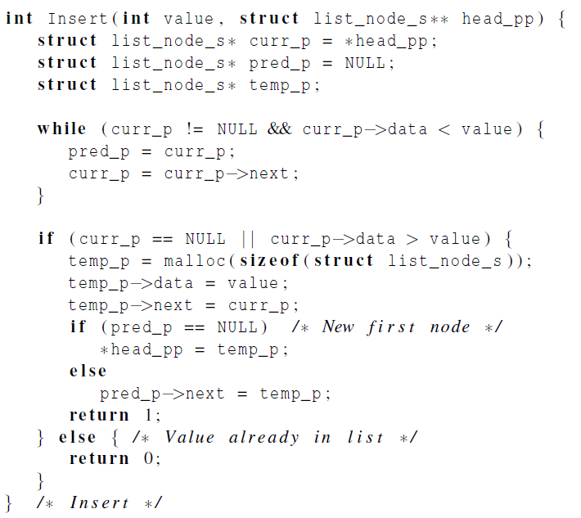
Insert

Slide 41
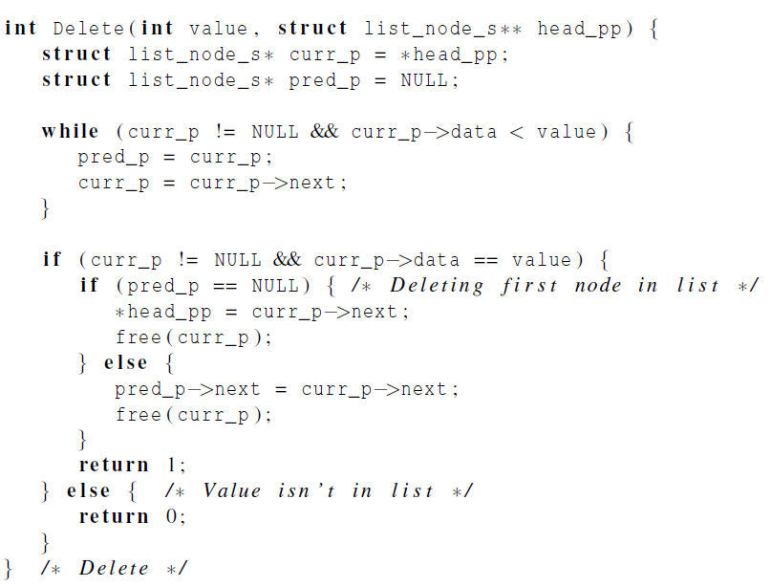
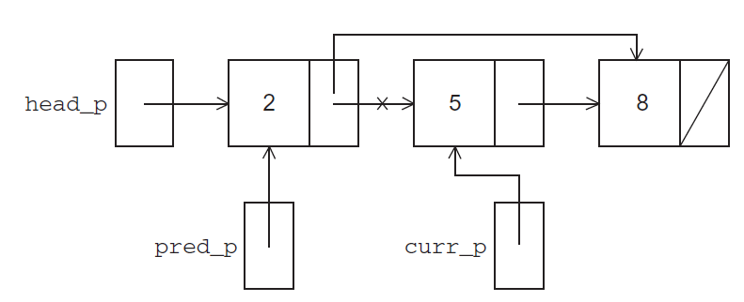
Delete

Slide 42
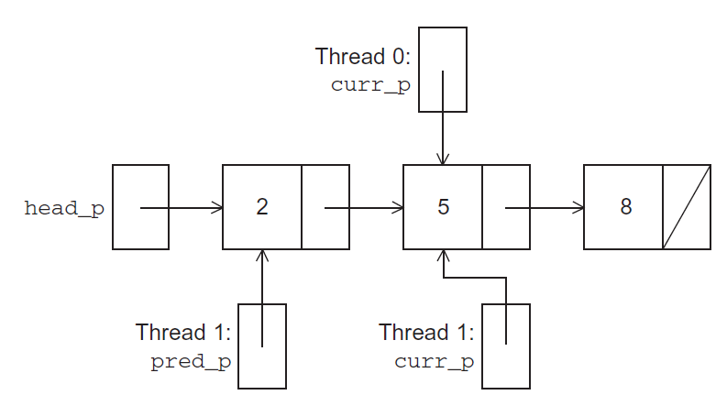
Linked List with Multi-thread

Slide 43
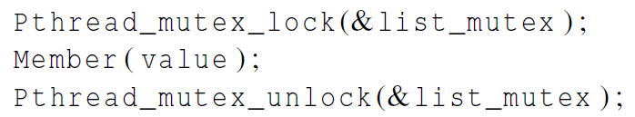
Solution #1
An obvious solution is to simply lock the list any time that a thread attempts to access it.
A call to each of the three functions can be protected by a mutex.
In place of calling Member(value).

Slide 44
Issues
We’re serializing access to the list.
If the vast majority of our operations are calls to Member, we’ll fail to exploit this opportunity for parallelism.
On the other hand, if most of our operations are calls to Insert and Delete, then this may be the best solution since we’ll need to serialize access to the list for most of the operations, and this solution will certainly be easy to implement.

Slide 45
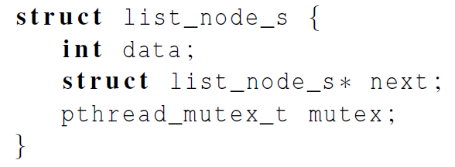
Solution #2
Instead of locking the entire list, we could try to lock individual nodes.
A “finer-grained” approach.

Slide 46
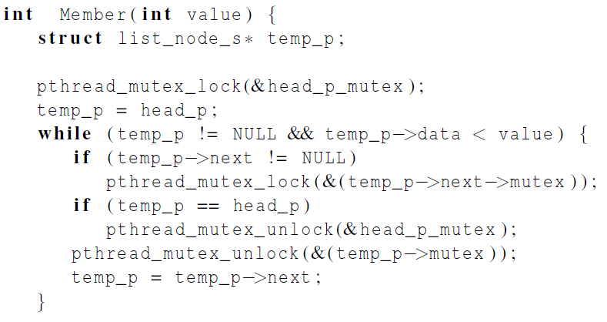
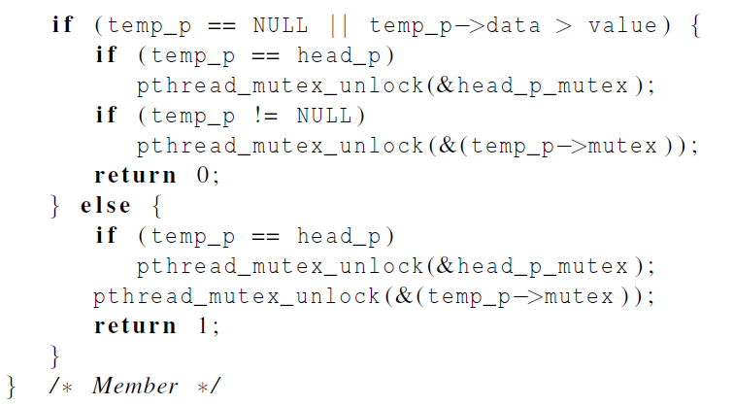
Solution #2

Slide 47
Issues
This is much more complex than the original Member function.
It is also much slower, since, in general, each time a node is accessed, a mutex must be locked and unlocked.
The addition of a mutex field to each node will substantially increase the amount of storage needed for the list.

Slide 48
Read-Write Locks
Neither of our multi-threaded linked lists exploits the potential for simultaneous access to any node by threads that are executing Member.
The first solution only allows one thread to access the entire list at any instant.
The second only allows one thread to access any given node at any instant.

Slide 49
Read-Write Locks
A read-write lock is somewhat like a mutex except that it provides two lock functions.
The first lock function is a read lock for reading, while the second locks it for writing.
If any threads own the lock for reading, any threads that want to obtain the lock for writing will block. But reading will not be blocked.
If any thread owns the lock for writing, any threads that want to obtain the lock for reading or writing will block in their respective locking functions

Slide 50
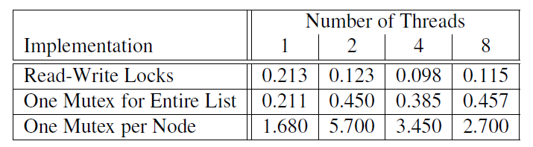
Linked List Performance
100,000 ops/thread
99.9% Member
0.05% Insert
0.05% Delete

Slide 51
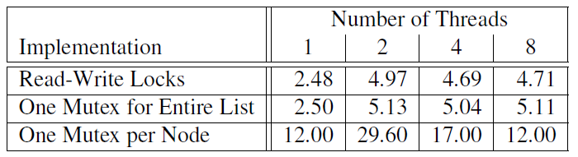
Linked List Performance
100,000 ops/thread
80% Member
10% Insert
10% Delete

