Slide 1
CS427 Multicore Architecture and Parallel Computing
Lecture 7 CUDA
Prof. Li Jiang
2014/11/05

Slide 2
CUDA
“Compute Unified Device Architecture”
General purpose programming model
User kicks off batches of threads on the GPU
Targeted software stack
Compute oriented drivers, language, and tools
Driver for loading computation programs into GPU
Standalone Driver -Optimized for computation
Interface designed for compute –graphics-free API
Data sharing with OpenGL buffer objects
Guaranteed maximum download & readback speeds
Explicit GPU memory management

Slide 3
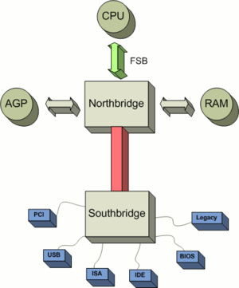
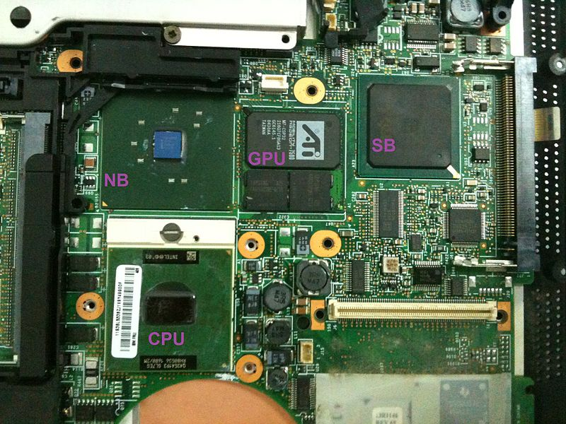
GPU Location

Slide 4
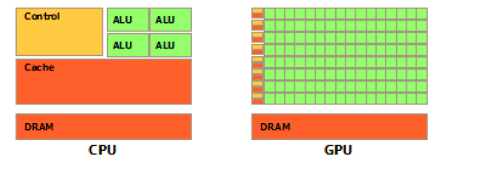
GPU Vs. CPU

Slide 5
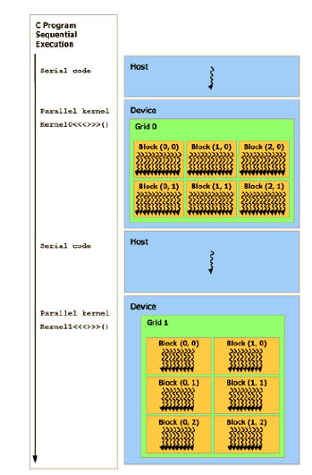
CUDA Execution Model
Notes:
Launch host code, all threads generated by a kernel launch are collectedly called a grid
The corresponding grid terminates and host code continue, until another kernel launch

Slide 6
CUDA Device and Threads
A compute device
Is a coprocessor to the CPU or host
Has its own DRAM (device memory)
Runs many threads in parallel
Is typically a GPU but can also be another type of parallel processing device
Data-parallel portions of an application are expressed as device kernels which run on many threads
Differences between GPU and CPU threads
GPU threads are extremely light weight
Very little creation overhead
GPU needs 1000s of threads for full efficiency
Multi-core CPU needs only a few

Slide 7
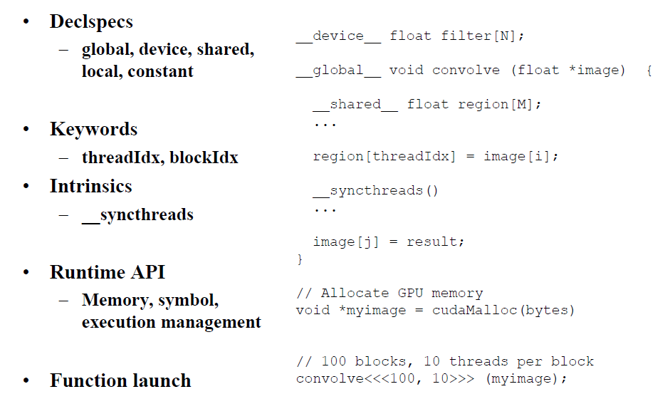
C Extension
Notes:
Label memory location, device function, thread id for selecting work and addressing shared memory

Slide 8
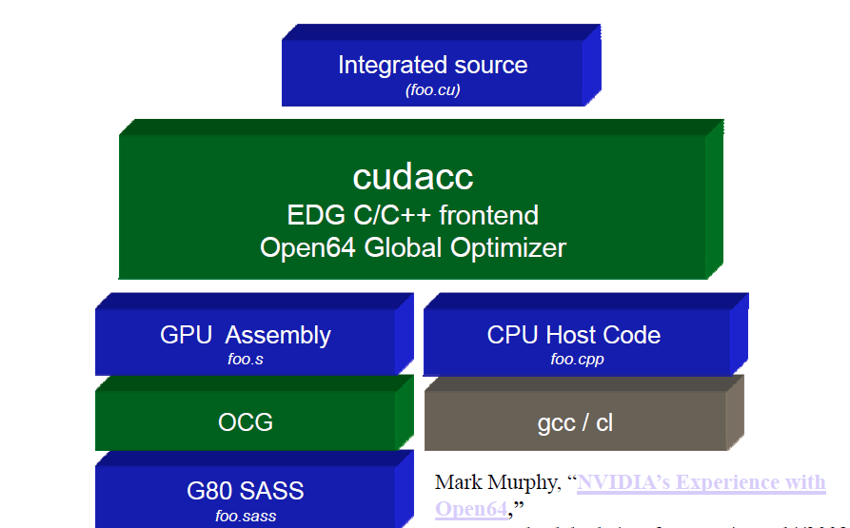
Compilation Flow
Notes:
Frontend differ traditional c code and cuda extension
Runtime of CUDACC compile

Slide 9
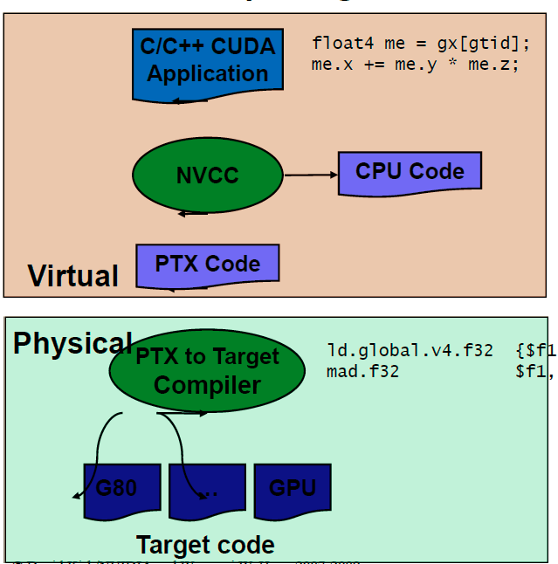
Compilation Flow

Slide 10
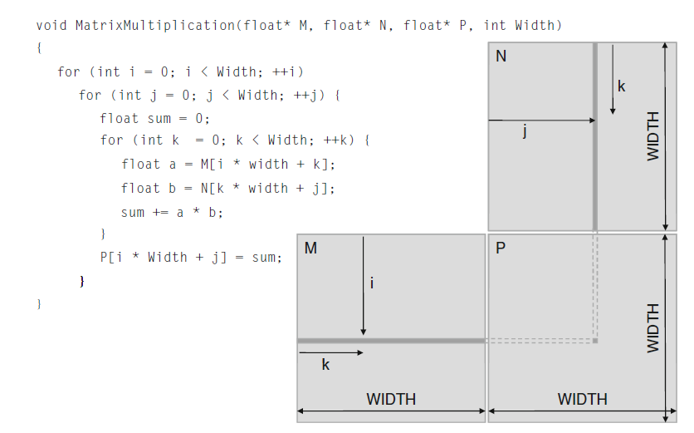
Matrix Multiplication
1000X1000=1,000,000 independent dot product
1000 multiply+1000 accumulate per dot
Notes:
One block for the whole matrix

Slide 11
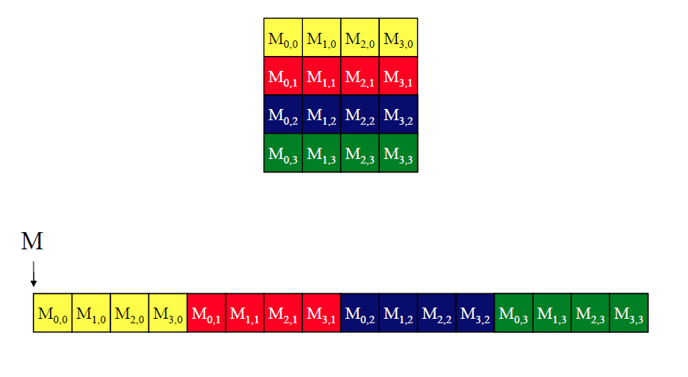
Matrix Layout
Notes:
Linearized
Row major order, row*width + col

Slide 12
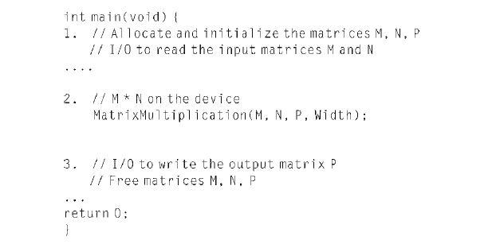
Matrix Main Program
Notes:
Allocate host memory to hold input data
kernel function: ship data out to device, activate the parallel execution and collect data back
Free memory

Slide 13
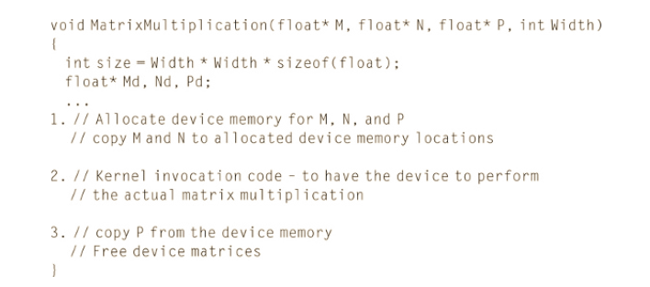
Kernel Program

Slide 14
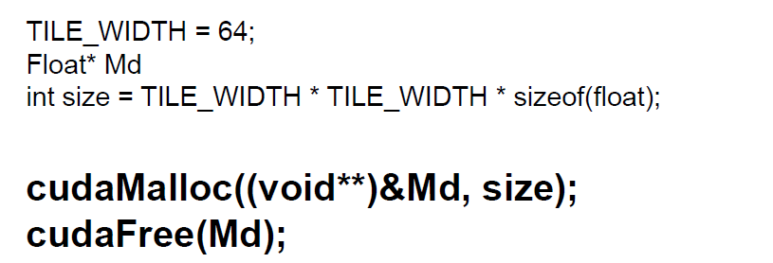
Creating CUDA Memory Space
Notes:
Called from the host code to allocate a piece of device global memory for an object, write the address of allocated memory into pointer variable
Void** because the function expects a general pointer, malloc is general function
The pointer should not be dereferenced in host code -> exceptions and runtime error

Slide 15
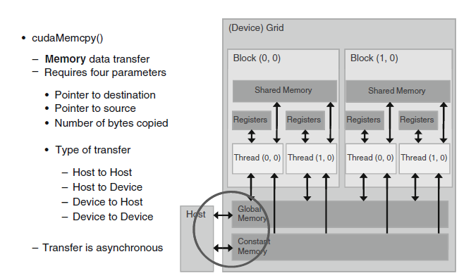
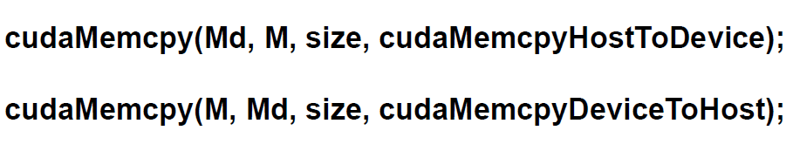
Memory Copy

Slide 16
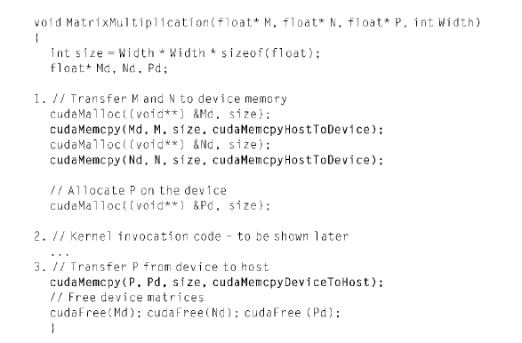
Kernel Program

Slide 17
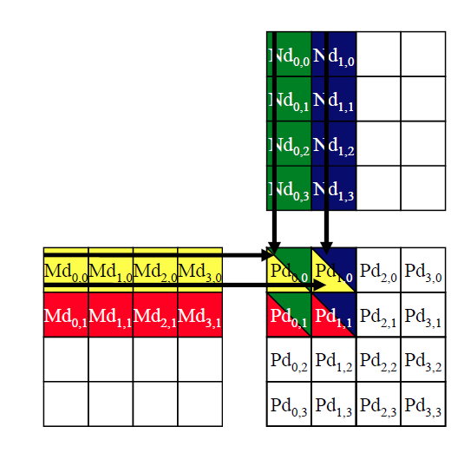
Calculating a Dot

Slide 18
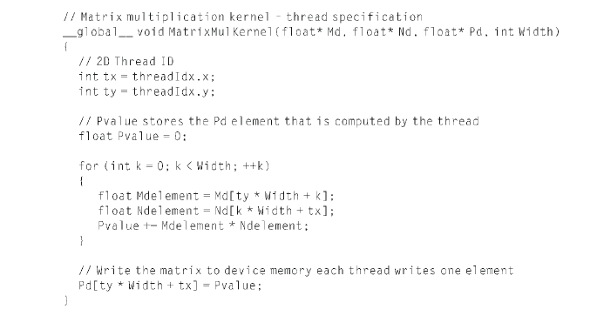
Kernel Program
Notes:
Threadidx unique for each thread, combine threadidx and blockidx to create a qunie global index for itself with the grid

Slide 19
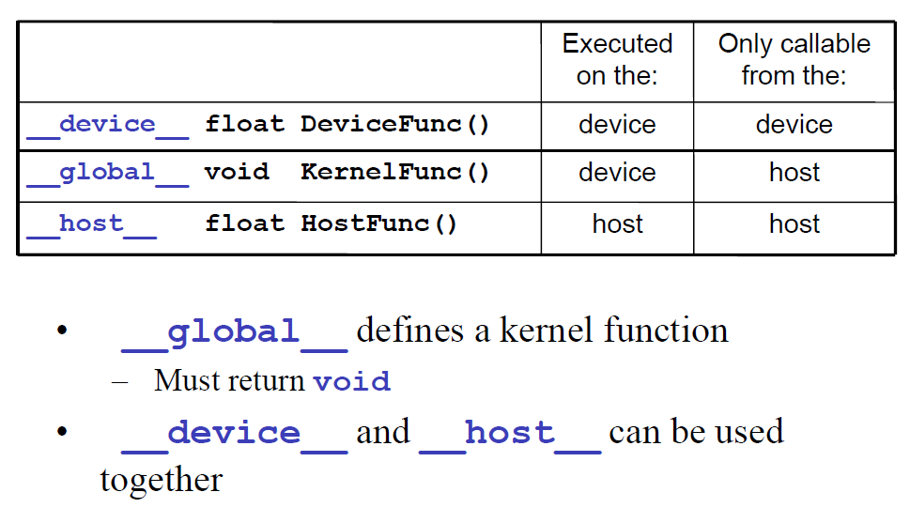
Function Declarations

Slide 20
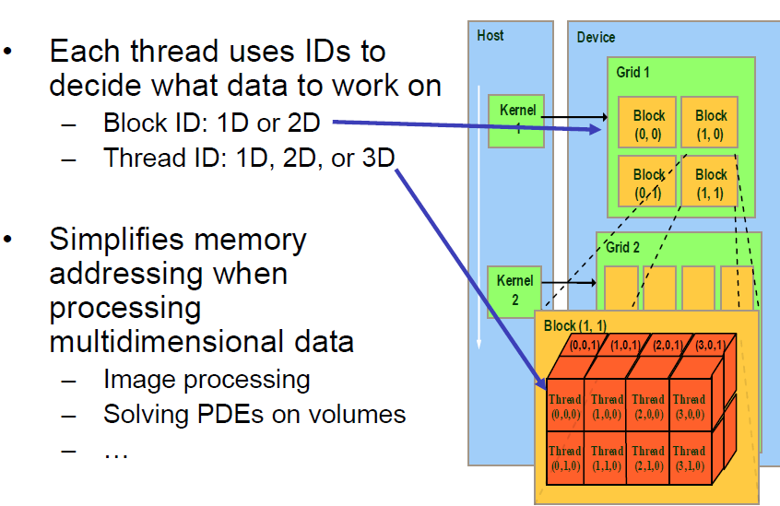
Thread Blocks
Notes:
Block(1,0) has blockidx.y = 1, blockidx.x = 0
Some considerations for deciding the dimensions
- memory locality
- data organizations
- border checking

Slide 21
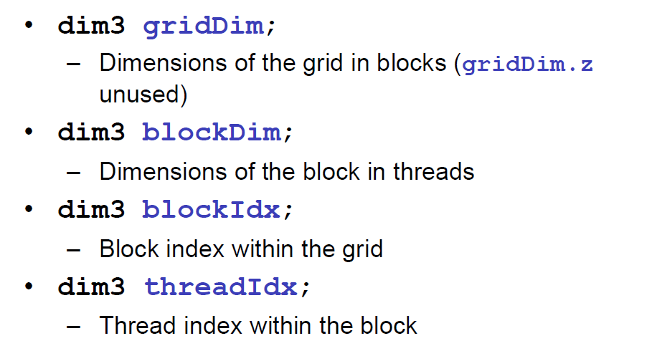
Building Variables
Notes:
Griddim - blockidx
Blockdim - threadidx

Slide 22
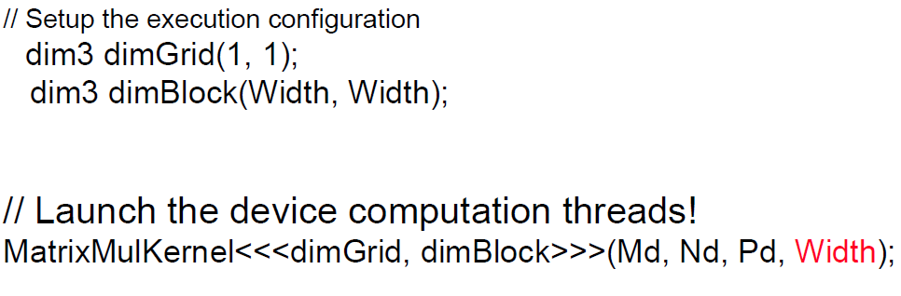
Kernel Invocation
Notes:
In host code
<<>>exeution configuration

Slide 23
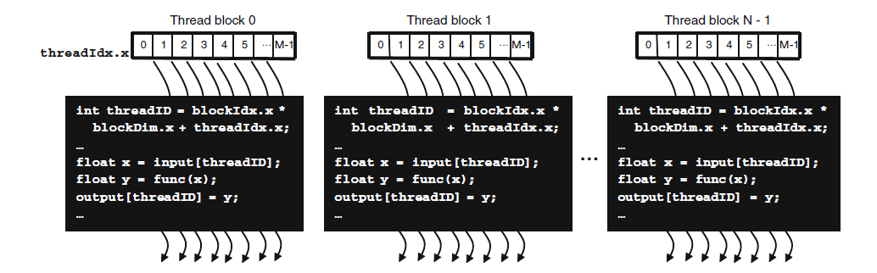

Thread Blocks
Notes:
Same kernel code
Different data portion
Execution configurations

Slide 24
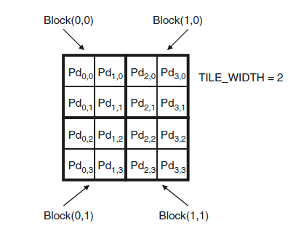
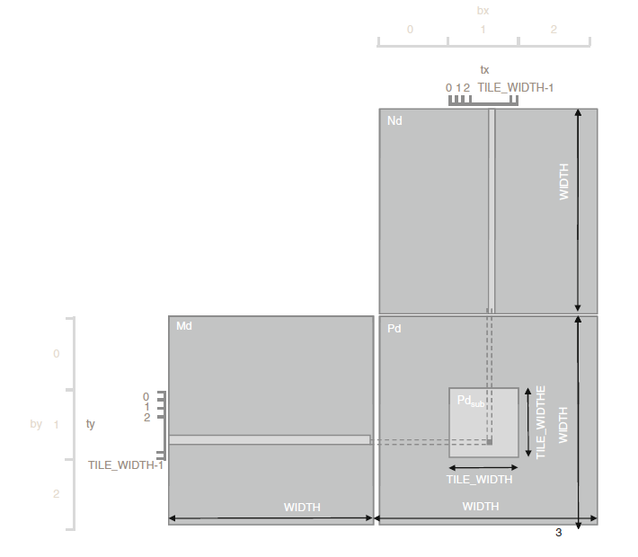
Matrix Program
Notes:
divide the data into smaller blocks, which can be executed by thread blocks
Dimension size differs in different hardware for better use

Slide 25
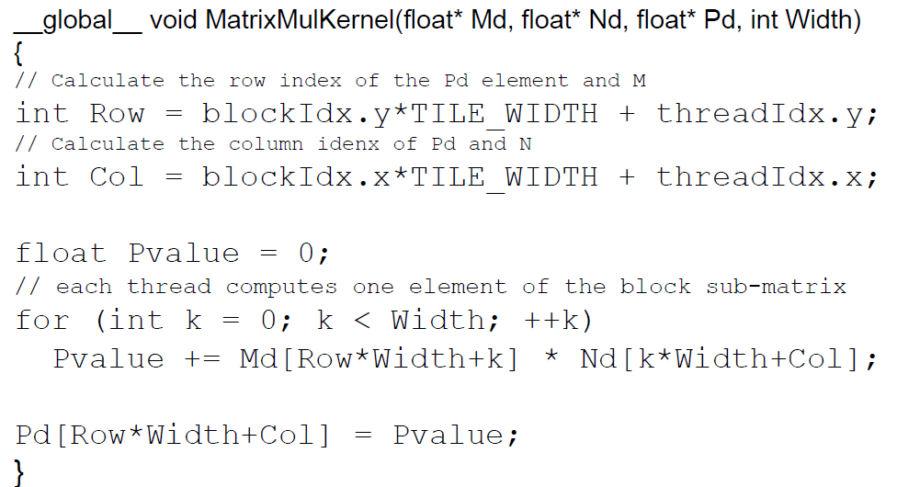
Kernel Program
Notes:
The major difference is the Tilewidth
Tilewidth compile-tie constant allow programmer to set to a different value when compiling for a particular hardware

Slide 26
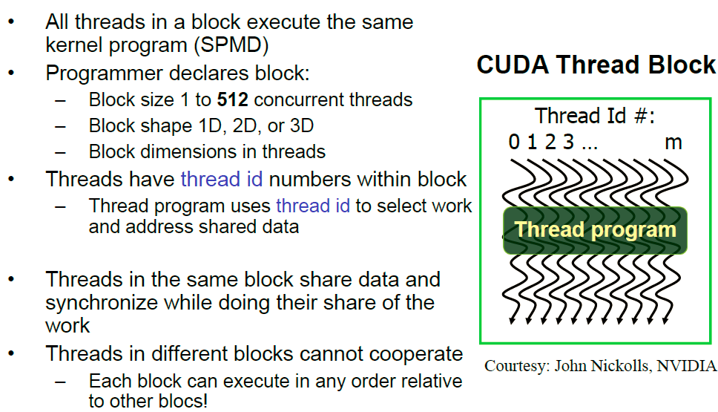
Characteristics of Thread Blocks

Slide 27
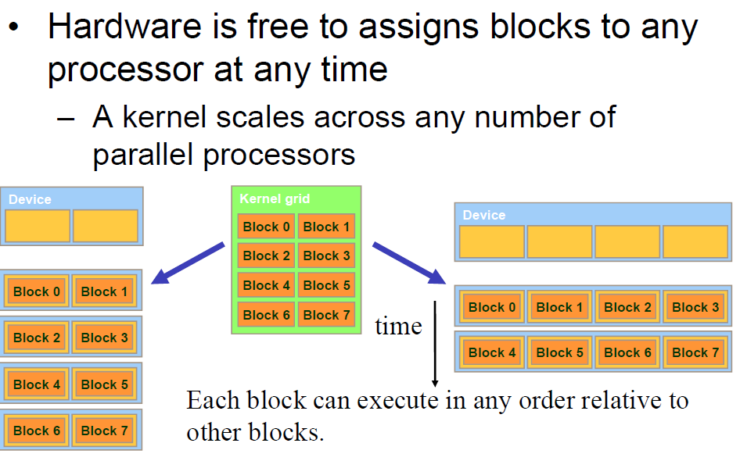
Transparency
Notes:
Must write scalable kernel code
This transparency is because of the limit that the threads within different blocks cannot be synchronized. It forbids the programmer to generate codes with data dependency among blocks

Slide 28
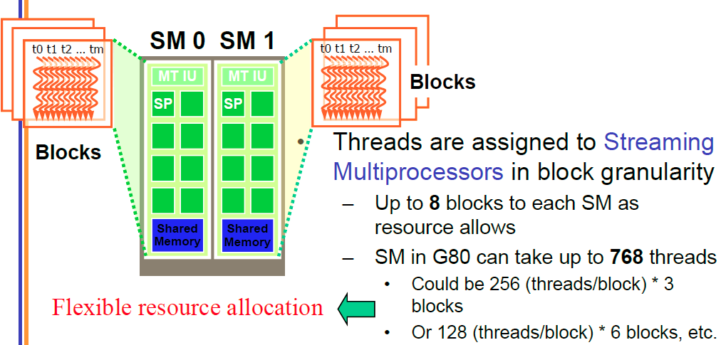
Threads Assignment
Notes:
Maximum 8 core per SM
Maximum 768 threads per SM

Slide 29
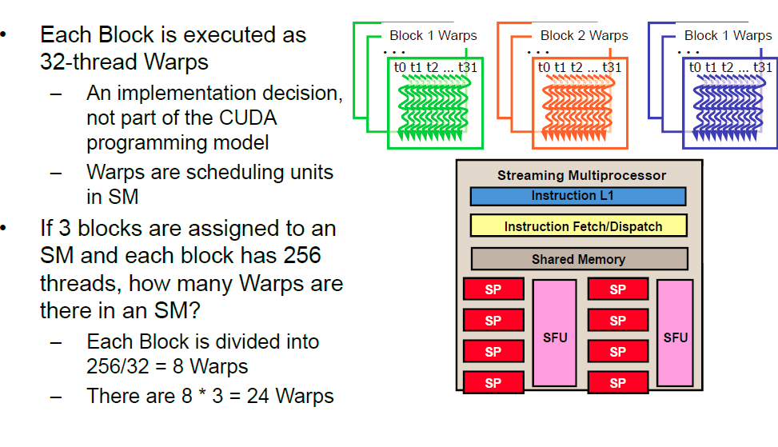
Threads Scheduling
Notes:
Each warp can have only one instruction at any time

Slide 30
Threads Allocation
For Matrix Multiplication using multiple blocks, should I use 8X8, 16X16 or 32X32 blocks?
For 8X8, we have 64 threads per Block. Since each SM can take up to 768 threads, there are 12 Blocks. However, each SM can only take up to 8 Blocks, only 512 threads will go into each SM!
For 16X16, we have 256 threads per Block. Since each SM can take up to 768 threads, it can take up to 3 Blocks and achieve full capacity unless other resource considerations overrule.
For 32X32, we have 1024 threads per Block. Not even one can fit into an SM!
Notes:
Animation

Slide 31
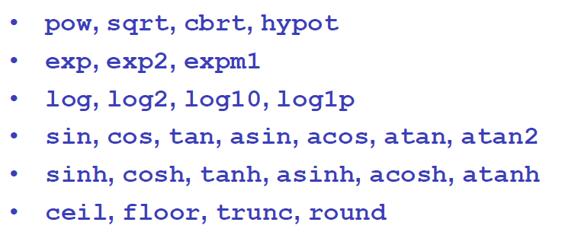
Special Functions
Notes:
???

Slide 32
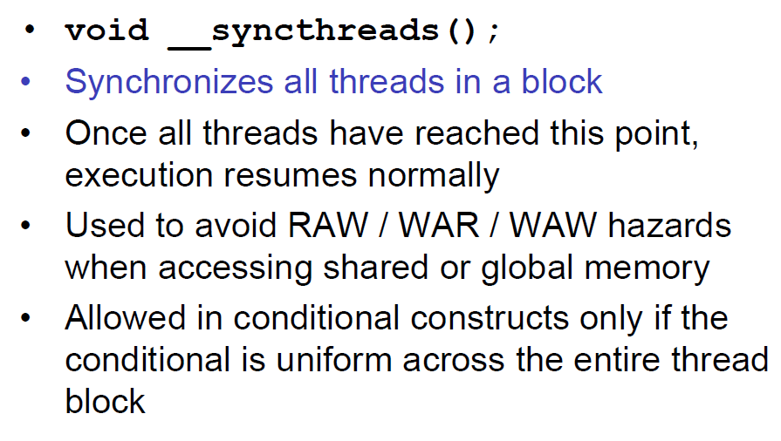
Synchronization
Notes:
like barriers
Conditions are uniform across the entire thread block, otherwise, some thread may be tracked and the barrier can never been passed through
For the same reason, any thread is scheduled in execution, all other threads in a thread block is scheduled in.

Slide 33
Memory Constraints
Compute to Global Memory Access Ratio (CGMA)
Two global memory access required for one multiplication
and one addition
CGMA=1
G80 Memory Bandwidth
86.4 GB/s memory bandwidth
4B per float type
86.4/4=21.6Gflops/s compute operations
G80 Compute Capability
367Gflops/s
21.6/367=5.8% potential is used
Notes:
Memory bandwidth is the bottleneck of the overall performance.
Execution units wait for memory access

Slide 34
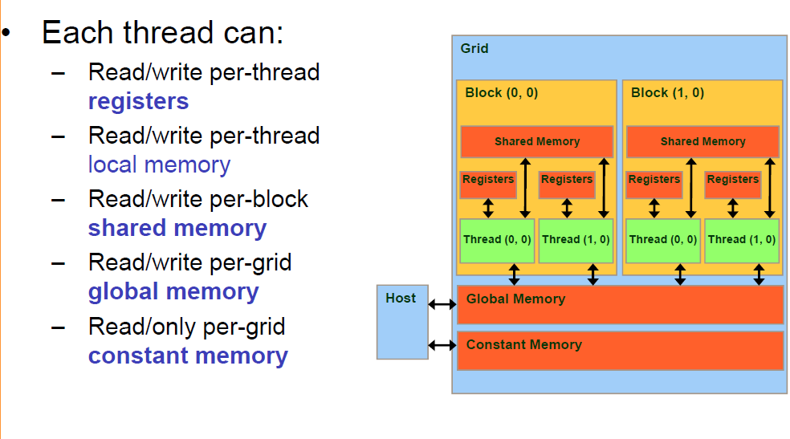
Memory Types
Notes:
Where is local memory?

Slide 35
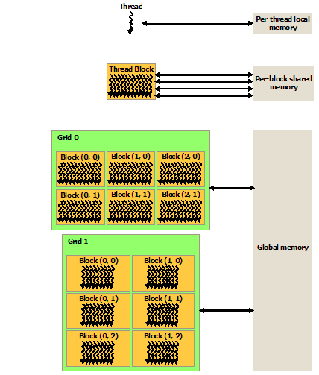
Memory Types
Can they share data

Slide 36
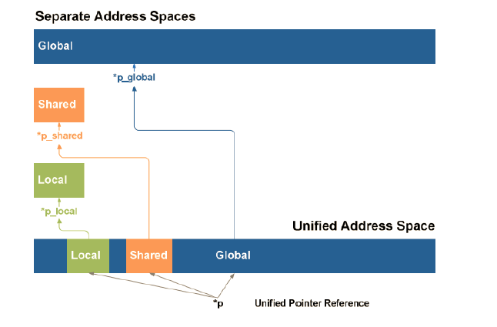
Unified Memory Space
Notes:
???

Slide 37
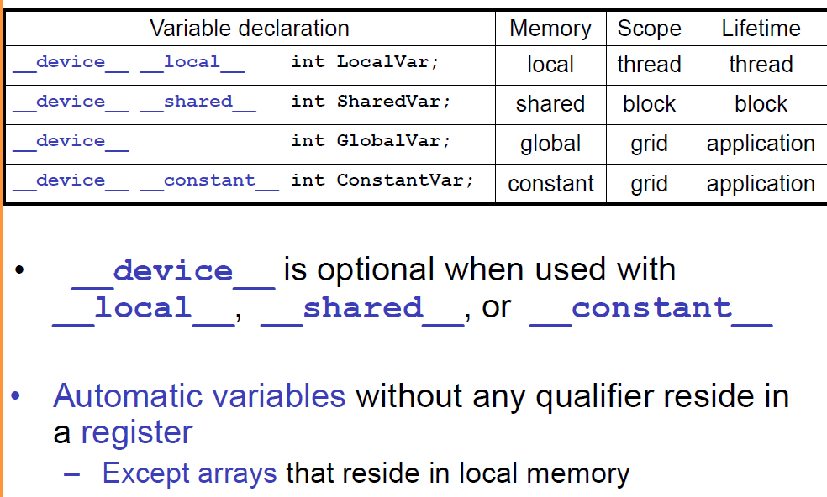
Memory Declaration
What about others?
Compiler may put them into registers if they have constant index
Notes:
-Scope identifies the range of threads that can access the variable
-lifetime tells the portion of the program’s execution duration when the variable is available for use: within kernel or throughout the entire application
-private: one-million threads have one-million private copies
-kernel is invoked several times, then, local value will be initialized several times
-

Slide 38
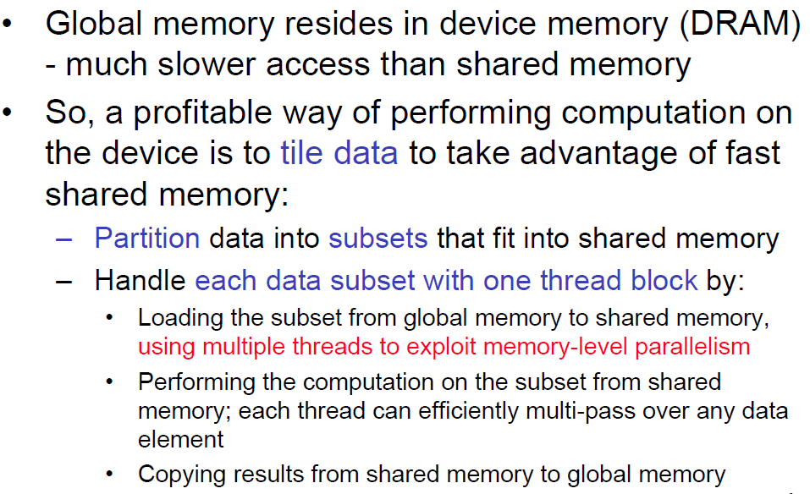
Memory Strategy
Notes:
Red lines: We'll see the examples later

Slide 39
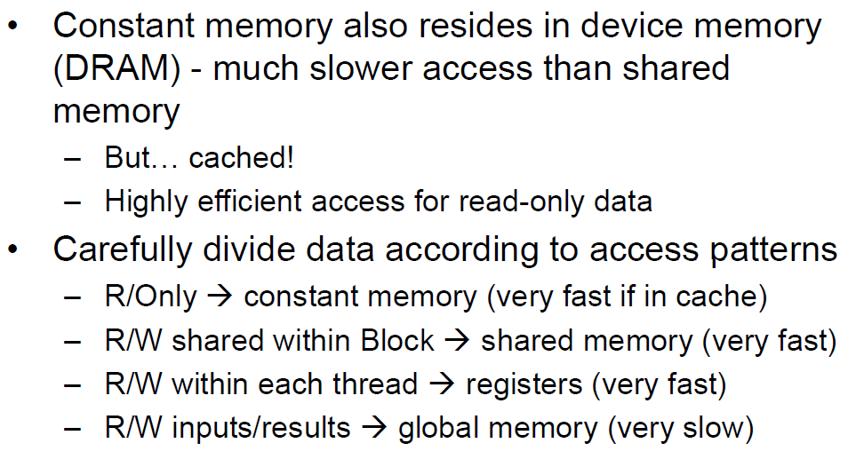
Memory Strategy

Slide 40

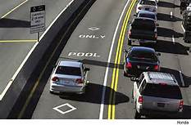
Shared Data in Matrix
Carpooling
Notes:
-for carpooling, peoples should have similar schedule
-for tileing, multiple threads access data from the same DRAM location, they can form a “caqrpool” and combine their accesses into one DRAM request

Slide 41
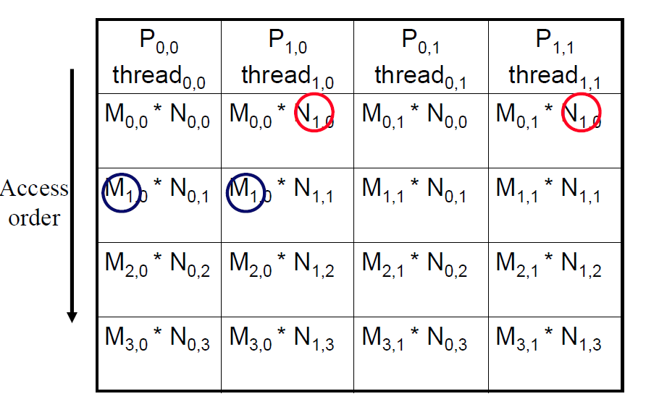
Shared Data in Matrix
Every Md and Nd Element is used twice in a 2x2 tile
Load the data into shared memory and saved for the later use
Save 15 global memory access in a 16x16 tile

Slide 42
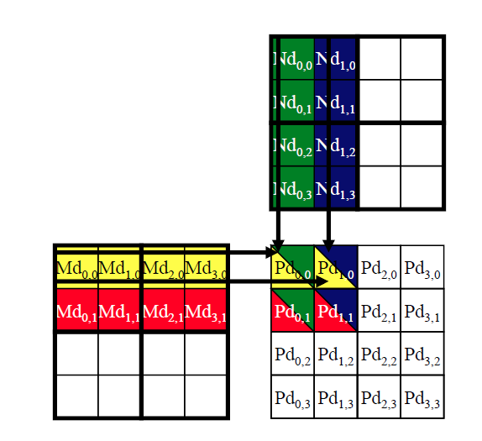
Matrix Tiling

Slide 43
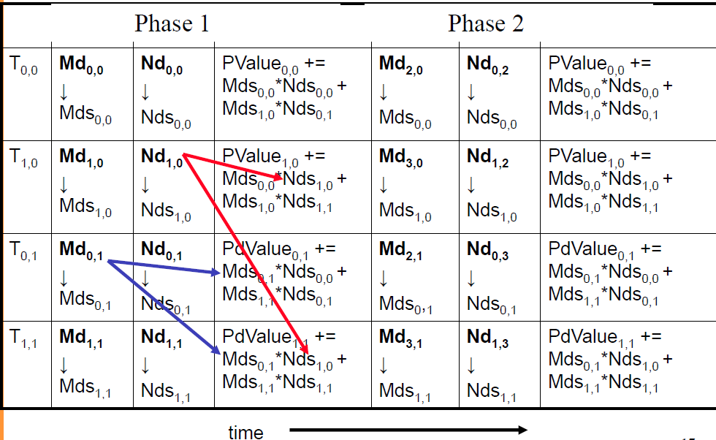
Matrix Tiling
Notes:
Reuse data

Slide 44
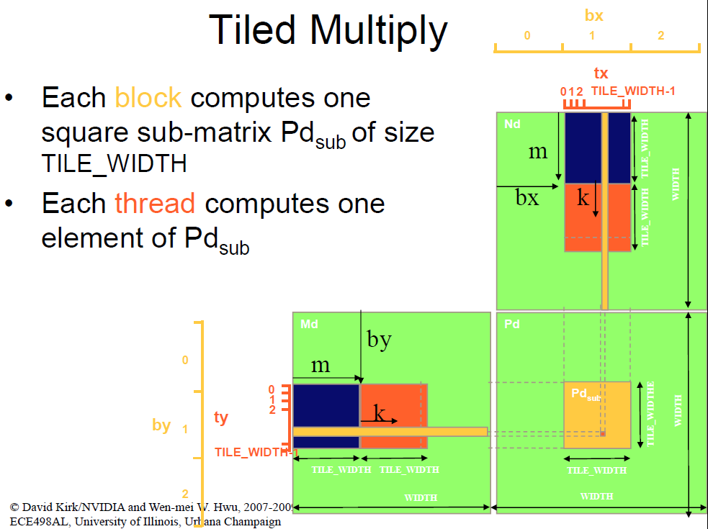
Tiled Multiply
Notes:
-Inner product tile, add results from all tiles‘results
-each thread load a data from Md and Nd according to its position
-when calculating, the required data is loaded with the help of other threads who are in the same row or in the same column

Slide 45
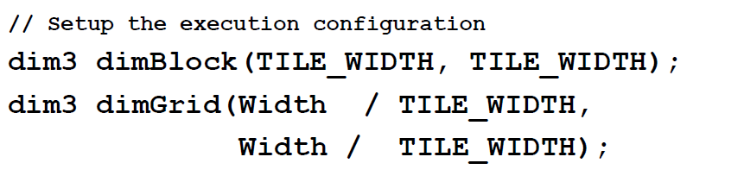
Tiling Code

Slide 46
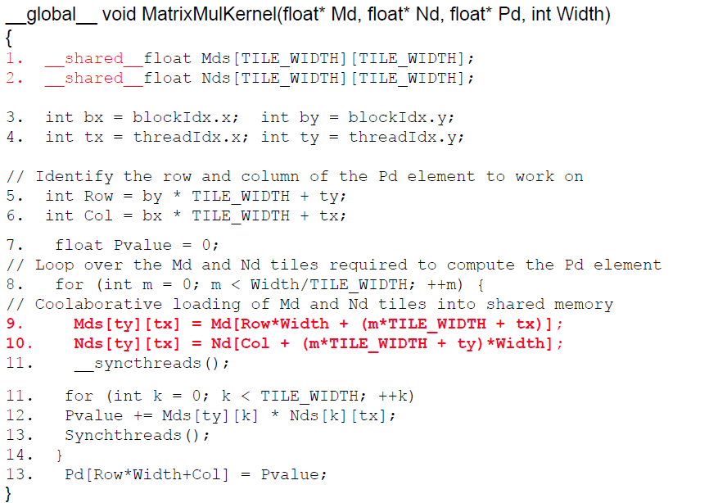
Tiling Code
register
Each block covers TILE_WIDTH elements
Two different directions
Each phase compute partial results

Slide 47
Tiling Impact
G80 without tiling
367Gflops/s
21.6/367=5.8% potential is used
G80 with 16x16 tiling
G80 has 16KB shard memory
16*16*2*4=2KB shared memory for each block, can accommodate 8 blocks
21.6*15=324Gflops/s
324/367=88% potential is used
However G80 only support 768 threads per SM
16*16=256 threads, 768/256=3 blocks
Only 6KB shared memory is used
Fermi can support 1536 threads per SM

Slide 48
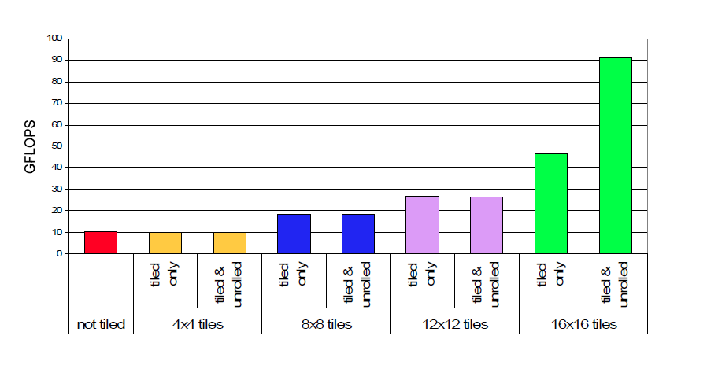
Performance

Slide 49
Fermi Parameters
Each Fermi SM has
32 threads per warp
48 warps per SM, 32*48=1536 threads
8 thread blocks
48KB RF
16KB L1 cache/48KB shared memory or vice versa
768KB L2 cache
Each Fermi GPU has
1-16 SM cores
Up to 6GB GDDR5 memory
PCI-E 2.0
M2070 : 1288Gflops/s SP, 150GB/s memory bandwidth

