Slide 1
CS427 Multicore Architecture and Parallel Computing
Lecture 8 CUDA, cont’d
Prof. Li Jiang
2014/11/13

Slide 2
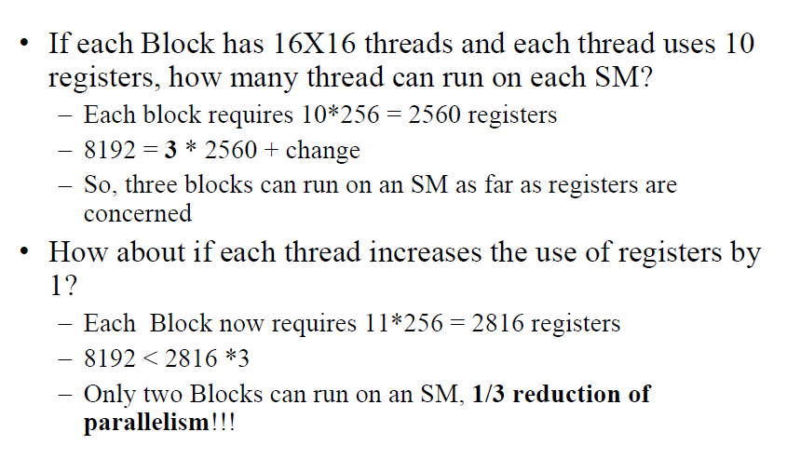
Register File Limitation
Thread reduction due to the limit of hardware resources is done at the block granularity
Notes:
- Thread reduction due to the limit of hardware resources is done at the block granularity

Slide 3
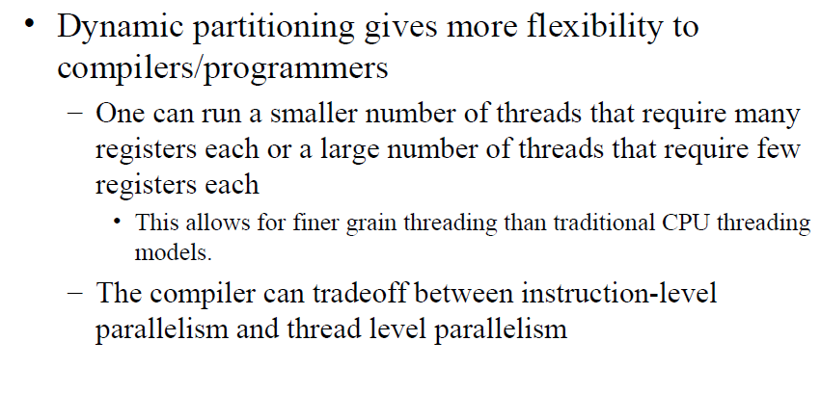
Dynamic Partitioning

Slide 4
ILP Vs. TLP
• Assume that a kernel has 256-thread Blocks, 4 independent instructions for each global memory load in the thread program, and each thread uses 10 registers, can fit 3 blocks, global loads have 400 cycles
– 4 cycles * 4 inst * 24 warps = 384 < 400
• If a compiler can use one more register to change the
dependence pattern so that 8 independent instructions exist for each global memory load, can only fit 2 blocks
– 4 cycles * 8 inst * 16 warps = 512 > 400, better hiding
memory latency
Notes:
Trade-off between register limit and concurrent threads

Slide 5
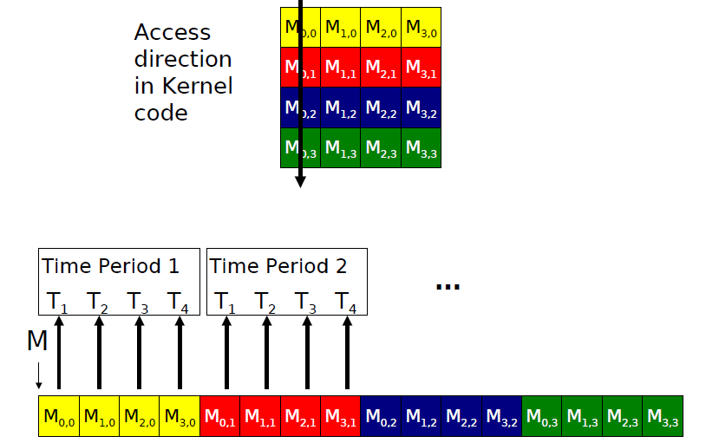
Memory Coalescing
T_{z,y,x}
Notes:
-how to partition a warp in 2-D hierarchy

Slide 6
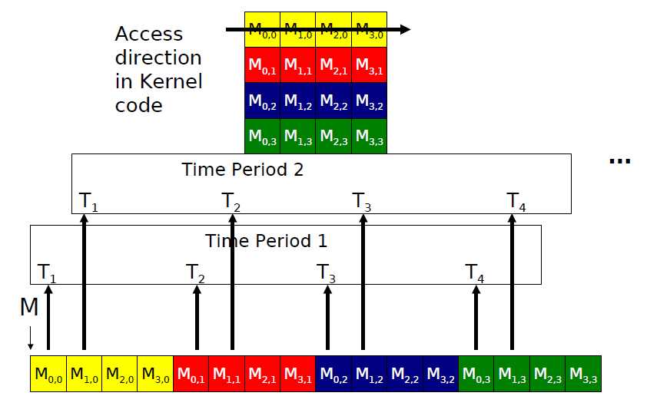
Memory Coalescing

Slide 7
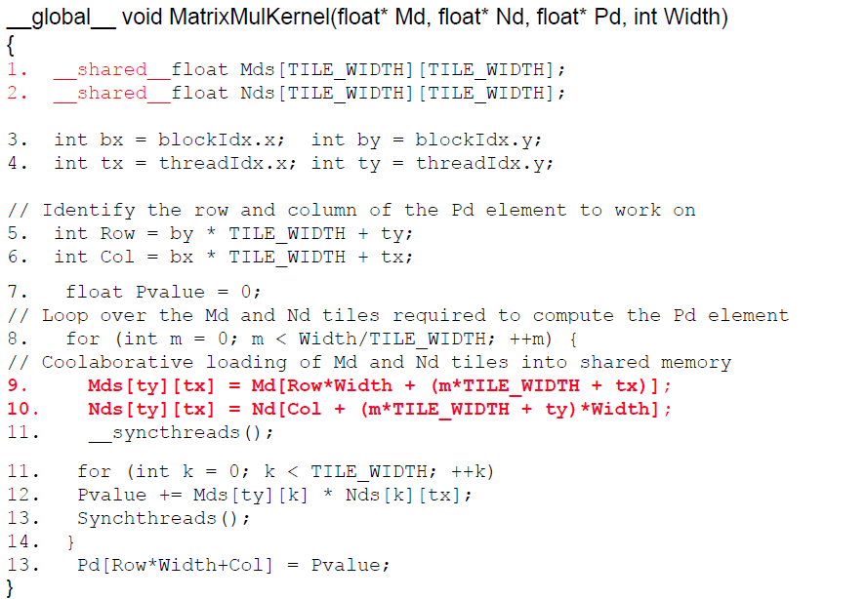
Memory Coalescing

Slide 8
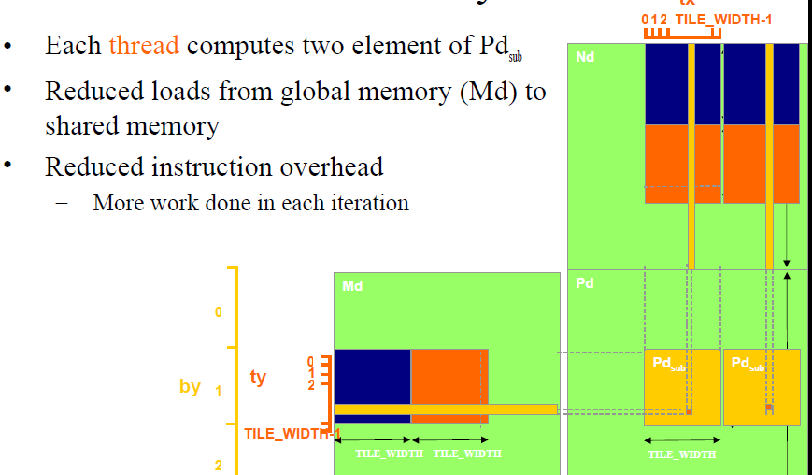
Increasing Per Thread Work

Slide 9
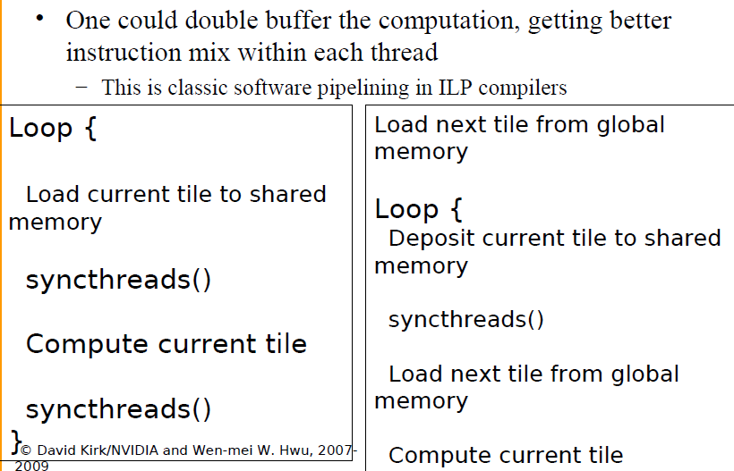
Double Buffering

Slide 10
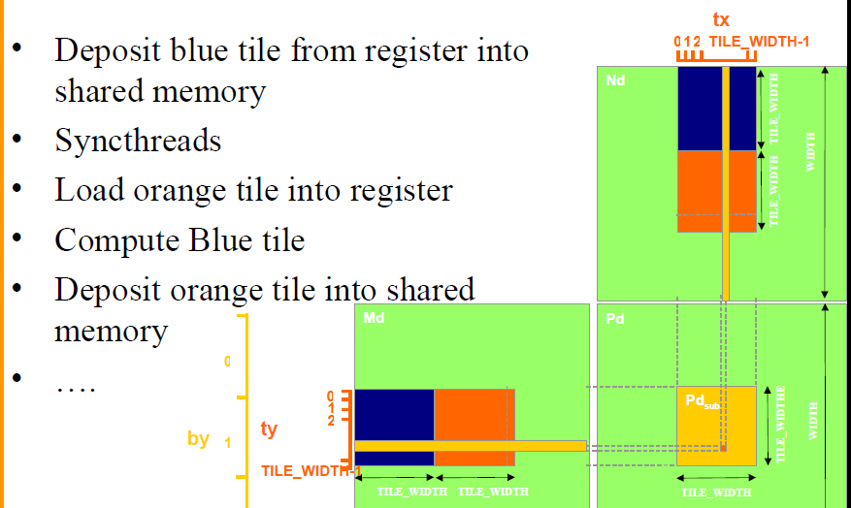
Double Buffering

Slide 11
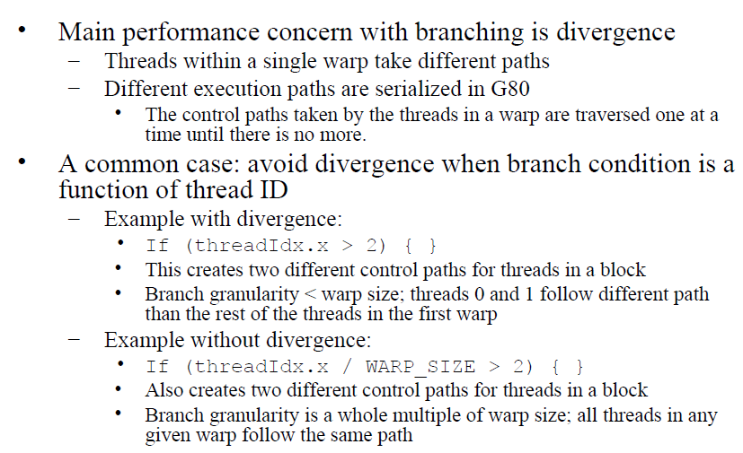
Divergence

Slide 12
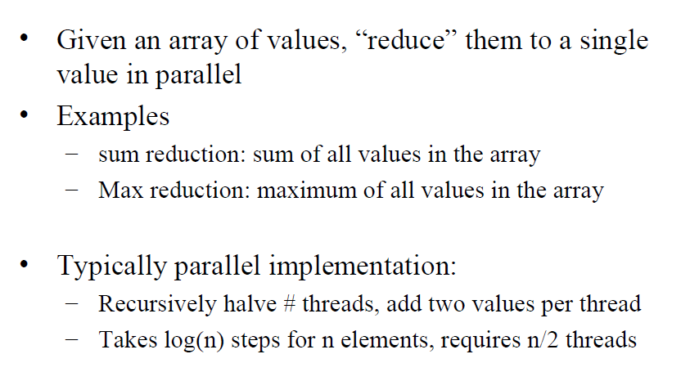
Reduction

Slide 13
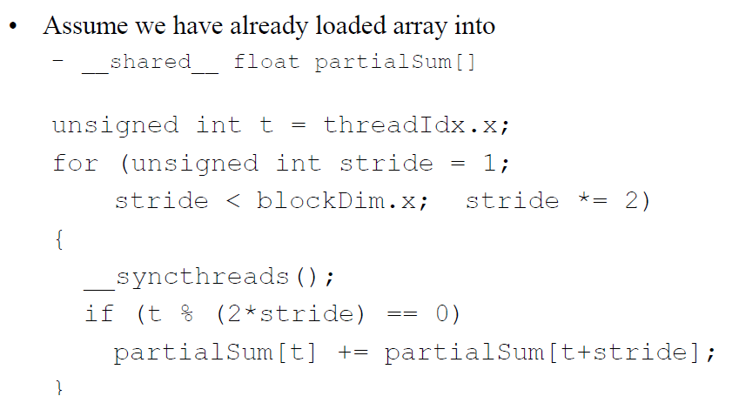
Reduction Program

Slide 14
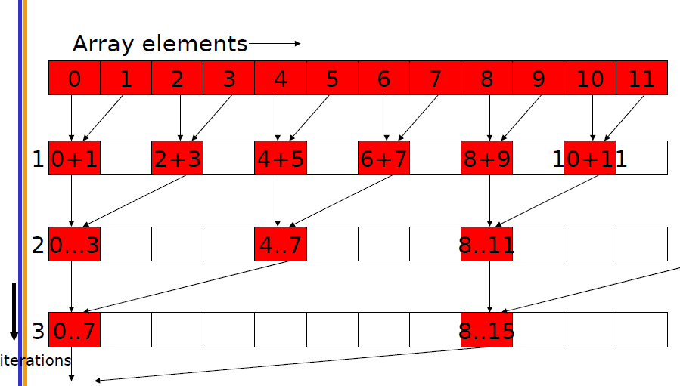
Reduction Program

Slide 15
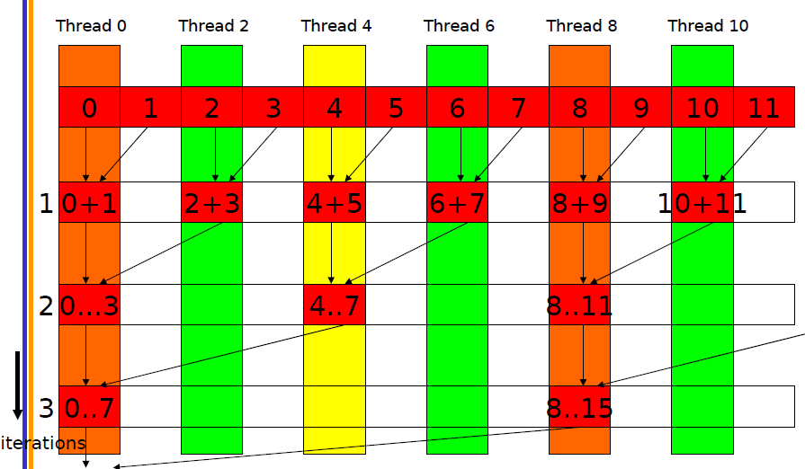
Divergence in Reduction
How to reduce the waste of threads? Try by yourself!

Slide 16
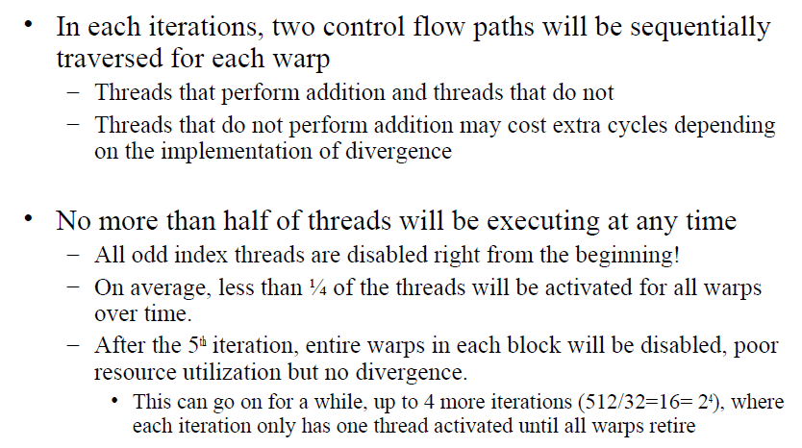
Problem in the Program

Slide 17
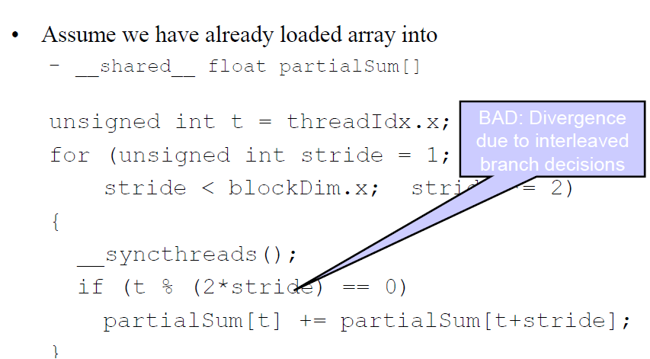
Problem in the Program

Slide 18
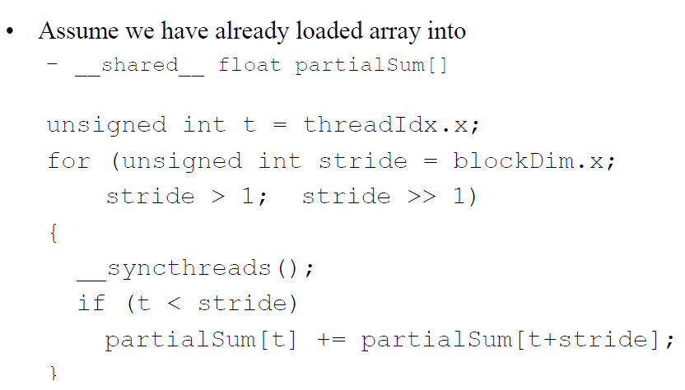
Better Implementation

Slide 19
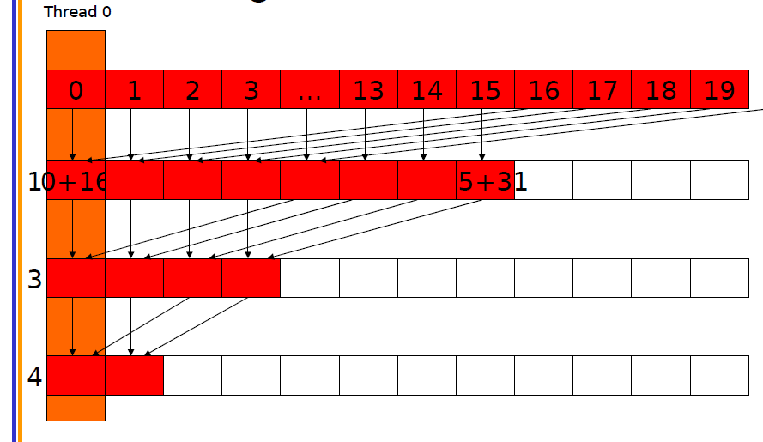
Better Implementation

Slide 20
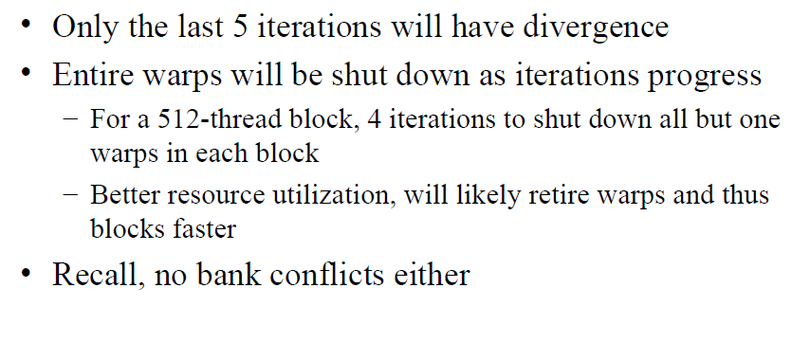
Better Implementation
How about the data locality?

Slide 21
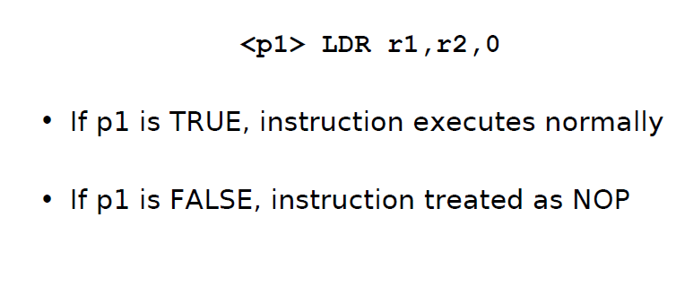
Predicate

Slide 22
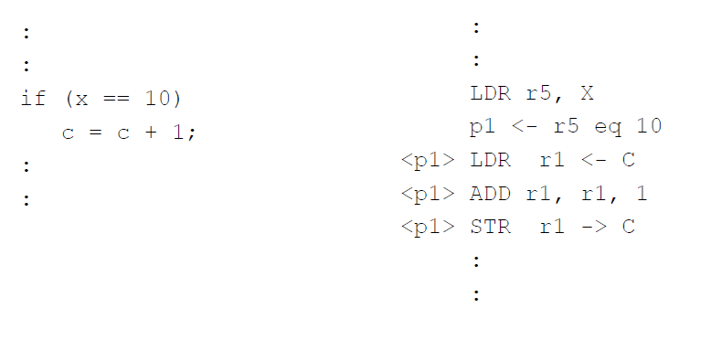
Predicate Example

Slide 23
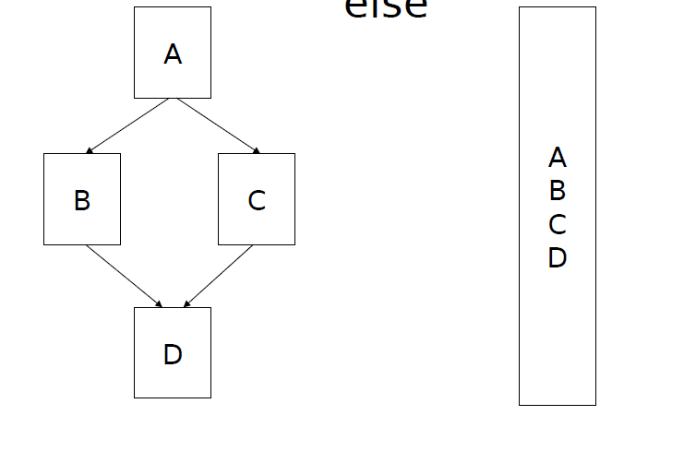
If-Else Predicate

Slide 24
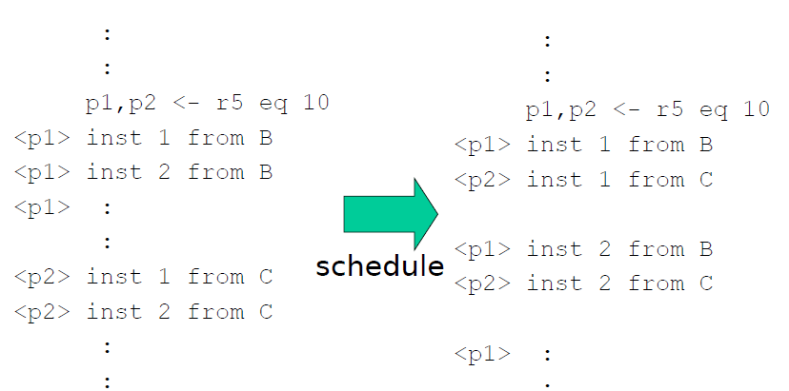
If-Else Predicate

Slide 25
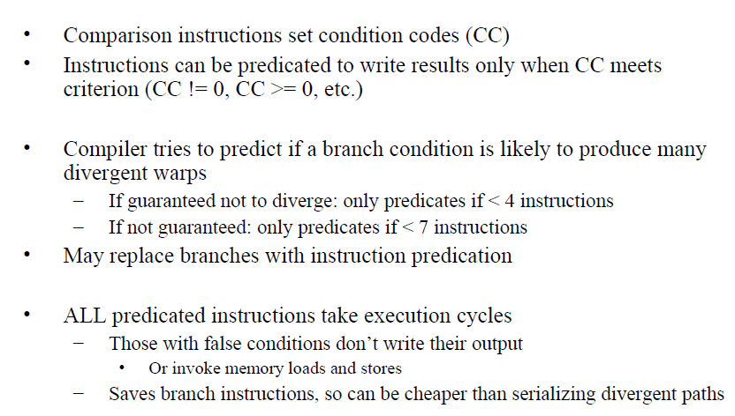
Predicate in G80

Slide 26
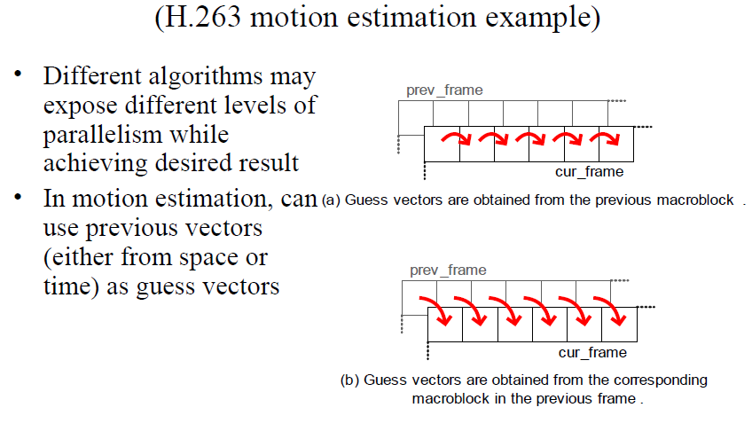
Algorithm Decision

Slide 27
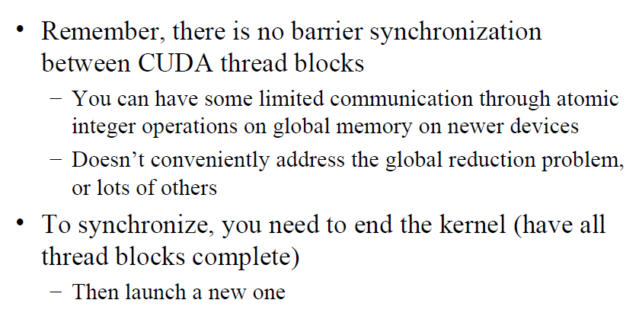
Global Synchronization

Slide 28
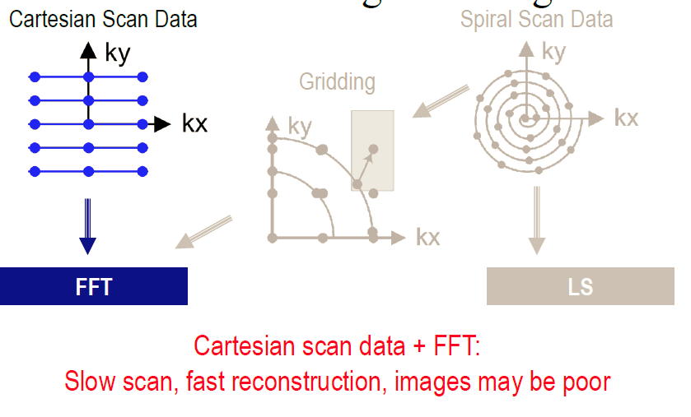
Case Study (MRI)

Slide 29
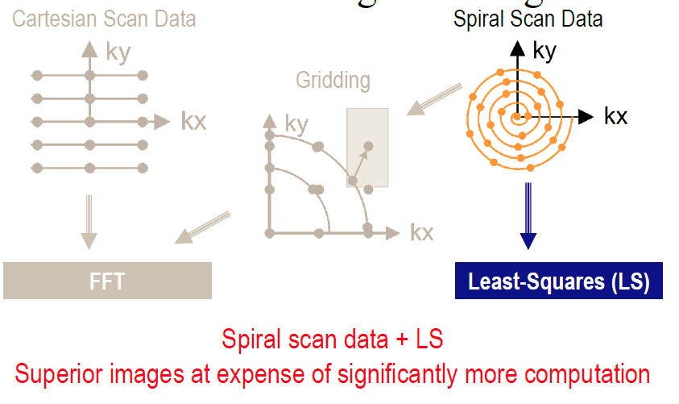
Case Study

Slide 30
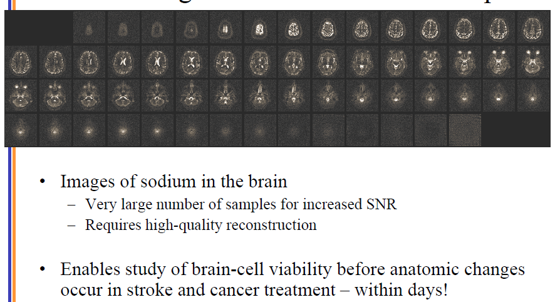
Case Study

Slide 31
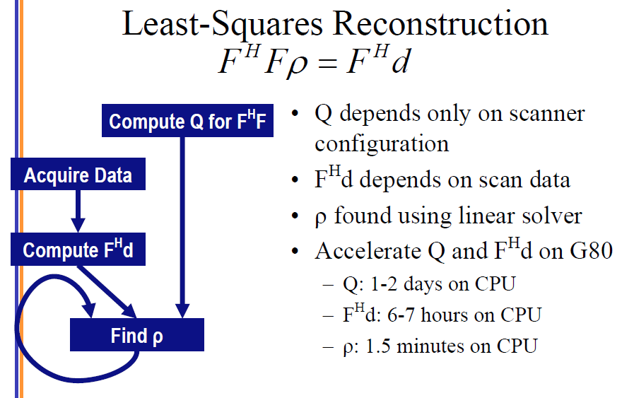
Case Study

Slide 32
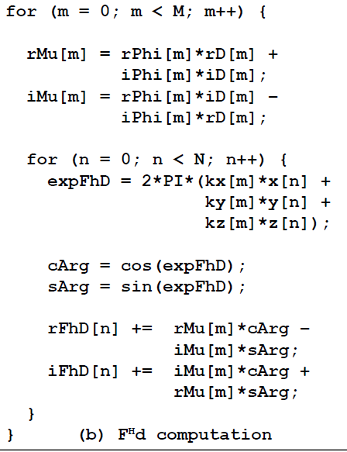
Case Study

Slide 33
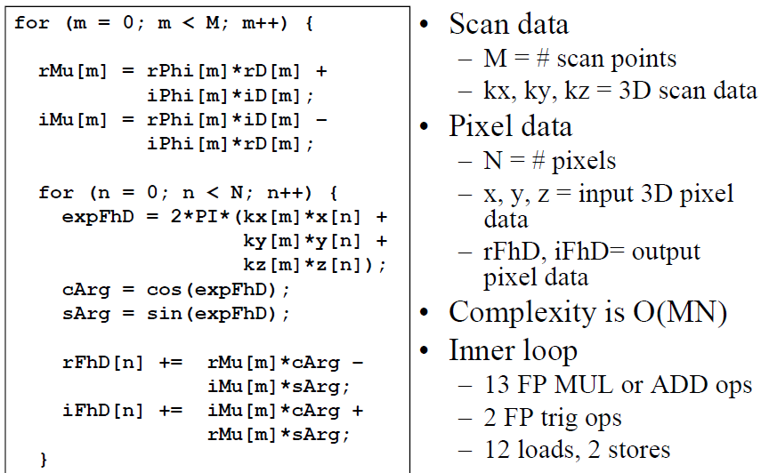
Case Study

Slide 34
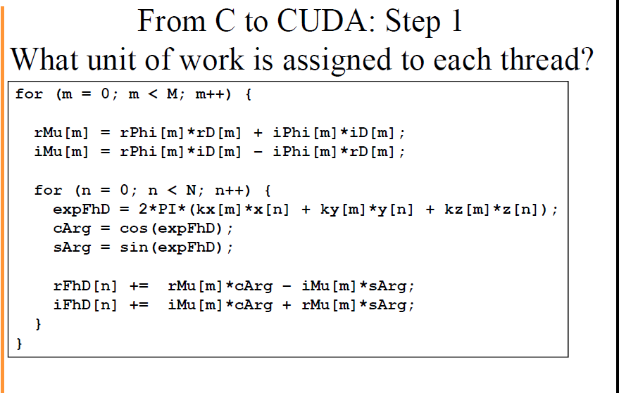
Case Study

Slide 35
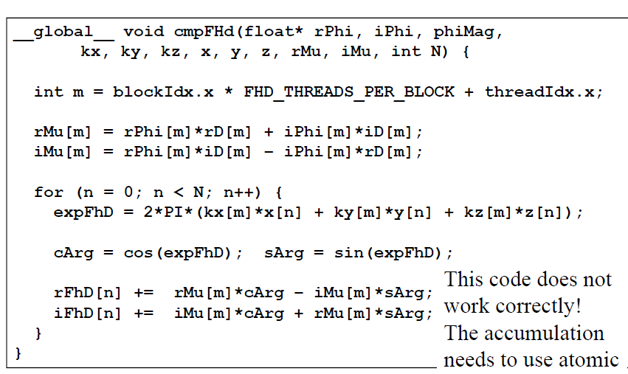
Case Study

Slide 36
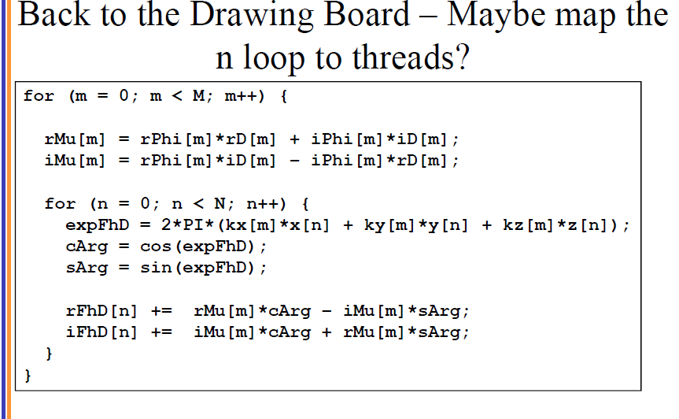
Case Study

Slide 37
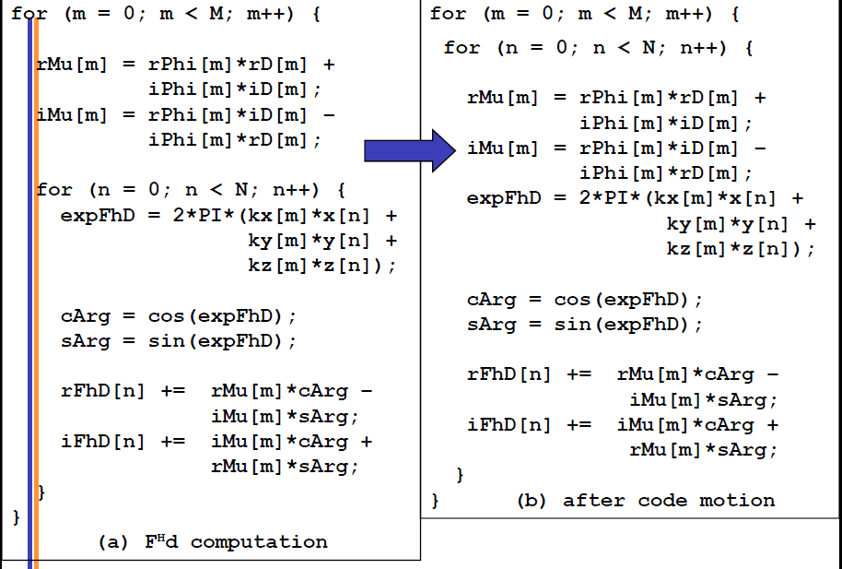
Case Study

Slide 38
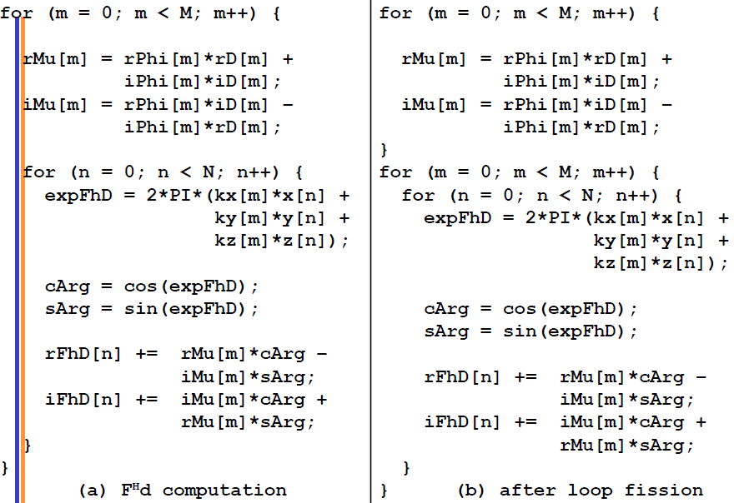
Case Study

Slide 39
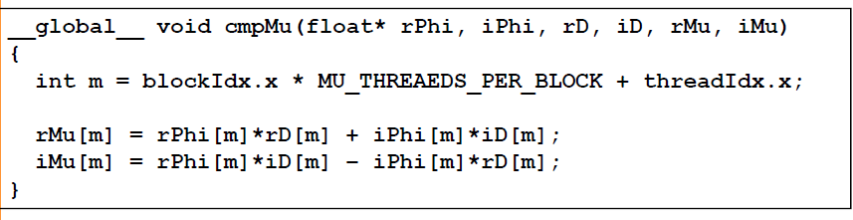
Case Study

Slide 40
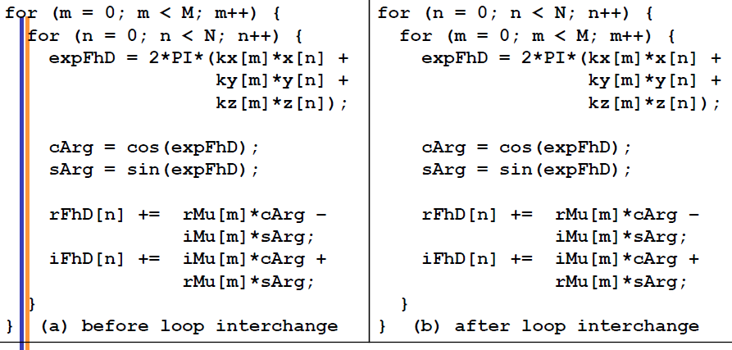
Case Study

Slide 41
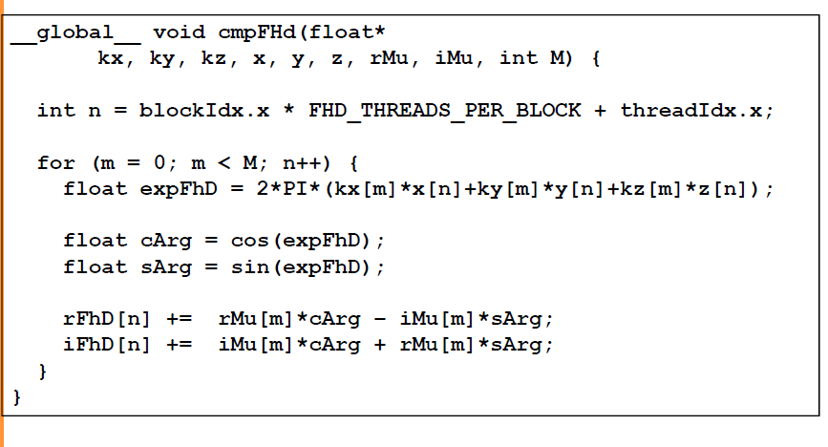
Case Study
m

Slide 42
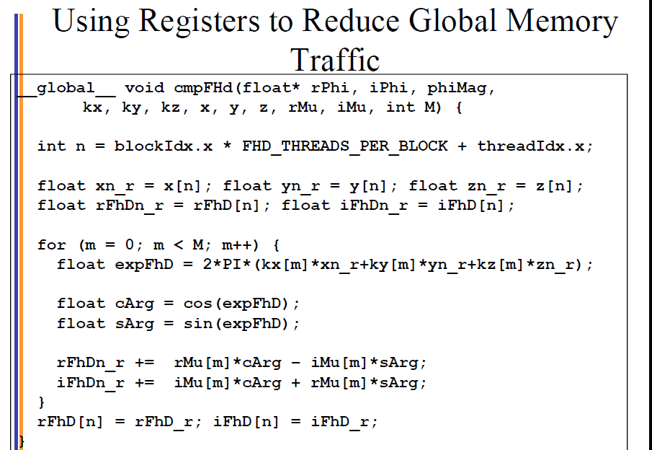
Case Study

Slide 43
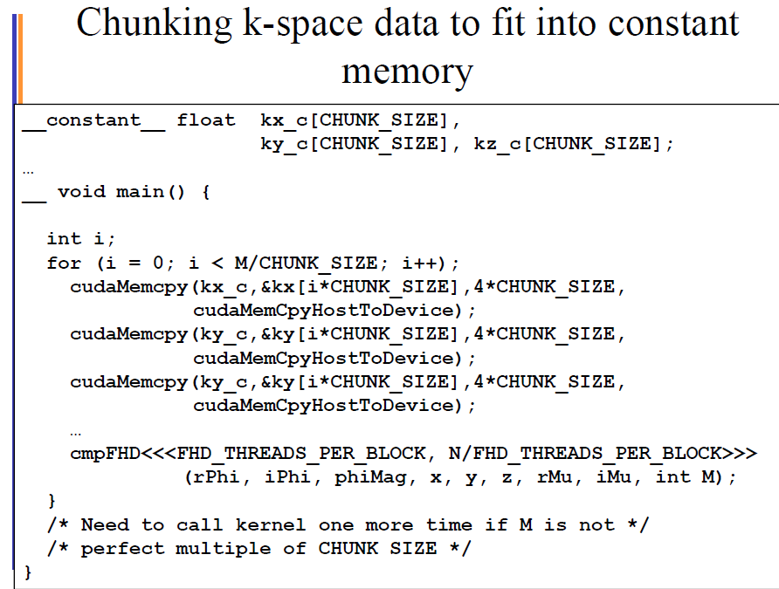
Case Study

Slide 44
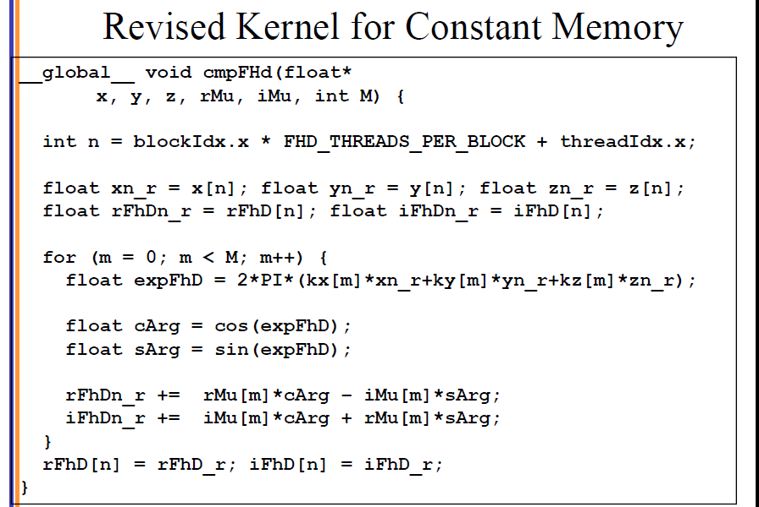
Case Study
Kx_c
Ky_c
Kz_c

Slide 45
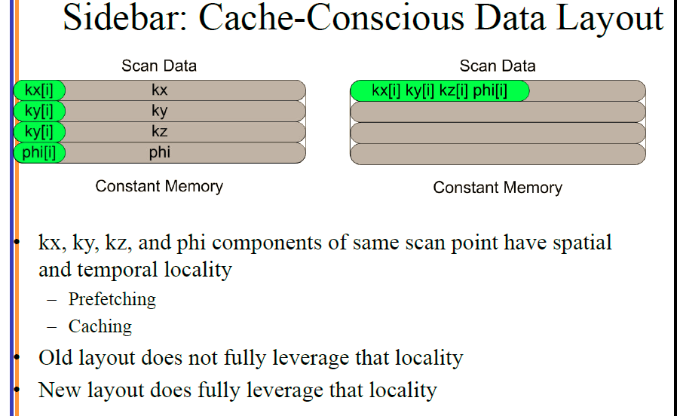
Case Study

Slide 46
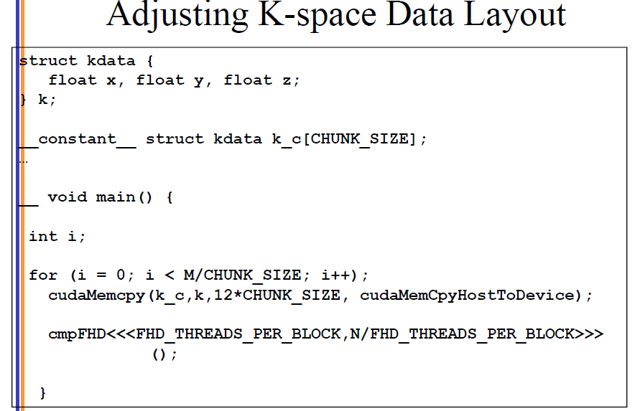
Case Study

Slide 47
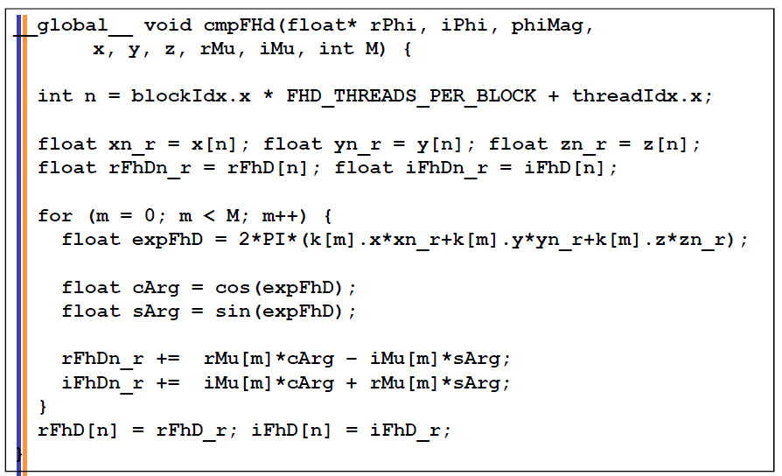
Case Study

Slide 48
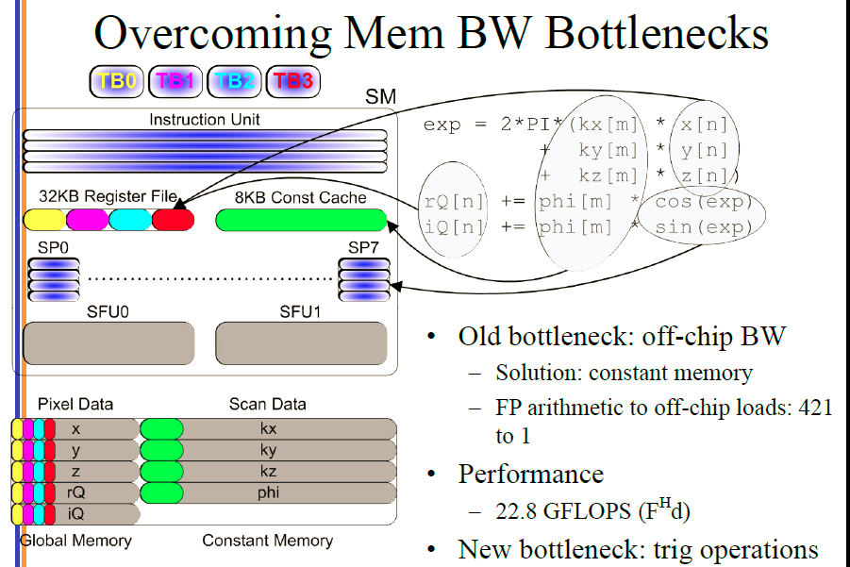
Case Study

Slide 49
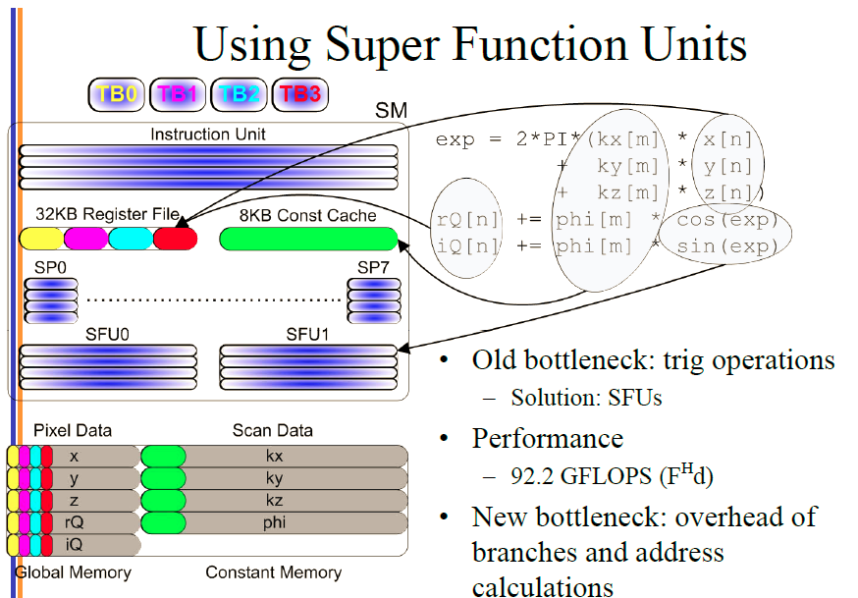
Case Study

Slide 50
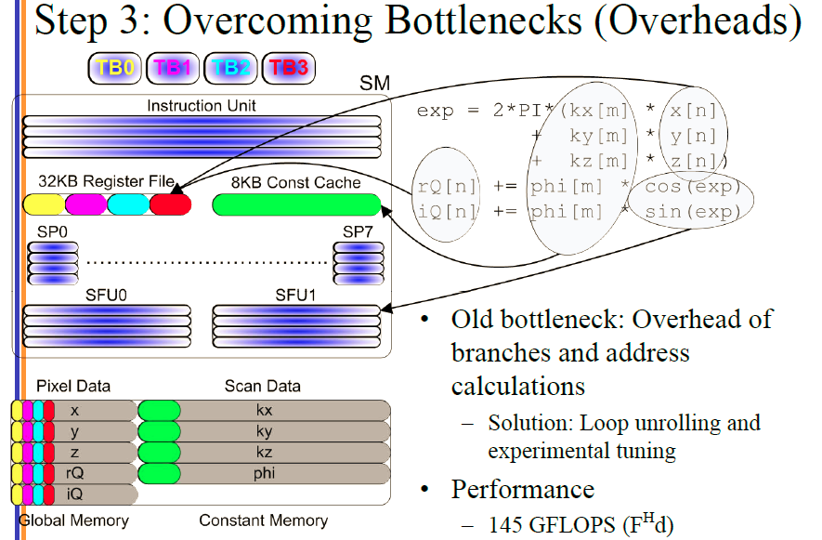
Case Study

Slide 51
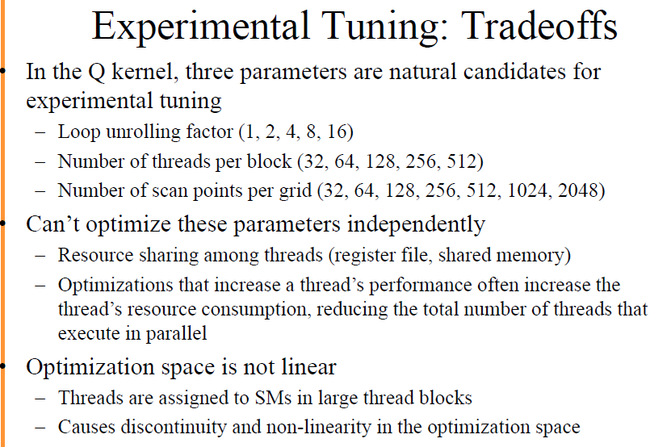
Case Study

Slide 52
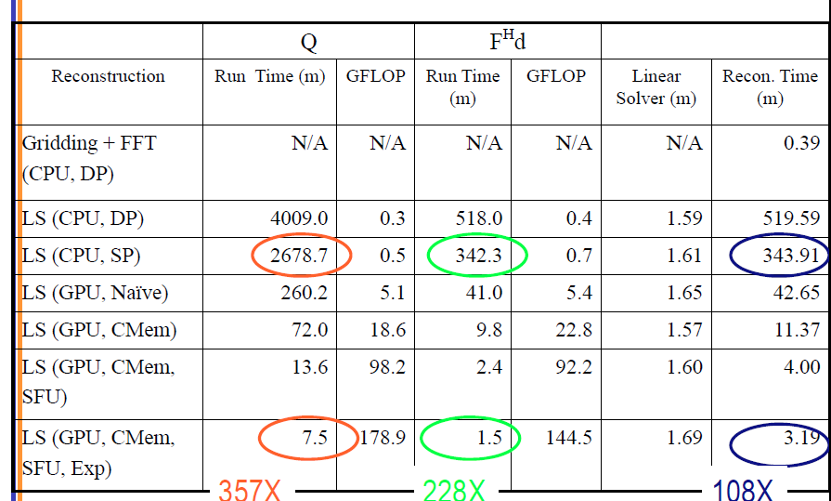
Case Study

Slide 53

Case Study

