Slide 1
CS427 Multicore Architecture and Parallel Computing
Lecture 4 OpenMP
Li Jiang
2014/10/14

Slide 2
Lecture objectives
Basics of OpenMP
Write a program with OpenMP
Compile and run
Exploit one of the most power feature: Parallelize serial for loops
Features of OpenMP
Parallelize the serial for loops
Task-parallelism
Explicit thread synchronization
Standard problems
The effect of cache memories on shared-memory programing
How to deal with a serial code (serial library)

Slide 3
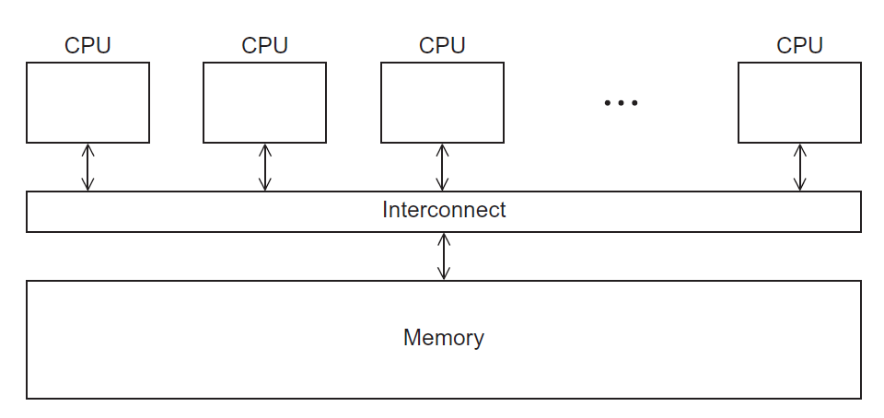
A Shared Memory System

Slide 4
Shared Memory Programming
Shared Memory Programming
Start a single process and fork threads.
Threads carry out work.
Threads communicate through shared memory.
Threads coordinate through synchronization (also through shared memory).
Distributed Memory Programming
Start multiple processes on multiple systems.
Processes carry out work.
Processes communicate through message-passing.
Processes coordinate either through message-passing or synchronization (generates messages).

Slide 5
OpenMP
An API for shared-memory parallel programming, MP = multiprocessing
Designed for systems in which each thread or process can potentially have access to all available memory.
System is viewed as a collection of cores or CPU’s, all of which have access to main memory.
Higher-level support for scientific programming on shared memory architectures.
Programmer identifies parallelism and data properties, and guides scheduling at a high level.
System decomposes parallelism and manages schedule.
See http://www.openmp.org
Differences from Pthread: implementation level, compatibility !!!

Slide 6
OpenMP
Common model for shared-memory parallel programming
Portable across shared-memory architectures
Scalable (on shared-memory platforms)
Incremental parallelization
Parallelize individual computations in a program while leaving the rest of the program sequential
Compiler based
Compiler generates thread program and synchronization
Extensions to existing programming languages (Fortran, C and C++)
mainly by directives
a few library routines

Slide 7
Programmer’s View
OpenMP is a portable, threaded, shared-memory programming specification with “light” syntax
Exact behavior depends on OpenMP implementation!
Requires compiler support (C/C++ or Fortran)
OpenMP will:
Allow a programmer to separate a program into serial regions and
parallel regions, rather than concurrently-executing threads.
Hide stack management for multiple threads
Provide synchronization constructs
OpenMP will not:
Parallelize automatically
Guarantee speedup
Provide freedom from data races

Slide 8
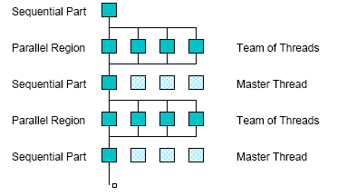
Execution Model
Fork-join model of parallel execution
Begin execution as a single process (master thread)
Start of a parallel construct:
Master thread creates team of threads (worker threads)
Completion of a parallel construct:
Threads in the team synchronize -- implicit barrier
Only master thread continues execution
Implementation optimization:
Worker threads spin waiting on next fork
fork
join

Slide 9
Pragmas
Pragmas are special preprocessor instructions.
Typically added to a system to allow behaviors that aren’t part of the basic C specification.
Compilers that don’t support the pragmas ignore them.
The interpretation of OpenMP pragmas
They modify the statement immediately following the pragma
This could be a compound statement such as a loop
#pragma omp …

Slide 10
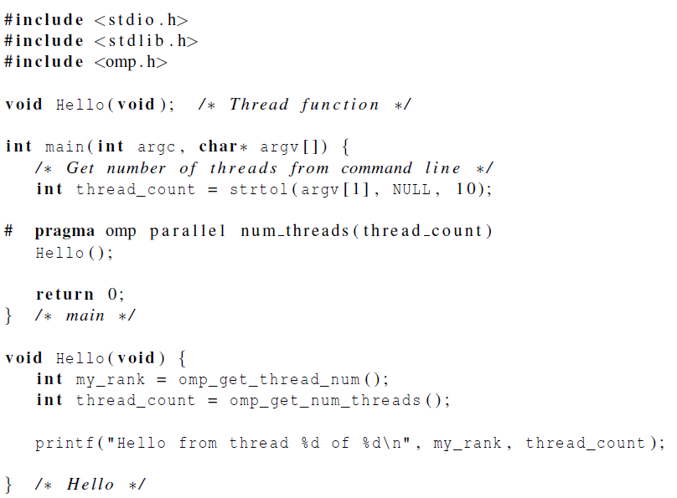
“Hello World”

Slide 11
“Hello World”
gcc −g −Wall −fopenmp −o omp_hello omp_hello . c
. / omp_hello 4
compiling
running with 4 threads
Hello from thread 0 of 4
Hello from thread 1 of 4
Hello from thread 2 of 4
Hello from thread 3 of 4
possible outcomes
Hello from thread 3 of 4
Hello from thread 1 of 4
Hello from thread 2 of 4
Hello from thread 0 of 4
Hello from thread 1 of 4
Hello from thread 2 of 4
Hello from thread 0 of 4
Hello from thread 3 of 4

Slide 12
Generate Parallel Threads
# pragma omp parallel num_threads ( thread_count
Most basic parallel directive.
The number of threads that run the following structured block of code is determined by the run-time system.
# pragma omp parallel num_threads ( thread_count
Clause: text that modifies a directive.
The num_threads clause can be added to a parallel directive.
It allows the programmer to specify the number of threads that should execute the following block.

Slide 13
Query Functions
int omp_get_num_threads(void);
Returns the number of threads currently in the team executing the parallel region from which it is called
int omp_get_thread_num(void);
Returns the thread number, within the team, that lies between 0 and omp_get_num_threads()-1, inclusive. The master thread of the team is thread 0
There may be system-defined limitations on the number of threads that a program can start.
setenv OMP_NUM_THREADS 16 [csh, tcsh]
The OpenMP standard doesn’t guarantee that this will actually start thread_count threads.
Use the above functions to get the actual thread number and ID.

Slide 14
Compiler Not Supporting OpenMP
#ifdef _OPENMP
# include <omp.h>
#endif
# ifdef _OPENMP
int my_rank = omp_get_thread_num ( );
int thread_count = omp_get_num_threads ( );
# e l s e
int my_rank = 0;
int thread_count = 1;
# endif

Slide 15
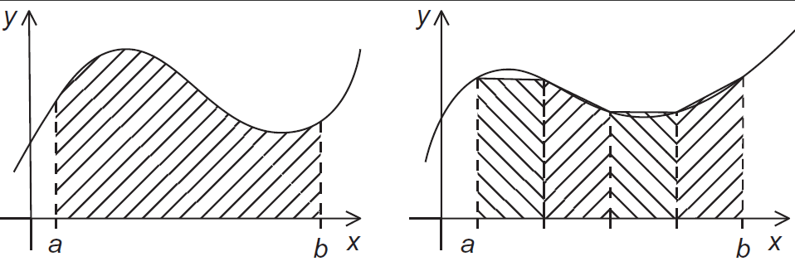
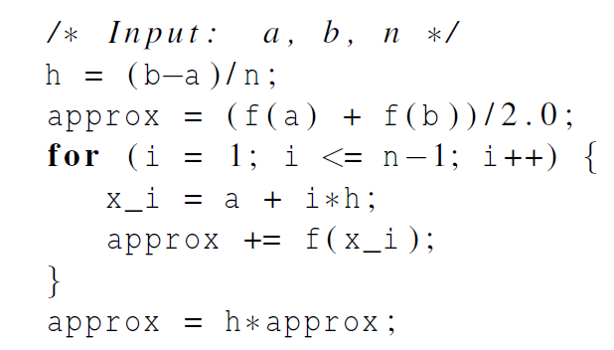
The Trapezoidal Rule

Slide 16
OpenMP Implementation
We identified two types of tasks:
a) computation of the areas of individual trapezoids, and
b) adding the areas of trapezoids.
There is no communication among the tasks in the first collection, but each task in the first collection communicates with task 1b.
So we aggregated tasks by assigning a contiguous block of trapezoids to each thread (and a single thread to each core).

Slide 17
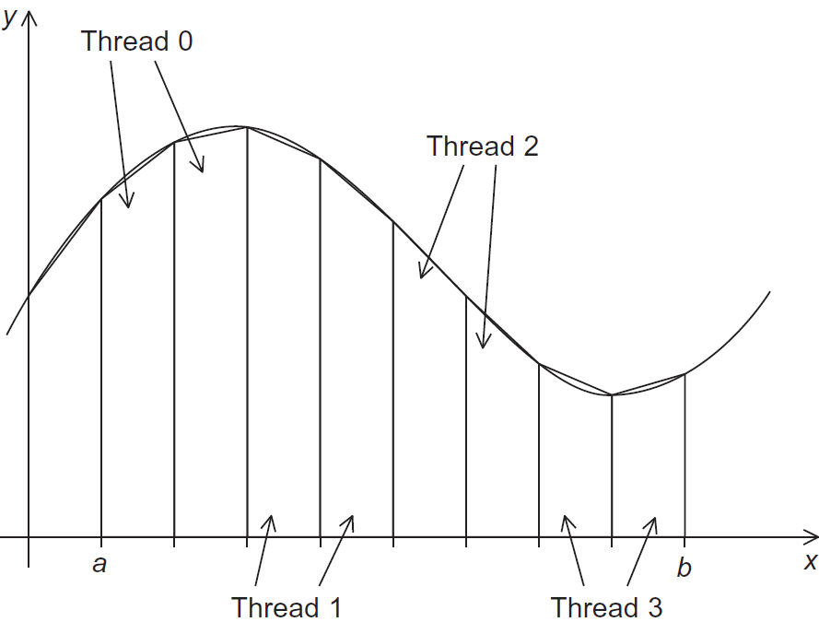
OpenMP Implementation

Slide 18
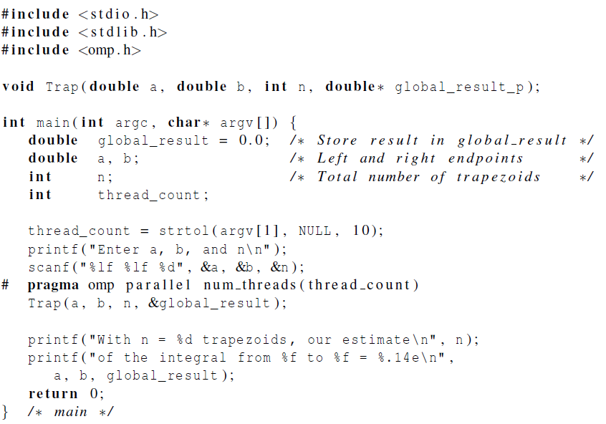
OpenMP Implementation
Can we write:
global_result += Trap(a,b,n); ?

Slide 19
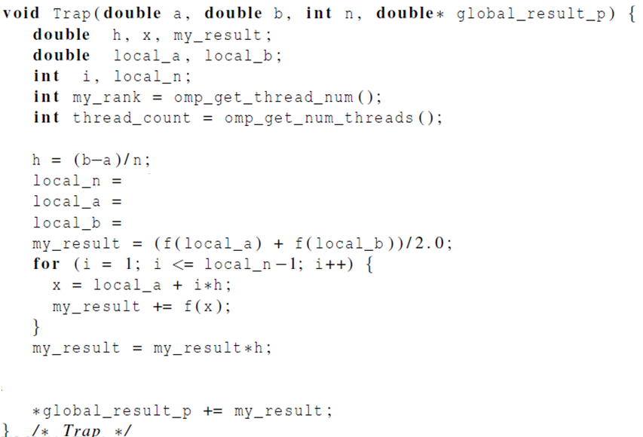
OpenMP Implementation

Slide 20
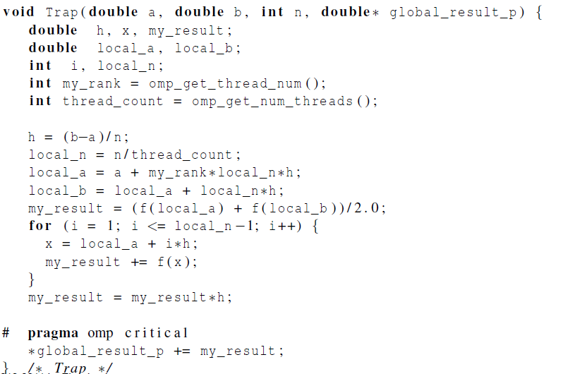
OpenMP Implementation
Why need this?

Slide 21
Scope of Variables
A variable that can be accessed by all the threads in the team has shared scope.
A variable that can only be accessed by a single thread has private scope.
The default scope for variables declared before a parallel block is shared.

Slide 22
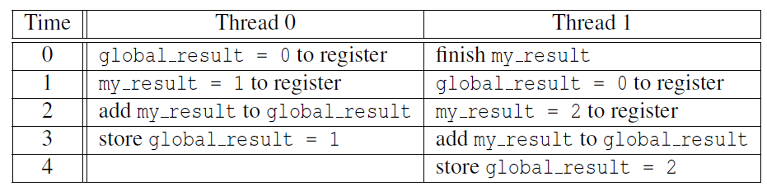
Mutual Exclusion
Unpredictable results when two (or more) threads attempt to simultaneously execute: global_result += my_result ;

Slide 23
Mutual Exclusion
#pragma omp critical [ ( name ) ]
structured-block
A thread waits at the beginning of a critical region until no other thread in the team is executing a critical region with the same name.
# pragma omp critical
global_result += my_result ;
only one thread can execute
the following structured block at a time

Slide 24
Reduction
A reduction operator is a binary operation (such as addition or multiplication).
A reduction is a computation that repeatedly applies the same reduction operator to a sequence of operands in order to get a single result.
All of the intermediate results of the operation should be stored in the same variable: the reduction variable.
+ bitwise & logical &
- bitwise | logical |
* bitwise ^ max/min

Slide 25
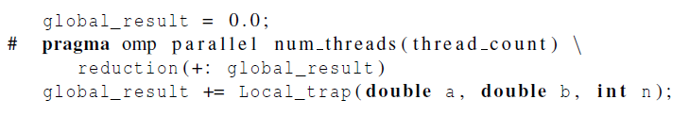
Reduction
A reduction clause can be added to a parallel directive.
+, *, -, &, |, ˆ, &&, ||
Associative or commutative : -, floating point

Slide 26
“Parallel For”
Forks a team of threads to execute the following structured block.
However, the structured block following the parallel for directive must be a for loop.
Furthermore, with the parallel for directive the system parallelizes the for loop by dividing the iterations of the loop among the threads.

Slide 27
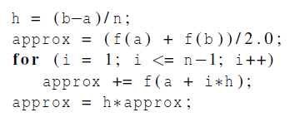
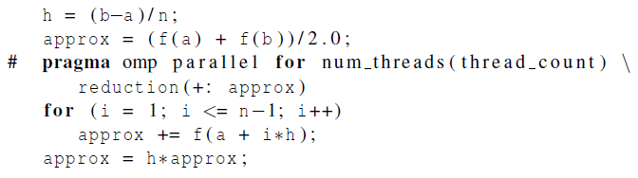
“Parallel For”
The scope of approx, and i

Slide 28
Caveats
No while loop, do while loop
The number of iterations can be determined
From the for statement
Prior to execution of the loop (break, dynamic start/end)
Index must be integer or pointer type
Start, end, incr NOT changeable
Incr Can only be modified incrementally

Slide 29
Caveats
fibo[ 0 ] = fibo[ 1 ] = 1;
for (i = 2; i < n; i++)
fibo[ i ] = fibo[ i – 1 ] + fibo[ i – 2 ];
note 2 threads
fibo[ 0 ] = fibo[ 1 ] = 1;
# pragma omp parallel for num_threads(2)
for (i = 2; i < n; i++)
fibo[ i ] = fibo[ i – 1 ] + fibo[ i – 2 ];
but sometimes we get this
1 1 2 3 5 8 13 21 34 55
this is correct
1 1 2 3 5 8 0 0 0 0

Slide 30
Caveats
OpenMP compilers don’t check for dependences among iterations in a loop that’s being parallelized with a parallel for directive.
A loop in which the results of one or more iterations depend on other iterations cannot, in general, be correctly parallelized by OpenMP.

Slide 31
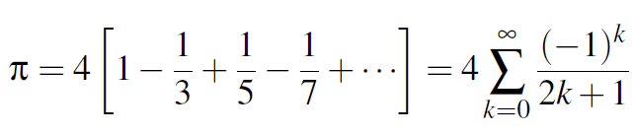
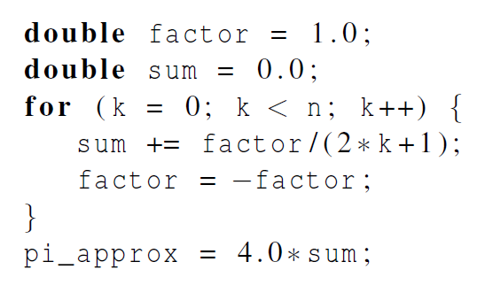
Estimating PI

Slide 32
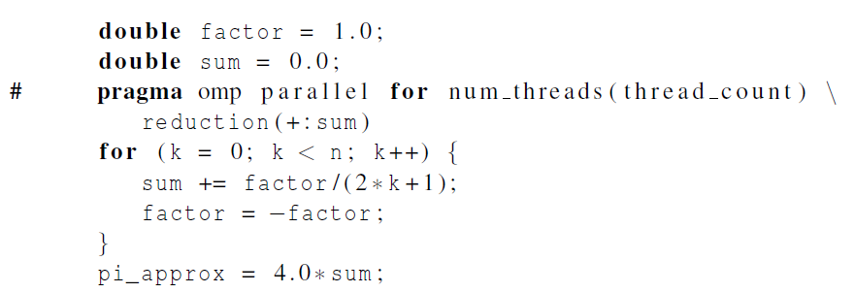
Estimating PI
loop dependency

Slide 33

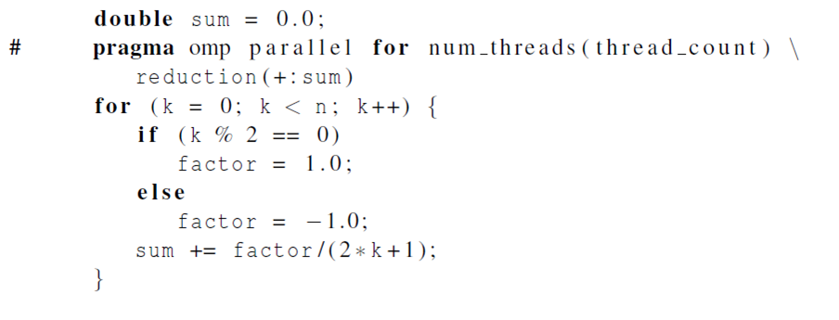
Estimating PI

Slide 34
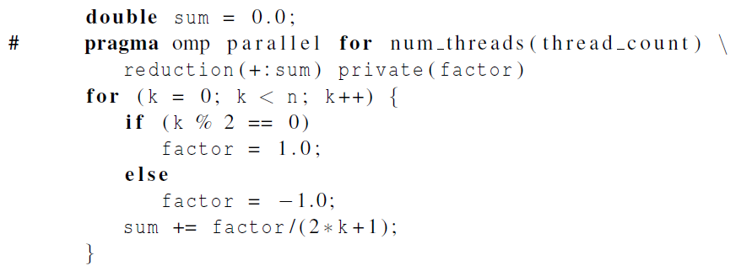
Estimating PI
Insures factor has private scope.

Slide 35
Loop Carried Dependence
for (i=0; i<100; i++) {
A[i]=A[i]+B[i];
B[i+1]=C[i]+D[i];
}
Eliminating loop dependence:
A[0]=A[0]+B[0];
for (i=0; i<99; i++) {
B[i+1]=C[i]+D[i];
A[i+1]=A[i+1]+B[i+1];
}
B[100]=C[99]+D[99];

Slide 36

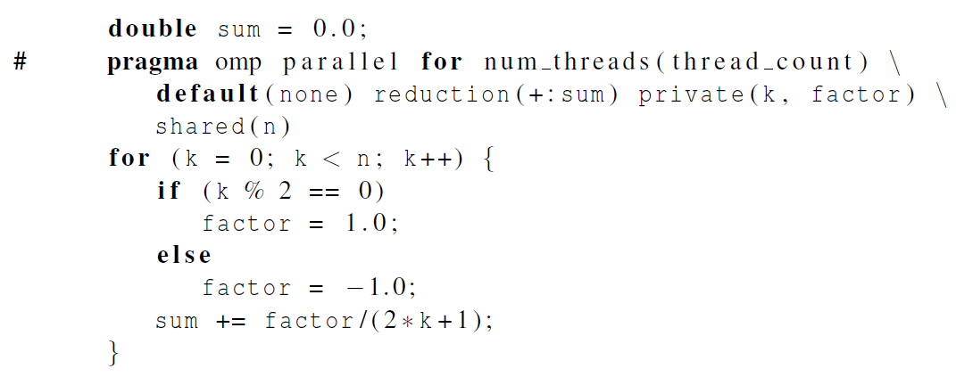
More on Scope of Variables
Lets the programmer specify the scope of each variable in a block.
With this clause the compiler will require that we specify the scope of each variable we use in the block and that has been declared outside the block.
# pragma omp for
for () {}
for () {}
for () {}
# pragma omp for
for () {}

Slide 37
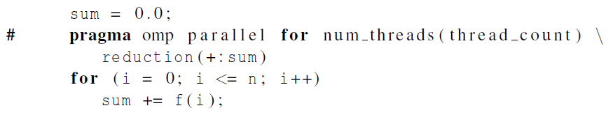
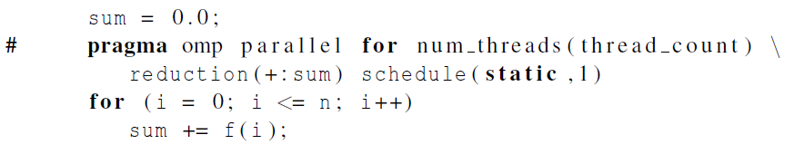
Loop Scheduling
Default schedule:
Cyclic schedule:

Slide 38
Loop Scheduling
schedule ( type , chunksize )
Type can be:
static: the iterations can be assigned to the threads before the loop is executed.
dynamic or guided: the iterations are assigned to the threads while the loop is executing.
auto: the compiler and/or the run-time system determine the schedule.
runtime: the schedule is determined at run-time.
The chunksize is a positive integer.

Slide 39
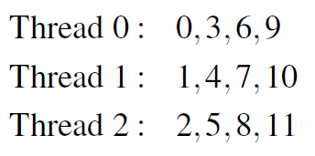


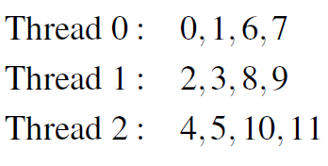

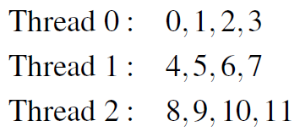
Static Scheduling
Round robin fashion

Slide 40
Dynamic Scheduling
The iterations are also broken up into chunks of chunksize consecutive iterations.
Each thread executes a chunk, and when a thread finishes a chunk, it requests another one from the run-time system.
This continues until all the iterations are completed.
The chunksize can be omitted. When it is omitted, a chunksize of 1 is used.

Slide 41
Guided Scheduling
Each thread also executes a chunk, and when a thread finishes a chunk, it requests another one.
However, in a guided schedule, as chunks are completed the size of the new chunks decreases exponentially.
If no chunksize is specified, the size of the chunks decreases down to 1.
If chunksize is specified, it decreases down to chunksize, with the exception that the very last chunk can be smaller than chunksize.

Slide 42
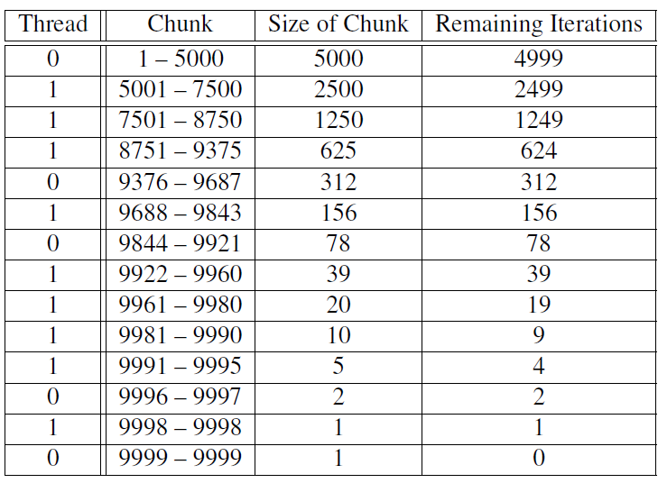
Guided Scheduling
Assignment of trapezoidal rule iterations 1–9999 using a guided schedule with two threads.

Slide 43
Runtime Scheduling
The system uses the environment variable OMP_SCHEDULE to determine at run-time how to schedule the loop.
The OMP_SCHEDULE environment variable can take on any of the values that can be used for a static, dynamic, or guided schedule.
For example
setenv OMP_SCHEDULE GUIDED,4 [csh, tcsh]
export OMP_SCHEDULE=GUIDED,4 [sh, ksh, bash]

Slide 44
Impact of Scheduling
Load balance
Same work in each iteration?
Processors working at same speed?
Scheduling overhead
Static decisions are cheap because they require no run-time coordination
Dynamic decisions have overhead that is impacted by complexity and frequency of decisions
Data locality
Particularly within cache lines for small chunk sizes
Also impacts data reuse on same processor

