Slide 1
CS427 Multicore Architecture and Parallel Computing
Lecture 2 Parallel Architecture
Li Jiang
2014/9/18

Slide 2
Lecture Objectives
Understand the core concept, but not the detail
Refresh your memory on Computer architecture
The early path towards Parallelsim

Slide 3


Basic Computer Model
programs
input
Computer runs one
program at a time.
output

Slide 4
Discussion and debate
Who invented the computer?
Von Neumann VS. Alan Turning

Slide 5
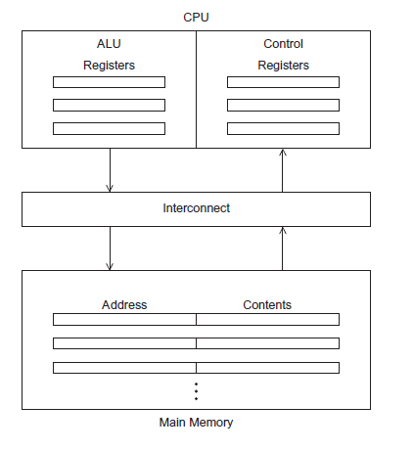

The Von Neumann Machine
Fixed computer
3-weeks to program on ENIAC
Stored-program computer
Inst. Set in memory
Self-modifying code

Slide 6
Main Components
Main memory
This is a collection of locations, each of which is capable of storing both instructions and data.
Every location consists of an address, which is used to access the location, and the contents of the location.
CPU
Control unit - responsible for deciding which instruction in a program should be executed.
ALU - responsible for executing the actual instructions.
Register – very fast storage, part of the CPU.
Program counter – stores address of the next instruction to be executed.
Bus
Wires and hardware that connects the CPU and memory.
Cache
Fill the gap between CPU and main memory

Slide 7
Pipeline
Dave Patterson’s Laundry example: 4 people doing laundry
wash (30 min) + dry (40 min) + fold (20 min) = 90 min Latency
6 PM
7
8
9
In this example:
Sequential execution takes 4 * 90min = 6 hours
Pipelined execution takes 30+4*40+20 = 3.5 hours
Bandwidth = loads/hour
BW = 4/6 l/h w/o pipelining
BW = 4/3.5 l/h w pipelining
BW <= 1.5 l/h w pipelining, more total loads
Pipelining helps bandwidth but not latency (90 min)
Potential speedup = Number pipe stages
Time
T
a
s
k
O
r
d
e
r
30
40
40
40
40
20
A
B
C
D

Slide 8
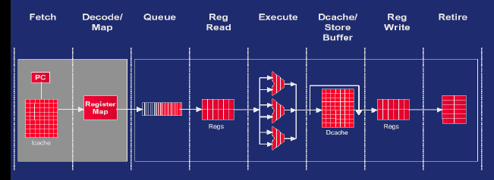
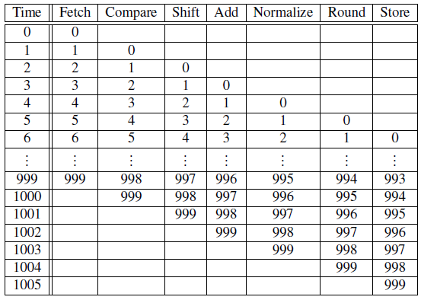

Pipeline

Slide 9
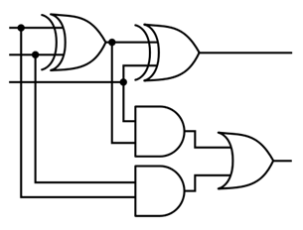
Multiple Issue
Multiple issue processors replicate functional units and try to simultaneously execute different instructions in a program.
for (i = 0; i < 1000; i++)
z[i] = x[i] + y[i];
z[3]
z[4]
z[1]
z[2]
adder #1
adder #2

Slide 10
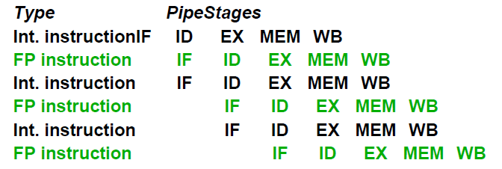

Multiple Issue
Static multiple issue
functional units are scheduled at compile time.
Dynamic multiple issue
functional units are scheduled at run-time.
Allow instruction behind stalls to proceed
Enable out-of-order execution and out-of-order completion
Tomasulo algorithm
.

Slide 11



Register Renaming
Multiple issue challenge
WAR, WAW harzard
Limited register resource
Register renaming

Slide 12
Loop Unrolling
for (i = 1 to bignumber)
A(i)
B(i)
C(i)
end
Without Unrolling: A(1) X X B(1) X X C(1) X X ...

Slide 13
Loop Unrolling
for (i = 1 to bignumber)
A(i)
B(i)
C(i)
end
After Unrolling:
for (i = 1 to bignumber/3)
A(i)
A(i+1)
A(i+2)
B(i)
B(i+1)
B(i+2)
C(i)
C(i+1)
C(i+2)
end
Without Unrolling: A(1) X X B(1) X X C(1) X X ...
With Unrolling: A(1) A(2) A(3) B(1) B(2) B(3) C(1) C(2) C(3) ...

Slide 14
Software Pipelining
for (i = 1 to bignumber)
A(i) ; 3
B(i) ; 3
C(i) ; 12(perhaps a floating point operation)
D(i) ; 3
E(i) ; 3
F(i) ; 3
End
Software Pipelining:
for i = (1 to bignumber - 6)
A(i+6)
B(i+5)
C(i+4)
D(i+2)
E(i+1)
F(i)
end

Slide 15
Software Pipelining
for (i = 1 to bignumber)
A(i) ; 3
B(i) ; 3
C(i) ; 12(perhaps a floating point operation)
D(i) ; 3
E(i) ; 3
F(i) ; 3
End
Software Pipelining:
for i = (1 to bignumber - 6)
A(i+6)
B(i+5)
C(i+4)
D(i+2)
E(i+1)
F(i)
end
Iteration 1: A(7) B(6) C(5) D(3) E(2) F(1)
Iteration 2: A(8) B(7) C(6) D(4) E(3) F(2)
Iteration 3: A(9) B(8) C(7) D(5) E(4) F(3)
Iteration 4: A(10) B(9) C(8) D(6) E(5) F(4)
Iteration 5: A(11) B(10) C(9) D(7) E(6) F(5)
Iteration 6: A(12) B(11) C(10) D(8) E(7) F(6)
Iteration 7: A(13) B(12) C(11) D(9) E(8) F(7)

Slide 16
Speculation
for (i = 0; i < 1000; i++)
z[i] = x[i] + y[i];
In speculation, the compiler or the processor makes a guess about an instruction, and then executes the instruction on the basis of the guess
Always speculate the branch is taken, 1/1000 error rate!

Slide 17
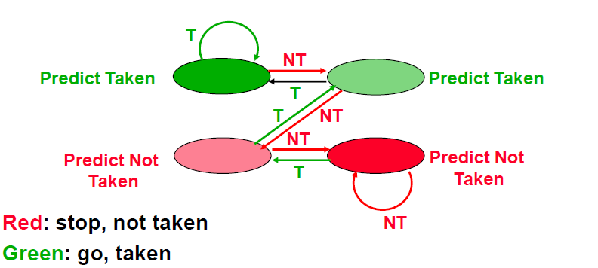
Speculation
for (i = 0; i < 1000; i++)
z[i] = x[i] + y[i];

Slide 18
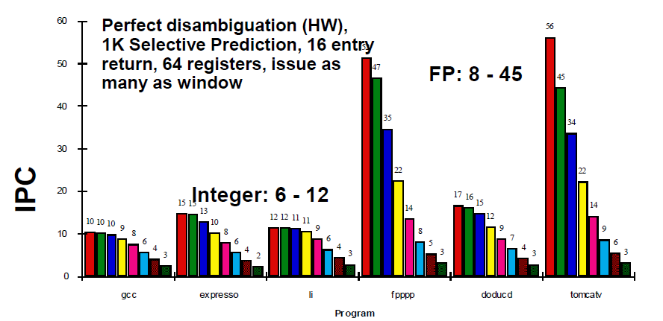
ILP in a Realistic Machine

Slide 19
Vector Processing
Scalar processing
traditional mode
one operation produces one result
SIMD processing
with SSE / SSE2
one operation produces multiple results
Limitation (branch divergence)
X
X
x3
x2
x1
x0
+
+
Y
Y
y3
y2
y1
y0
X + Y
X + Y
x3+y3
x2+y2
x1+y1
x0+y0
Slide Source: Alex Klimovitski & Dean Macri, Intel Corporation

Slide 20
Vector Processing
Intel SSE2 data types: anything that fits into 16 bytes
Instructions perform add, multiply etc. on all the data in this 16-byte register in parallel
Pros:
Saving decode time, execute I →automatically→execute I+1 …
Challenges:
Need to be contiguous in memory and aligned, addressing
Some instructions to move data around from one part of register to another
4x floats
2x doubles
16x bytes
Year

Slide 21
Vector Processing
Vector Register
Fixed length bank holding a single vector has at least 2 read and 1 write ports typically 8-32 vector registers, each holding 64-128 64-bit elements
Vector Functional Units (FUs)
Fully pipelined, start new operation every clock typically 4 to 8 FUs: FP add, FP mult, FP reciprocal (1/X), integer add, logical, shift; may have multiple of same unit
Vector Load-Store Units (LSUs)
fully pipelined unit to load or store a vector; may have multiple LSUs
Scalar registers
Single element for FP scalar or address
Cross-bar to connect FUs , LSUs, registers

Slide 22
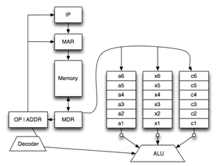
Vector Processing
Interleaved memory
Multiple “banks” of memory
Access independently

Slide 23
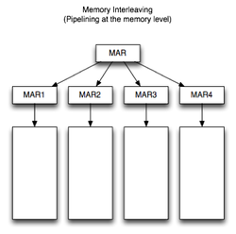
Vector Processing
Interleaved memory
Multiple “banks” of memory
Access independently
How to distribute the data of a vector?

Slide 24
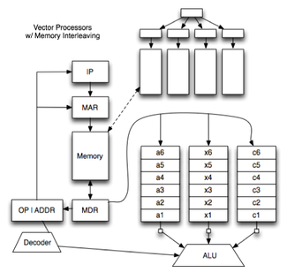
Vector Processing
Interleaved memory
Multiple “banks” of memory
Access independently
How to distribute the data of a vector?
Elements of a vector are distributed across multiple banks

Slide 25
Vector Processing
Interleaved memory
Multiple “banks” of memory
Access independently
Elements of a vector are distributed across multiple banks
Strided memory access and hardware scatter/gather
Access element of a vector located at fixed/iregular intervals
add | data
1
2
3
4
5
6
7
WHY？
Hardware accelerator

Slide 26
Vector Processing
How it works
Suppose there are n * n data to be processed
But the width of vector processor is m, m < n
for ( i = 0 ; i < n; i++)
for ( j = 0; j < n; j++){
A[i][j] = -A[i][j]
}
Year

Slide 27
Vector Processing
How it works
Suppose there are n * n data to be processed
But the width of vector processor is m, m < n
Divide problem into blocks, execute block by block
for ( i = 0 ; i < n; i++)
for ( j = 0; j < n; j++){
A[i][j] = -A[i][j]
}
Year

Slide 28
Vector Processing
Branch divergence
Single instruction requires all the ALUs execute the same instruction or are idle
Degrade the overall performance
for ( i = 0 ; i < n; i++)
for ( j = 0; j < n; j++){
if (A[i][j] < 0)
A[i][j] = -A[i][j]
}
Year

Slide 29
Vector Processing
Branch divergence
Single instruction requires all the ALUs execute the same instruction or are idle
Degrade the overall performance
for ( i = 0 ; i < n; i++)
for ( j = 0; j < n; j++){
if (A[i][j] < 0)
A[i][j] = -A[i][j];
else
A[i][j] = 2*A[i][j];
}
Year

Slide 30
Vector Processing
if (A[i][j] < 0)
A[i][j] = -A[i][j]
Vector-mask control takes a Boolean vector
when vector-mask registers loaded from vector test, vector instructions operate only on vector elements whose corresponding entries in the vector-mask register are 1.
Still requires clock even if result not stored
M[i][j] = (A[i][j] < 0)
A[i][j] -= M[i][j]*2*A[i][j]
Year

Slide 31
“DLXV” Vector Instructions
Instr. Operands Operation Comment
ADDV V1,V2,V3 V1=V2+V3 vector + vector
ADDSV V1,F0,V2 V1=F0+V2 scalar + vector
MULTV V1,V2,V3 V1=V2xV3 vector x vector
MULSV V1,F0,V2 V1=F0xV2 scalar x vector
LV V1,R1 V1=M[R1..R1+63] load, stride=1
LVWS V1,R1,R2 V1=M[R1..R1+63*R2] load, stride=R2
LVI V1,R1,V2 V1=M[R1+V2i,i=0..63] indir.("gather")
CeqV VM,V1,V2 VMASKi = (V1i=V2i)? comp. setmask
MOV VLR,R1 Vec. Len. Reg. = R1 set vector length
MOV VM,R1 Vec. Mask = R1 set vector mask

Slide 32
Vector Processing
Easy to get high performance
N operations:
are independent
use same functional unit
access disjoint registers
access registers in same order as previous instructions
access contiguous memory words or known pattern
can exploit large memory bandwidth
hide memory latency (and any other latency)
Scalable
get higher performance as more HW resources available
Compact
Describe N operations with 1 short instruction (v. VLIW)
Predictable
(real-time) performance vs. statistical performance (cache)
Multimedia ready
choose N * 64b, 2N * 32b, 4N * 16b, 8N * 8b

Slide 33
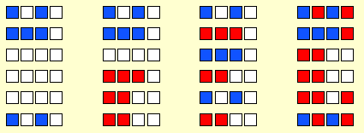
Multithreading
Hardware multithreading provides a means for systems to continue doing useful work when the task being currently executed has stalled.
No dependency between inst. From different threads
Ex., the current task has to wait for data to be loaded from memory
Coarse-grained - only switches threads that are stalled waiting for a time (e.g., L2 cache miss)-consuming operation to complete.
Pros: switching threads doesn’t need to be nearly instantaneous.
Cons: the processor can be idled on shorter stalls, and thread switching will also cause delays.
Share CPU/RF/Cache, fast context switching
Fine-grained - the processor switches between threads after each instruction, skipping threads that are stalled.
Pros: potential to avoid wasted machine time due to stalls.
Cons: a thread that’s ready to execute a long sequence of instructions may have to wait to execute every instruction.
More redundancy
Excute

Slide 34
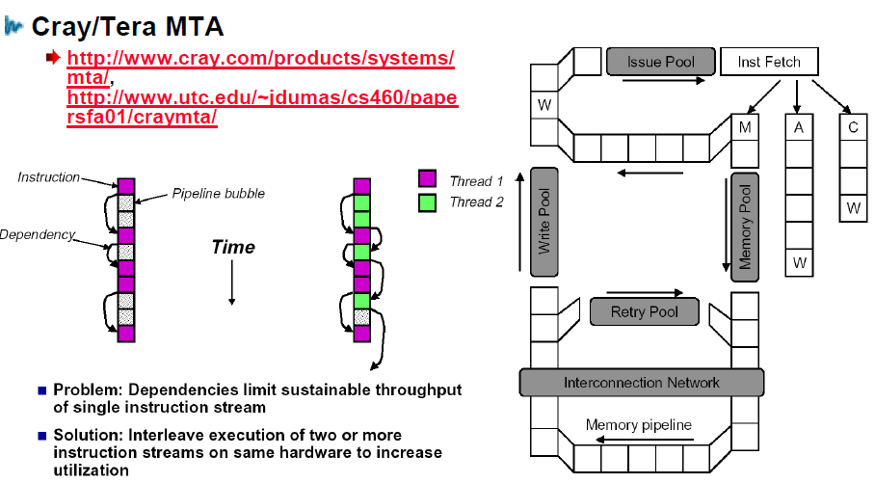
Multithreading
Simultaneous Multithreading (SMT)
Ins. from different threads

Slide 35
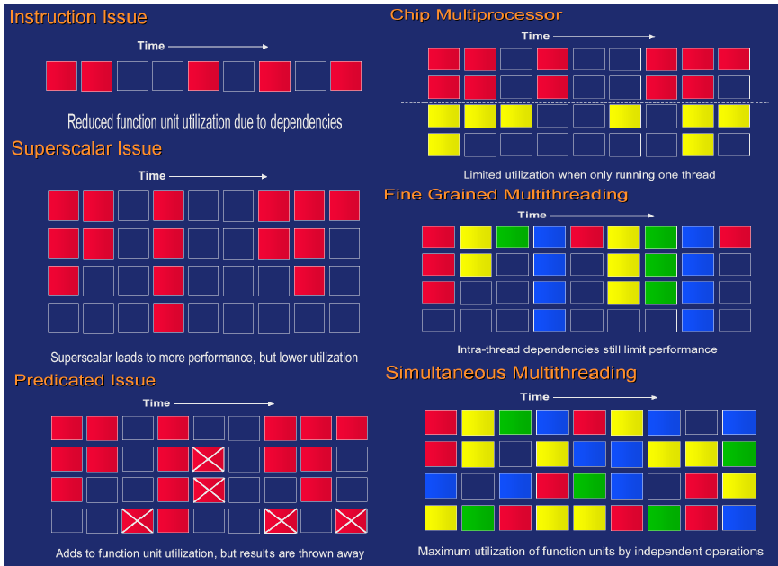
Parallel Processors

Slide 36
Memory Hierarchy
Most programs have a high degree of locality in their accesses
spatial locality: accessing things nearby previous accesses
temporal locality: reusing an item that was previously accessed
Memory hierarchy tries to exploit locality
processor
control
Second level cache (SRAM)
Main memory
(DRAM)
Secondary storage (Disk)
Tertiary storage
(Disk/Tape)
datapath
registers
on-chip cache
Speed | 1ns | 10ns | 100ns | 10ms | 10sec
Size | B | KB | MB | GB | TB

Slide 37
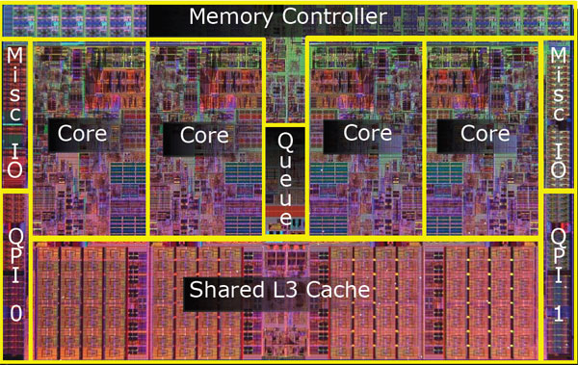
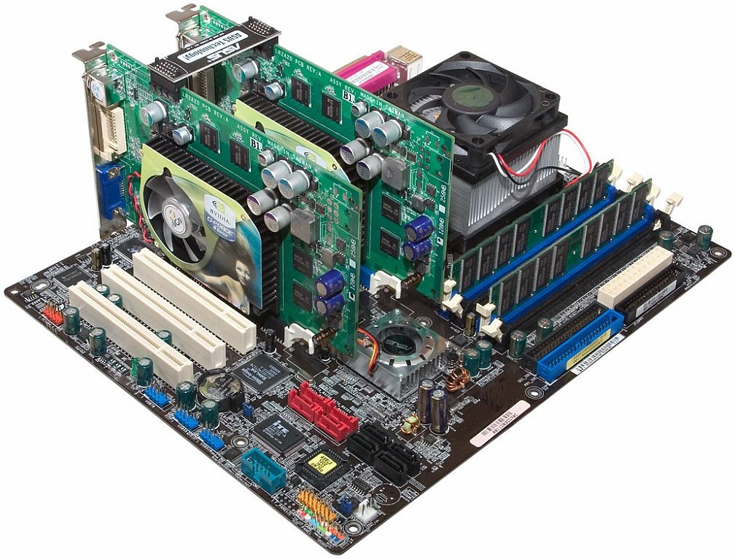
Memory Hierarchy
Intel i7

Slide 38
Processor-DRAM Gap
Memory hierarchies are getting deeper
Processors get faster more quickly than memory
1000
µProc
60%/yr.
CPU
“Moore’s Law”
100
Processor-Memory
Performance Gap: (grows 50% / year)
Performance
10
DRAM
7%/yr.
DRAM
1
1980
1981
1982
1983
1984
1985
1986
1987
1988
1989
1990
1991
1992
1993
1994
1995
1996
1997
1998
1999
2000
Time

Slide 39

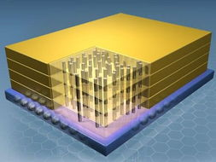
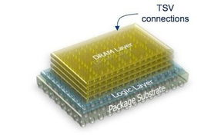
News: 3D Memory Cube
Micron

Slide 40

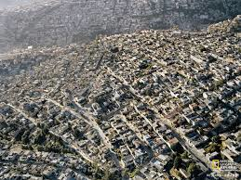
News: 3D Memory Cube

Slide 41
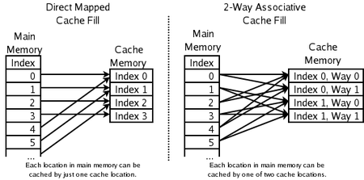
Cache Mappings
Full associative
a new line can be placed at any location in the cache.
Direct mapped
each cache line has a unique location in the cache to which it will be assigned.
n-way set associative
each cache line can be place in one of n different locations in the cache.

Slide 42
Cache Write
Cache write
the value in cache may be inconsistent with the value in main memory.
Write-through caches
handle this by updating the data in main memory at the time it is written to cache.
Write-back caches
mark data in the cache as dirty. When the cache line is replaced by a new cache line from memory, the dirty line is written to memory.

Slide 43
Reduce Misses
Classifying Misses: 3 Cs
Compulsory
The first access to a block is not in the cache, so the block must be brought into the cache. Also called cold start missesor first reference misses.(Misses in even an Infinite Cache)
Capacity
If the cache cannot contain all the blocks needed during execution of a program, capacity misses will occur due to blocks being discarded and later retrieved.(Misses in Fully Associative Size X Cache)
Conflict
If block-placement strategy is set associative or direct mapped, conflict misses (in addition to compulsory & capacity misses) will occur because a block can be discarded and later retrieved if too many blocks map to its set. Also called collision missesor interference misses.(Misses in N-way Associative, Size X Cache)
Maybe four: 4th “C”
Coherence-Misses caused by cache coherence: data may have been invalidated by another processor or I/O device

Slide 44
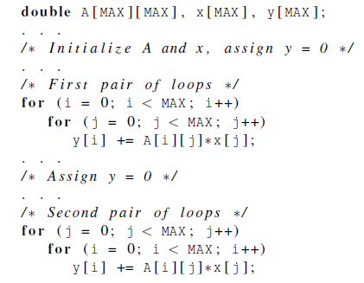
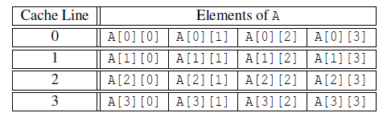
Cache and Program
Indirect control the cache
Cache are controlled by hardware
Programmer don’t directly determine which data and which instructions are in the cache
Assuming only two cache lines
Knowing the principle of spatial and temporal locality allows us to have indirect control

Slide 45
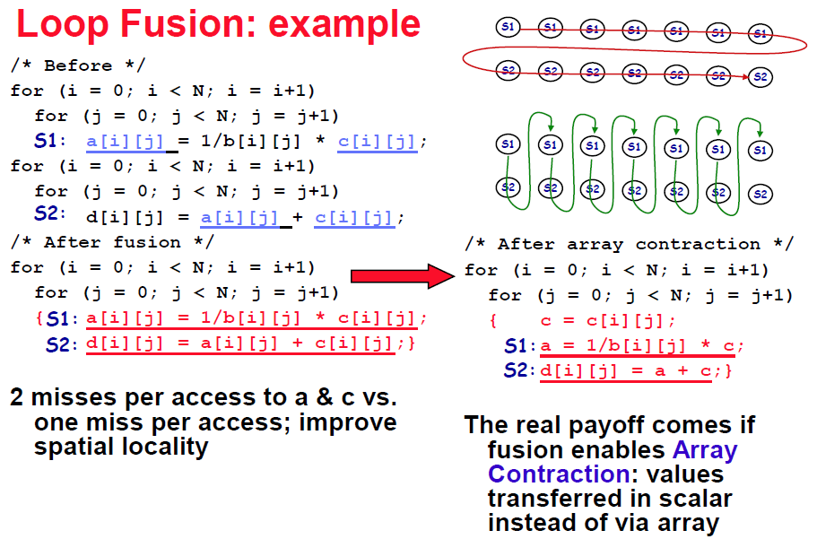
Cache and Program

Slide 46
Common Techniques
Merging Arrays
improve spatial locality by single array of compound elements vs. 2 arrays
Permuting a multidimensional array
improve spatial locality by matching array layout to traversal order

Slide 47
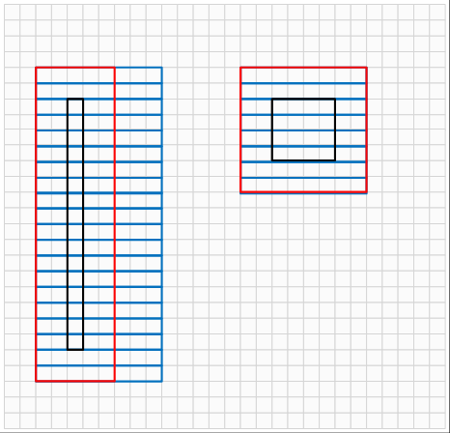
Common Techniques
Merging Arrays
improve spatial locality by single array of compound elements vs. 2 arrays
Permuting a multidimensional array
improve spatial locality by matching array layout to traversal order

Slide 48
Common Techniques
Merging Arrays
improve spatial locality by single array of compound elements vs. 2 arrays
Permuting a multidimensional array
improve spatial locality by matching array layout to traversal order
Loop Interchange
change nesting of loops to access data in order stored in memory
Loop Fusion
Combine 2 independent loops that have same looping and some variables overlap
Blocking
Improve temporal locality by accessing “blocks” of data repeatedly vs. going down whole columns or rows
Matrix Multiplication

Slide 49
Second Level Cache
L2 Equations
AMAT = Hit TimeL1+ Miss RateL1x Miss PenaltyL1
Miss PenaltyL1= Hit TimeL2+ Miss RateL2x Miss PenaltyL2
AMAT = Hit TimeL1+Miss RateL1x (Hit TimeL2+Miss RateL2+ Miss PenaltyL2)
Local miss rate—misses in this cache divided by the total number of memory accesses to this cache(Miss rateL2)
Global miss rate—misses in this cache divided by the total number of memory accesses generated by the CPU(Miss RateL1x Miss RateL2)
Global Miss Rate is what matters

Slide 50
Virtual Memory
If we run a very large program or a program that accesses very large data sets, all of the instructions and data may not fit into main memory.
Virtual memory functions as a cache for secondary storage.
It only keeps the active parts of running programs in main memory.
Swap space
those parts that are idle are kept in a block of secondary storage.
Pages
blocks of data and instructions. Usually these are relatively large. Most systems have a fixed page size that currently ranges from 4 to 16 kilobytes.

Slide 51
Virtual Memory
Program with 4 pages (A, B, C, D)
Any chunk of Virtual Memory assigned to any chuck of Physical Memory (“page”)
Virtual Memory
Physical Memory
0
A
0
4 KB
B
4 KB
B
8 KB
C
8 KB
12 KB
D
12 KB
A
16 KB
Disk
20 KB
C
D
24 KB
How we design address?
28 KB
Use the physical address in virtual memory?
In a multitasking OS, if multiple programs access to the same address

Slide 52
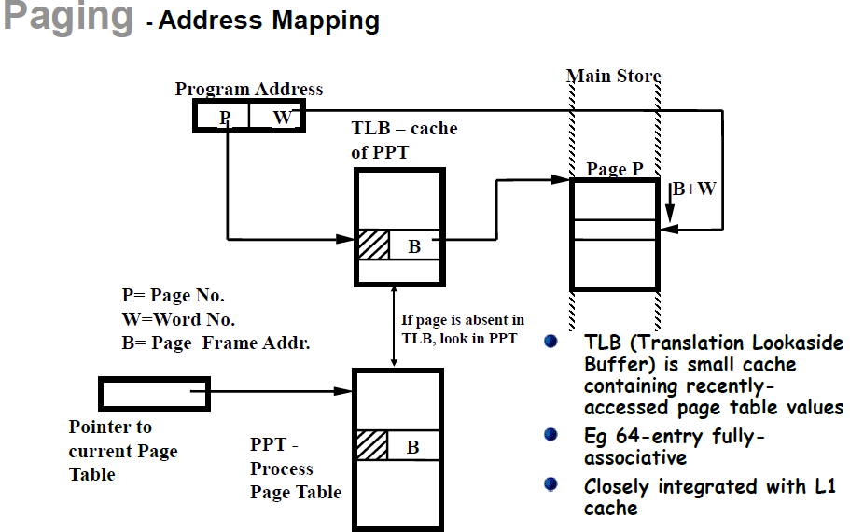
Address Mapping

Slide 53
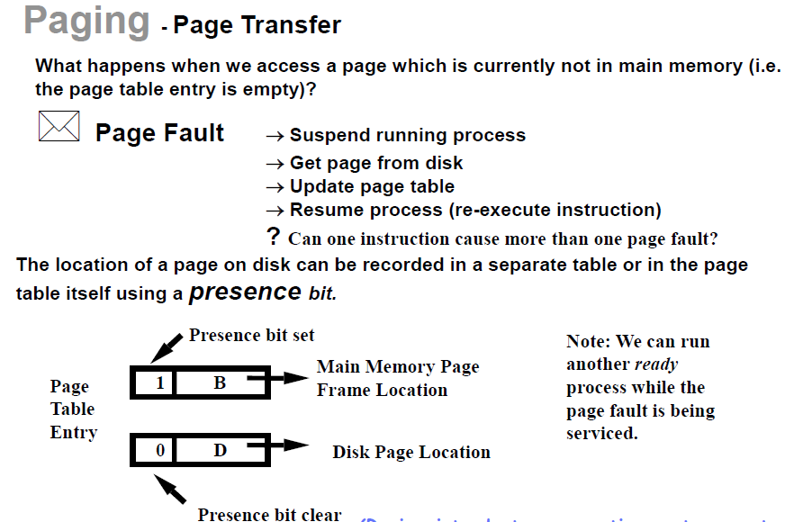
Page Fault

Slide 54
Main Memory
Performance of Main Memory
Latency: Cache Miss Penalty
Access Time: time between request and word arrives
Cycle Time: time between requests
Turn around time (write-read)
Burst read/write mode
Bandwidth: I/O & Large Block Miss Penalty (L2)
Main Memory is DRAM: Dynamic Random Access Memory
Dynamic since needs to be refreshed periodically (8 ms, 1% time)
Addresses divided into 2 halves (Memory as a 2D matrix):RAS or Row Access Strobe
CAS or Column Access Strobe
Cache uses SRAM: Static Random Access Memory
No refresh (6 transistors/bit vs. 1 transistor)
Size: DRAM/SRAM 4-8,
Cost/Cycle time: SRAM/DRAM 8-16

Slide 55
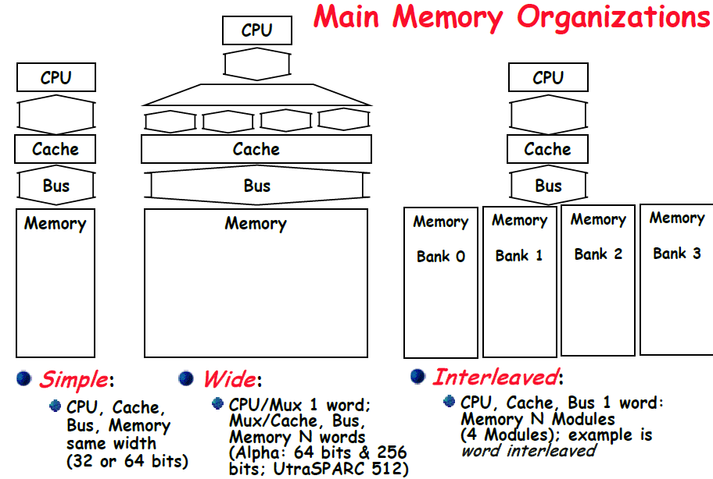
Memory Organization

Slide 56
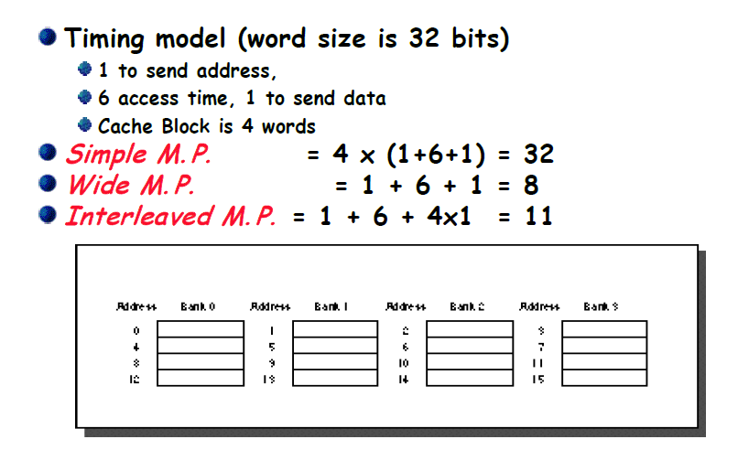
Main Memory Performance

Slide 57
Avoid Bank Conflict
Even a lot of banks, still bank conflict in certain regular accesses
e.g. Storing 256x512 array in 512 banks and column processing (512 is an even multiple of 128)
int x[256][512];
for (j = 0; j < 512; j = j+1)
for (i = 0; i < 256; i = i+1)
x[i][j] = 2 * x[i][j];
Inner Loop is a column processing which causes bank conflicts
Column processing
Bank0 Bank1 Bank127 ,…, Bank511
0,0 0,1 ,..., 0,127 ,..., 0,511
1,0 1,1 ,..., 1,127 ,..., 1,511
...
127,0 127,1 ,..., 127,127 ,..., 127,511
...
128,0 128,1 ,..., 128,127 ,..., 128,511
...
255,0 255,1 ,..., 255,127 ,..., 255,511
Column elements are in the same bank

