Slide 1
CS427 Multicore Architecture and Parallel Computing
Lecture 1 Introduction
Li Jiang
2014/9/16

Slide 2
Course Details
Time: Tue 8:00-9:40pm, Thu 8:00-9:40am, the first 16 weeks
Location: 东上院 405
Course Website: http://www.cs.sjtu.edu.cn/~jiangli/teaching
Instructor: Prof. Li Jiang, jiangli@cs.sjtu.edu.cn
TA: Weichao Tang
Textbook:“An Introduction to Parallel Programming”- by Peter Pacheco
Reference:
“Computer Architecture: A Quantitative Approach, 4th Edition” –by John Hennessy and David Patterson
“Programming Massively Parallel Processors, A Hands-on Approach” –by David Kirk and Wen-mei Hwu
Grades:
Homework (30%), Project (30%), Midterm exam (30%), Attendance (10%)

Slide 3
Course Objectives
Study the state-of-art multicore processor architectures
  Why are the latest processors turning into multicore
  What is the basic computer architecture to support multicore
Learn how to program parallel processors and systems
  Learn how to think in parallel and write correct parallel programs
  Achieve performance and scalability through understanding of architecture and software mapping
Significant hands-on programming experience
  Develop real applications on real hardware
Discuss the current parallel computing context
  What are the drivers that make this course timely
  Contemporary programming models and architectures, and where is the field going

Slide 4
Course Importance
Multi-core and many-core era is here to stay
  Why? Technology Trends
Many programmers will be developing parallel software
  But still not everyone is trained in parallel programming
  Learn how to put all these vast machine resources to the best use!
Useful for
  Joining the work force
  Graduate school
Our focus
  Teach core concepts
  Use common programming models
  Discuss broader spectrum of parallel computing

Slide 5
Course Arrangement
1 lecture for introduction
2 lectures for parallel computer architecture/system
2 lectures for OpenMP
3 lectures for GPU architectures and CUDA
3 lectures for Map&reduce
1 lecture for project introduction

Slide 6
What is Parallel Computing
Parallel computing: using multiple processors in parallel to solve problems more quickly than with a single processor
Examples of parallel machines:
  A cluster computer that contains multiple PCs combined together with a high speed network
  A shared memory multiprocessor (SMP) by connecting multiple processors to a single memory system
  A Chip Multi-Processor (CMP) contains multiple processors (called cores) on a single chip
Concurrent execution comes from desire for performance; unlike the inherent concurrency in a multi-user distributed system

Slide 7
Why Parallel Computing NOW
Researchers have been using parallel computing for decades:
  Mostly used in computational science and engineering
  Problems too large to solve on one computer; use 100s or 1000s
Many companies in the 80s/90s “bet” on parallel computing and failed
  Computers got faster too quickly for there to be a large market
Why are we adding an undergraduate course now?
  Because the entire computing industry has bet on parallelism
  There is a desperate need for parallel programmers
Let’s see why…

Slide 8
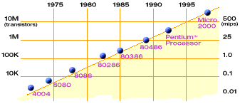
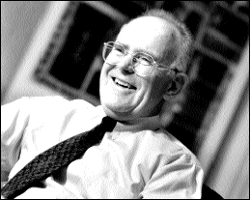
Microprocessor Capacity
2X transistors/Chip Every 1.5 years
Called “Moore’s Law”
Gordon Moore (co-founder of Intel) predicted in 1965 that the transistor density of semiconductor chips would double roughly every 18 months.
Microprocessors have become smaller, denser, and more powerful.

Slide 9
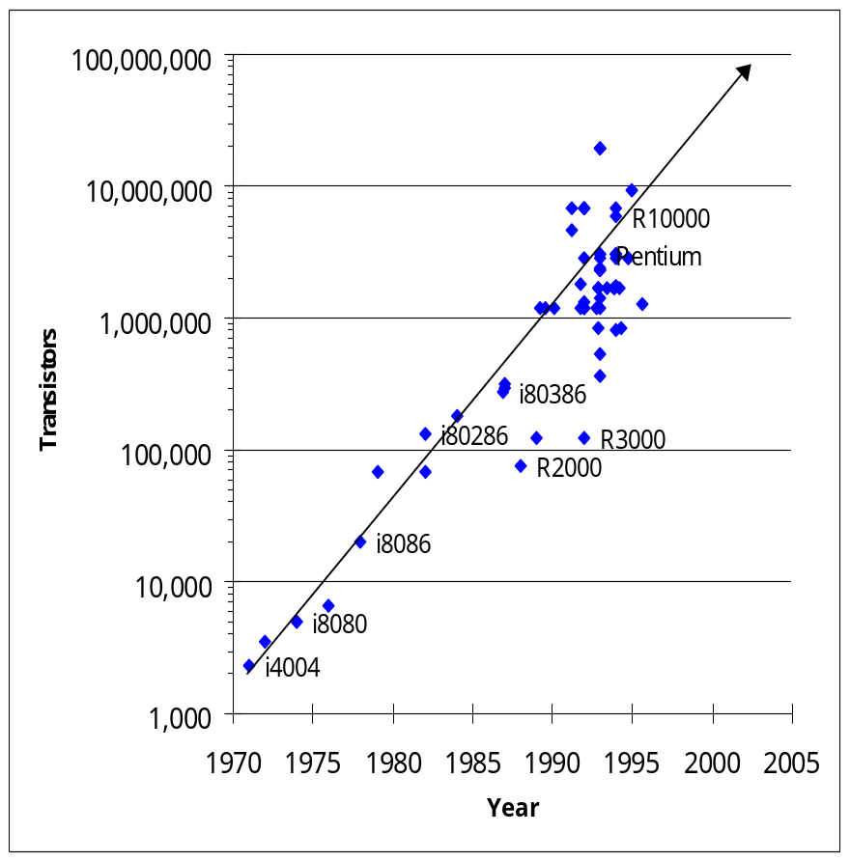
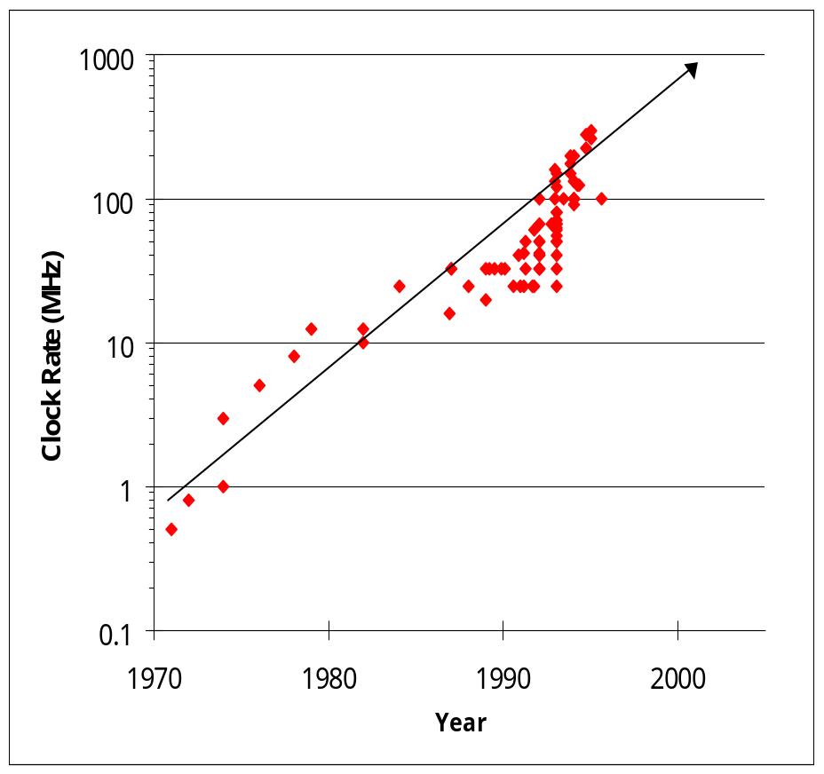
Microprocessor Speed
Growth in transistors per chip
Increase in clock rate
Why bother with parallel programming? Just wait a year or two…

Slide 10
Limit #1: Power Density
Can soon put more transistors on a chip than can afford to turn on.
-- Patterson ‘07
Scaling clock speed (business as usual) will not work
10000
Sun’s
Surface
Rocket
1000
Nozzle
Nuclear
100
Reactor
Power Density (W/cm²)
Hot Plate
8086
10
4004
P6
8008
8085
386
Pentium®
8080
286
486
Source: Patrick
Gelsinger, Intel®
1
1970
1980
1990
2000
2010
Year

Slide 11
Parallelism Saves Power
Exploit explicit parallelism for reducing power
Power = C * V² * F Performance = Cores * F
Capacitance Voltage Frequency
Power = 2C * V² * F Performance = 2Cores * F
Power = 2C * V²/4 * F/2 Performance = 2Cores * F/2
Power = (C * V² * F) Performance = Cores * F
Using additional cores
  Increase density (= more transistors = more capacitance)
  Increase cores (2x), but decrease frequency (1/2): same performance at (1/4) the power
Additional benefits
  Small/simple cores → more predictable performance

Slide 12
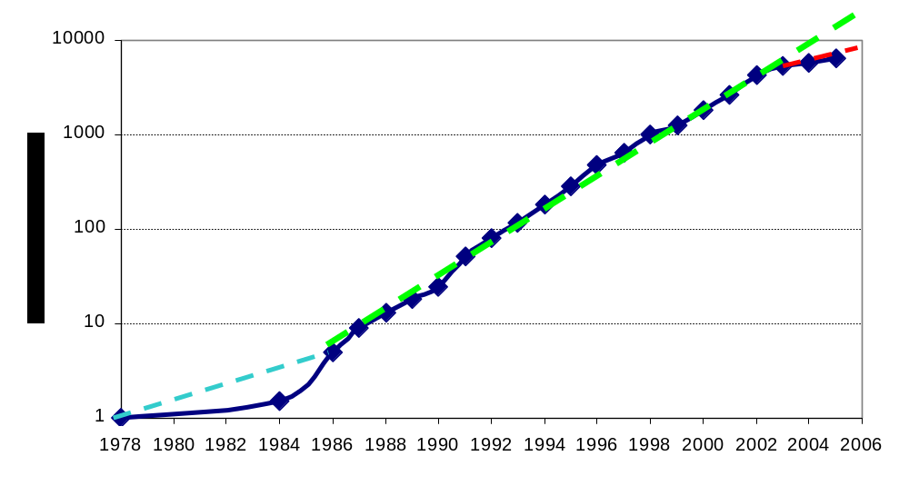
Limit #2: ILP Tapped Out
Application performance was increasing by 52% per year as measured by the SpecInt benchmarks here
From Hennessy and Patterson, Computer Architecture: A Quantitative Approach, 4th edition, 2006
½ due to transistor density
½ due to architecture changes, e.g., Instruction Level Parallelism (ILP)
VAX : 25%/year 1978 to 1986
RISC + x86: 52%/year 1986 to 2002
Year

Slide 13
Limit #2: ILP Tapped Out
Superscalar (SS) designs were the state of the art; many forms of parallelism not visible to programmer
  multiple instruction issue
  dynamic scheduling: hardware discovers parallelism between instructions
  speculative execution: look past predicted branches
  non-blocking caches: multiple outstanding memory ops
You may have heard of these before, but you haven’t needed to know about them to write software
Unfortunately, these sources have been used up
Year

Slide 14
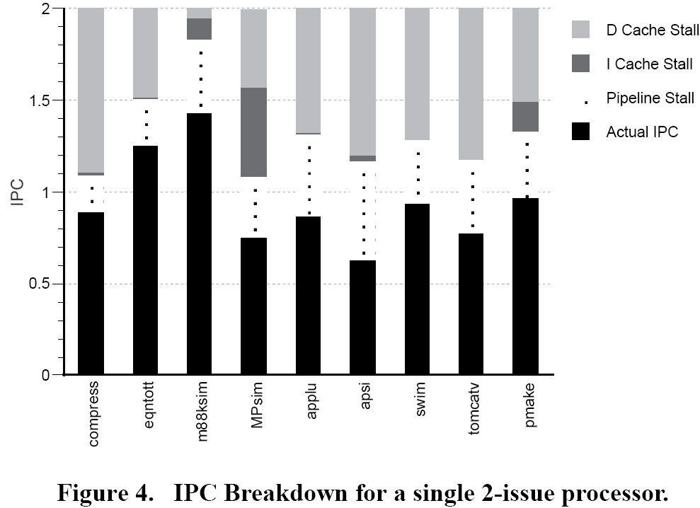
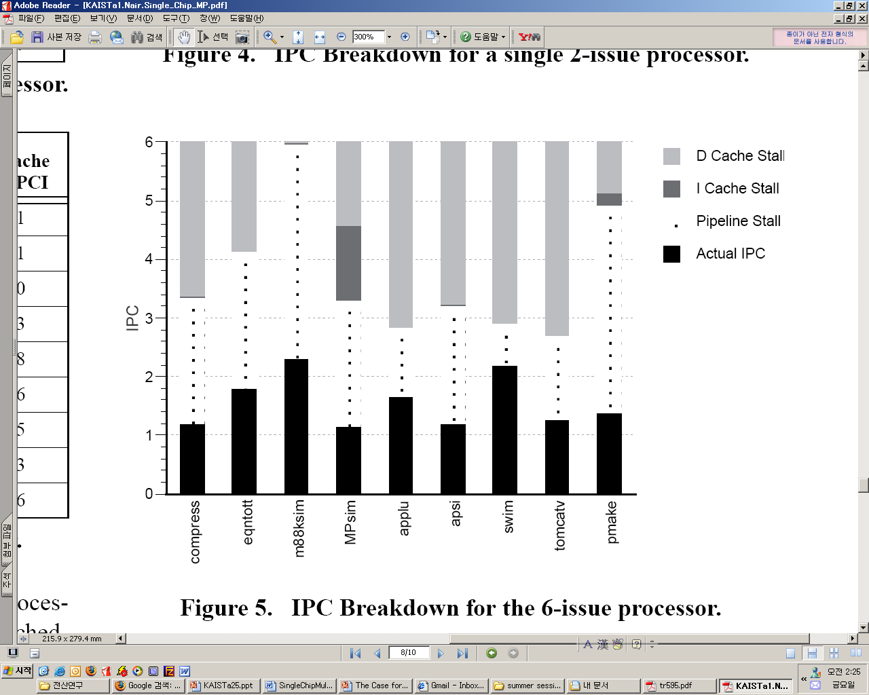
Limit #2: ILP Tapped Out
Measure of success for hidden parallelism is Instructions Per Cycle (IPC)
The 6-issue has higher IPC than 2-issue, but far less than 3x
Reasons are: waiting for memory (D and I-cache stalls) and dependencies (pipeline stalls)
Year
Graphs from: Olukotun et al, ASPLOS, 1996

Slide 15
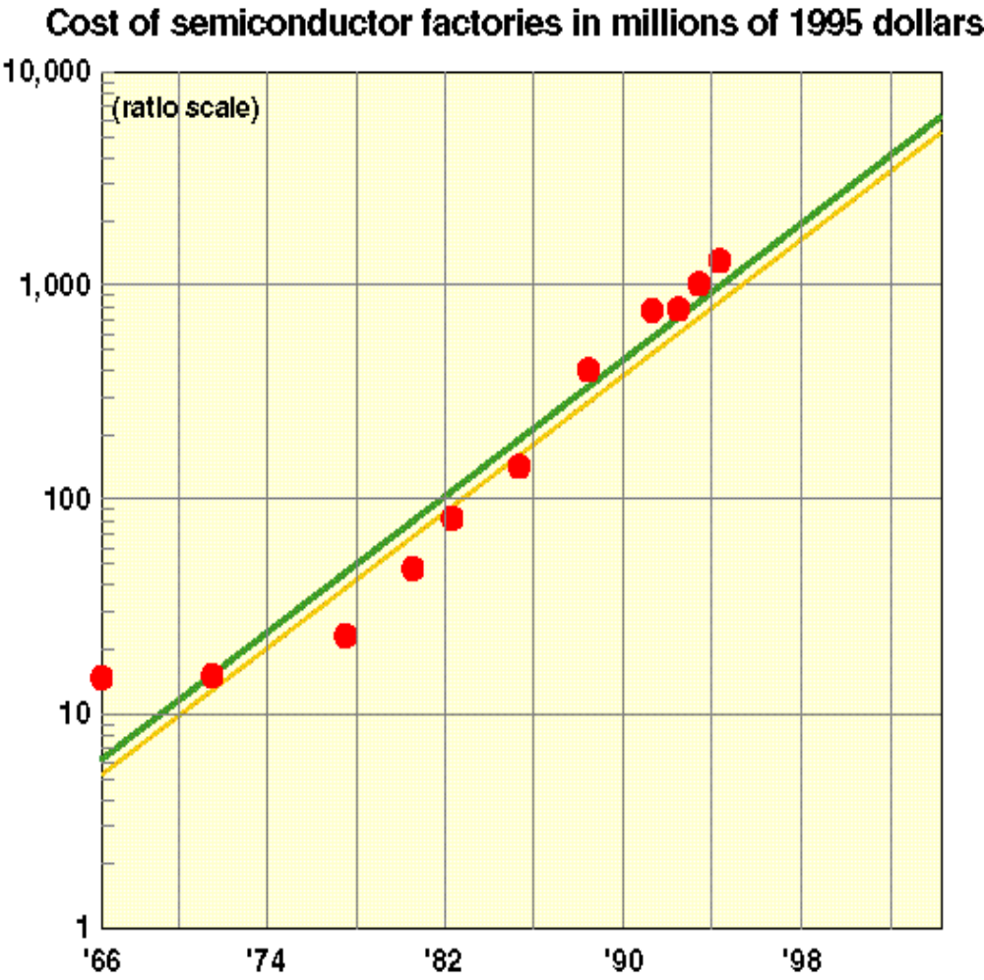
Limit #3: Chip Yield
Manufacturing costs and yield problems limit use of density
Moore’s (Rock’s) 2nd law: fabrication costs go up
Yield (% usable chips) drops
Parallelism can help
  More smaller, simpler processors are easier to design and validate
  Can use partially working chips:
  E.g., Cell processor (PS3) is sold with 7 out of 8 “on” to improve yield
Year

Slide 16
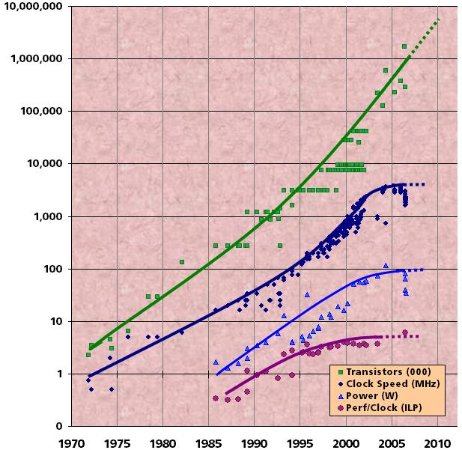
Current Situation
Chip density is continuing increasing
  Clock speed is not
  Number of processor cores may double instead
There is little or no hidden parallelism (ILP) to be found
Parallelism must be exposed to and managed by software
Source: Intel, Microsoft (Sutter) and Stanford (Olukotun, Hammond)

Slide 17
Multicore In Products
All microprocessor companies switch to MP (2X CPUs / 2 yrs)
And at the same time,
The STI Cell processor (PS3) has 8 cores
The latest NVidia Graphics Processing Unit (GPU) has 1024 cores
Intel has demonstrated an Xeon-Phi chip with 60 cores
Manufacturer/Year | AMD/’05 | Intel/’06 | IBM/’04 | Sun/’07
Processors/chip | 2 | 2 | 2 | 8
Threads/Processor | 1 | 2 | 2 | 16
Threads/chip | 2 | 4 | 4 | 128

Slide 18
Paradigm Shift
What do we do with all the transistors?
  Movement away from increasingly complex processor design and faster clocks
  Replicated functionality (i.e., parallel) is simpler to design
  Resources more efficiently utilized
  Huge power management advantages
All Computers are Parallel Computers.

Slide 19
Why Parallelism
These arguments are no long theoretical
All major processor vendors are producing multicore chips
  Every machine will soon be a parallel machine
  All programmers will be parallel programmers???
New software model
  Want a new feature? Hide the “cost” by speeding up the code first
  All programmers will be performance programmers???
Some may eventually be hidden in libraries, compilers, and high level languages
  But a lot of work is needed to get there
Big open questions
  What will be the killer apps for multicore machines
  How should the chips be designed, and how will they be programmed?

Slide 20
Scientific Simulation
Traditional scientific and engineering paradigm
  Do theory or paper design.
  Perform experiments or build system.
Limitations:
  Too difficult -- build large wind tunnels.
  Too expensive -- build a throw-away passenger jet.
  Too slow -- wait for climate or galactic evolution.
  Too dangerous -- weapons, drug design, climate experimentation.
Computational science paradigm
  Use high performance computer systems to simulate the phenomenon
  Base on known physical laws and efficient numerical methods.

Slide 21
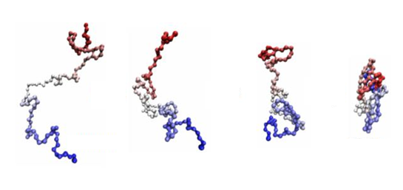



Scientific Simulation

Slide 22

Example
Problem is to compute
  f(latitude, longitude, elevation, time) →
  temperature, pressure, humidity, wind velocity
Approach
  Discretize the domain, e.g., a measurement point every 10 km
  Devise an algorithm to predict weather at time t+δt given t
Source: http://www.epm.ornl.gov/chammp/chammp.html

Slide 23
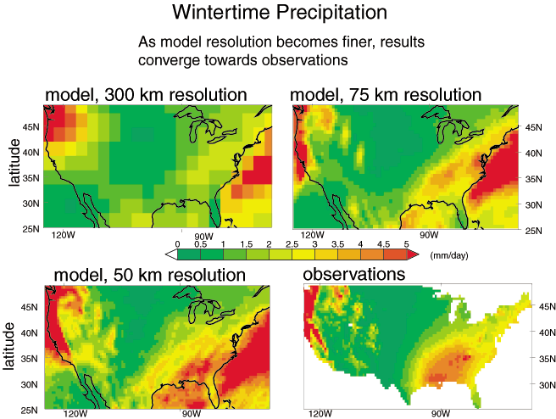
Example

Slide 24
Steps in Climate Modeling
Discretize physical or conceptual space into a grid
  Simpler if regular, may be more representative if adaptive
Perform local computations on grid
  Given yesterday’s temperature and weather pattern, what is today’s expected temperature?
Communicate partial results between grids
  Contribute local weather result to understand global weather pattern.
Repeat for a set of time steps
  Possibly perform other calculations with results
  Given weather model, what area should evacuate for a hurricane?

Slide 25
Steps in Climate Modeling
One processor
computes this part
Another processor
computes this part in
parallel
Processors in adjacent blocks in the grid communicate their result.

Slide 26
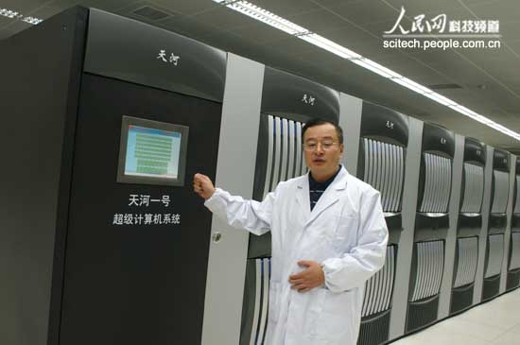
The Need for Scientific Simulation
Scientific simulation will continue to push on system requirements
  To increase the precision of the result
  To get to an answer sooner (e.g., climate modeling, disaster modeling)
Major countries will continue to acquire systems of increasing scale
  For the above reasons
  And to maintain competitiveness

Slide 27



Commodity Devices
More capabilities in software
Integration across software
Faster response
More realistic graphics
Computer vision

Slide 28
Approaches to Write Parallel Program
Rewrite serial programs so that they’re parallel.
  Sometimes the best parallel solution is to step back and devise an entirely new algorithm
Write translation programs that automatically convert serial programs into parallel programs.
  This is very difficult to do.
  Success has been limited.
  It is likely that the result will be a very inefficient program.

Slide 29
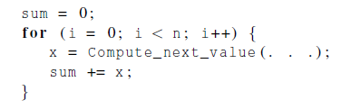
Parallel Program Example
Compute “n” values and add them together
Serial solution

Slide 30
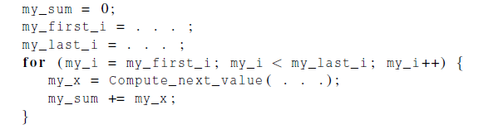
Parallel Program Example
We have “p” cores, “p” much smaller than “n”
Each core performs a partial sum of approximately “n/p” values
Each core uses it’s own private variables
and executes this block of code
independently of the other cores.

Slide 31
Parallel Program Example
After each core completes execution of the code, is a private variable my_sum contains the sum of the values computed by its calls to Compute_next_value.
Ex., 8 cores, n = 24, then the calls to Compute_next_value return:
1,4,3, 9,2,8, 5,1,1, 5,2,7, 2,5,0, 4,1,8, 6,5,1, 2,3,9

Slide 32
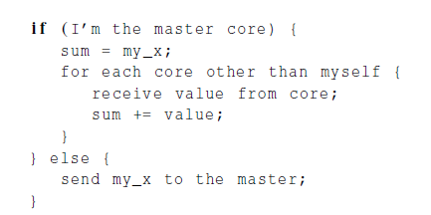
Parallel Program Example
Once all the cores are done computing their private my_sum, they form a global sum by sending results to a designated “master” core which adds the final result.

Slide 33
Parallel Program Example
Core | 0 | 1 | 2 | 3 | 4 | 5 | 6 | 7
my_sum | 8 | 19 | 7 | 15 | 7 | 13 | 12 | 14
Global sum
8 + 19 + 7 + 15 + 7 + 13 + 12 + 14 = 95
Core | 0 | 1 | 2 | 3 | 4 | 5 | 6 | 7
my_sum | 95 | 19 | 7 | 15 | 7 | 13 | 12 | 14

Slide 34
Better Parallel Program Example
Don’t make the master core do all the work.
Share it among the other cores.
Pair the cores so that core 0 adds its result with core 1’s result.
Core 2 adds its result with core 3’s result, etc.
Work with odd and even numbered pairs of cores.
Repeat the process now with only the evenly ranked cores.
Core 0 adds result from core 2.
Core 4 adds the result from core 6, etc.
Now cores divisible by 4 repeat the process, and so forth, until core 0 has the final result.

Slide 35
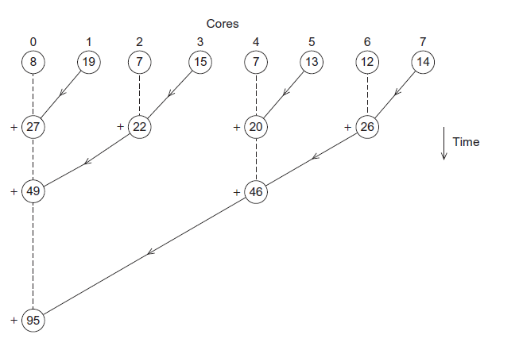
Better Parallel Program Example

Slide 36
Better Parallel Program Example
The difference is more dramatic with a larger number of cores.
If we have 1000 cores
  The first example would require the master to perform 999 receives and 999 additions.
  The second example would only require 10 receives and 10 additions.
That’s an improvement of almost a factor of 100!

Slide 37
Types of Parallelism
Task parallelism
  Partition various tasks carried out solving the problem among the cores.
Data parallelism
  Partition the data used in solving the problem among the cores.
  Each core carries out similar operations on it’s part of the data.

Slide 38


Types of Parallelism
15 questions
300 exams

Slide 39

Types of Parallelism
TA#1
TA#2
TA#3

Slide 40
Types of Parallelism
Data Parallelism
TA#1
TA#3
100 exams
100 exams
TA#2
100 exams

Slide 41

Types of Parallelism
Task Parallelism
TA#1
TA#3
Questions 11 - 15
Questions 1 - 5
TA#2
Questions 6 - 10

Slide 42
Principles of Parallelism
Finding enough parallelism (Amdahl’s Law)
Granularity
Locality
Load balance
Coordination and synchronization
Performance modeling
All of these things makes parallel programming even harder than sequential programming.

Slide 43
Finding Enough Parallelism
Suppose only part of an application seems parallel
Amdahl’s law
  let s be the fraction of work done sequentially, so (1-s) is fraction parallelizable
  P = number of processors
Speedup(P) = ?

Slide 44
Finding Enough Parallelism
Suppose only part of an application seems parallel
Amdahl’s law
  let s be the fraction of work done sequentially, so (1-s) is fraction parallelizable
  P = number of processors
Speedup(P) = Time(1)/Time(P)
<= 1/(s + (1-s)/P)
<= 1/s
Even if the parallel part speeds up perfectly performance is limited by the sequential part

Slide 45
Overhead of Parallelism
Given enough parallel work, this is the biggest barrier to getting desired speedup
Parallelism overheads include??

Slide 46
Overhead of Parallelism
Given enough parallel work, this is the biggest barrier to getting desired speedup
Parallelism overheads include
  cost of starting a thread or process
  cost of communicating shared data
  cost of synchronizing
  extra (redundant) computation
Each of these can be in the range of milliseconds (=millions of flops) on some systems
Tradeoff:

Slide 47
Overhead of Parallelism
Given enough parallel work, this is the biggest barrier to getting desired speedup
Parallelism overheads include
  cost of starting a thread or process
  cost of communicating shared data
  cost of synchronizing
  extra (redundant) computation
Each of these can be in the range of milliseconds (=millions of flops) on some systems
Tradeoff: Algorithm needs sufficiently large units of work to run fast in parallel (I.e. large granularity), but not so large that there is not enough parallel work

Slide 48
Locality
Conventional
Storage
Hierarchy
Proc
Cache
L2 Cache
L3 Cache
Memory
Large memories are slow, fast memories are small
Storage hierarchies are large and fast on average

Slide 49
Locality
Conventional
Storage
Hierarchy
Proc
Proc
Proc
Cache
Cache
Cache
L2 Cache
L2 Cache
L2 Cache
L3 Cache
L3 Cache
L3 Cache
potential
interconnects
Memory
Memory
Memory
Large memories are slow, fast memories are small
Storage hierarchies are large and fast on average
Parallel processors, collectively, have large, fast cache
  the slow accesses to “remote” data we call “communication”
Algorithm should do most work on local data

Slide 50
Load Balancing
Load imbalance is the time that some processors in the system are idle due to
  insufficient parallelism (during that phase)
  unequal size tasks

Slide 51
Load Balancing
Load imbalance is the time that some processors in the system are idle due to
  insufficient parallelism (during that phase)
  unequal size tasks
Examples of the latter
  adapting to “interesting parts of a domain”
  tree-structured computations
  fundamentally unstructured problems
Algorithm needs to balance load

Slide 52
Locks and Barriers
Thread 1
Thread 3
load sum
update sum
store sum
load sum
update sum
store sum
Locks
  A barrier is used to block threads from proceeding beyond a program point until all of the participating threads has reached the barrier.

