Slide 1
CS427 Multicore Architecture and Parallel Computing
Lecture 9 MapReduce
Prof. Li Jiang
2014/11/19

Slide 2
What is MapReduce
Origin from Google, [OSDI’04]
A simple programming model
Functional model
For large-scale data processing
Exploits large set of commodity computers
Executes process in distributed manner
Offers high availability

Slide 3
Motivation
Large-Scale Data Processing
Want to use 1000s of CPUs
But don’t want hassle of managing things
MapReduce provides
Automatic parallelization & distribution
Fault tolerance
I/O scheduling
Monitoring & status updates

Slide 4
Benefit of MapReduce
Map/Reduce
Programming model from Lisp
(and other functional languages)
Many problems can be phrased this way
Easy to distribute across nodes
Nice retry/failure semantics

Slide 5
Distributed Word Count
Split data
count
count
Split data
count
count
Very
big
data
merged
count
Split data
count
count
merge
Split data
count
count

Slide 6
Distributed Grep
Split data
grep
matches
Split data
grep
matches
Very
big
data
All
matches
Split data
grep
matches
cat
Split data
grep
matches
Notes:
The map function emits a line if it matches a supplied pattern. The reduce function is an identity function that just copies the supplied intermediate data to the output.

Slide 7
Map+Reduce
Map
Accepts input key/value pair
Emits intermediate key/value pair
R
E
D
U
C
E
Reduce
Accepts intermediate key/value* pair
Emits output key/value pair
Very
big
data
M
A
P
Partitioning
Function
Result

Slide 8
Map+Reduce
map(key, val) is run on each item in set
emits new-key / new-val pairs
reduce(key, vals) is run for each unique key emitted by map()
emits final output

Slide 9
Square Sum
(map f list [list₂ list₃ …])
(map square ‘(1 2 3 4))
(1 4 9 16)
(reduce + ‘(1 4 9 16))
(+ 16 (+ 9 (+ 4 1) ) )
30
Unary operator
Binary operator

Slide 10
Word Count
Input consists of (url, contents) pairs
map(key=url, val=contents):
For each word w in contents, emit (w, “1”)
reduce(key=word, values=uniq_counts):
Sum all “1”s in values list
Emit result “(word, sum)”

Slide 11
Word Count
map(key=url, val=contents):
For each word w in contents, emit (w, “1”)
reduce(key=word, values=uniq_counts):
Sum all “1”s in values list
Emit result “(word, sum)”
Count, Illustrated
see 1
bob 1
run 1
see 1
spot 1
throw 1
bob 1
run 1
see 2
spot 1
throw 1
see bob throw
see spot run

Slide 12
Reverse Web-Link
Map
For each URL linking to target, …
Output <target, source> pairs
Reduce
Concatenate list of all source URLs
Outputs: <target, list (source)> pairs

Slide 13
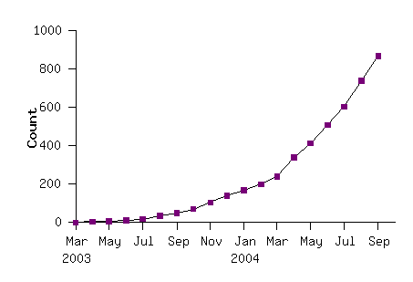
Model is Widely Used
Example uses:
distributed grep |  | distributed sort |  | web link-graph reversal
term-vector / host |  | web access log stats |  | inverted index construction
document clustering |  | machine learning |  | statistical machine translation
... |  | ... |  | ...

Slide 14
Implementation
Typical cluster:
100s/1000s of 2-CPU x86 machines, 2-4 GB of memory
Limited bisection bandwidth
Storage is on local IDE disks
GFS: distributed file system manages data (SOSP'03)
Job scheduling system: jobs made up of tasks, scheduler assigns tasks to machines
Implementation is a C++ library linked into user programs

Slide 15
Execution
How is this distributed?
Partition input key/value pairs into chunks, run map() tasks in parallel
After all map()s are complete, consolidate all emitted values for each unique emitted key
Now partition space of output map keys, and run reduce() in parallel
If map() or reduce() fails, reexecute!

Slide 16
Architecture
Master node
user
Job tracker
Slave node 1
Slave node 2
Slave node N
Task tracker
Task tracker
Task tracker
Workers
Workers
Workers

Slide 17
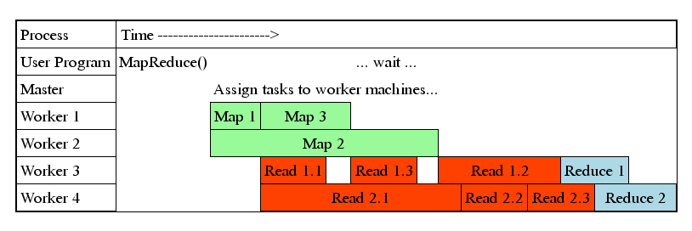
Task Granularity
Fine granularity tasks: map tasks >> machines
Minimizes time for fault recovery
Can pipeline shuffling with map execution
Better dynamic load balancing
Often use 200,000 map & 5000 reduce tasks
Running on 2000 machines

Slide 18
GFS
Goal
global view
make huge files available in the face of node failures
Master Node (meta server)
Centralized, index all chunks on data servers
Chunk server (data server)
File is split into contiguous chunks, typically 16-64MB.
Each chunk replicated (usually 2x or 3x).
Try to keep replicas in different racks.

Slide 19
GFS
GFS Master
Client
C₀
C₁
C₁
C₀
C₅
…
C₅
Chunkserver 1
Chunkserver 2
Chunkserver N
C₂
C₅
C₃
C₂

Slide 20
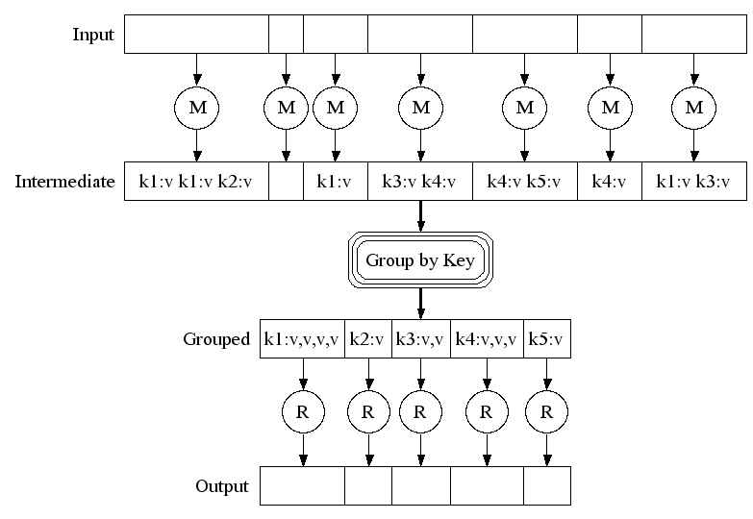
Execution

Slide 21
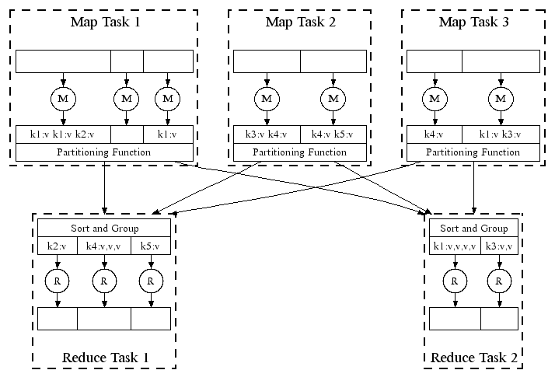
Execution

Slide 22
Workflow

Slide 23
Locality
Master scheduling policy
Asks GFS for locations of replicas of input file blocks
Map tasks typically split into 64MB (== GFS block size)
Map tasks scheduled so GFS input block replica are on same machine or same rack
Effect
Thousands of machines read input at local disk speed
Without this, rack switches limit read rate

Slide 24
Fault Tolerance
Reactive way
Worker failure
Heartbeat, Workers are periodically pinged by master
NO response = failed worker
If the processor of a worker fails, the tasks of that worker are reassigned to another worker.
What about a completed Map task or Reduce task?
Master failure
Master writes periodic checkpoints
Another master can be started from the last checkpointed state
If eventually the master dies, the job will be aborted

Slide 25
Fault Tolerance
Proactive way (Redundant Execution)
The problem of “stragglers” (slow workers)
Other jobs consuming resources on machine
Bad disks with soft errors transfer data very slowly
Weird things: processor caches disabled (!!)
When computation almost done, reschedule in-progress tasks
Whenever either the primary or the backup executions finishes, mark it as completed

Slide 26
Fault Tolerance
Input error: bad records
Map/Reduce functions sometimes fail for particular inputs
Best solution is to debug & fix, but not always possible
On segment fault
Send UDP packet to master from signal handler
Include sequence number of record being processed
Skip bad records
If master sees two failures for same record, next worker is told to skip the record

Slide 27
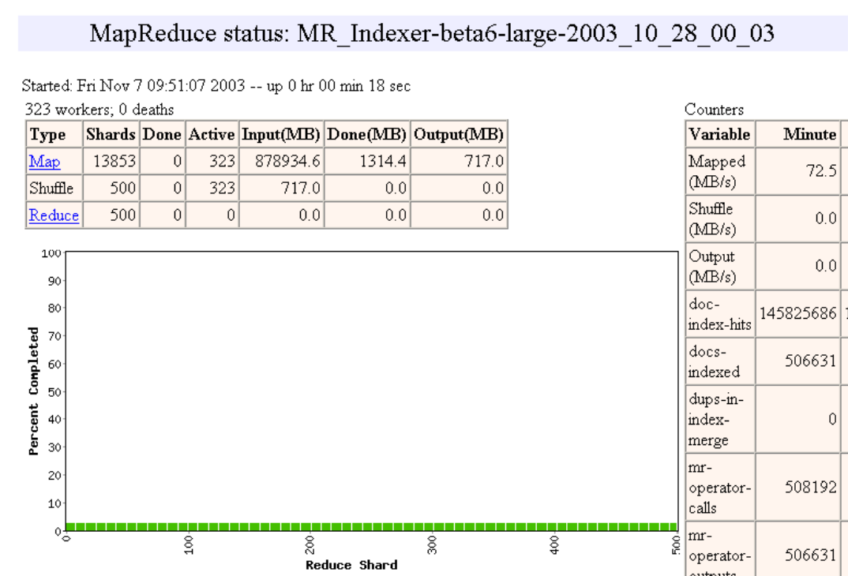

Slide 28
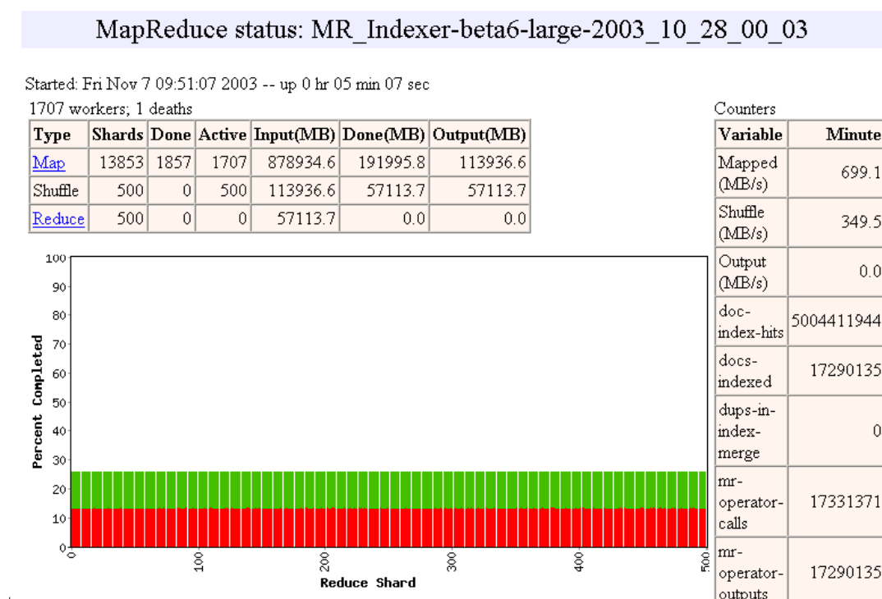

Slide 29
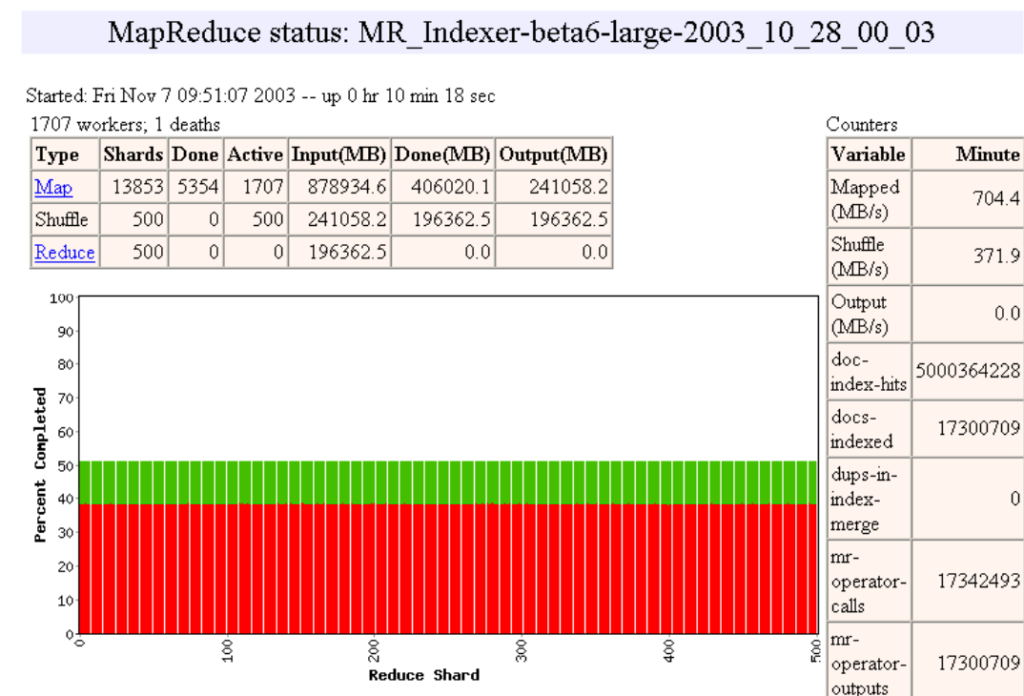

Slide 30
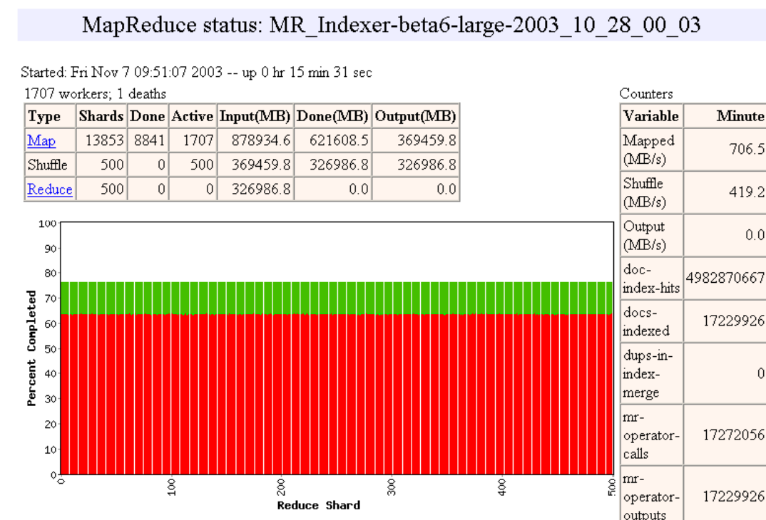

Slide 31
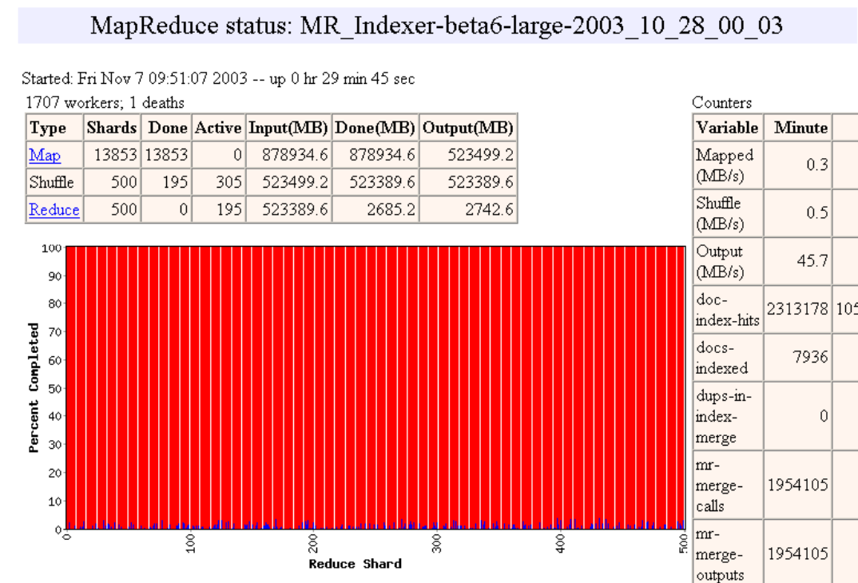

Slide 32
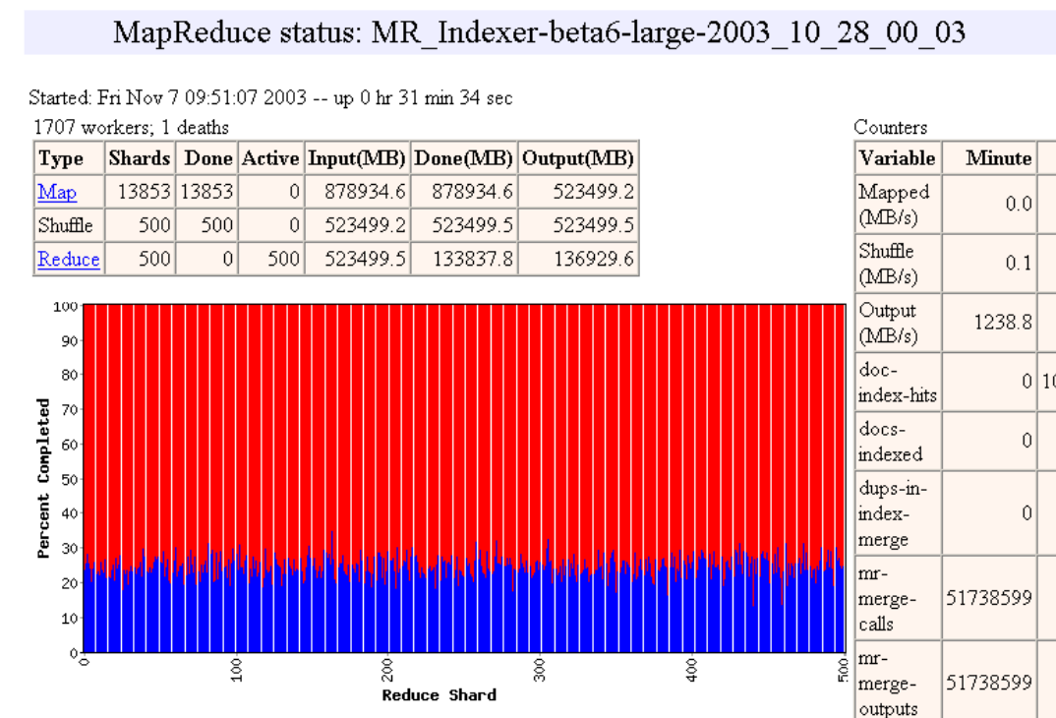

Slide 33
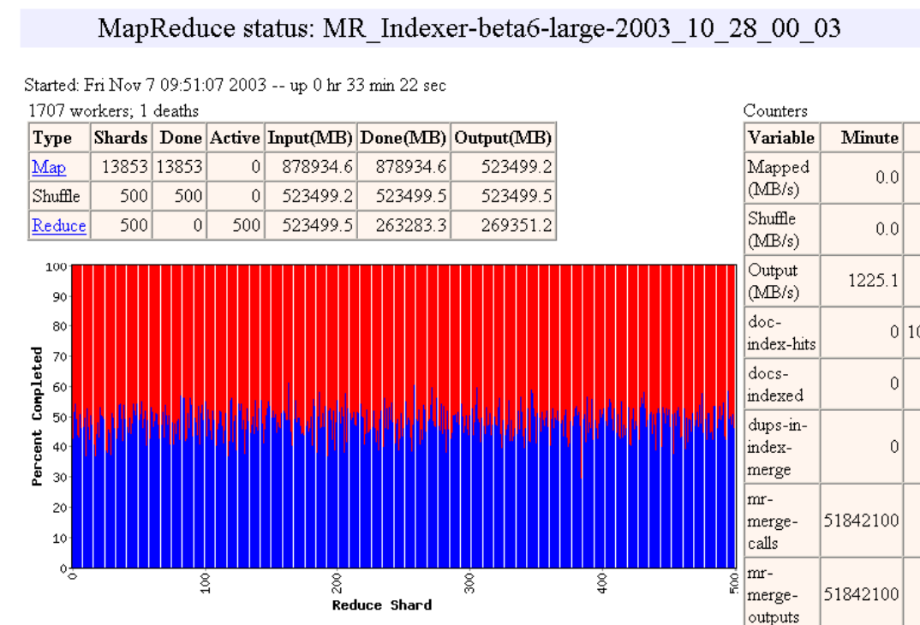

Slide 34
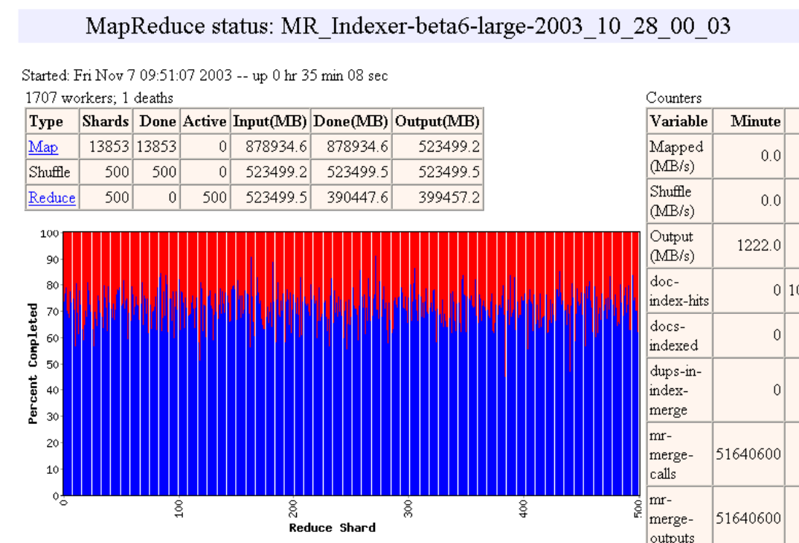

Slide 35
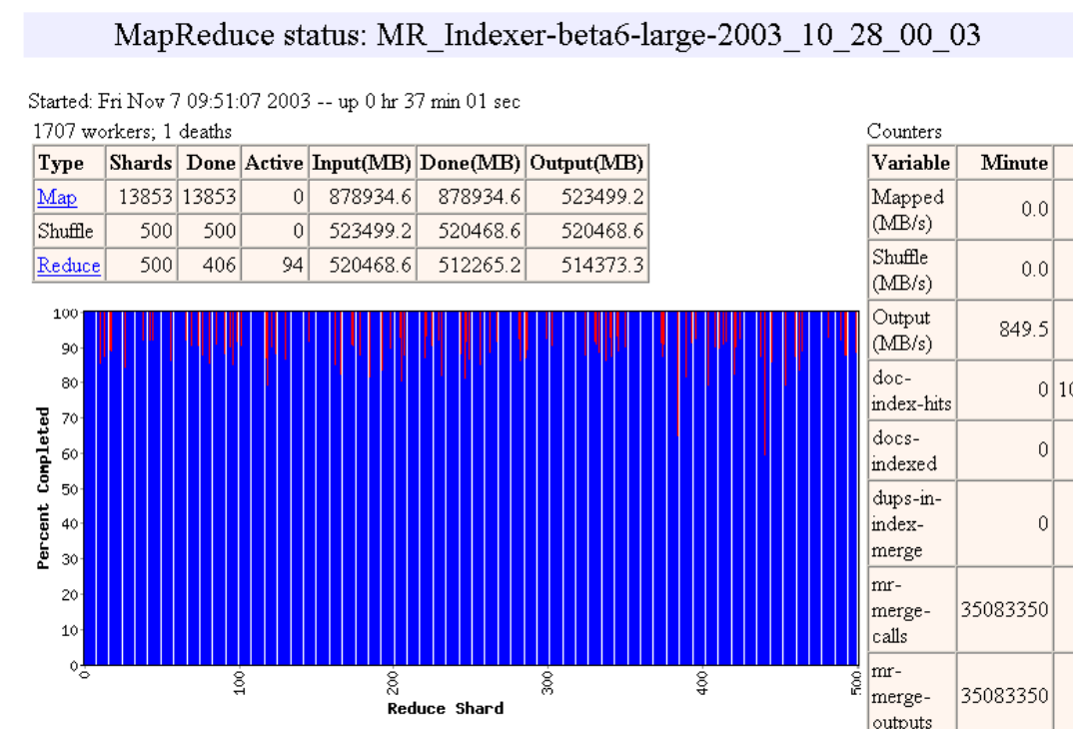

Slide 36


Slide 37


Slide 38
Refinement
Task Granularity
Minimizes time for fault recovery
load balancing
Local execution for debugging/testing
Compression of intermediate data

Slide 39
Notes
No reduce can begin until map is complete
Master must communicate locations of intermediate files
Tasks scheduled based on location of data
If map worker fails any time before reduce finishes, task must be completely rerun
MapReduce library does most of the hard work for us!

Slide 40
Case Study
User to do list:
indicate:
Input/output files
M: number of map tasks
R: number of reduce tasks
W: number of machines
Write map and reduce functions
Submit the job

Slide 41
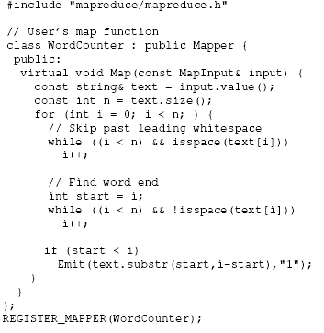
Case Study
Map

Slide 42
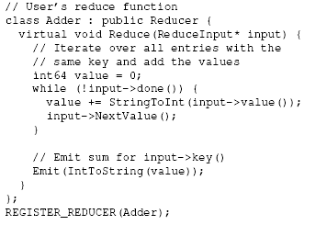
Case Study
Reduce

Slide 43
Case Study
Main

Slide 44


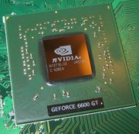
Commodity Platform
MapReduce
Cluster,
1, Google
2, Apache Hadoop
Multicore CPU,
Phoenix @ stanford
GPU,
Mars@HKUST

Slide 45
Hadoop
Google | Yahoo
MapReduce | Hadoop
GFS | HDFS
Bigtable | HBase
Chubby | (nothing yet… but planned)

Slide 46
Hadoop
Apache Hadoop Wins Terabyte Sort Benchmark
The sort used 1800 maps and 1800 reduces and allocated enough memory to buffers to hold the intermediate data in memory.

Slide 47
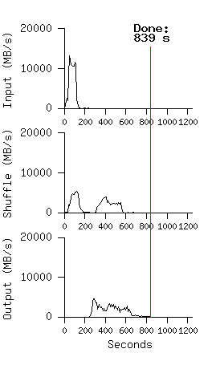
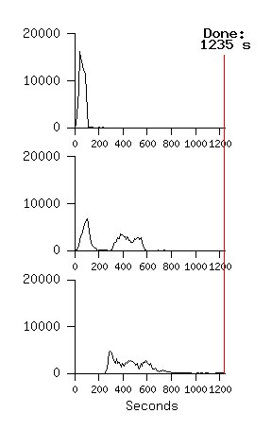
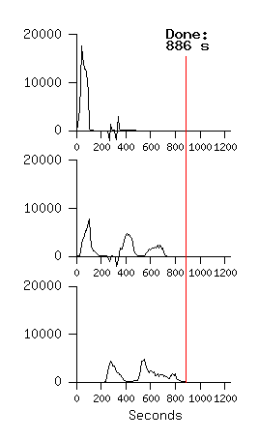
MR_Sort
Normal No backup tasks 200 processes killed
Backup tasks reduce job completion time a lot!
System deals well with failures

Slide 48
Hadoop
Hadoop Config File:
conf/hadoop-env.sh：Hadoop enviroment
conf/core-site.xml：NameNode IP and Port
conf/hdfs-site.xml：HDFS Data Block Setting
conf/mapred-site.xml：JobTracker IP and Port
conf/masters：Master IP
conf/slaves：Slaves IP

Slide 49
Hadoop
Start HDFS and MapReduce
[hadoop@ Master ~]$ start-all.sh
JPS check status：
[hadoop@ Master ~]$ jps
Stop HDFS and MapReduce
[hadoop@ Master ~]$ stop-all.sh

Slide 50
Hadoop
Create（/root/test) two data files:
file1.txt：hello hadoop hello world
file2.txt：goodbye hadoop
Copy files to HDFS：
[hadoop@ Master ~]$ dfs –copyFromLocal /root/test test-in
test-in is a data file folder under HDFS
Run hadoop WorldCount Program：
[hadoop@ Master ~]$ hadoop jar hadoop-0.20.1-examples.jar
wordcount test-in test-out

Slide 51
Hadoop
Check test-out，the results are in test-out/part-r-00000
username@Master:~/workspace/wordcount$ hadoop dfs -ls test-out
Found 2 items
drwxr-xr-x - hadoopusr supergroup 0 2010-05-23 20:29 /user/hadoopusr/test-out/_logs
-rw-r--r-- 1 hadoopusr supergroup 35 2010-05-23 20:30 /user/hadoopusr/test-out/part-r-00000
Check the results
username@Master:~/workspace/wordcount$ hadoop dfs -cat test-out/part-r-00000
GoodBye 1
Hadoop 2
Hello 2
World 1
Copy results from HDFS to Linux
username@Master:~/workspace/wordcount$ hadoop dfs -get test-out/part-r-00000 test-out.txt
username@Master:~/workspace/wordcount$ vi test-out.txt
GoodBye 1
Hadoop 2
Hello 2
World 1

Slide 52
Hadoop
Program Development
Programmers develop on his local machine and upload the files to the Hadoop cluster
Eclipse development environment
Eclipse is an open source enviroment（IDE），provide integrated platform for Java.
Eclipse official website：http://www.eclipse.org/

Slide 53
MPI Vs. MapReduce
 | MPI | MapReduce
Objective | General distributed programming model | Large-scale data processing
Availability | Weaker, harder | better
Data Locality | MPI-IO | GFS
Usability | Difficult to learn | easier

Slide 54
Course Summary
Most people in the research community agree that there are at least two kinds of parallel programmers that will be important to the future of computing
Programmers that understand how to write software, but are naive about parallelization and mapping to architecture (Joe programmers)
Programmers that are knowledgeable about parallelization, and mapping to architecture, so can achieve high performance (Stephanie programmers)
Intel/Microsoft say there are three kinds (Mort, Elvis and Einstein)
This course is about teaching you how to become Stephanie/Einstein programmers

Slide 55
Course Summary
Why OpenMP, Pthreads, Mapreduce and CUDA?
These are the languages that Einstein/Stephanie programmers use.
They can achieve high performance.
They are widely available and widely used.
It is no coincidence that both textbooks I’ve used for this course teach all of these except CUDA.

Slide 56
Course Summary
It seems clear that for the next decade architectures will continue to get more complex, and achieving high performance will get harder.
Programming abstractions will get a whole lot better.
Seem to be bifurcating along the Joe/Stephanie or Mort/Elvis/Einstein boundaries.
Will be very different.
Whatever the language or architecture, some of the fundamental ideas from this class will still be foundational to the area.
Locality
Deadlock, load balance, race conditions, granularity…

