Slide 1
Resilient RTK Positioning for Disaster Rescue
Level 3 — RTK under a compound GNSS-degradation disaster
Mean error held to 0.968 m under disaster conditions — 5x better than total GNSS failure. Approach navigation PASSED (92.4% within 2 m).
UAV Emergency Rescue BDS · RTK Positioning Module · Tevin Wills · 2026-06-04
1 / 4
Notes:
Open with the problem, not the method. We needed RTK to survive a disaster zone where GNSS degrades on multiple axes at once. Headline: even under the compound disaster, RTK held mean error under 1 metre and passed the approach target. The honest gap is precision landing, which I'll come to on slide 3.

Slide 2
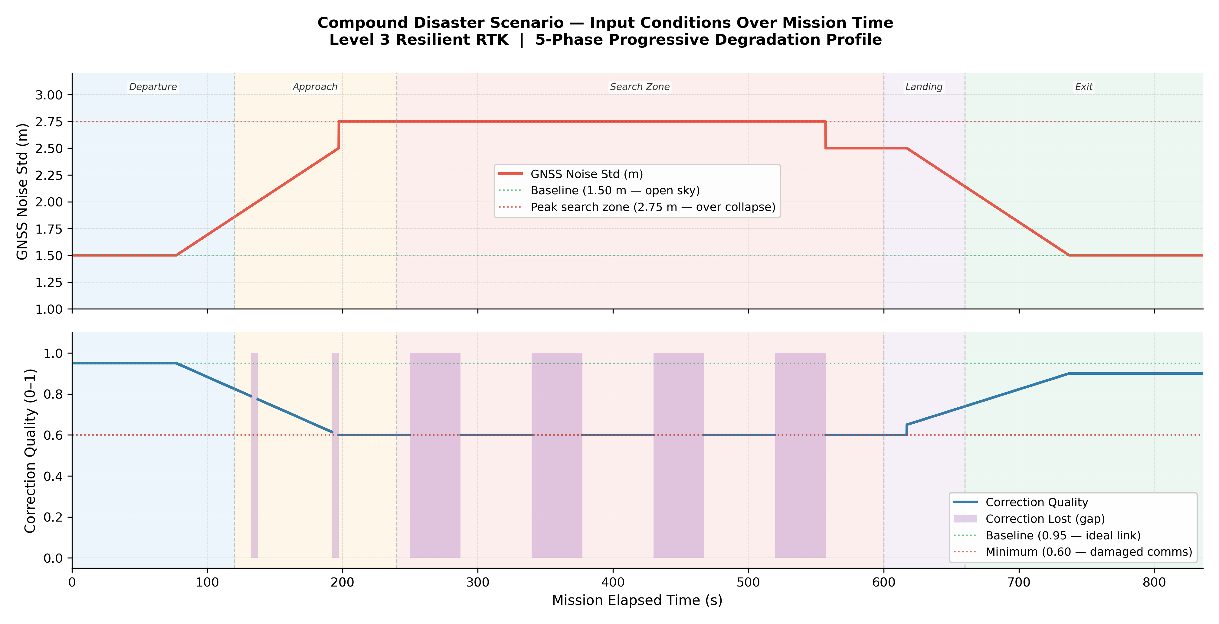
The compound disaster we designed
Three co-occurring degradations: noise 1.5 -> 2.75 m, quality 0.95 -> 0.60, dropouts 37.5 s / 90 s across 5 phases
2 / 4
Notes:
This is the input model, not a result. Real disaster zones don't fail one way at a time, so we degrade noise, correction quality and correction availability together, progressively, across the five mission phases. Peak degradation is the Search Zone over the collapse site: 2.75 m noise, 0.60 quality, and 37.5-second correction dropouts every 90 seconds.

Slide 3
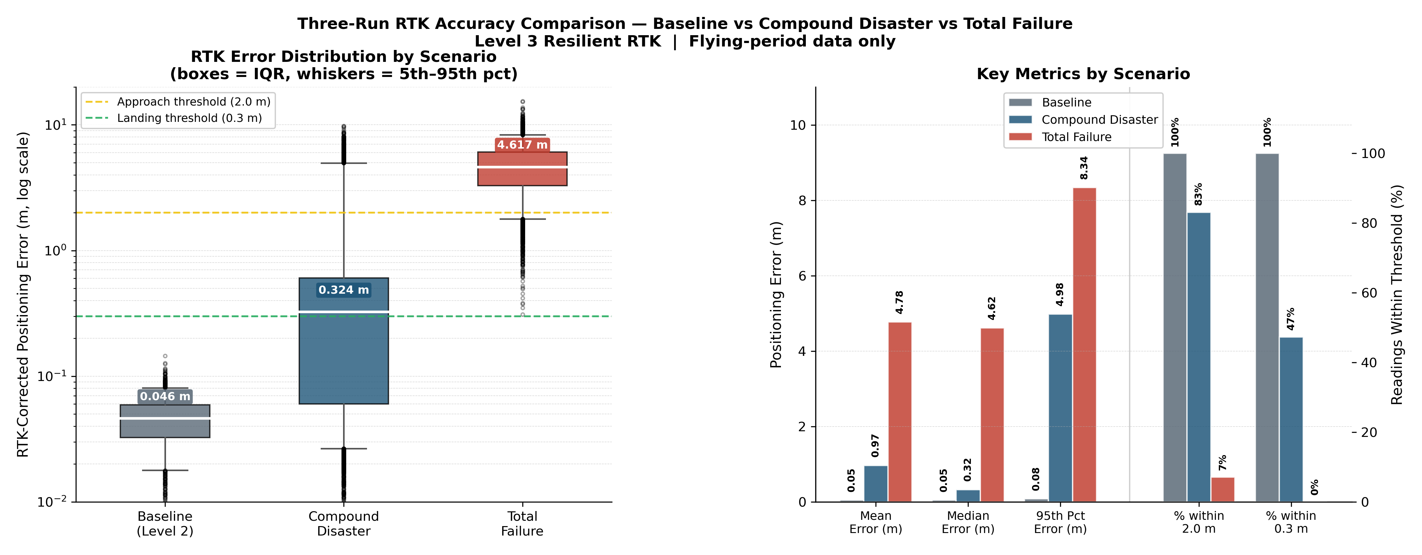
What we confirmed
• Graceful degradation: compound 0.968 m vs total failure 4.776 m (~5x better)
• Approach navigation PASSED — 92.4% within 2.0 m (target 90%)
• Precision landing FELL SHORT — 31.5% within 0.3 m (target 80%)
3 / 4
Notes:
Three runs bracket the result: ideal baseline at 5 cm, total failure at nearly 5 m, and the compound disaster in between at under 1 m — about five times better than having no corrections. We passed the approach target comfortably. The honest finding is precision landing: we hold approach-grade accuracy but only reach the 0.3 m bar 31.5% of the time during the disaster, because we're in RTK Float, not Fixed.

Slide 4
Takeaway & next steps
Confirmed
• RTK degrades gracefully — usable accuracy under sustained degradation
• Approach viable (92.4%) + honest, dynamic uncertainty + correct viability states
• Data proven real — PX4 ULog and analysis CSV agree on the trajectory
Next
• Close the landing gap — RTK Fixed re-lock / re-convergence in the landing phase
• Re-fly both runs with one identical mission for strict comparability
• Phase 3 — validate the noise model against real BeiDou data via RTKLIB
4 / 4
Notes:
To close: three things confirmed — graceful degradation, viable approach navigation with an honest uncertainty signal, and provably real flight data. The single open engineering gap is precision landing, and the next step is a Fixed-lock recovery protocol for the landing phase. Beyond that, Phase 3 grounds the whole noise model in real BeiDou measurements through RTKLIB. Thank you.

