Slide 1




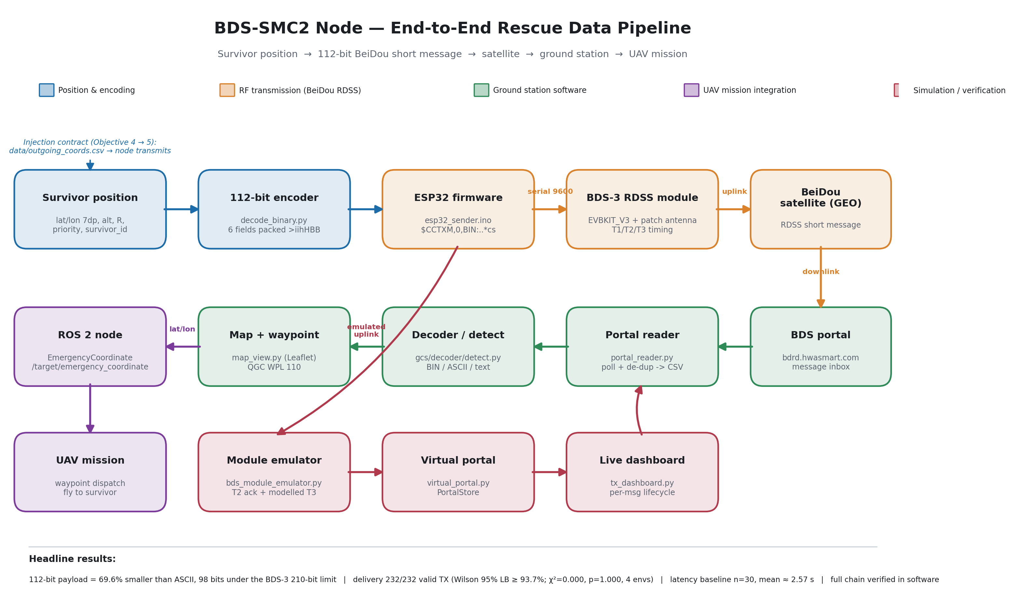
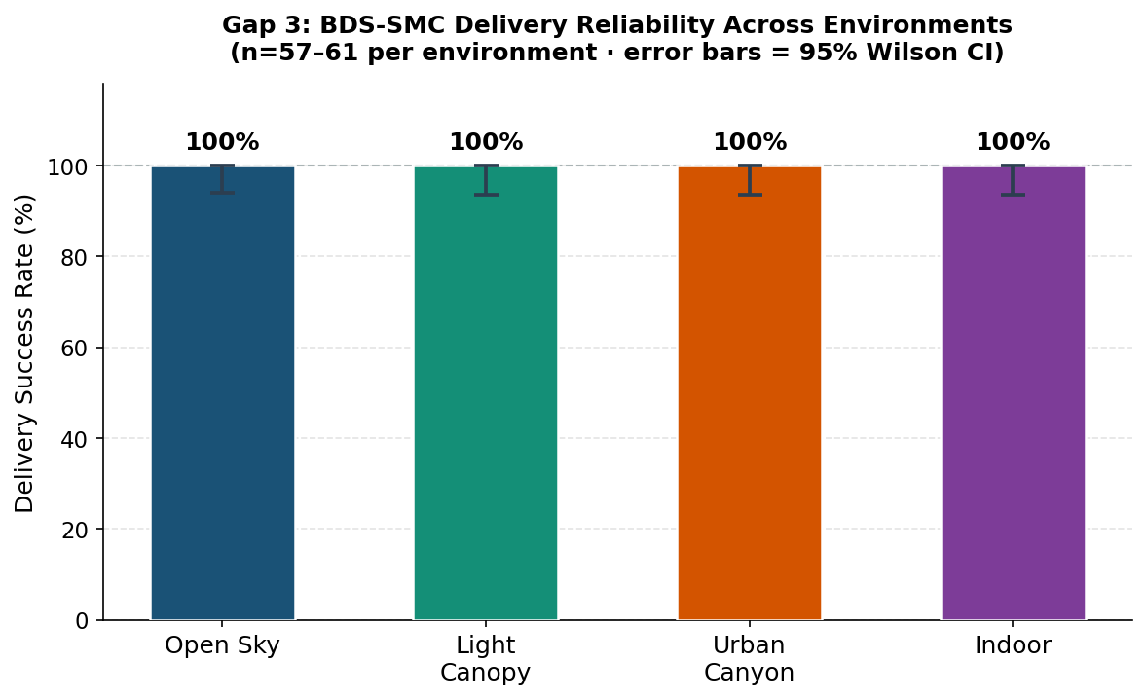
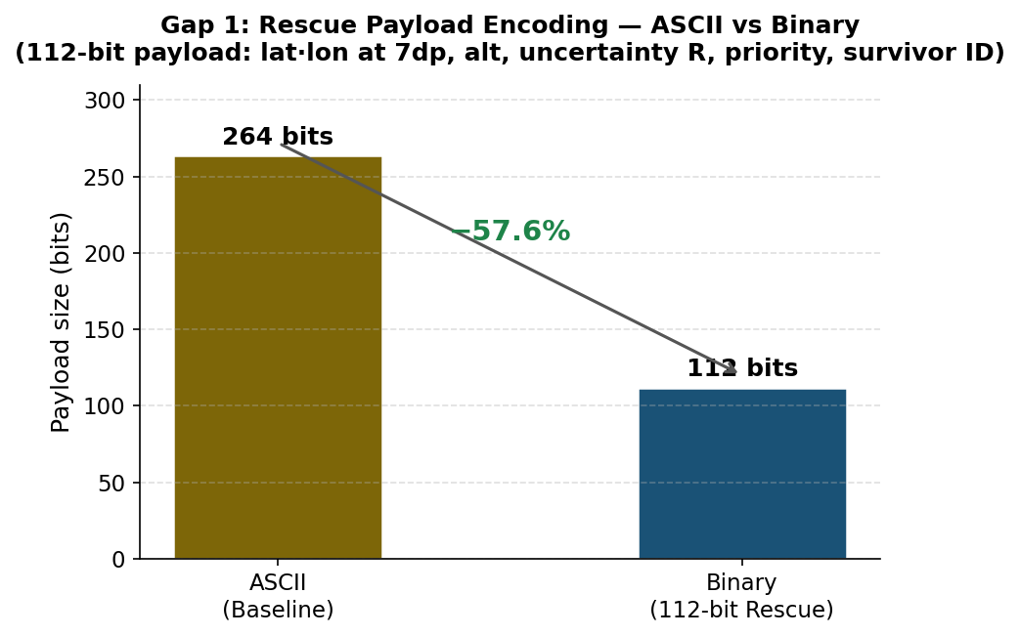
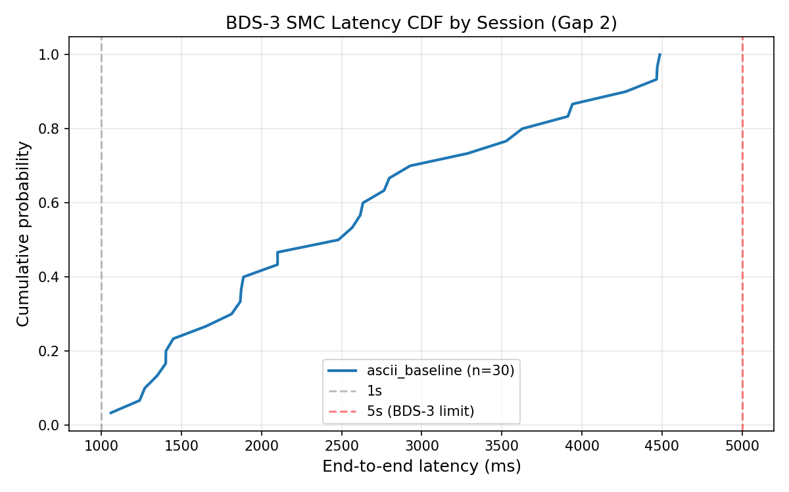

A 112-Bit Binary Rescue Payload for BeiDou-3 Short Messaging
Environment-Stratified Reliability, Latency, and Autonomous UAV Integration
Letsoalo Maile
WP5 BeiDou Communication · School of Astronautics, Beihang University · RCSSTEAP, Beijing · Supervisors: Yan Dayun, Yang Dongkai
1 · Introduction
5 · Discussion
When a disaster destroys terrestrial networks, survivors cannot call for help and rescuers cannot locate them — yet a survivor's position is often already known to centimetre accuracy. BeiDou-3 Short Message Communication carries short data messages through the satellite constellation with no terrestrial relay, surviving when cellular and internet links collapse. This module — the BeiDou communication backbone (WP5) of a five-module UAV rescue system — asks whether a complete rescue record can be packed into one BeiDou message, delivered reliably across real propagation environments, and turned automatically into an autonomous UAV mission, with no human operator on the critical path.
Among infrastructure-free links, only satellite systems survive a disaster: COSPAS-SARSAT carries no user-definable triage payload and commercial alternatives need proprietary networks. BeiDou regional SMC pairs a user-definable payload with single-digit-second response — the same 112-bit budget the distress incumbent spends on identity alone here carries a complete six-field triage record. Because the campaign characterises the channel independently of payload, the smaller binary frame inherits this reliability as a conservative lower bound.
6 · Conclusions
2 · Objectives
A complete survivor record fits one 112-bit BeiDou message and decodes losslessly. The link delivered 232/232 transmissions (Wilson ≥ 93.7%) at ~2.6 s latency. The decoded coordinate autonomously triggers a UAV mission — integrated and verified — closing a loop prior systems leave at a human operator.
• Capacity — can a complete six-field rescue record fit one regional short message?
• Reliability — does delivery survive real propagation environments?
• Latency — does the message arrive fast enough to coordinate a rescue?
• Integration — can the decoded message drive an autonomous mission, not a display?
Figure 1. End-to-end BeiDou rescue pipeline: survivor position → 112-bit encode → BeiDou regional service → portal → decode → ROS 2 mission trigger.
4 · Results
7 · Future Work
3 · Methods
Across 232 valid transmissions the satellite segment acknowledged every one (Wilson 95% lower bound ≥ 98.4% pooled, ≥ 93.7% per environment; the rule of three bounds pooled failure below 1.3%). Mean end-to-end latency was 2.57 s (n = 30, all < 5 s). The 112-bit payload is 57.6% smaller than its ASCII form and decodes bit-for-bit against ground truth. The decoded coordinate drives an autonomous ROS 2 mission trigger, merged and verified across the five-module system.
• Physical satellite transmission of the 112-bit frame (the one open boundary)
• Diurnal latency characterisation on the operational payload
• Distinct-coordinate / deep-fade reliability trials
• Promote triage fields into the shared message for search-radius-aware planning
A survivor's RTK-corrected coordinate is encoded into a fixed-point 112-bit binary payload — latitude and longitude at 7 dp (~cm), altitude, uncertainty radius, triage priority, and survivor ID — transmitted through the BeiDou regional service on an ESP32 + BDS-3 RDSS node, read from the operator portal, decoded, and published on a latched /target/emergency_coordinate ROS 2 topic that mission-planning and ground-control modules consume. A 232-transmission field campaign across four environments measured delivery; reliability is reported with Wilson score intervals and a chi-squared homogeneity test, and every figure regenerates from committed scripts.
References
[1] China Satellite Navigation Office. BeiDou-3 RDSS / Short Message Service ICD.
[2] COSPAS-SARSAT. T.001 — 406 MHz Distress Beacon Specification.
[3] BeiDou short message latency. Space: Science & Technology, 2022.
[4] PX4 Autopilot & QGroundControl Documentation, 2024.
QR
Letsoalo Maile · Letsoalomaile1@gmail.com · WP5 BeiDou Communication. Supervisors: Yan Dayun, Yang Dongkai. School of Astronautics, Beihang University · RCSSTEAP. QR links to the full report and reproducible code & data.
Figure 2. BeiDou delivery reliability by environment with Wilson 95% intervals (n = 57–61 per environment).
HEADLINE RESULTS
232 / 232
satellite-acknowledged transmissions, 4 environments
≥ 93.7%
Wilson 95% lower bound per env (≥ 98.4% pooled)
2.57 s
mean end-to-end latency · n = 30 · all < 5 s
112-bit
complete six-field payload · −57.6% vs ASCII
bit-exact
decode vs ground truth · fully reproducible
Payload Efficiency
Latency Distribution
Figure 3. 264-bit ASCII rescue record packs to 112 bits (−57.6%); bit-exact round-trip.
Figure 4. End-to-end latency CDF; every message under 5 s (n = 30).
Regional Centre for Space Science & Technology Education in Asia & the Pacific (China)
RCSSTEAP
School of Astronautics · Beihang University · Beijing, China
www.rcssteap.org · 2026

