Slide 1




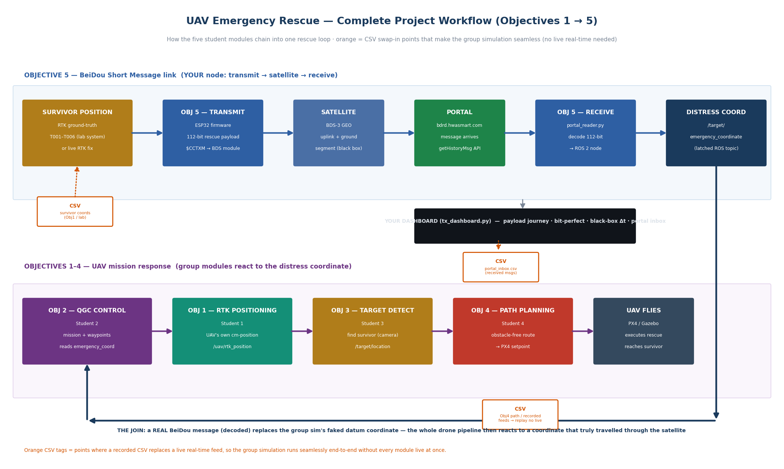
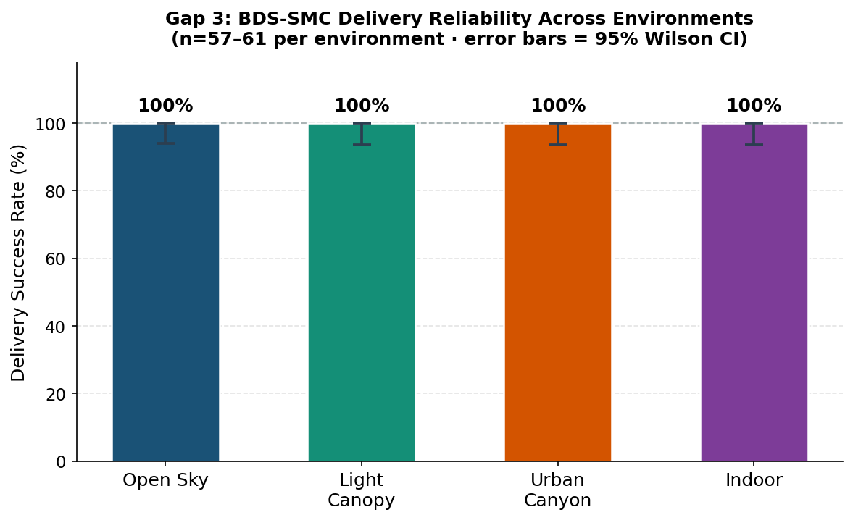

UAV Emergency Rescue System for Disaster Response
Tevin Lemalasia · Letsoalo Maile · Aman Ullah · Afiq Sulistya · Uwase Yvonne
School of Astronautics, Beihang University · RCSSTEAP, Beijing, China
1 · Introduction
5 · Discussion
Earthquakes and floods destroy the terrestrial networks survivors rely on, exactly where rescue demand peaks. In the 72-hour golden window, time is spent locating victims rather than reaching them. BeiDou-3 Short Message Communication (BDS-SMC) sends short data messages through the satellite constellation with no terrestrial relay, surviving when cellular and internet links collapse. This project designs and validates an integrated, simulation-first multi-module UAV system that autonomously locates survivors and carries their precise position over BeiDou into an autonomous rescue mission — closing the loop from satellite message to UAV action with no human operator on the critical path.
Among infrastructure-free links, only satellite systems survive a disaster: COSPAS-SARSAT carries no user-definable triage payload and commercial alternatives need proprietary networks. BeiDou regional SMC pairs a user-definable payload with single-digit-second response — the same 112-bit budget the distress incumbent spends on identity alone here carries a complete six-field triage record. The reliability result characterises the channel independently of payload, so the binary frame inherits it as a conservative lower bound. Physical uplink of the final frame is the one open boundary.
6 · Conclusions
2 · Objectives
A complete survivor record fits one 112-bit BeiDou message and decodes losslessly. The link delivered 232/232 transmissions (Wilson ≥ 93.7%) at ~2.6 s latency. The decoded coordinate autonomously triggers a UAV mission — integrated and verified — a closed loop prior systems leave at a human operator.
• RTK-GNSS positioning to centimetre accuracy as the system position source
• Autonomous UAV mission control via QGroundControl / PX4 (MAVLink)
• YOLO-based survivor detection with precise object positioning
• Obstacle-avoidance path planning for rubble environments
• BeiDou SMC: encode survivor PNT, transmit, decode, inject as a mission trigger
Figure 1. End-to-end rescue chain across the five objectives (O1 RTK → O3 detect → O4 plan → O5 BeiDou → O2 mission).
4 · Results
7 · Future Work
3 · Methods
The decoded coordinate drives an autonomous ROS 2 mission trigger, merged and verified across the five-module system. The BeiDou link delivered all 232 field transmissions across open sky, light canopy, urban canyon and indoor (Wilson 95% lower bound ≥ 98.4% pooled, ≥ 93.7% per environment); mean end-to-end latency was 2.57 s (n = 30, all < 5 s). The 112-bit payload is 57.6% smaller than its ASCII form and decodes bit-for-bit against ground truth. Module targets: RTK < 15 cm, detection ≤ 1 m, collision-free planning, full autonomous waypoint execution.
• Physical satellite transmission of the 112-bit frame
• Diurnal latency characterisation on the operational payload
• Distinct-coordinate / deep-fade reliability trials
• Promote triage fields into the shared message for search-radius-aware planning
• Hardware field deployment beyond simulation
A simulation-first stack (ROS 2 + Gazebo + PX4 SITL + QGroundControl) integrates five work packages. An earthquake Gazebo world models collapsed buildings and blocked roads with all terrestrial networks disabled, leaving BDS-3 short messaging as the only channel. Modules are built independently, then merged via ROS 2 topics. The communication backbone encodes an RTK-corrected coordinate into a fixed-point 112-bit binary payload (lat, lon at 7 dp, altitude, uncertainty radius, triage priority, survivor ID), transmits it through the BeiDou regional service, decodes it at a ground station, and publishes it on a latched /target/emergency_coordinate topic that mission-planning and ground-control modules consume. Delivery reliability and latency are measured in a field campaign and reported with Wilson confidence bounds.
References
[1] China Satellite Navigation Office. BeiDou-3 RDSS / Short Message Service ICD.
[2] COSPAS-SARSAT. T.001 — 406 MHz Distress Beacon Specification.
[3] BeiDou short message latency. Space: Science & Technology, 2022.
[4] PX4 Autopilot & QGroundControl Documentation, 2024.
QR
Corresponding author: Letsoalo Maile · Letsoalomaile1@gmail.com. Supervisors: Yan Dayun · Yang Dongkai. School of Astronautics, Beihang University · RCSSTEAP. QR links to the full report and reproducible code/data.
Figure 2. BeiDou delivery reliability by environment with Wilson 95% intervals (n = 57–61 per environment).
Regional Centre for Space Science & Technology Education in Asia & the Pacific (China)
RCSSTEAP
School of Astronautics · Beihang University · Beijing, China
www.rcssteap.org · 2026

