Slide 1
Introduction to Machine Learning: A Hands-on Workshop for Beginners
Zoë Wilkinson Saldaña, MSI
Arcus Education, DBHi

Slide 2

Hello!
Background: data science, computational social science, academic libraries (Cornell University, University of Michigan)
Research interests: data visualization pedagogy; FOSS; LGBTQIA+ online communities
ALSO: pinball, cats, trains, games
Zoë Wilkinson Saldaña, MSI
Data Instructional Specialist
Arcus Education

Slide 3
Machine Learning with METACHOP
Introduction to Machine Learning *
Machine Learning II / Topics in ML

Slide 4
Machine Learning with METACHOP
Our schedule for today:
Presentation + Colab Setup: 12:10pm – 1pm
Hands-on Notebook for Classification Pipeline: 1pm– 2:30pm
Wrap-up discussion: 2:30pm-2:50pm
Self-guided work, learner questions: Here till 3:30pm

Slide 5
Machine Learning with METACHOP
Reasoning about applying machine learning to research questions
Develop a reusable pipeline for future analysis
Find peers, colleagues, collaborators, co-learners

Slide 6

Turn to your neighbors
What project or problem are you currently working on that you hope to apply machine learning to?
What is the most important thing you hope to learn today?
Icons made by Freepik from www.flaticon.com

Slide 7
Why approach a research question with machine learning?

Slide 8
What is machine learning?

Slide 9
Building models from data
Generalizing from observed data to new, previously unobserved data (e.g. future observations, new datasets in problem domain)
Tunable parameters (how the model “learns”)

Slide 10
Relationship to Statistics
Statistics
model first
inference emphasis
Machine learning
data first
prediction emphasis

Slide 11
Types of machine learning

Slide 12
Types of Machine Learning
Supervised
Unsupervised
Reinforcement

Slide 13
Supervised learning
(xi,yi)∝p(x,y) i.i.d.
xi∈ℝp
yi∈ℝ
f(xi)≈yi

Slide 14
Generalization
Not only f(xi)≈yi
also for new data: f(x)≈y

Slide 15
Examples of Supervised Learning
spam detection
medical diagnosis
ad click prediction

Slide 16
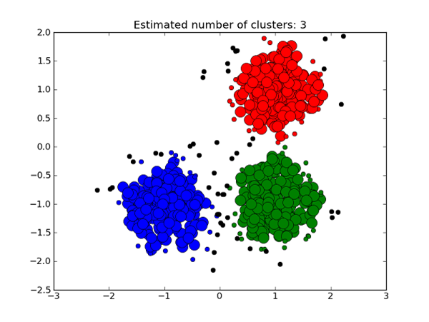
Unsupervised Learning
xi∝p(x) i.i.d.
Learn about p.
https://medium.com/deep-math-machine-learning-ai/different-types-of-machine-learning-and-their-types-34760b9128a2

Slide 17
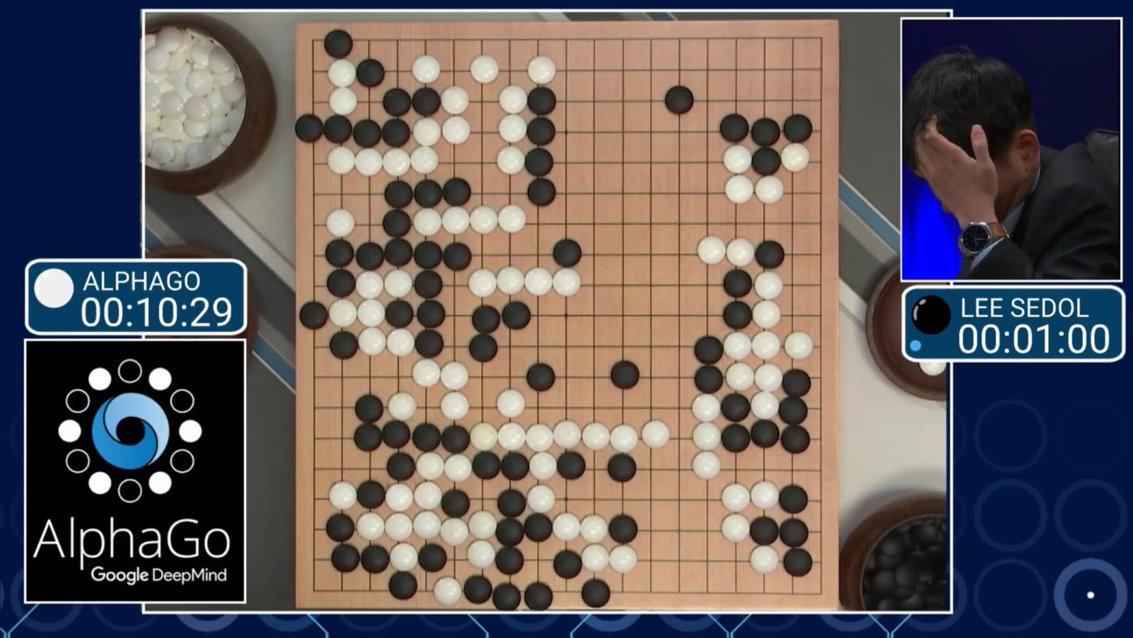
Reinforcement Learning

Slide 18
Explore & Learn

Slide 19
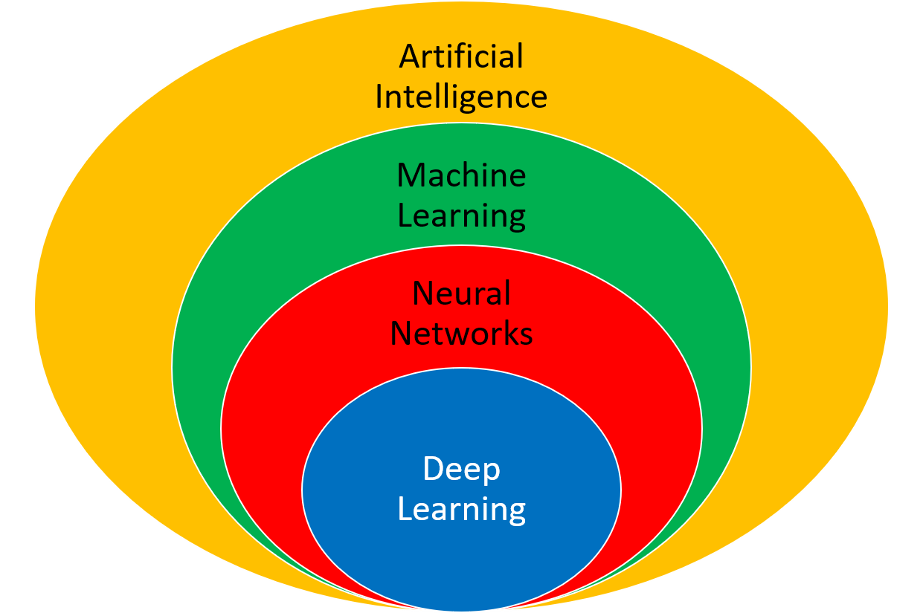
Other kinds of learning
Semi-supervised
Active Learning
Forecasting
…
https://apmonitor.com/do/index.php/Main/DeepLearning

Slide 21
Classification and Regression
Classification
target y discrete
Will you pass?
Regression
target y continuous
How many points will you get in the exam?

Slide 22
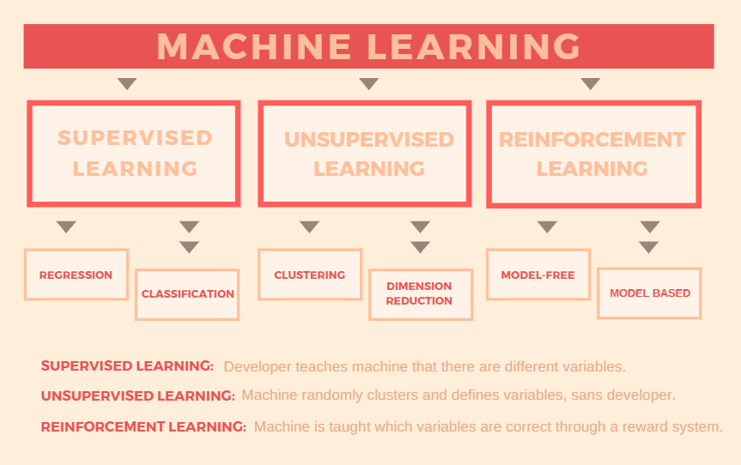

Slide 23
Guiding principles in ML

Slide 24
Goal considerations

Slide 25
The Cost of Complex Systems
Data driven first? yes! (or maybe)
Machine Learning first: No!

Slide 26
Thinking in Context!
What is the baseline?
What is the benefit?

Slide 27
Communicating Results
Explainable results
[Example of classifications]

