Slide 1
Introduction to Machine Learning: A Hands-on Workshop for Beginners
Zoë Wilkinson Saldaña, MSI
Arcus Education, DBHi

Slide 2

Hello!
Background: data science in academic libraries (Cornell University, University of Michigan)
Research interests: critical data science pedagogy; open source collaboration; reproducibility
Zoë Wilkinson Saldaña, MSI
Data Instructional Specialist
Arcus Education

Slide 3
Machine Learning with METACHOP
Introduction to Machine Learning *
Machine Learning II / Topics in ML

Slide 4
Machine Learning with METACHOP
Our schedule for today:
Presentation + Colab Setup: 12:10pm – 1pm
Hands-on Notebooks, Part One and Two: 1pm– 2:30pm
Wrap-up discussion: 2:30pm-2:50pm
Self-guided work, learner questions: Here till 3:30pm

Slide 5
TAKEAWAYS
Critically apply machine learning methods to research questions
Develop + iterate a classification pipeline (using scikit-learn)
Find peers, colleagues, collaborators, co-learners

Slide 6

Turn to your neighbors
What project or problem are you currently working on that you hope to apply machine learning to?
What is the most important thing you hope to learn today?
Icons made by Freepik from www.flaticon.com

Slide 7
Why approach a research question with machine learning?

Slide 8
What is machine learning?

Slide 9
What is machine learning?
Generalizing from observed data to new, previously unobserved data (e.g. future observations, new datasets in problem domain)
Focused on “prediction” tasks such as assigning a label or value

Slide 10
Relationship to Statistics
Statistics
model first
inference emphasis
Machine learning
data first
prediction emphasis

Slide 11
Types of machine learning

Slide 12
Types of Machine Learning
Supervised
Unsupervised
Reinforcement

Slide 13
Supervised learning
Map an input to an output
Predicting a label (benign/malignant) or continuous value (9 hours)
Relies on previously labeled pairs of input and output values, or labeled training data
(x_{i},yi)∝p(x,y) i.i.d.
x_{i}∈ℝ^{p}
y_{i}∈ℝ
f(x_{i})≈y_{i}

Slide 14
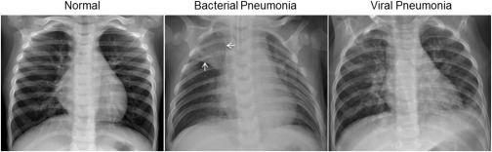
Examples of Supervised Learning
spam detection
medical diagnosis
ad click prediction
Assigning class (normal/bacterial pneumonia/viral pneumonia) to chest X-rays

Slide 15
Generalization
Not only f(xi)≈yi
also for new data: f(x)≈y

Slide 16
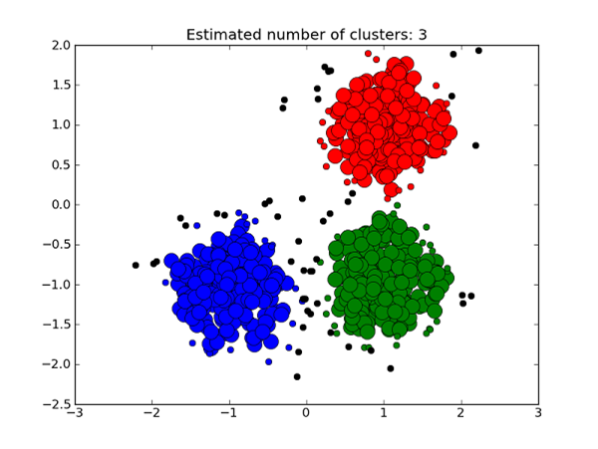
Unsupervised Learning
Assign labels to data
Training data does not include labels; system must identify itself, or based on a simple parameter (e.g. number of clusters)
x_{i}∝p(x) i.i.d.
Learn about p.
https://medium.com/deep-math-machine-learning-ai/different-types-of-machine-learning-and-their-types-34760b9128a2

Slide 17
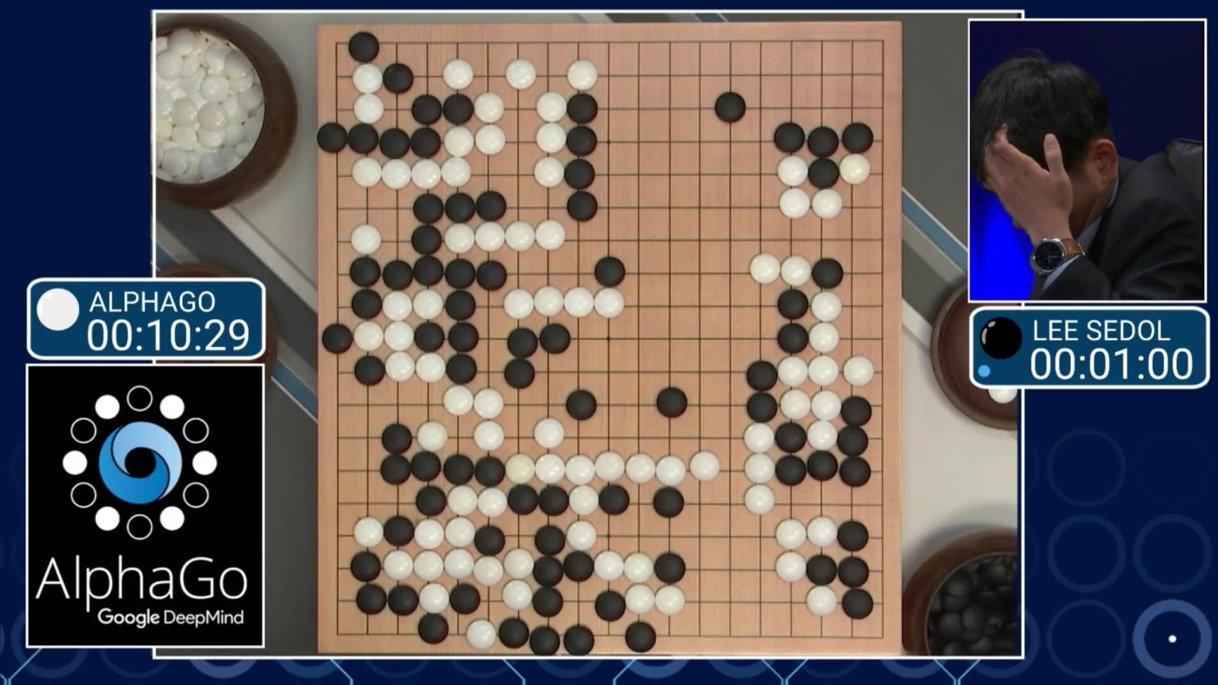
Reinforcement Learning

Slide 18
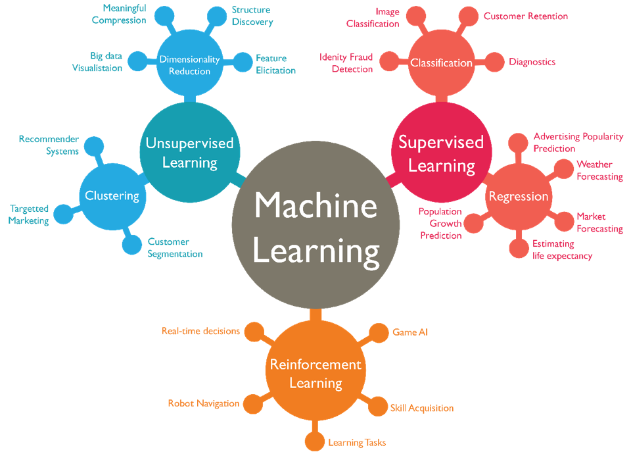

Slide 19
Turn to your neighbors
As a table, come up with one example each of a problem that could be solved with:
Supervised learning
Unsupervised learning
Reinforcement learning
What data would you need
Icons made by Freepik from www.flaticon.com

Slide 20
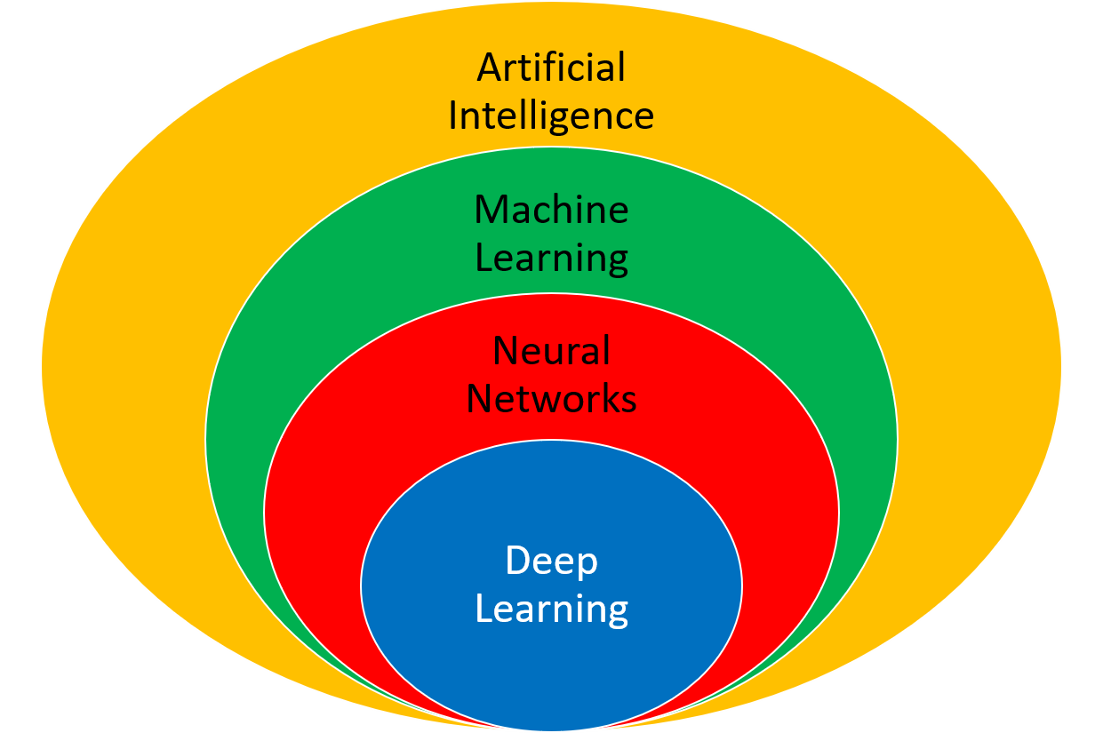
Other kinds of learning
Semi-supervised
Active Learning
Forecasting
…
https://apmonitor.com/do/index.php/Main/DeepLearning

Slide 22
Classification and Regression
Classification
target y discrete
Will you pass?
Regression
target y continuous
How many points will you get in the exam?

Slide 23
Guiding principles in ML

Slide 24
Goal considerations

Slide 25
The Cost of Complex Systems
Data driven first? yes! (or maybe)
Machine Learning first: No!

Slide 26
Thinking in Context!
What is the baseline?
What is the benefit?

Slide 27
Communicating Results
Explainable results
[Example of classifications]

