Slide 1
Analyzing Passenger Satisfaction: A Data-Driven Approach to Airline Reviews
Google Data Analytics Capstone: Complete a Case Study
By Patrick James Pangilinan

Slide 2
Ask
Prepare
Process
Analyze
Share
Act
Notes:
This presentation is divided into six parts.
The first will be covering the Ask process, where the business questions are asked.
Next, we will talk about the Prepare process, this is where the dataset and the tools used are introduced.
Afterwards, we move onto the Process phase, this is the part where the dataset is cleaned and the features are standardized
Next, we delve into the Analyze phase, where we explore the dataset using statistical methods and visualizations to uncover patterns and insights.
After that, we will discuss the Share phase, where findings are communicated through visualizations, charts, and dashboards to make the insights clear and actionable.
Lastly, we conclude with the Act phase, where conclusions and recommendations are made based on the findings.

Slide 3
ASK
What factors (Seat Comfort, Staff Service, Food & Beverages, etc.) have the most significant impact on the overall rating of the passenger?
Do ratings vary significantly between people flying for leisure (solo, couple, or with family) and those flying for business?
Are there differences in satisfaction between airlines? Which airlines are rated highest or lowest
Notes:
"The customer is always right, in matters of taste." Within the aviation industry, the satisfaction of the passengers plays big role in shaping the reputation of an airline. This case study looks at these reviews to find patterns in what passenger’s value most and how airlines can improve their services. Specifically, this case study hopes to answer the following questions:

Slide 4
PREPARE
Title: Airlines Review Dataset
Source: Kaggle
Author: Elijah Alabi
Airlines Covered:
Singapore Airlines, Qatar Airways, ANA, Emirates, Japan Airlines
Turkish Airlines, Air France, Cathay Pacific, EVA Air, Korean Air

Slide 5
PREPARE
Dataset Size:
Rows: 8,100 reviews
Columns: 17 (Numerical and Categorical Data)
General Information:
Title, Name, Review Date, Airline, Verified, Reviews, Recommended
Travel Details:
Type of Traveller, Month Flown, Route, Class
Ratings:
Seat Comfort, Staff Service, Food & Beverages, Inflight Entertainment, Value For Money, Overall Rating

Slide 6
PROCESS
df = df[df['Verified'] == "True"]
df = df.drop(["Title", "Name", "Review Date", "Verified", "Reviews", "Route", "Class", "Recommended"], axis=1)
df = df[~df['Airline'].isin(['All Nippon Airways', 'Japan Airlines', 'Korean Air', 'EVA Air'])]
df['Overall Rating'] = MinMaxScaler(feature_range=(1, 5)).fit_transform(df[['Overall Rating']])
Notes:
To ensure the reliability of our analysis, we started by including only the reviews that were marked as "Verified." This step ensures that the feedback comes from genuine passengers and reduces noise in the dataset.
Next, we removed columns that were not essential to our analysis, such as Title, Name, and Review Date. This helps streamline the dataset and focus only on factors directly related to customer satisfaction and service quality.
To maintain consistency and avoid bias, we excluded airlines with less than 500 reviews, such as All Nippon Airways and Japan Airlines. This ensures that our analysis is based on a significant sample size for each airline.
The Overall Rating column was originally on a scale of 1-10, while other ratings were on a scale of 1-5. We used MinMaxScaler to rescale the Overall Rating to match the 1-5 range, making it easier to compare across factors.
Finally, we checked for missing values to ensure data completeness. Fortunately, there were no null values in the dataset, so no further imputation was necessary.

Slide 7
ANALYZE
What factors (Seat Comfort, Staff Service, Food & Beverages, etc.) have the most significant impact on the overall rating of the passenger?
Value for Money has the strongest correlation with the overall rating (0.89).
Staff Service also shows a moderate positive correlation (0.21).
Other factors, including Seat Comfort, Food & Beverages, and Inflight Entertainment, have weaker correlations with the overall rating (0.19, 0.16, and 0.15 respectively).
This suggests that "Value for Money" significantly influences the overall rating compared to other factors.

Slide 8
ANALYZE
Do ratings vary significantly between people flying for leisure (solo, couple, or with family) and those flying for business?
Solo Leisure travelers gave the highest average rating (3.13), indicating greater satisfaction.
Couple Leisure and Business travelers provided similar, moderately high ratings (2.92 and 2.87, respectively).
Family Leisure travelers gave the lowest average rating (2.65), showing the least satisfaction.

Slide 9
ANALYZE
Are there differences in satisfaction between airlines? Which airlines are rated highest or lowest?
F-statistic: 187.69, indicating substantial group differences.
P-value: < 0.05, leading to the rejection of the null hypothesis.
Conclusion: Significant differences exist in overall ratings among airlines.
Qatar Airways: Highest-rated airline with a high median and low variance in ratings.
Turkish Airlines: Lowest-rated airline with a low median and moderate variance.

Slide 10
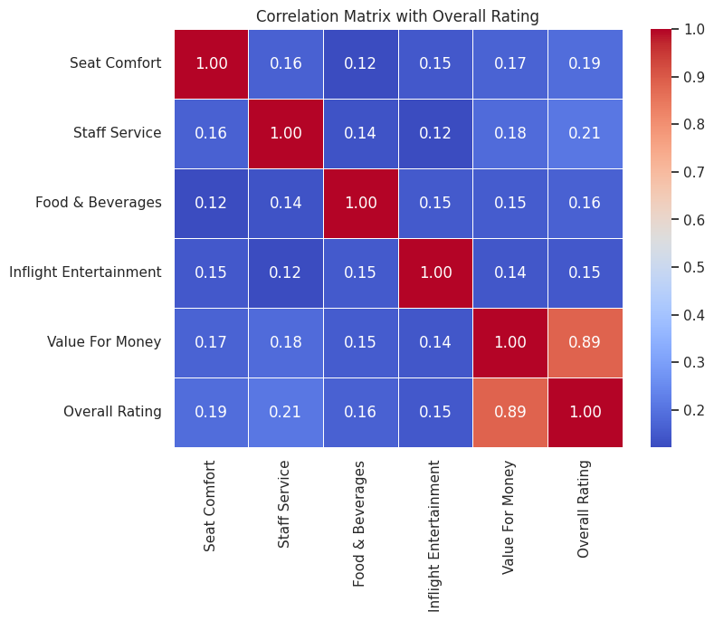
SHARE

Slide 11
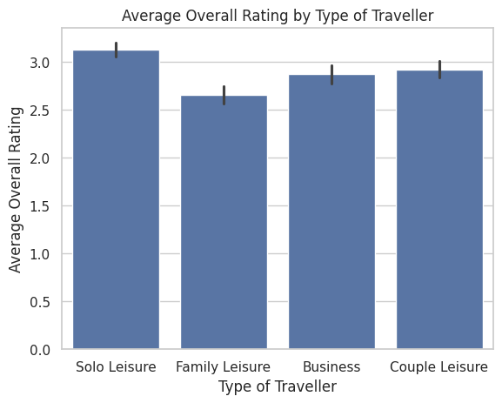
SHARE

Slide 12
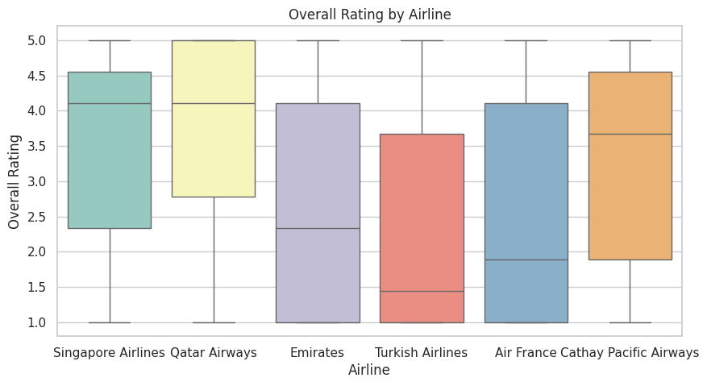
SHARE

Slide 13
ACT
Key Insights
"Value for Money" has the strongest correlation with Overall Ratings (0.89).
Staff Service shows a moderate correlation (0.21), while other factors have weaker impacts.
Solo Leisure travelers are most satisfied (avg. rating: 3.13); Family Leisure travelers are least satisfied (2.65).
Qatar Airways: High median, low variance → Top-rated airline.
Turkish Airlines: Low median, moderate variance → Needs improvement.

Slide 14
ACT
Recommendations
Focus on better "Value for Money" through pricing and package deals.
Enhance family-friendly services to boost satisfaction for Family Leisure travelers.
Improve inflight comfort and amenities for a better passenger experience.
Maintain Qatar Airways' high standards; address issues for Turkish Airlines.

Slide 15
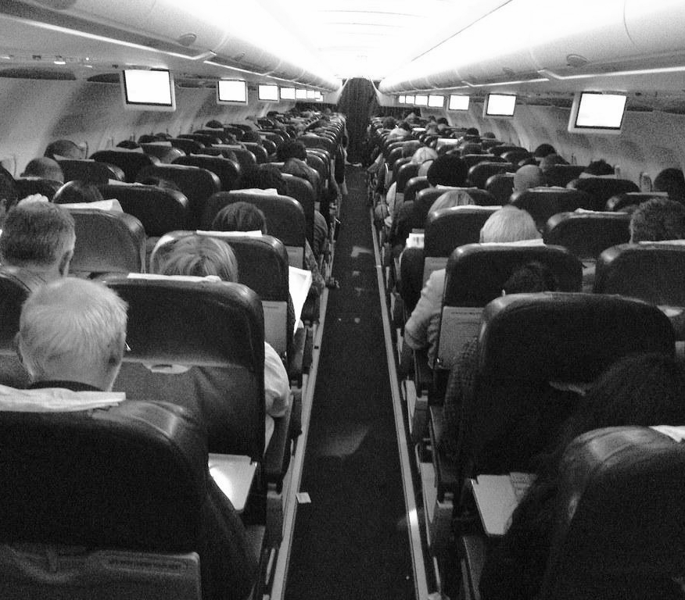
Thanks
For
Listening!

