Slide 1

AI Security Red Team Assessment
Subtitle: CIFAR-10 Classifier Security Analysis
Presented by: TEWDROS TILAHUN
September 2026

Slide 2

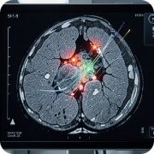
Why AI Red Teaming Matters
AI Security Gap
Real-World Stakes
Traditional cybersecurity focuses on networks and credentials
AI introduces novel attack surfaces
Autonomous vehicles: Misclassified stop signs → accidents
Financial fraud: Manipulated credit scoring → fraudulent approvals
Medical imaging: Adversarial scans → wrong diagnoses
model manipulation
adversarial inputs, and behavioral exploitation that bypass conventional controls.

Slide 3
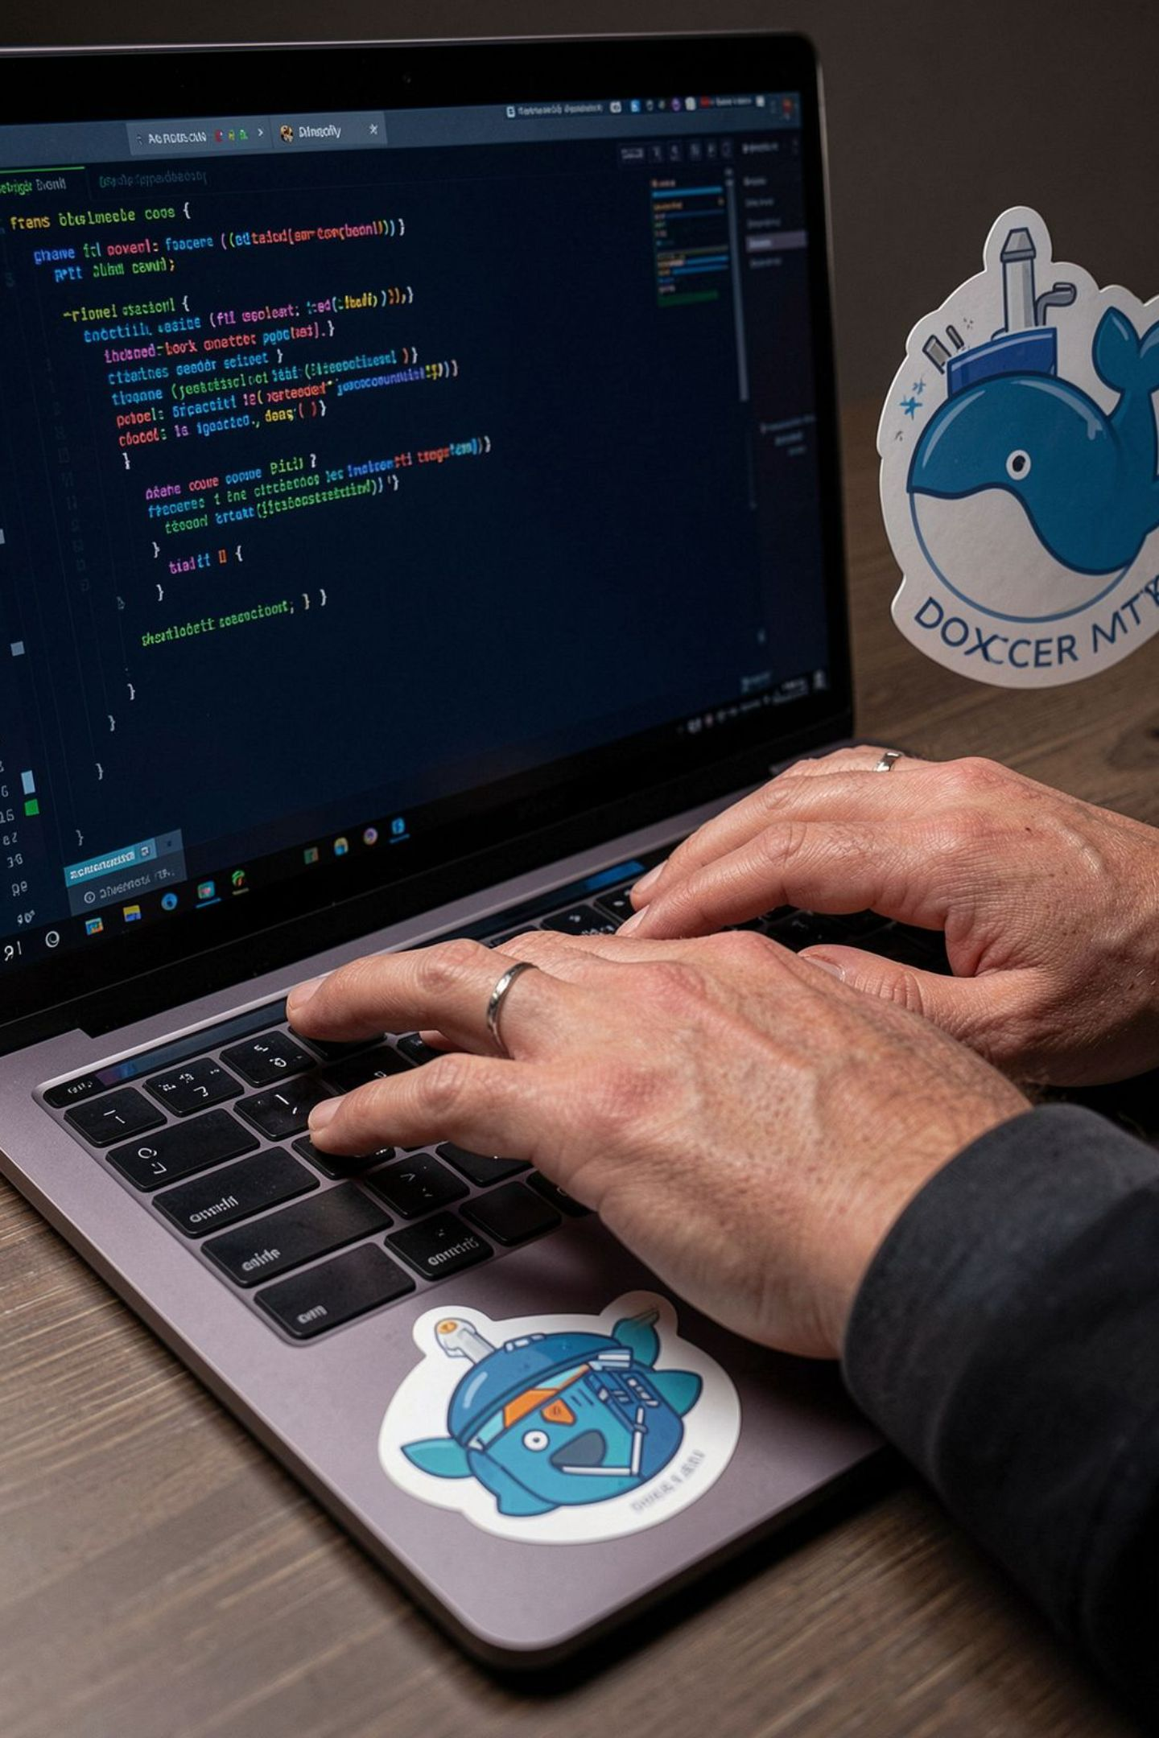
What Is AI Red Teaming?
Proactive adversarial testing that simulates real attackers to find
vulnerabilities before attackers do
Model Robustness
Pipeline Security
Assess if adversarial inputs can reliably change model outputs under realistic constraints.
Test containerization, API endpoints, authentication, and logging for exposure paths and attack amplification.
Data Protection
Evaluate risks of model extraction, data leakage, and theft of training artifacts or IP.

Slide 4
Assessment Scope
Target System
Attack Vectors Tested
PyTorch CNN classifier trained on CIFAR-10 (10 categories)
Local training & deployment via Docker + FastAPI
Baseline clean-image accuracy: 80.25%
White-box adversarial examples (FGSM, PGD)
Black-box query attacks (Square Attack)
Model extraction & transfer attacks
Infrastructure & API security review
Methodology
MITRE ATLAS taxonomy + NIST adversarial ML guidance; testing performed in a controlled, ethical local environment.

Slide 5

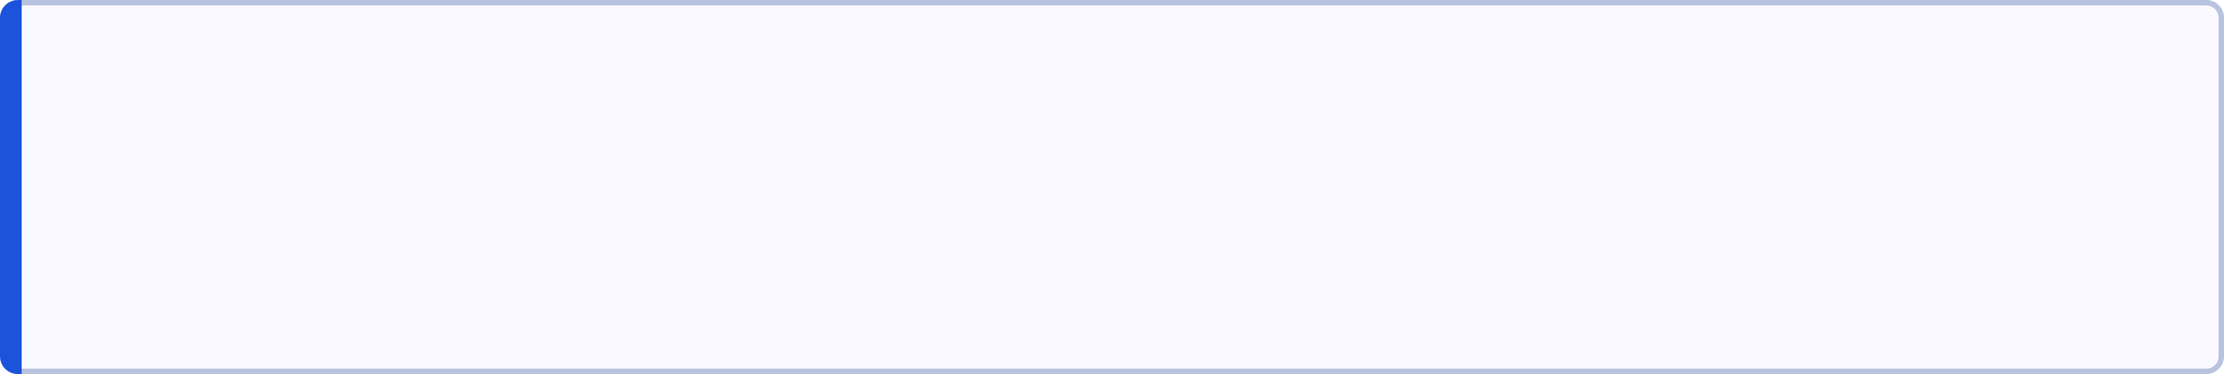
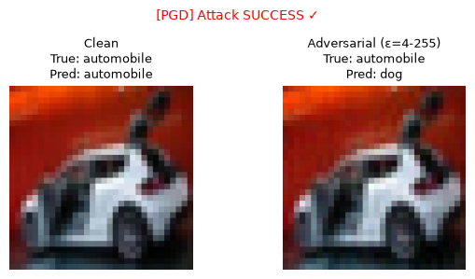
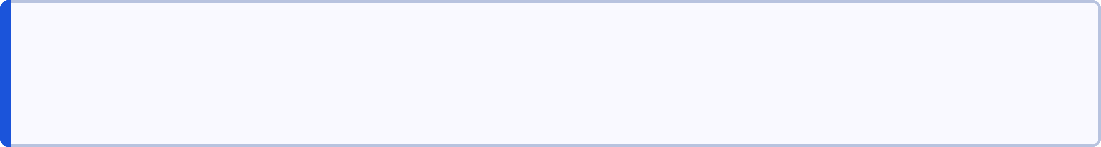
Understanding Adversarial Examples
Adversarial examples are inputs that appear unchanged to humans but exploit model decision boundaries to produce incorrect outputs. Perturbations are typically tiny (e.g., ≤ epsilon = 8/255).
Models optimize for average-case accuracy on clean data and remain sensitive to high-dimensional perturbations.
Small pixel shifts (<3%) can reduce accuracy drastically; robust models should retain >40% at ε=8/255.
High-dimensional spaces have many "shortcuts" models exploit

Slide 6
The Spectrum of Threats
Attackers range from low-effort API abusers to sophisticated insiders with model access. Even low-sophistication attackers achieved high success in our tests.
Attacker Type | Access Required | Observed Result
White-box | Model weights + gradients | PGD — 100% success
Black-box | API query access | Square Attack — 87% success
Transfer / Extraction | Surrogate model from queries | Model extraction → 80% transfer success

Slide 7

Why Traditional Defenses Fail
Firewalls and encryption don't block adversarial inputs — they are valid, correctly formatted requests.
Input validation checks file type and size but cannot detect semantic manipulations that exploit learned features.
Access controls may limit who can send requests but not whether those requests are adversarial.
Mitigation requires AI-aware controls: adversarial training, query-rate limiting, output noise/obfuscation, and active monitoring of model behavior.

Slide 8

Attack 1 — FGSM (White-box Baseline)
Fast Gradient Sign Method: single-step gradient-based perturbation used as a fast baseline attack.
Execution
Results (ε=8/255)
Takeaway
Applied to 200 images — runtime: 28 seconds.
Attack success: 91.62% — model accuracy fell from 83.5% to 8.4%; all classes impacted.
Even a single-step attack reliably degrades model performance — indicates shallow robustness.

Slide 9
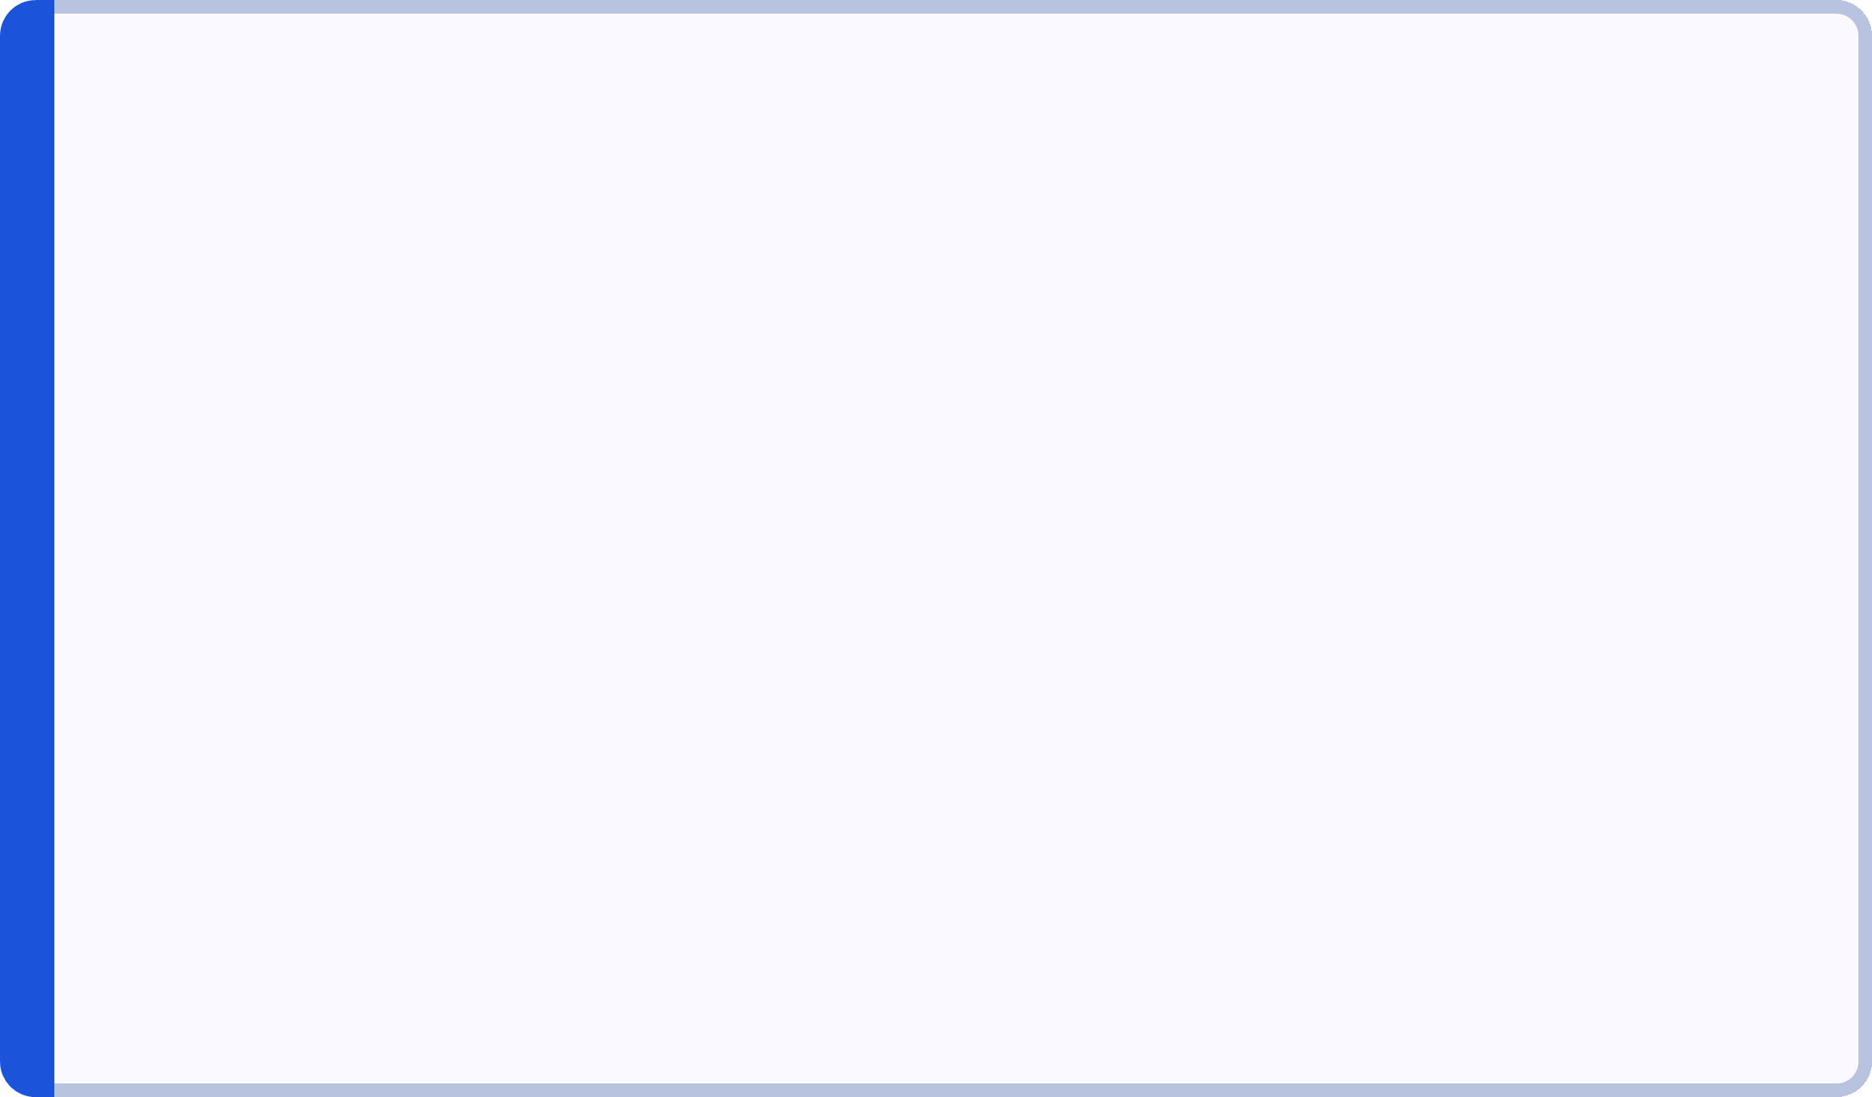
Attack 2 — PGD (White-box Advanced)
Projected Gradient Descent: iterative, multi-step method with random starts — the de facto robustness benchmark.
Parameters
Results
Implication
20 iterations, random restarts, ε=8/255.
Attack success: 100.00% — model accuracy collapsed to 0.00% (all 167 previously-correct images misclassified).
The model exhibits an absolute vulnerability ceiling — adversarial training or architectural changes required to shift it.

Slide 10

Attack 3 - Square Attack (Black-box)
87% success with only API access—no model knowledge required
Method:
Query-based optimization
No gradients needed (API queries only)
Random square perturbations
Adaptive search strategy
Query Budget Analysis:
Budget | Success Rate | Median Queries | Time
50 | 42.77% | 7 | 58s
200 | 68.67% | 14 | 148s
500 | 86.75% | 31 | 271s
Key Finding: attacks used 46,572 queries with out rate limiting and Most successful attacks need only 31 queries (median)

Slide 11
Attack 4 - Model Extraction & transfer attacks
10,000 queries replicate 80% of model behavior—enables transfer attacks
Victim parameters: 1,342,122
Surrogate parameters: 620,810
It has 4steps
1
2
3
4
Query API 10,000 times
Train surrogate on victim's predictions
Test agreement
Adversarial transfer
Results:
80.3%
95
Agreement rate
Queries/second
(surrogate mimics victim)
(no throttling)
80.12%
8.8
Transfer success
Total time (minutes)
(adversarials crafted on surrogate fool victim)
Impact:
Intellectual property stolen
Attacker gains gradient access (white-box capability from black-box starting point)

Slide 12
Attack Success Comparison
Black-box attacks rival white-box effectiveness But they are more practical
Success Rate Summary:
Attack | Access Level | Success Rate | Severity
PGD (white-box) | Model weights + gradients | 100% | CRITICAL
FGSM (white-box) | Model weights + gradients | 92% | CRITICAL
Square (black-box) | API queries only | 87% | CRITICAL
Extraction+Transfer (black-box) | API queries only | 80% | CRITICAL
Key Insight: Gap between white-box (100%) and black-box (80-87%) is narrow
Black-box attacks are practical, not theoretical
API access is sufficient for high-success attacks
Threat Realism Ranking:
Model extraction (most realistic: API-only, 10-min setup)
Square Attack (highly realistic: query-based, no model access)
PGD (moderate: requires stolen weights or insider)
FGSM (baseline: simplest attack, high success)

Slide 13
Root Cause Analysis
Model has zero adversarial robustness by design—not trained to resist attacks
Why Is The Model Vulnerable?
1. No Adversarial Training
2. No Input Validation
Trained only on clean data
Never exposed to adversarial examples
Decision boundaries optimized for accuracy, not robustness
API accepts all valid images
No adversarial detection
No anomaly scoring
3. Overconfident Predictions
2. Smooth Decision Boundaries
Trained High confidence without calibration makes the model overconfident and brittle
Small perturbations cause drastic confidence shifts
Neural networks are differentiable everywhere
Gradients point directly toward misclassification
Smooth boundaries make gradient-based attacks effective (FGSM,PDG)

Slide 14
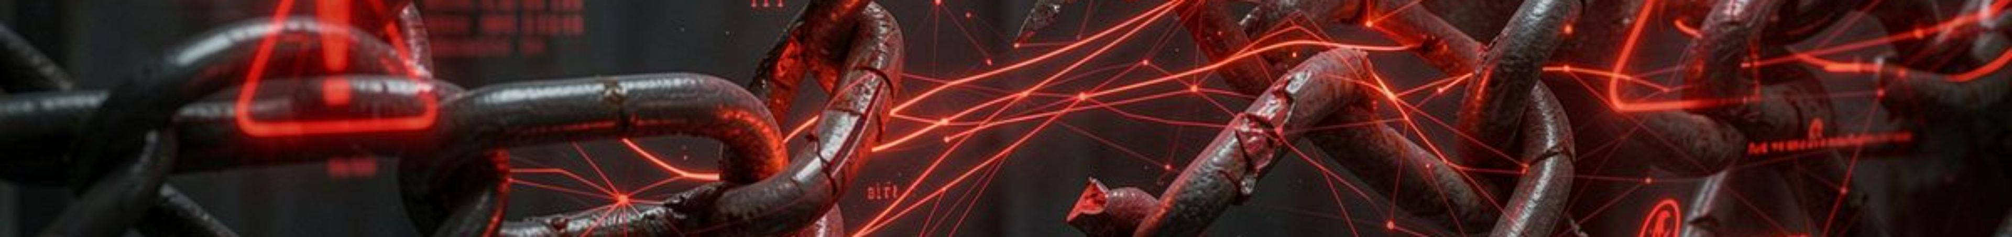
Infrastructure & API Weaknesses
Pipeline security gaps amplify model vulnerabilities
Critical Findings:
ID | Vulnerability | Impact | Severity
V-01 | No authentication | Anyone can query model | CRITICAL
V-02 | Full probability exposure | Enables extraction & Square Attack | CRITICAL
V-03 | Verbose metadata endpoint | Leaks architecture details | HIGH
V-04 | No rate limiting | Unlimited queries allowed | CRITICAL
V-05 | No logging/monitoring | Attacks go undetected | MEDIUM
V-06 | Container weaknesses | Root user, model in image | MEDIUM
Attack Enablers:
Model extraction: Needs api queries + full probabilities ✓
Square Attack: Needs full probabilities for optimization ✓
All attacks: Proceed undetected (no logging) ✓

Slide 15
Mitigations
Layered defense addresses both model and pipeline weaknesses
Mitigation Strategy:
M-01: API Authentication
M-02: Minimize Response Data
M-04: Rate Limiting
M-03: Remove Metadata Endpoint
M-05: Comprehensive Logging
M-06: Container Hardening
M-07: Adversarial Training

Slide 16


