Slide 1
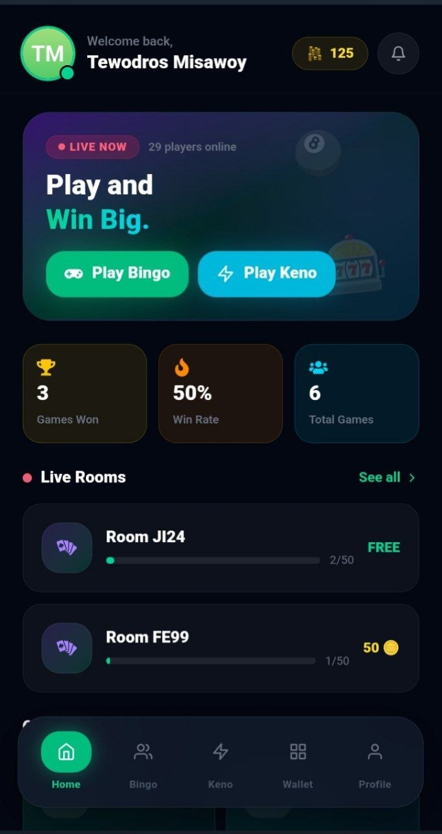
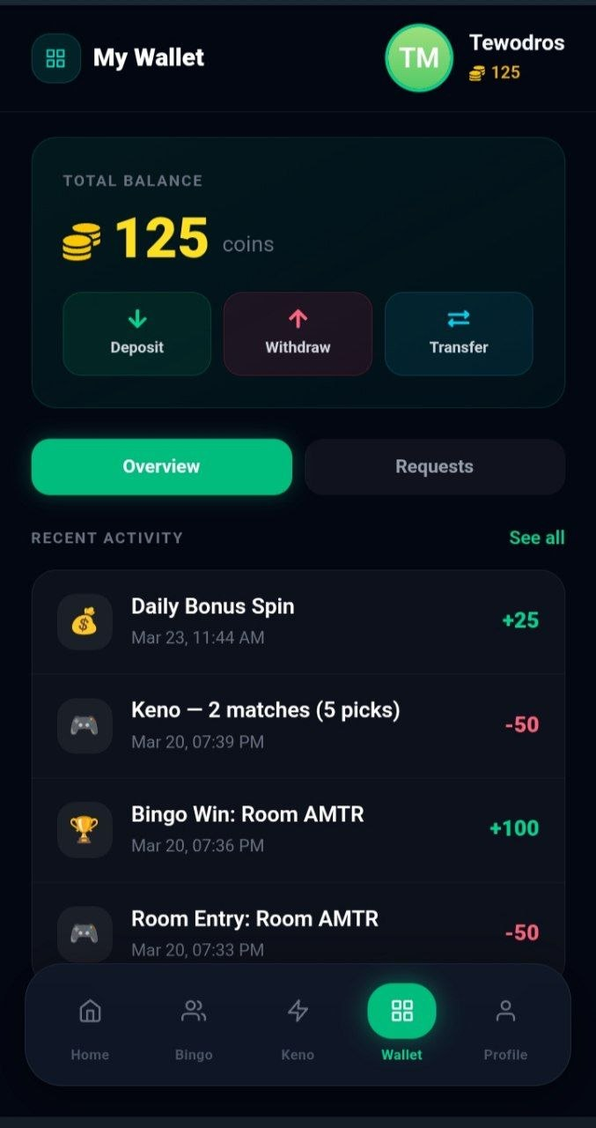
Bingo Game
Investor Pitch Deck: Telegram Integration
Instant social gaming inside Telegram.
Real-time multiplayer bingo and keno in a Telegram Mini App with an integrated wallet.
Telegram Mini App
Wallet-ready gameplay
Raising Seed

Slide 2
The Problem
Friction Kills Conversion Before the First Match
App installs
Massive drop-off
Sign-ups
Slow onboarding
Payments
Confusing setup
Every extra step increases CAC and lowers retention.
Speed to first play wins.

Slide 3
The Solution
Real-time bingo and keno
Instant wallet payouts
No download
No separate account setup
Open chat
Launch Mini App
Tap
Instant-play gaming inside Telegram.
Play -> Compete -> Win

Slide 4
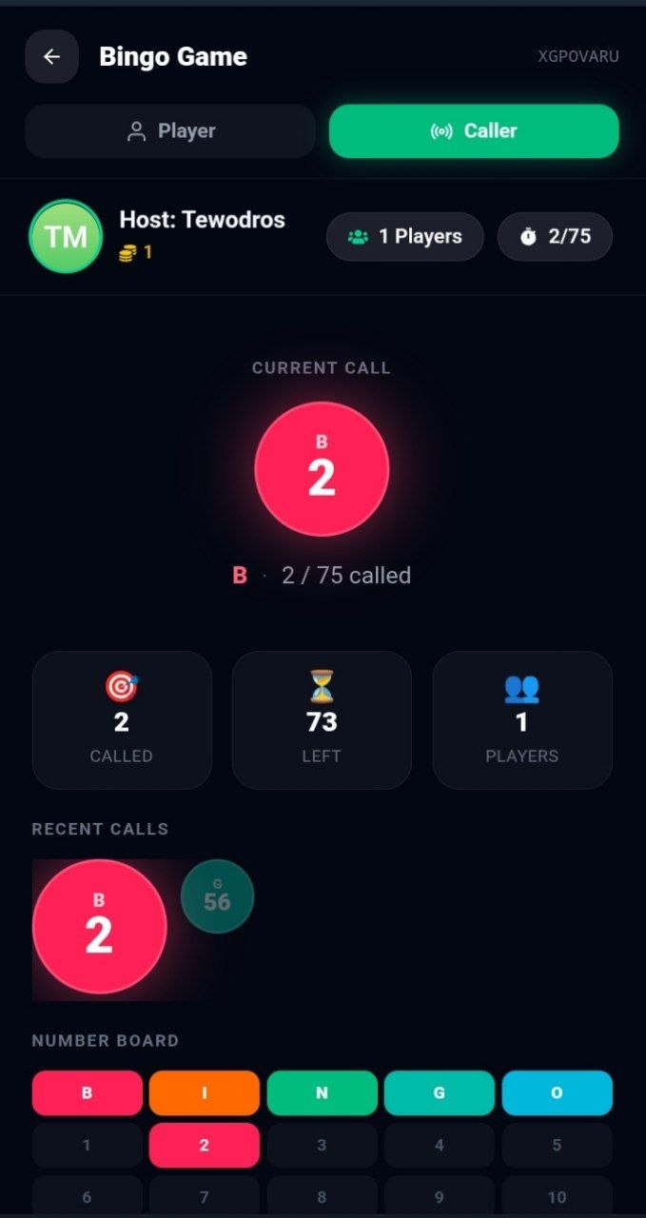
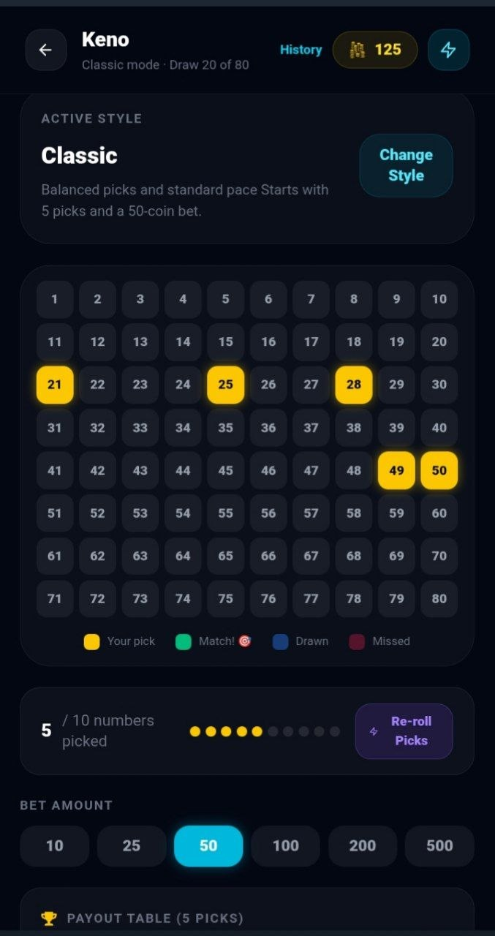
Product Overview
Real-Time Multiplayer Interface Built for Social Play
Join live bingo and keno rooms
Track gameplay, rooms, and payouts live
Play short, repeatable sessions
Re-enter through chat and invites
Built for mobile-first users who already play, share, and pay.
Built for Telegram-native play

Slide 5
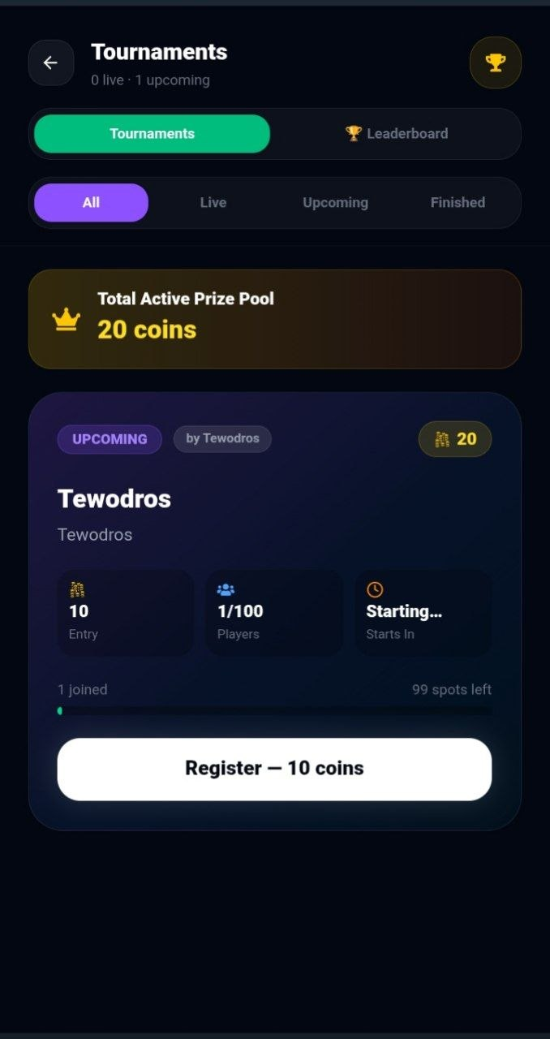
Key Features
Live multiplayer
Real-time urgency and retention
Tournaments
Higher spend per user
In-app wallet
Simple deposits, balances, and payouts
Social invites
Viral growth loops
Each feature improves acquisition, retention, or monetization.
Bingo Game

Slide 6
Target Audience
Telegram power users
Discover, share, and transact
Casual gamers
Fast, repeatable fun
Social gaming communities
Mobile-first spenders
Targets: CAC < $1.50, D1 > 35%, D7 > 15%, payer conversion > 6%, wallet attach > 40%.
Bingo Game

Slide 7
Market Opportunity
• TAM: $180B+ global mobile gaming
• SAM: 90M+ Telegram users in launch geos
• SOM: 1.5M reachable players in year 1
Focus markets: Ethiopia, Nigeria, Kenya, South Africa, India, and Brazil where chat, mobile pay, and casual gaming overlap.
TAM
SAM
SOM
Why now: Mini Apps convert Telegram community traffic into first paid play in under 60 seconds.
We start with high-engagement communities, then expand into adjacent geos and new game modes.

Slide 8
Business Model
$1-$3 entry fees + 10%-15% rake
$0.50-$2 boosts and extra cards
3%-5% net wallet spread on top-ups
$4.99 VIP pass for power players
Example: 1,000 paying users x 8 entries/month x $0.30 take = $2.4k net before upsells.
Bingo Game

Slide 9
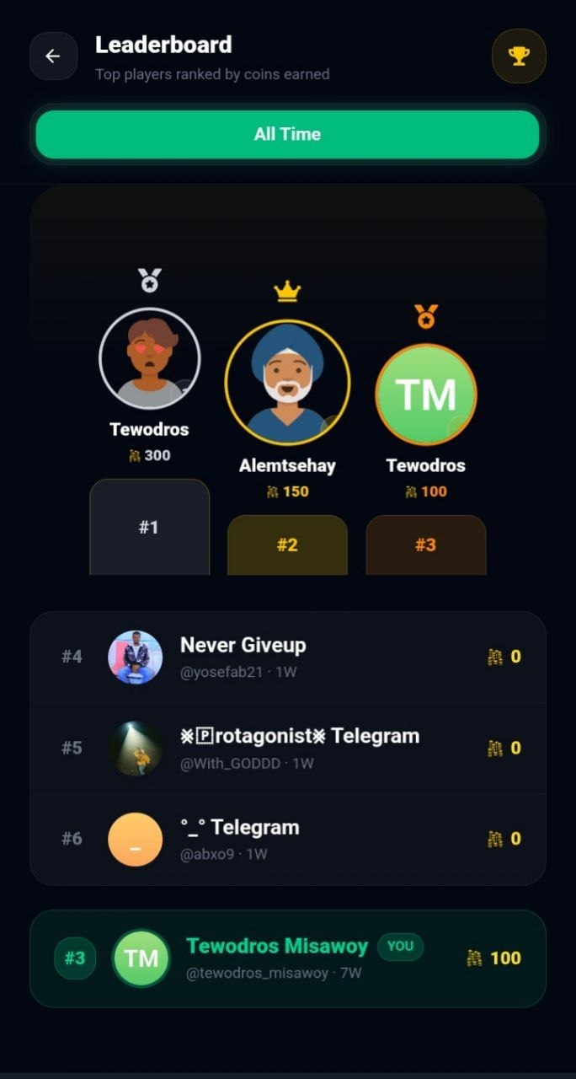
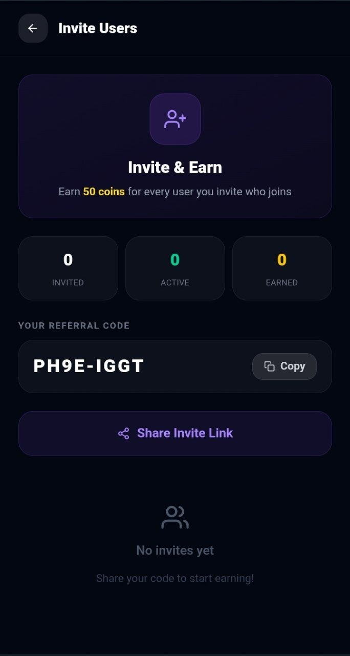
Competitive Advantage & Go-To-Market
• Launch in Ethiopia, Nigeria, Kenya, South Africa, and India first
• Seed demand in Telegram gaming, rewards, prediction, and campus communities
• Creators and group admins get rev-share plus branded rooms
• Double-sided referral reward unlocks after the first paid session
Telegram gaming communities
Micro-creators + group admins
Double-sided wallet referrals
Targets: CAC < $1.50 by month 6 and LTV/CAC > 3x in mature cohorts
Referral trigger: inviter and invitee each earn wallet credit after the first paid session.
Bingo Game

Slide 10
Growth Roadmap & Closing
Months 0-3: MVP live in 2 launch markets; D1 > 30%; D7 > 12%
Months 4-9: 25k MAU; CAC < $1.50; wallet attach > 35%
Months 10-15: 75k MAU; payer conversion > 6%; LTV/CAC trending to 3x
Months 16-18: 100k MAU; LTV/CAC > 3x; add 2 new game modes
Raising $1.2M seed for 18 months of product, growth, and compliance.
Use of funds: 45% product, 30% growth, 15% ops/compliance, 10% support/data.

