Slide 1


Jest in JavaScript
By: Sam Henderson

Slide 2
What is Jest?
Test runner in JavaScript
Very popular
3 main categories of testing

Slide 3
Where jest came from
Released in 2014
Created by Christoph Nakazawa
Maintained by Facebook
Similar to mocha

Slide 4
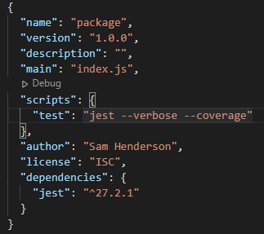
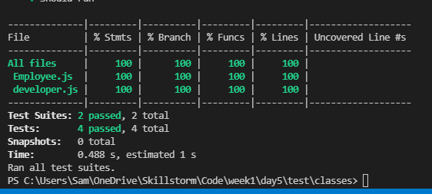
Why use jest?
Jest is quick
Runs in parallel
Many useful features

Slide 6
Thank you for listening

