Slide 1


CSS
By: Sam Henderson

Slide 2


What is CSS
CSS is used to control how HTML elements are displayed on screen
Style sheets cut down clutter on HTML documents

Slide 3

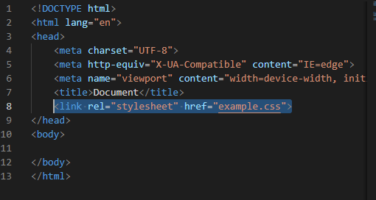
How to use css
Create Files
Link your style sheet

Slide 4
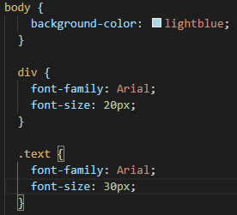
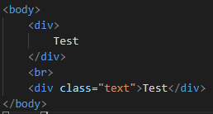

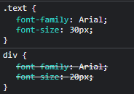
How to use css
Style sheet
HTML
Result

Slide 5
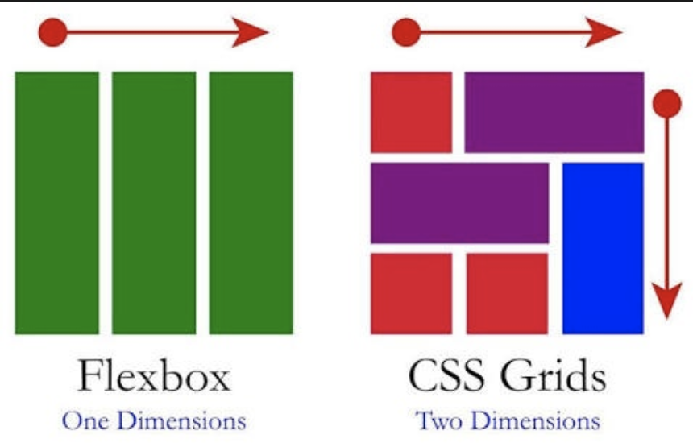


Ways to display
Flexbox vs Grid
Implementation

Slide 6
Thank you for listening

