Slide 1


Types in Typescript
By: Sam Henderson

Slide 2
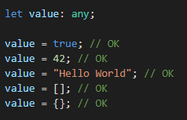
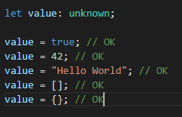
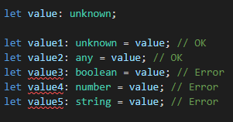
Any & unknown
Any works like JavaScript types
Unknown is similar
Unknown must be checked
Notes:
With a type other than any or unknown

Slide 3



Void & never
Void returns nothing
Never is for error handling
Void can be assigned but never cannot
Notes:
void is return type for a function that never return anything
Never is return type for a function that always throws an exception
Something interesting, void and never can be assigned as types

Slide 4
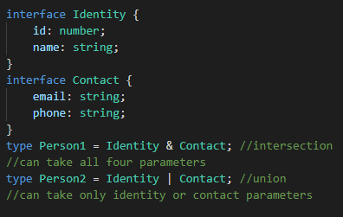
Union & intersection
Allows you to create new types
Intersection combines all properties
Union can only use one or the other

Slide 5
Thank you for listening

