Slide 1


React hooks
By: Sam Henderson
Notes:
Talking about a couple additional react hooks

Slide 2
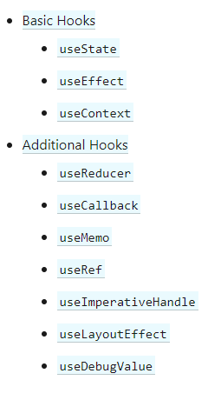
What are hooks
Hooks were added to React in the 16.8 release
Hooks are quicker and cleaner
There are only 10 hooks
Hooks are opt-in and fully backwards-compatible
Notes:
Used to have to write your own classes to use certain features but hooks fixed this
By using hooks, don’t have to write classes, makes things a lot quicker and clean
Right now only 10 hooks, but you can create your own. 3 basic, 7 additional which are variants of basic or for specific cases

Slide 3
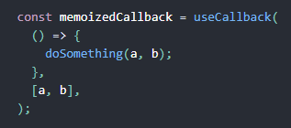
usecallback
Pass inline callback and array of dependencies
Returns a callback that only changes when dependencies change
Useful for preventing unneeded renders

Slide 4
Usememo
Pass create function and array of dependencies
Will compute a value only when dependencies change
Useful for preventing expensive calculations
Notes:
Similar to useCallback

Slide 5
Uselayouteffect
Variant of useEffect
Runs immediately after all DOM mutations
Useful for getting other styles for an element
Notes:
Unlike useEffect which runs after react renders your component
After everything renders

Slide 6
Thank you for listening

