Slide 1


Session vs cookies
By: Sam Henderson
Notes:
The differences, how, and what they’re used for

Slide 2
The difference
Used for storing user data across different webpages
Sessions stored server-side / cookies stored client-side
Sessions are temporary / cookies expire
Sessions have no storage limit / cookies limited to 4kb
Notes:
Both important for keeping track of info provided for different purposes
Main difference SLIDE making sessions more secure than cookies
End when the browser is closed / After a set time set by the server
Important to note

Slide 3
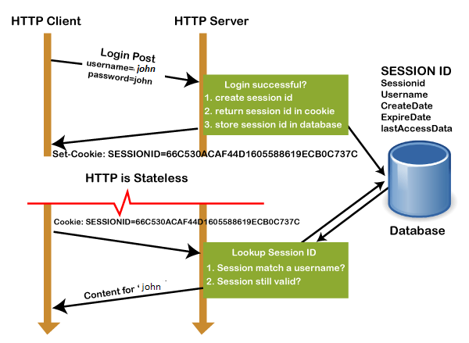
how session works
Notes:
First, client makes request to server with GET or POST method
Next, sessionID created on server, ID is saved in database, returns sessionID with a cookie as response to client
Lastly, cookie with sessionID stored on browser sent back to server, server matches ID with saved sessionID, responds with HTTP200

Slide 4

why use cookies
Cookies can be used for analytics
Useful for keeping track of users
Relevant advertisement
Notes:
Cookies have a unique ID, example, makes it easy to keep track of visits to your website no counting twice
Cookies useful for keeping track of users, like what they browse, store in cart, want to stay signed in
Controversial topic targeted ads, but cookies are useful tool that allow relevant ads shown to users based on browsing

Slide 5
Thank you for listening

