Slide 1
Examples
And Demos
Tools
Examples
Demos
SDK Tools (Flashing, Boot, …)
Protocol stacks
And Middleware
TI Resource Explorer (TIREX)
TinyUSB
LwIP (TCP/UDP)
Industrial Protocols
SysConfig
Drivers and
HAL
Board Peripheral Drivers
SOC Peripheral Drivers
Industrial Protocol FW HAL
TI CLANG Compiler
OS
Kernel
Code Composer Studio (CCS)
FreeRTOS POSIX
Driver Porting Layer (DPL)
FreeRTOS Kernel
No RTOS
ARM A53, ARM R5F, ARM M4F + SOC peripherals + EVM peripherals
X86 Host (Windows / Linux)

Slide 2
Examples
And Demos
Tools
Examples
Demos
SDK Tools (Flashing, Boot, …)
Protocol stacks
And Middleware
TI Resource Explorer (TIREX)
TSN/ AVB
LwIP (TCP/UDP)
Mbed-TLS
FAT FS
SysConfig
Drivers and
HAL
Bootloaders
(SBL)
Board Peripheral Drivers
SOC Peripheral Drivers
TI CLANG,C7x Compilers
OS
Kernel
Code Composer Studio (CCS)
FreeRTOS POSIX
Driver Porting Layer (DPL)
FreeRTOS Kernel
No RTOS
ARM A53, ARM R5F, ARM M4F, TI C7x + SOC peripherals + EVM peripherals
X86 Host (Windows / Linux)

Slide 3
Examples
Tools
Examples
SDK Tools (Flashing, Boot, …)
TI Resource Explorer (TIREX)
Drivers and
HAL
Board Peripheral Drivers
SOC Peripheral Drivers
Software Diagnostics Library (SDL)
SysConfig
TI CLANG Compiler
OS
Kernel
Code Composer Studio (CCS)
FreeRTOS POSIX
Driver Porting Layer (DPL)
FreeRTOS Kernel
No RTOS
ARM A53, ARM R5F, TI C7X + SOC peripherals + EVM peripherals
X86 Host (Windows / Linux)

Slide 4
Examples
Tools
Examples
SDK Tools (Flashing, Boot, …)
TI Resource Explorer (TIREX)
Drivers and
HAL
Board Peripheral Drivers
SOC Peripheral Drivers
Software Diagnostics Library (SDL)
SysConfig
TI CLANG Compiler
OS
Kernel
Code Composer Studio (CCS)
FreeRTOS POSIX
Driver Porting Layer (DPL)
FreeRTOS Kernel
No RTOS
ARM A53, ARM M4F, ARM R5F + SOC peripherals + EVM peripherals
X86 Host (Windows / Linux)

Slide 5
Examples
And Demos
Tools
Examples
MMWave Demos
SDK Tools (Flashing, Boot, …)
Protocol stacks
And Middleware
LwIP (TCP/UDP)
MMWave Framework
TI Resource Explorer (TIREX)
SysConfig
Drivers and
HAL
Board Peripheral Drivers
SOC Peripheral Drivers
TI C6000 Compiler
TI CLANG Compiler
OS
Kernel
FreeRTOS POSIX
Driver Porting Layer (DPL)
Code Composer Studio (CCS)
FreeRTOS Kernel
No RTOS
ARM R5F, TI C66x + SOC peripherals + EVM peripherals
X86 Host (Windows / Linux)

Slide 6
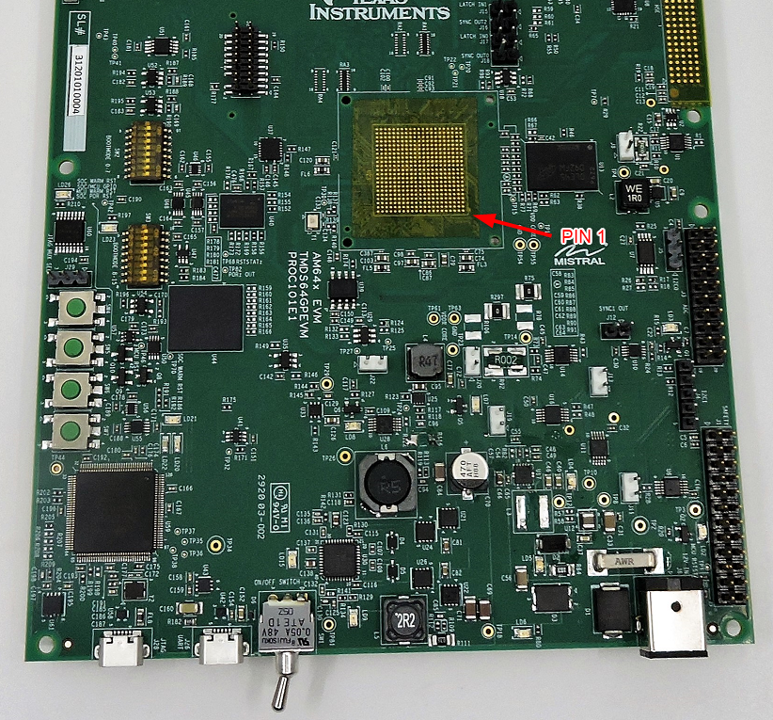
SD card
BOOT MODE 0-15
JTAG XDS110
UART to USB
Power switch
Power supply (12V, 5A)
<number>

Slide 7
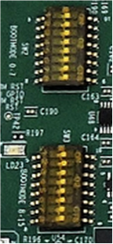
BOOTMODE
0:7 (SW2)
BOOTMODE
8:15 (SW3)
BOOTMODE
0:7 (SW2)
BOOTMODE
8:15 (SW3)
NO BOOT MODE
OSPI BOOT MODE
BOOTMODE
0:7 (SW2)
BOOTMODE
8:15 (SW3)
BOOTMODE
0:7 (SW2)
BOOTMODE
8:15 (SW3)
UART BOOT MODE
SD BOOT MODE
<number>

Slide 8
BOOTMODE
0:7 (SW2)
BOOTMODE
8:15 (SW3)
BOOTMODE
0:7 (SW2)
BOOTMODE
8:15 (SW3)
DEV BOOT MODE
EMMC BOOT MODE
<number>

Slide 9
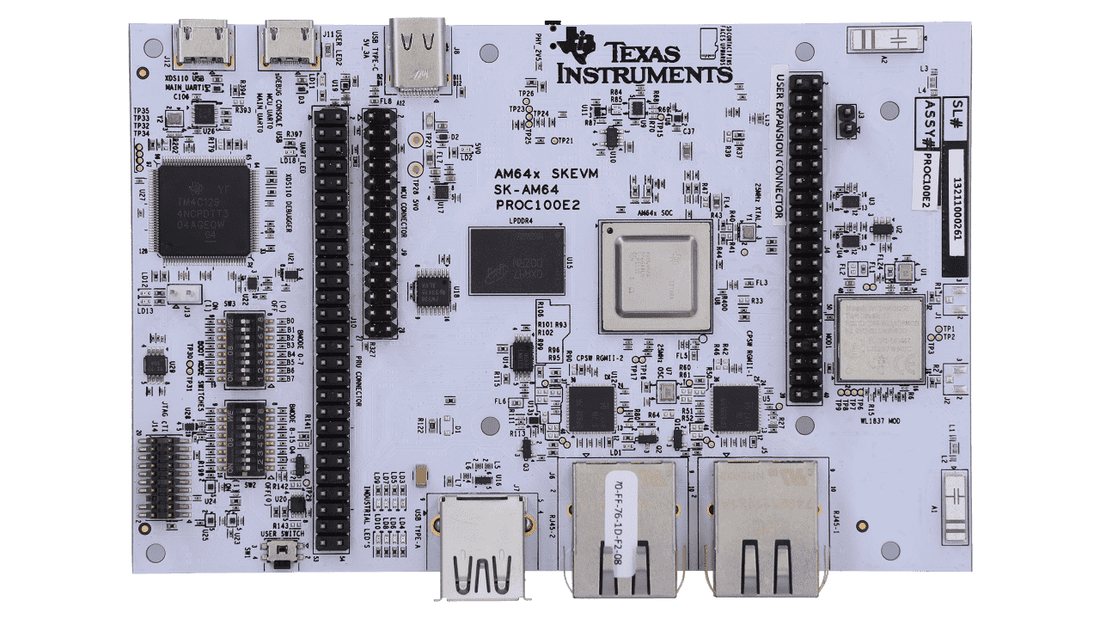
UART to USB
Power supply (12V, 5A)
JTAG XDS110
BOOT MODE SW2 (0-7)
BOOT MODE SW3 (8-15)
<number>

Slide 10
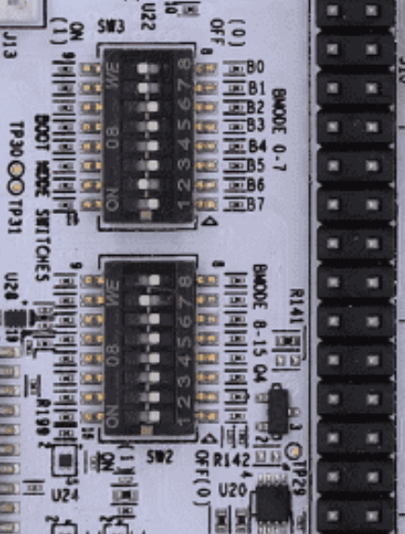
c
c
c
c
BOOTMODE
8:15 (SW3)
BOOTMODE
0:7 (SW2)
BOOTMODE
8:15 (SW3)
BOOTMODE
0:7 (SW2)
UART BOOT MODE
OSPI BOOT MODE
<number>

Slide 11
c
c
c
c
BOOTMODE
8:15 (SW3)
BOOTMODE
0:7 (SW2)
BOOTMODE
8:15 (SW3)
BOOTMODE
0:7 (SW2)
SD BOOT MODE
NO BOOT MODE
<number>

Slide 12
c
c
BOOTMODE
8:15 (SW3)
BOOTMODE
0:7 (SW2)
EMMC BOOT MODE
<number>

Slide 13
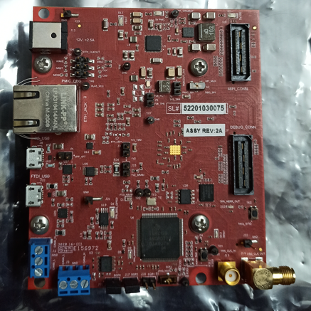
Power Supply
(12V 5A)
Jtag XDS 110
Uart to USB
Reset Button
Boot Mode
Switches

Slide 14
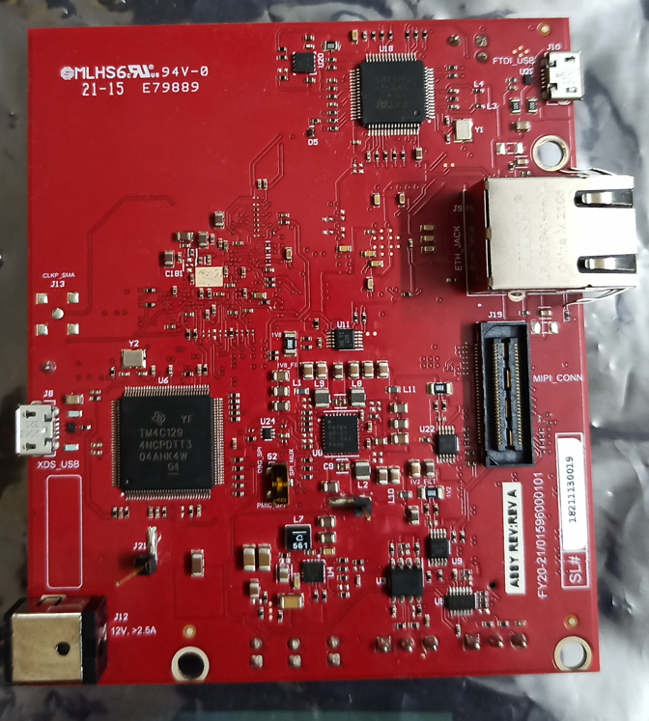
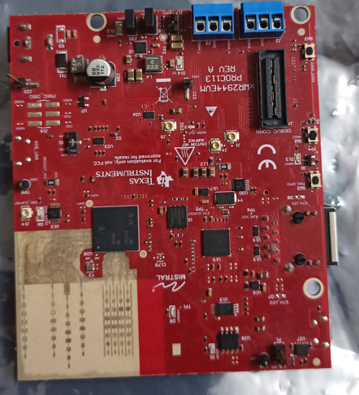
Uart to USB
Boot Mode
Switches
Reset Button
Jtag XDS 110
Power Supply
(12V 5A)
<number>

Slide 15
Application
Layer 7 - Application
EtherCAT Slave Stack
ARM
Processor
FW HAL for EtherCAT Slave
Customer
Third Party
TI
PRUICSS Driver
PRU Firmware
PRUICSS
PRUICSS with 2x MII
Layer 2 - Data Link
Layer 1 - Physical
Ethernet PHY
Ethernet PHY

Slide 16
RPRC Format
Offset
RPRC Header
Section 1 Header
Section 1 Content
Section 2 Header
Section 2 Content
Section 3 Header
Section 3 Content
RPRC Magic Word
Entry Point
Reserved
Section Count
Version
0x00000000
0x00000004
(20 Bytes)
0x00000008
0x0000000C
0x00000010
Section Run Address
Reserved
Section Size
Reserved
Reserved
0x00000000
(20 Bytes)
0x00000004
0x00000008
0x0000000C
0x00000010

Slide 17
RPRC Format
Offset
RPRC Header
Section 1 Header
Section 1 Content
Section 2 Header
Section 2 Content
Section 3 Header
Section 3 Content
RPRC Magic Word
Entry Point
Reserved
Section Count
Version
0x00000000
0x00000004
(20 Bytes)
0x00000008
0x0000000C
0x00000010
Section Run Address
Reserved
Section Size
Reserved
Reserved
0x00000000
(20 Bytes)
0x00000004
0x00000008
0x0000000C
0x00000010

Slide 18
XIP gen
RPRC Header (entry point = 0x0)
Section 1 Header (addr = 0x0, size = 0x80)
Section 1 Content
Section 2 Header (addr = 0x70080000, size = 8KB)
Section 2 Content
Section 3 Header (addr = 0x60100000, size = 64KB)
Section 3 Content
Section 4 Header (addr = 0x60110000, size = 16KB)
Section 4 Content
RPRC Header (entry point = 0x0)
Section 1 Header (addr = 0x0, size = 0x80)
Section 1 Content
Section 2 Header (addr = 0x70080000, size = 8KB)
Section 2 Content
Non-XIP RPRC file
xipGen
XIP RPRC file
RPRC Header (entry point = NOT USED)
Section 1 Header (addr = 0x60100000, size = 80 KB)
Section 1 Content (merged content of section 3 + section 4)
XIP sections
Merged
XIP section
17

Slide 19
Post build steps
v
.c
.obj
compiler
.rprc
…
.out
.rprc
xipGen
.c
.obj
compiler
out2rpc
.rprc_xip
…
linker
multiCoreGen
.appimage
.lib
CPU1
…
.appimage_xip
v
multiCoreGen
.c
.obj
compiler
.rprc
…
.out
.rprc
xipGen
.c
.obj
compiler
out2rpc
.rprc_xip
…
linker
.lib
CPUn
17

Slide 20
Post build steps
v
.c
.obj
compiler
…
.out
.rprc
.c
.obj
compiler
out2rpc
…
linker
.lib
.appimage
CPU1
multiCoreGen
…
v
.c
.obj
compiler
…
.out
.rprc
.c
.obj
compiler
out2rpc
…
linker
.lib
CPUn
17

Slide 21
Multi-core Image
Offset
Multi-Core Header
Core 1 Meta Header
Core 2 Meta Header
….
Header End
Core 1 RPRC
Core 2 RPRC
….
Core N RPRC
Magic Word
Number of Cores
Device ID
Reserved
0x00000000
(16 Bytes)
0x00000004
0x00000008
0x0000000C
Meta Header
Offset: 0x10 + (8 * Core Index)
(8 Bytes)
Core ID
RPPC Image Offset
0x00000000
0x00000004
Offset: 0x10 + (8 * Num Cores)
(8 Bytes)
Reserved
End of Header
0x00000000
0x00000004
RPRC Images
*Refer RPRC Format

Slide 22
User Space application
User Application
RP Message Char
R5F application
R5F application
M4F application
User Application
User Application
User Application
Kernel Space
RP Message
IPC RP Message
IPC RP Message
IPC RP Message
Mail Box Driver
IPC Notify
IPC Notify
IPC Notify
Linux Kernel
NO RTOS or FreeRTOS
NO RTOS or FreeRTOS
NO RTOS or FreeRTOS
A53
R5FSS0-0
R5FSS0-1
M4FSS0-0
21

Slide 23
User Space application
User Application
RP Message Char
M4F application
User Application
Kernel Space
RP Message
IPC RP Message
Mail Box Driver
IPC Notify
Linux Kernel
NO RTOS or FreeRTOS
A53
M4FSS0-0
21

Slide 24
User Space application
User Application
RP Message Char
R5F application
R5F application
M4F application
User Application
User Application
User Application
Kernel Space
RP Message
IPC RP Message
IPC RP Message
IPC RP Message
Mail Box Driver
IPC Notify
IPC Notify
IPC Notify
Linux Kernel
NO RTOS or FreeRTOS
NO RTOS or FreeRTOS
NO RTOS or FreeRTOS
A53
MCU-R5FSS0-0
WKUP-R5FSS0-0
C75SS0-0
21

Slide 25
User Space application
User Application
RP Message Char
R5F application
R5F application
User Application
User Application
Kernel Space
RP Message
IPC RP Message
IPC RP Message
Mail Box Driver
IPC Notify
IPC Notify
Linux Kernel
NO RTOS or FreeRTOS
NO RTOS or FreeRTOS
A53
MCU-R5FSS0-0
WKUP-R5FSS0-0
21

Slide 26
R5F application
R5F application
R5F application
R5F application
User Application
User Application
User Application
User Application
IPC RP Message
IPC RP Message
IPC RP Message
IPC RP Message
IPC Notify
IPC Notify
IPC Notify
IPC Notify
NO RTOS or FreeRTOS
NO RTOS or FreeRTOS
NO RTOS or FreeRTOS
NO RTOS or FreeRTOS
R5FSS0-0
R5FSS0-1
R5FSS1-0
R5FSS1-1
21

Slide 27
R5F application
R5F application
R5F application
R5F application
C75 application
C75 application
User Application
User Application
User Application
User Application
User Application
User Application
IPC RP Message
IPC RP Message
IPC RP Message
IPC RP Message
IPC RP Message
IPC RP Message
IPC Notify
IPC Notify
IPC Notify
IPC Notify
IPC Notify
IPC Notify
NO RTOS or FreeRTOS
NO RTOS or FreeRTOS
NO RTOS or FreeRTOS
NO RTOS or FreeRTOS
NO RTOS or FreeRTOS
NO RTOS or FreeRTOS
R5FSS0-0
R5FSS0-1
R5FSS1-0
R5FSS1-1
C75SS0-0
C75SS1-0
21

Slide 28
R5F application
R5F application
C66 application
User Application
User Application
User Application
IPC RP Message
IPC RP Message
IPC RP Message
IPC Notify
IPC Notify
IPC Notify
NO RTOS or FreeRTOS
NO RTOS or FreeRTOS
NO RTOS or FreeRTOS
R5FSS0-0
R5FSS0-1
C66 DSP
21

Slide 29
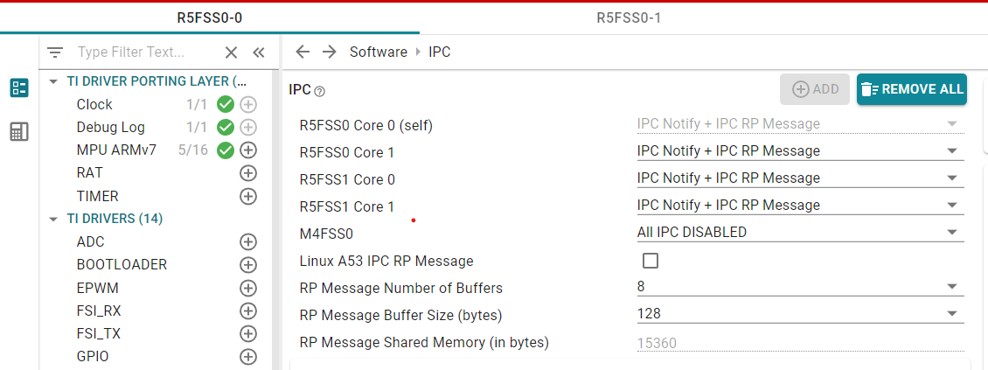
Enable IPC between current CPU and another CPU
Keep IPC disabled with a CPU if not needed
Check this to enable IPC with Linux
21

Slide 30
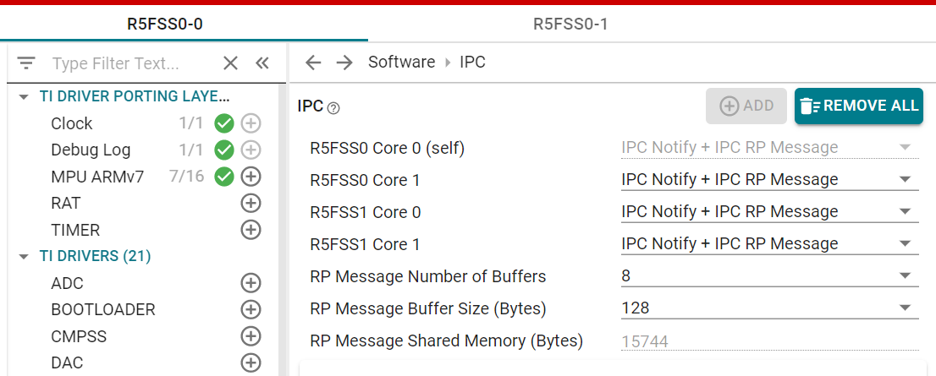
Enable IPC between current CPU and another CPU
21

Slide 31
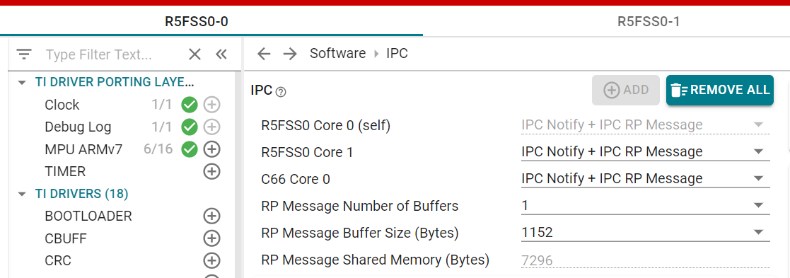
Enable IPC between current CPU and another CPU
21

Slide 32

Boot flow
ROM BOOT
SBL BOOT
POWER-ON
ROM Bootloader (RBL)
Secondary Bootloader (SBL)
Application Binary
21

Slide 33
SBL Boot flow
RPRC 1
…….
…….
RPRC N
SBL Parse
MULTICORE APPIMAGE
For each RPRC
Initialize Core
Load RPRC Image
Set Entry Point
Release Core from Reset
RPRCs for N CPUs were found in the multicore appimage
21

Slide 34
Application Layer
cdc_echo example
Tiny USB
CDC-ACM Class
USB Device Core
FreeRTOS / NORTOS Services
TinyUSB Porting Layer (DCD)
Device Driver
USB Device Core Driver
SoC Porting Layer
SOC Specific USB Controller Hardware

Slide 35
Application
Layer 7 - Application
EtherNet/IP Adapter Stack
Customer
lwIP Stack
ARM
Processor
TI / Third Party
TI
EtherNet/IP Adapter FWHAL
ICSS-EMAC
PRUICSS Driver
PRU Firmware
PRUICSS
PRUICSS with 2x MII/RGMII
Layer 2 - Data Link
Layer 1 - Physical
Ethernet PHY
Ethernet PHY

Slide 36
ARM
PTP Driver+Stack/DLR Driver
TCP/IP Stack
Yes
No
If PTP/DLR ?
L3 RAM
Priority Queue 0
Priority Queue 1
Priority Queue 2
Priority Queue 3
21

Slide 37
Application
Layer 7 - Application
Profinet Device Stack
Customer
lwIP Stack (including SNMP)
ARM
Processor
TI / Third Party
TI
Profinet Device FWHAL
ICSS-EMAC
PRUICSS Driver
PRU Firmware
PRUICSS
PRUICSS with 2x MII/RGMII
Layer 2 - Data Link
Layer 1 - Physical
Ethernet PHY
Ethernet PHY

Slide 38
Application
Layer 7 - Application
lwIP Stack (including SNMP)
ARM
Processor
PRP FWHAL
ICSS-EMAC
PRUICSS Driver
PRU Firmware
PRUICSS
PRUICSS with 2x MII/RGMII
Layer 2 - Data Link
Layer 1 - Physical
Ethernet PHY
Ethernet PHY

Slide 39
ARM
Profinet Stack
lwIP Stack
MSRAM
Priority Queue 0
Priority Queue 1
Priority Queue 2
Priority Queue 3
LLDP, MRP, PTCP
RTA, DCP
VLAN Priority
4-7
VLAN Priority
0-3
21

Slide 40
HOST
Queue 3
Queue 4
Queue 1
Queue 2
Collision Queue
PORT 0
PORT 1
Queue 3
Queue 4
Queue 3
Queue 4
Queue 1
Queue 2
Collision Queue
Queue 1
Queue 2
Collision Queue

Slide 41
ICSS EMAC RX/TX Data Path
MII/RGMII picks up the data and copies it to L2 FIFO and sends a signal to firmware
Firmware copies the data to queue buffers (MSRAM) and signals host through an interrupt
Host services the interrupt and copies the data from MSRAM to application buffers
RX
Application creates the packet
Host copies the data to queue buffers (MSRAM) from application buffers and signals PRU to pick it up
Firmware picks up the data and puts it in Tx FIFO
MII/RGMII picks up the data and sends it on the wire
TX

Slide 42
ICSS EMAC Storm Prevention Architecture
Broadcast/
Multicast Packet Received
On PRU
On ARM
Drop Packet
Check Credit Value
Storm Prevention Credits
Credits = 0
Credit Value > 0
Decrement Credits
Reset value with default
Allow packet to pass
21

Slide 43



ROUTER with
DHCP SERVER
192.168.1.1
EVM
192.168.1.100
HOST PC
192.168.1.101
21

Slide 44
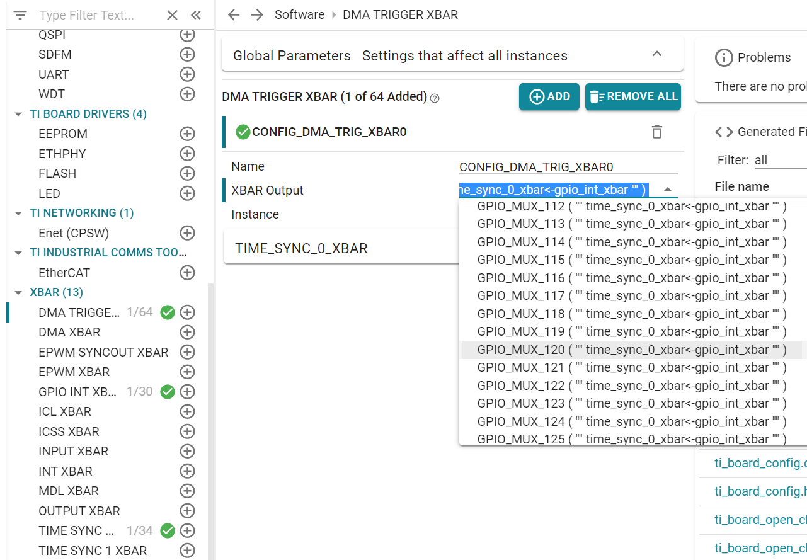
21

Slide 45
AM263 - ADC Multiple SOC EPWM Example
SOC0
RESULT0
ADC 0
SOC1
RESULT1
SOC2
RESULT2
EPWM 0
SOC A
SOC0
RESULT0
ADC 1
SOC1
RESULT1
SOC2
RESULT2
21

Slide 46
AM263 - ADC Burst Mode Oversampling Example
SOC0
RESULT0
ADC 0
SOC1
RESULT1
EPWM 0
SOC A
SOC12
Burst mode enabled
SOC13
SOC14
RESULT2
SOC15
21

Slide 47
AM263 - ADC SOC Continuous DMA Example
ADC 0
SOC0
RESULT0
DMA Channel 0
RESULT BUFFER0
EPWM 0
SOC A
ADC 1
SOC0
RESULT0
DMA Channel 1
RESULT BUFFER1
21

Slide 48
AM263 – DAC DMA Sine wave Example
DMA Trigger
RTI1
EDMA
DAC
Sine wave output
EDMA Destination
Sine Table
(Buffer with sine values)
EDMA Source
21

Slide 49
EPWM
EDMA
Time Base
SOCA
DMA XBar
DMA Trigger XBar
Configuration Array
Counter Compare
Data transfer to EPWM registers
21

Slide 50
CTRIPH
EPWM
PWM_B
PWM output signal
CMPSSA
TRIP4
Input signal to CMPSS
CMPINxP
CTRIPOUTH
OUTPUT XBAR
XBAROUT
Trip output signal
CMPIN1P exceeds internal DAC output
Internal DAC output
CMPSS input signal
PWM output signal
PWM tripped
t
t
21

Slide 51
EPWM0
ADC EVT
OST TRIP Input
PWM output signal
Ramp Waveform
ADC
EPWM1
DAC
ADC EVT
CBC TRIP Input
PWM output signal
PPB
EPWM2
ADC EVT
Direct TRIP Input
PWM output signal
ADC Input exceeds PPB High limit
DAC Output signal
(ADC Input)
PPB High level
PPB Low level
PWM tripped
t
PWM output signal
t
21

Slide 52
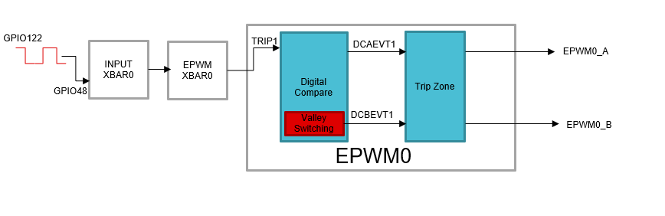
<number>

Slide 53
CMPAHR(8)
CMPBHR(8)
HRPWM Micro-edge Positioner (MEP) Calibration Module
HRCNFG
TBPRDHR(8)
HRMSTEP
EPWM(0-4)
EPMWA
ePWMxA
EPMWB
ePWMxB
<number>

Slide 54
SCICLIENT OPERATION
APPLICATION
Any system control request – resource, power, clock, security
Sciclient sends a TISCI message to the SYSFW/HSM Runtime with the specifics of the request, on a secure proxy thread allotted for this particular core.
SECURE PROXY THREAD
SYSFW/HSM Runtime
SCICLIENT
SYSFW sends back a response after processing the request
<number>

Slide 55
SCICLIENT
RESOURCE MANAGEMENT
POWER MANAGEMENT
SECURITY
FIREWALLS
PROCESSOR BOOT
<number>

Slide 56
SYSFW-HS-FS
TI MEK
SYSFW-HS-FS-ENC
TI MPK
SYSFW-HS-FS-ENC-CERT
Unsigned, unencrypted SYSFW for HS-FS device
Encrypted SYSFW for HS-FS device
X509 Certificate for the Encrypted SYSFW for HS-FS device
(sysfw-hs-fs-enc.bin)
(sysfw-hs-fs-enc-cert.bin)
SYSFW
Unsigned, unencrypted SYSFW for GP device
(sysfw.bin)
<number>

