Slide 1
Jacinto™ Automotive Processor
Jacinto 7 Ethernet Switch

Slide 2
Agenda
Ethernet Switch IP Features Overview
Deep Dive – Software Architecture
CPSW LLD
Ethernet Firmware
EthFw Demos
Jacinto 7 EVM – CPSW support
Deep Dive – EthFw
Folder Structure
Docs organization
Sample Examples
CPSW and PHY integration
Switch configuration & Debugging

Slide 3
Ethernet SwitcH
IP Overview

Slide 4
Ethernet Switch – CPSW Functional Block Diagram
Host Port – Classify and Routing to compute cores
External MAC / Ethernet Ports

Slide 5
Ethernet Switch – Feature Overview
CPSW (Ethernet Switch) IP
Switch
4-port Group1
Top Level Features
9 Ports – 8 MAC Ports, 1 Host Port
Support for RMII, RGMII, SGMII, QSGMII
Packet Classification (64 classifiers) & filtering using L2/VLAN/L3
InterVLAN routing support
UDP/TCP Checksum offload
Multicast/broadcast rate limiter
Reset isolation
Port Mirroring, Port Trunking
SERDES
Lane1
Port1
P1 FIFO
SGMII
1/2.5G MAC1
RGMII/RMII (pinmux)
QSGMII
Port2
P2 FIFO
1G MAC2
SGMII/ RGMII/RMII
P3 FIFO
1G MAC3
Sharing w/ other SERDES / pins
Port3
SGMII/ RGMII/RMII
Port4
P4 FIFO
1G MAC4
SGMII/ RGMII/RMII
CPU
4-port Group2
SERDES
Lane2
Port5
P5 FIFO
1/2.5G MAC5
SGMII
RGMII/RMII (pinmux)
QSGMII
Port6
P6 FIFO
1G MAC6
SGMII/ RGMII/RMII
Port7
P7 FIFO
1G MAC7
Sharing w/ other SERDES / pins
SGMII/ RGMII/RMII
Port8
P8 FIFO
1G MAC8
SGMII/ RGMII/RMII

Slide 6
Ethernet Switch – Auto Use-cases entitlement
Safety Features
SECDED ECC protection of table entries
Ram error detection and correction (ECC) with full end to end packet protection (CRC)
Security
L2/L3 address whitelisting, L2 address blacklisting
Advanced classification and Policing based on L2/L3 headers using Port number, Priority, ONU, DA, SA, VLAN inner/outer, EtherType, IPSA and IPDA
Policing for rate limiting matched flows – three color marking on policed rates with drop controls
Deep packet inspection via integrated compute cores
AVB/TSN Features
IEEE802.1Qav – Egress AVB rate shaping
IEEE802.1Qbb and IEEE802.3x Flow control
TSN Features
IEEE802.1Qbv/1Qaz time base scheduling
IEEE802.3br/IEEE802.1Qbu Frame Preemption

Slide 7
Ethernet Switch – Feature Summary
Key Building Blocks
ALE with 1k entries
Classifier module for L2/L3 header inspection (96 HW classifier rules)
Ingress port: Rate-limit, filter
FlowID assignment for Host traffic
AVB, TSN features support
Traffic shaper
L2/L3 HW Checksum offload
Inter-VLAN routing in HW
Transmit from Host
Classifier support for rate-limit per flow
TSN support: Time aware scheduling, pre-emption, Traffic Shaping with 8 HW Priority queue/port
Per-port priority regeneration support
Ethernet Switch Subsystem
DMA Logic
Flow ID
Classifier
ALE
Forwarding Between Ports
VLAN-aware line rate L2 switching
Per-flow ingress port rate limiting, filtering
Per-port broadcast, multicast rate limit
Traffic to Host DMA port
Classifier for header inspection
FlowID for packet steering and multiple queue support
Traffic Shaper
Firewall, Filter
L2-based filter (OUI deny, MAC authentication)
Classifier based L2/L3 filtering
No match drop
MAC multicast range, IP CIDR mask filtering
HW filter for untagged, IPV4, dual tag, IP fragment, L3 Next Header check
Traffic to Host Inter-VLAN routing
ALE match: traffic match to host port
Classifier: Flow matching for HW offload
HW offload for matched flow : packet header modification in HW

Slide 8
Ethernet SWITCH
Deep Dive –Software Architecture

Slide 9
Ethernet Switch – Data Flow
Ethernet Firmware Supporting Multiple Clients
Linux
(A72-x)
TI-RTOS
(MCU-x R5F-x)
AutoSAR
(MCU0 R5F-x)
Multiple CPUs on the SoC can perform network IO simultaneously using the switch once the switch is configured via the FW
Subsequent packet IO can happen directly between the CPU specific network stack and switch HW via UDMA
Switch configuration
ETHFW (R5F)
CPSWx (Switch HW)
Data/Packet IO
Config

Slide 10
Ethernet Switch – Data Flow Detailed
A72 Virtual Net Dev (SDK1.0)
AUTOSAR CPSW CDD (POST SDK1.0)
A72
(Remote Core)
MCU R5
(Remote Core)
EthFw
Apps
Switch R5
(Master Core)
Apps
OS
Network Stack
Attach Core
Attach Core
OS
Network Stack
CPSW Driver
Apps
Alloc Resources
RM
Alloc Resources
CPSW Driver
Network Stack
CPSW Driver
Submit and retrieve packet calls
Submit and retrieve packet calls
Alloc Resources:
Rx Flow Num
Tx Ch Num
MAC Address
Rx Ch
Tx Ch
Configures Registers
(open ALE, MAC ports, MDIO, Stats, etc)
DMA Resources
Host Port
Direct Control Path
CPSW 9G
IPC Control Path
Direct Data Path
MAC Ports

Slide 11
Ethernet Switch – Ref. AUTO Use-case
C7x/Other R5
A72
snmpd
mstpd
lldpd
lacp
mvrp
Apps
MCU R5
iproute2
brctl
ethtool
vconfig
tc
User
Kernel
OS
NDK
EMAC_LLD
Application
Bonds
Bridges
VXLAN
Remote Configuration Client
RTE
AVTP
BMCA
RT Netlink
ethtool ioctl
switchdev driver
cpsw driver
COMM
CDD
CDD
CDD
BSWM
SOME/IP
COM
Customer Function
XML,JSON
swp0
PDUR
HTTP
swp1
Remote Configuration Client
swp1
Remote Configuration Client
SD
UDPNM
DoIP
ETHXCP
MIRROR
PTP
swp7
SOAD
DNS
TLS
TCP/IP
IPv4,ARP,ICMPv4
IPv6,NDP,ICMPv6
UDP,TCP,DHCPv4,DHCPv6
Main R5 (switch)
Ethernet State Machine
Ethernet Interface
Remote Configuration Server
Ethernet Switch Driver
Ethernet Driver 2G
Ethernet Transceiver
Ethernet Driver 9G
Firmware Application API
Other Drivers
TI-RTOS
Apps
IP Router
EAPOL
802.1AS
AVB
SRP
NM
NDK
CPSW_LLD
ENETPHY
LLD
ALE
LLD
CPSW_2G
CPSW_9G
CPSW 2G Register
CPSW 9G Register
MCU Domain
Main Domain
Direct Control Path
IPC Control Path
Kernel driver (LCPD)
PDK CPSW LLD (AUTO)
Switch resident protocols
Direct Data Path
Demo app (AUTO)
Ethernet Firmware (AUTO)

Slide 12
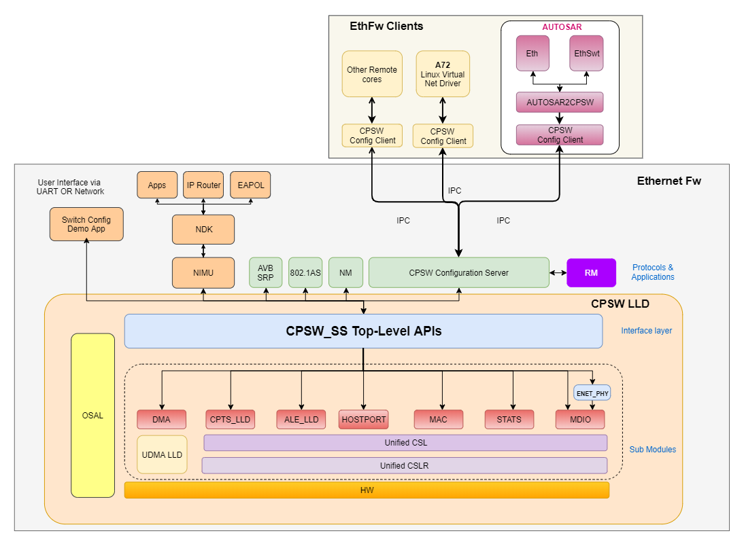
Ethernet Switch – Software Stack
EthFw Submodules
CPSW LLD – driver layer for CPSW9G IP
CPSW Remote Configuration Server
CPSW Remote Configuration RTOS Client
Switch Resource Manager
Switch Resident Protocols
TCP/IP NDK
Switch Configuration App
EthFw Software Stack

Slide 13
Ethernet SWITCH
Software Releases

Slide 14
Ethernet Switch – EthFw 1.0: IS / IS NOT
SDK 1.0
Post SDK 1.0
Basic Switching
VLAN
RGMII
1G/100M
Host Port Packet Tx/Rx
Switch R5 as packet source/sink
IPC based switch configuration from other cores
Linux virtual netdev driver integration
A72 data path
TCP/IP stack (NDK)
Multicast switching
InterVLAN routing
Network Security
Classifier/Policer
QoS/Packet Priority regeneration
Traffic Shaping
Timesync (802.1ASrev)
Time aware scheduling (802.1Qbv) - EST
SGMII
RMII
QSGMII and 2.5 Gbps support
Port Mirroring
Port Trunking
IET (Interspersing express traffic)
ENET PHY – power mgt
Switch compliance testing
Time sensitive networking
OS | CPSW 2G (Direct driver) | CPSW 9G (Virtual driver)
TI RTOS | Y | SDK 1.0
Linux | Y | SDK 1.0
AUTOSAR | Y | Post SDK 1.0
QNX | SDK 1.0 | Post SDK 1.0

Slide 15
Ethernet SWITCH
Jacinto 7 EVM: CPSW Support

Slide 16
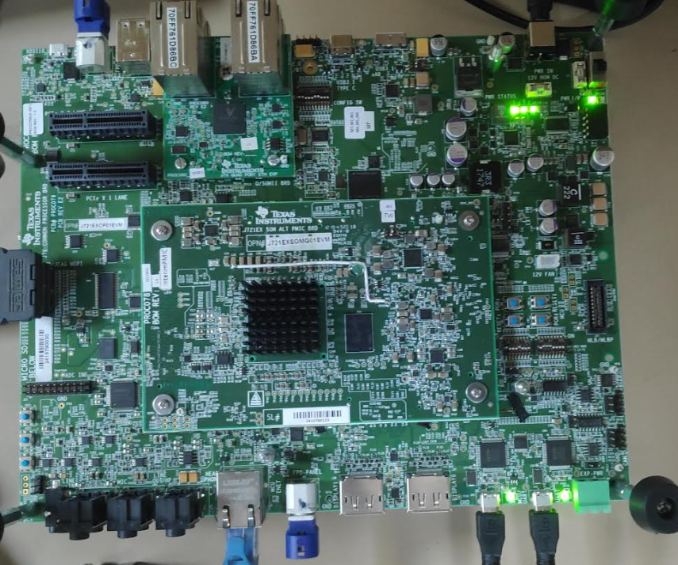
Ethernet Switch – Jacinto 7 EVM Baseboard
MCU_ENET
DP83867 RGMII PHY
1 Gbps
CPSW 2G MDIO bus
ENET_EXP DB
1 x QSGMII Expansion Daughter Board
Not supported as SDK1.0
ENET EXP BOARD
(QSGMII)
With SDK1.0 only CPSW2G supported on Baseboard, GESI DB is needed for CPSW9G
MCU_ENET
(RGMII)

Slide 17
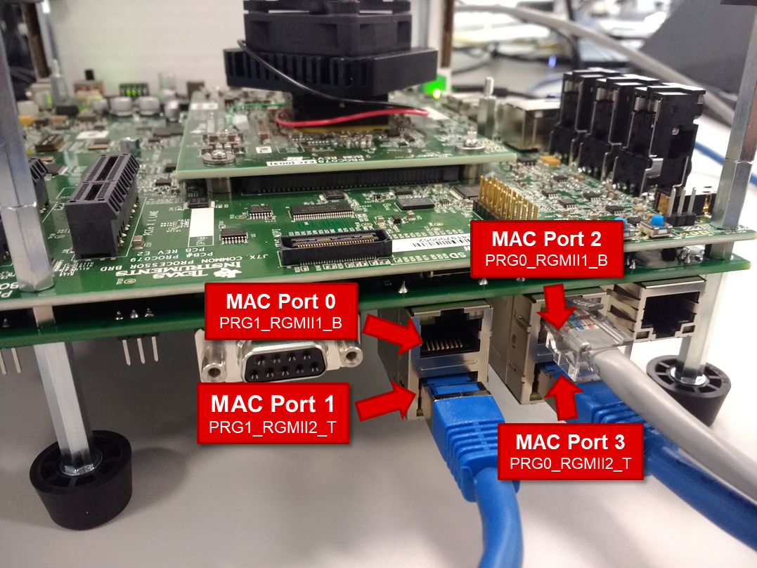
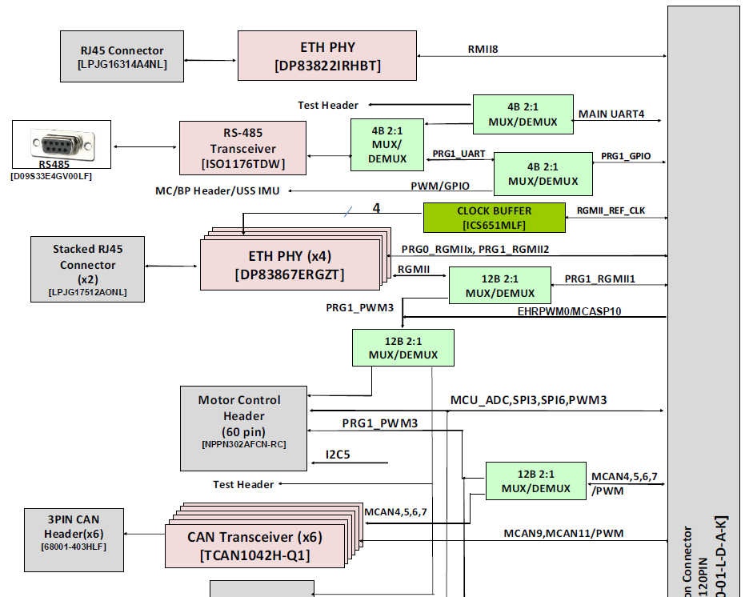
Ethernet Switch – GESI Board
4 x RGMII PHYs
DP83867
1 Gbps
CPSW 9G MDIO bus
1 x RMII PHY (Post SDK1.0)
DP83822
100 Mbps
CPSW 9G MDIO bus
RMII PORT 5

Slide 18
Ethernet SWITCH
Demos

Slide 19
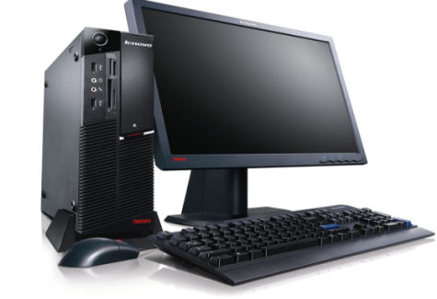
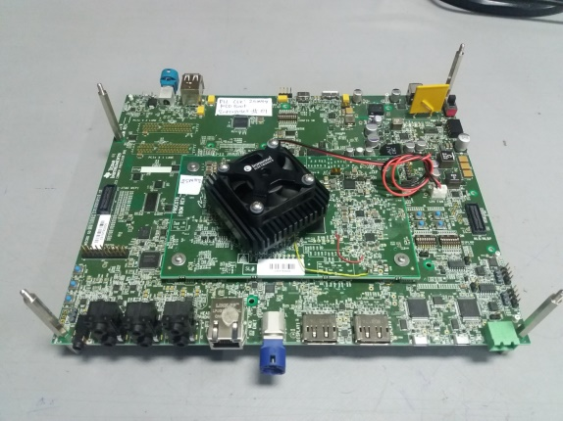
Ethernet Switch – Firewall
Demonstrate
Packet classification Network security, firewall
Filter on L2 header: OUI, SA, VLAN
Filter on L3 header: frag, SA/DA
Differentiation
Network security based on L2/L3 header fields (wire rate)
Timeline: SDK 1.0
Demo Apps
Firewall
Filter Rules
Traffic Classification
TI-RTOS
Switch Config
Utility
Forward
I/F
NDK
Config I/F
Data I/F
Demo Packet Streams
CPSW_LLD
Packet verifier
Application
Packet Generator
Main Domain R5
Packet Capture
J7 EVM
Linux PC
Linux PC

Slide 20
Ethernet Switch – Classification and InterVLAN Routing
Demo Apps
Demonstrate
Packet classification
L2 header: addr, EtherType, VLAN, priority, port number
L3 header: SA/DA
InterVLAN routing
Wire rate, up-to 4 routes
Differentiation
Ethernet sharing across multiple cores / VMs
HW packet header inspection/classification
InterVLAN routing in HW at line rate
Timeline: SDK 1.1
Classification and Forwarding
HW-routing
InterVLAN
Traffic Classification
SW Routing
TI-RTOS
Switch Config
Utility
Forward
I/F
NDK
Config I/F
Data I/F
Demo Packet Streams
CPSW_LLD
Packet verifier
Application
Packet Generator
Main Domain R5
Packet Capture
J7 EVM
Linux PC
Linux PC
VM1
(A72)
Packet Capture
Packet verifier
Application

Slide 21
Gateway Demo: CAN ←→ Ethernet
Demonstrates Latency and CPU Load for routing application
Shows early CAN response
AUTOSAR MCAL driver
RTOS driver for CAN + Linux for ETH:
JTAG
USB/UART
PC/Laptop
DRA82x EVM
Used to Load and Run Application on DRA80xM
For console O/P
Code Composer Studio
UART console
Demo Routing Application
SYSB
I
OS
Early CAN response
SYSB
I
OS
NDK
DMSC Firmware
Send & Receive MESSAGE - CAN & DRA82xM
Receive & Send MESSAGE -Ethernet & DRA82xM
CAN Driver
Network Driver
CPSW9G
CAN Driver
Routing SW using just R5F – Cortex A free for other application usage
<100us driver routing latency
CSL FL/RL
CSL FL/RL
PCAN PC Tool
Network Apps
Main Domain
R5
M3 DMSC
MCU0 R5
MCUSS
USB
RJ45
DB9
RJ45
PCAN Module
Cable for CAN
Ethernet Cable

Slide 22
Ethernet SWITCH
Deep Dive – Ethernet Firmware

Slide 23
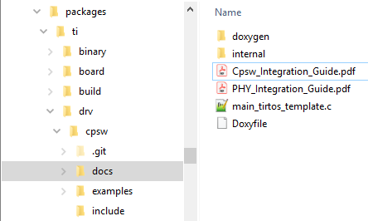
Ethernet Switch – CPSW Integration
Integration into app:
CPSW configuration parameters: ALE, MAC, Host, MDIO
DMA configuration parameters
Print/tracing functions
CPSW init and open
Resource Manager attach
IOCTLs and helper functions
MAC/PHY configuration
Close sequence
NDK integration C-file template
CPSW LLD examples: loopback, sanity, NIMU

Slide 24
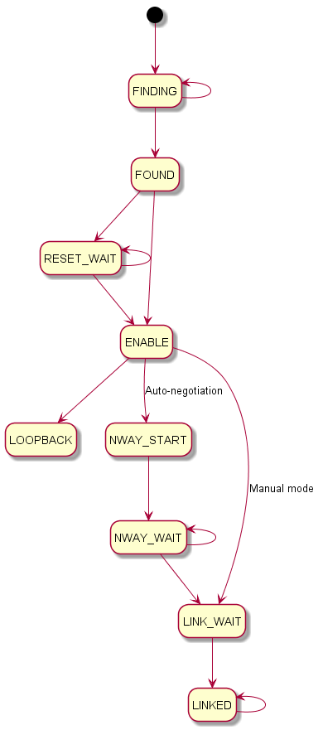
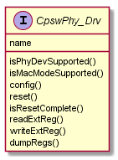
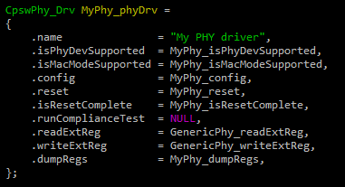
Ethernet Switch – PHY Integration
PHY abstraction layer as part of CPSW LLD
State machine based
PHY-specific drivers can implement their own callbacks or reuse generic implementation
Runtime device to driver mapping based on PHY ID
Auto-negotiation and manual mode
Clause-22 support
“PHY Integration Guide” document provided as part of CPSW docs

Slide 25
Ethernet SWITCH
Switch Configuration and Debugging

Slide 26
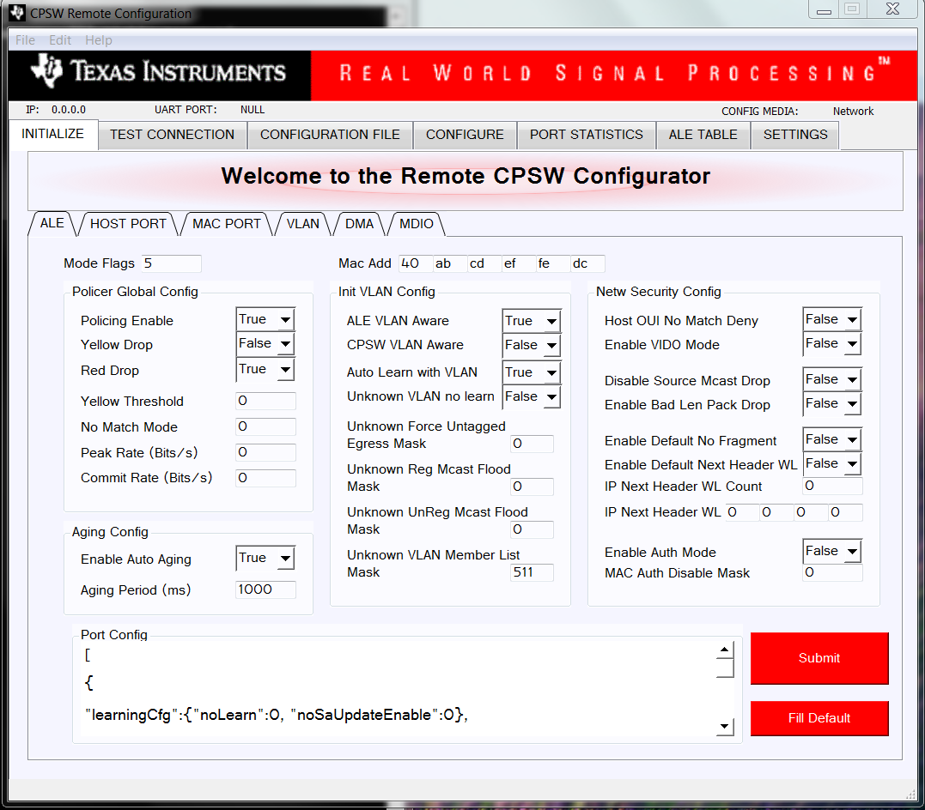
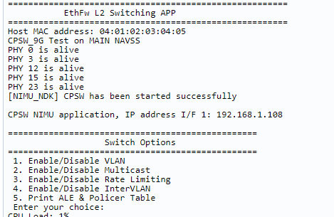
Ethernet Switch – Switch Configuration
Default configuration loaded during EthFw init – part of
Run-time switch configuration supported Switch Config via Network (config GUI) & UART
Fig – Switch Config GUI
Fig – UART Based Config

Slide 27
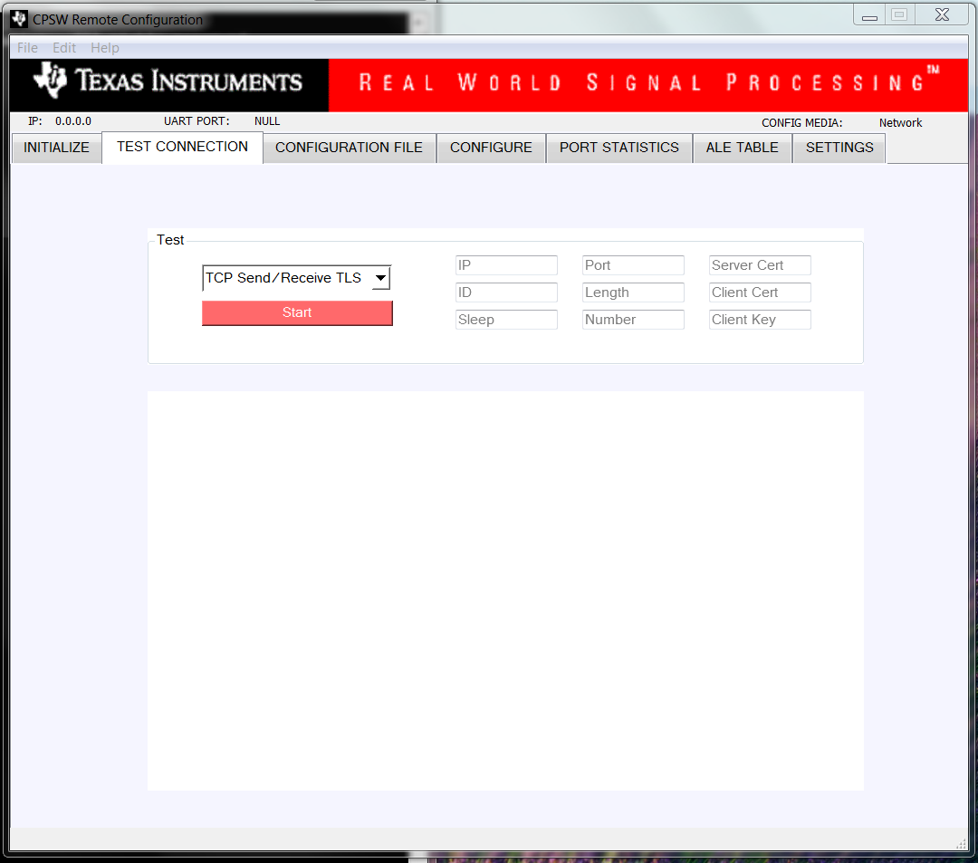
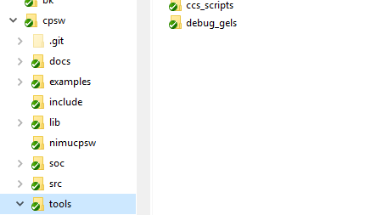
Ethernet Switch – Debugging
Fig – Stress Test Connection
Debugging Infrastructure
GEL Scripts
HW error stats report.
Dump Switch forwarding table
PHY reg read/write configuration
Debug and diagnostic APIs/IOCTLs
DMA statistics
Switch config dump IOCTLs
Runtime configurable trace support
GUI support to run stress tests, get switch statistics.
Fig – UART Based Config

Slide 28
Q & A

Slide 29
backup

Slide 30
Ethernet Switch – Key Usecases
J7
J7
L2 Switching Usecase
L2 Aggregator Usecase
ARM R5F
ARM R5F
Host port
Host port
J7
J7
Traffic from any external port to any external port
Traffic from multiple external ports aggregated and sent over external port
L2 Switching with Traffic to/from
Compute Cores
PCIe / Ethernet Bridge
A72
ARM R5F
A72
ARM R5F
Host port
Host port
PCIe
Traffic from any external port to Jacinto 7 compute cores

Slide 31
Ethernet Switch – Integrated Switch Key Value Propositions
Use-case | Key Features | Software Enablement
Gateway – Network Security | IP address whitelisting Protocol whitelisting Rate limiting Traffic shaping MAC Authentication | ALE driver with full IP entitlement Support for switch configuration via AUTOSAR/Linux
IO Hub | Support for 2-port driver & 9-port driver to connect vehicle network to switch | Support for multicore data planes using packet based classifications (flows) Single driver supporting all CPSW IP variants on Jacinto 7, Maxwell, Pascal. Scatter-gather
Central Gateway | Programmable L3 routing InterVLAN routing (4 hardware routes) 200ms Ethernet response | AUTOSAR MCAL switch dev LCPD Virtual netdev driver TCP/IP stack (NDK integration) Performance optimizations
Ethernet Surround View | IET/EST 802.1AS (PTP) IEEE 802.1Qav (Forwarding) | Time sync support TSN support

Slide 32
Ethernet Switch – Release Plan
Milestone | CPSW_LLD | EthFw | Demos | Date
SDK 0.8 | Basic Switching VLAN RGMII 1G / 100M Host TX / RX | Switch config via UART |  | 30 March 2019
SDK 0.9 Bring-up | Multicast switching InterVLAN routing Ethernet PHY | TCP/IP stack (NDK integration) Switch config via telnet A72 remote core support Main R5_1 as packet source/sink Bring-up complete on EVM | CAN ↔ Ethernet gateway L2 Switching – multicast, VLAN | 30 June 2019
SDK 1.0 RTM | Network Security Classifier/Policer QoS/Packet Priority regeneration Traffic Shaping | Linux A72 Virtual driver integration | Firewall Demo InterVLAN routing and Traffic Classification demo | 30 Sep 2019

Slide 33
Ethernet Switch – Usecases Entitlement
Latency improvement to meet requirements
Direct data path from AUTOSAR R5 to Switch – eliminates need of IPC
Plan for TSN features to enable deterministic latency like EST, IET and switch FIFO tuning
Optimized ETH driver for CPU load
Receive and transmit interrupt pacing
Support for scatter-gather to enable zero copy transmit
L3 checksum offload support
Support for enabling InterVLAN routing in hardware
L3 routing
Dedicated switch R5 for Ethernet switch (CPSW9G) control – can be controlled via AUTOSAR or Linux
Multi-core support – support direct data path for each core (no IPC during data movement)
Support for enabling hardware features to classify and route traffic to intended core
Linux Virtual netdev driver & AUTOSAR Ethernet switch (CPSW9G) driver enablement

Slide 34
Ethernet Switch – Customer Enablement & Demos
J7
J7
A72
Main R5F
Linux Virtual MAC
Host port
Main R5F
MCU R5F
Host port
L2 Switch Usecase
Traffic from any external port to any external port
Features:
Switch config via UART
VLAN
Multicast
RGMII, 100M / 1G
L2 Aggregator Usecase
Traffic from multiple external ports aggregated and sent over external port
Features:
Network security
Policer
QoS / Packet priority regeneration
InterVLAN routing
L2 Switching
with internal cores
Traffic from multiple external ports aggregated to J7 compute cores
Features:
Traffic shaping
Traffic classification
TCP/IP (NDK) stack on Switch R5F
Packet TX/RX from MCU R5F

Slide 35
Ethernet SWITCH
Performance

Slide 36
Ethernet Switch – Performance
Content to be added

Slide 37
Ethernet Switch – Performance Measurment
Content to be added – CPU load, Network throughput

Slide 38
Ethernet SWITCH
Switch Certification

Slide 39









Ethernet Switch – Standards Ecosystem
Independent Test &
Certification Houses
Special Interest Groups
TC11
TSN switch
Avnu Profile
EthernetDriver
EthernetSwitchDriver
IEEE 802.1AS-Rev/IEEE 802.1Qbu/IEEE 802.1Qbv/802.1Qcc/802.1Qci/
802.1Qch/ 802.1CB/ 802.1CM
TSN
IEEE 802.3az
Energy Efficient
IEEE 802.1AS/IEEE 802.1Qav/IEEE 802.1Qat
IEEE 1722/IEEE 1733
AVB
Standards Body
IEEE 802.1/IEEE 802.3/IEEE 802.1Q
Basic Ethernet
Silicon Vendor
Tier 1
OEM
Security Penetration
Testing
TC11
Automotive
TC8

Slide 40

Ethernet Switch – Roadmap
AVNU pre-certification tools
Cost : $20,000 per annum for UNHIoL membership
(Share with ICSS team)
IXIA Equipment
Cost : $0 (Plan on using ICSS team’s chassis.)
Ruetz Systems
Switch Qualification Certification
Cost : unknown
AVNU test plan
Cost : $0 (available to TI as Avnu member)
UNHIoL
AVNU TSN switch certification
Cost : ~ $10K
ESCRYPT test plan
Cost : $0 (available from SVA team)
ESCRYPT
Security pen test certification
Cost : ~ $50K
OPEN ALLIANCE TC 11 test plan
Cost : $0 (open access)
Cadence test suite
for Switch DV
Internal Pre-Certification
Test
J7ES RTL 1.0
4Q 2018
J7ES Samples
1Q 2019
SDK 1.0
3Q 2019
Timeline
TBD

Slide 41
Ethernet Switch – Linux Virtual Net Driver

