Slide 1
EthFw – v0.8 Release Gate PPT 02April 2019

Slide 2
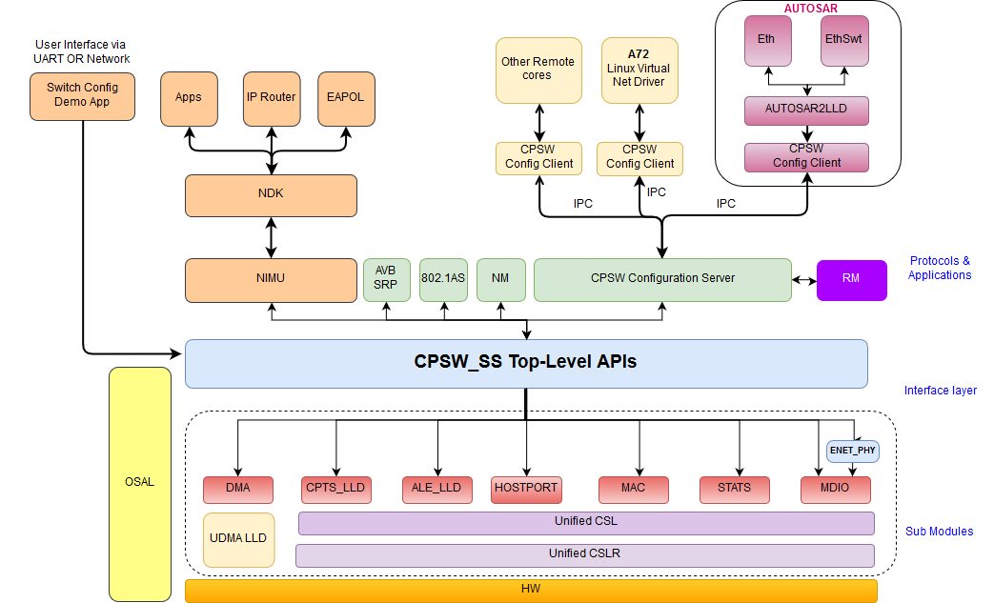
Release Overview
SW Process Used: QRAS AP00216 (rev.A)
Platforms supported: VLAB simulator (VLAB 2.4.6, VLAB-Toolbox keystone-0.14.5-rc1, J7 ES configuration)
Key Features
L2 Switching demo
NDK integration
UART-based logging
EthFw Stack 0.8 (Block is scope of 0.8 release)

Slide 3
Requirement Summary
Requirements Summary
Component | Implemented | T:
EthFw | 9 | 9
Scope Change – Review and Alignment
Date/Venue | Record Numbers if applicable | Change | Feature Description | Reason | Comments and Approval
4/2/2019 EthFw CCB | ETHFW-181 | Added to 0.8 | Switching across ports on VLAB | Needed to add new requirement for VLAB testing as existing cover EVM only. | APPROVED
All requirements are Unit and Regression.
No Performance requirement for this release.
Scope change tracker: Link

Slide 4
Test Summary
Component | Test report
EthFw | Traceability: Link Report: Link
Requirement Metrics
Platform | Met | Partially Met | Not Met | Not Validated | Not testable | Test Gap | Not Applicable | Total
J721E-vlab | 9(100%) | 0 (0%) | 0 (0%) | 0 (0%) | 0 (0%) | 0 (0%) | 0 (0%) | 9(100%)
Requirement Not/Partially Met
Requirement | Description | Defect

Slide 5
Defect Summary
Defects Fixed in this release
NA
Known Issues
NA

Slide 6
Release Gate Deliverables : Create Phase
Deliverable | Status | Comments
Risk Management plan | NA | Covered in SDK PPT
Create Review checklist | NA | Covered in SDK PPT
Design Document | NA | This initial release includes only the sample demos in application space.
Code Review Results | Updated. Galileo Link | Done as a part of merge on Bitbucket
Test Plan | Completed. Galileo Link
Static Code Analysis Report | NA | MISRA not part of 0.8 release
BitBucket repo – use git tag -ETHFW_0.8_DOCS_REVIEW_APPROVED for 0.8 docs

Slide 7
Release Gate Deliverables : Validate Phase
Deliverable | Status | Comments
Risk Management plan | NA | Covered in SDK PPT
Validate phase Review checklist | NA | Covered in SDK PPT
Software Test Report | Completed. Galileo : Link
Customer Documents | Completed. Link
Software Manifest | Completed. Link
Static Code Analysis Report | NA | Static analysis not part of 0.8 release
Bi-directional traceability | Completed. Traceability: Link
BitBucket repo – use git tag -ETHFW_0.8_DOCS_REVIEW_APPROVED for 0.8 docs

Slide 8
Quality Status
Current Status
KW warnings: NA
Foqus Update : Completed
MISRA-C issues: NA
All requirements (JIRA): Re-scoped requirements Completed & moved to implemented state(link)
All defects/bugs in closed state (JIRA): No defects
SDF (JIRA): ETHFW-194
JIRA defect status
Critical – 0
Internal :0
Customer :0
Major - 0
Internal :0
Customer :0
Minor - 0
Internal :0
Customer :0
System Test: completed: (all 9 requirements fully met)

Slide 9
Release Readiness
Current Status
Code freeze : Completed
RC package creation and System Test cycle – Completed
CM Record - ETHFW-186
Documentation:
API Guide, Developer Guides - NA
User Guides, Test Report – Completed
Release Notes – Completed
Training Materials, Feature List – NA
Data Sheets – NA
SRAS/OSRB Review: SRAS00006191Completed
Click-wrap License: NA
Export control clearance: NA
Final installer creation and BFT: Completed
Release web page update/upload to mysecure ti.com: NA
Release email: 5-Apr-2019, after the release review meeting
Release schedule : EthFw 00.08.00.00 on 5th April 2019

Slide 10
Release Approval
Function | Designate | Approval
SW Development | Gagan/Yashwant
Software Test | Sivaraj/Badri
Quality | Vimala/Mohan
Business Unit/Product management | Dave Maples
Product Development management | Manoj/Jayant
* Conditionally Approved Subject to action being closed

