Slide 1
HeapMultiBuf Memory Manager for BIOS 6.0
Chris McCormick

Slide 2
Requirements
HeapMultiBuf addresses the need for a deterministic memory manager that can allocate multiple block sizes.
Deterministic: You can always predict the amount of time a call to alloc will take, and the worst case is known for a call to free.
Multiple Block Sizes: The user can specify what block sizes they would like to be able to allocate, as well as the size of each pool.
Few Restrictions: There can be multiple buffers with the same block size, even if the alignments are the same/different. User can specify arbitrary block sizes (actual sizes will be multiples of the alignment).

Slide 3
Requirements, Cont.
HeapMultiBuf should minimize the restrictions posed on buffer configuration.
Block Sizes:
User might use sizeof to configure the block size, in which case they don’t necessarily know the sizes they’re asking for.
  There can be multiple buffers with the same block size, with same or different alignments.
  The user may specify block sizes that are not multiples of the alignment (though the actual block sizes will be).
  Bufs can be configured in any order, and HeapMultiBuf will sort them internally.

Slide 4
Implementation
A HeapMultiBuf manager consists of multiple user-specified buffers of memory, each with its own block size.
Each buffer is just a HeapBuf instance. Calls to HeapMultiBuf functions just call the corresponding function of the appropriate HeapBuf.
HeapMultiBuf
HeapBuf
HeapBuf
64
128
64
64
128
64
128
64
128

Slide 5
Implementation, Cont.
bufsBySize and bufsByAddr
2 Arrays to sort HeapBufs
  By size for alloc: Search by size for the first large enough block.
  By address for free: User doesn’t specify align on free. Two buffers could have same blockSize, different align. Only way to distinguish is by address comparison.

Slide 6
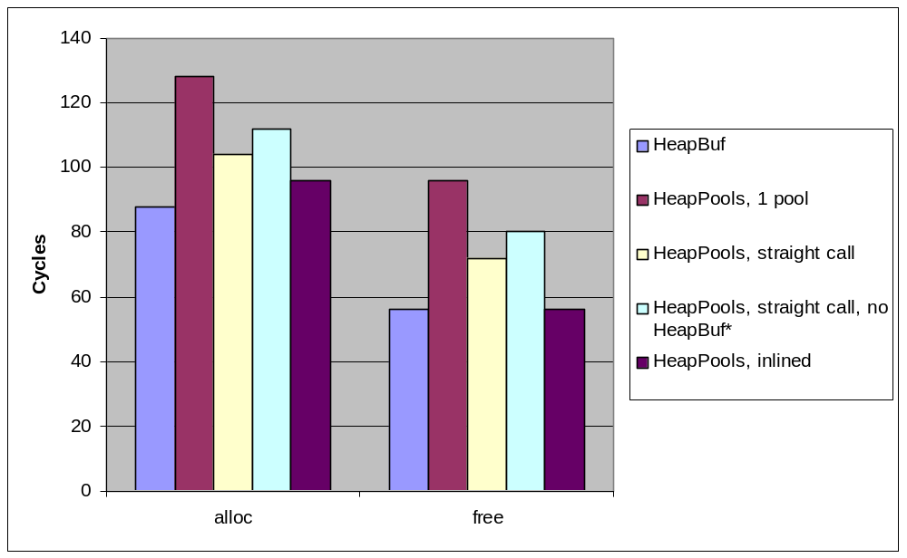
Performance
 | alloc | free
HeapBuf | 88 | 56
HeapMultiBuf, 1 pool | 128 | 96
HeapMultiBuf, straight call | 104 | 72
HeapMultiBuf, straight call, no HeapBuf* | 112 | 80
HeapMultiBuf, inlined | 96 | 56
*Call does not get inlined

Slide 7
Issues and Tradeoffs
“Pool Borrowing”
If we’re out of 64 byte blocks, should we borrow a 128 byte block?
  Tradeoffs:
  - Alloc becomes non-deterministic (may have to search for next larger available block).
  + Better to risk a longer alloc than risk running out of memory? You can know the worst case alloc.
  - Pool borrowing does not guarantee alloc success.
    If you borrow a 128 word block to satisfy a 64 word request, you now have one less 128 word block available that you may have needed.
    If user can’t predict heap usage, they need to handle the out of memory case with or without pool borrowing.
  - Performance cost.
Recommendation:
Keep implementation simple.
Customer should optimize heap sizes to avoid running out of memory.

Slide 8
Pool Borrowing Details
Implementation Challenges
When you free a block, you need to know which pool the block came from.
1. Compare address of block to pool addresses.
- Slows down ALL calls to free
- OR -
2. Return block size or handle. Stored by user and provided on call to free.
Either:
a. Change alloc/free signature
b. Create alloc_extended/free_extended signature
c. Return a pointer to a structure, or place the value at the beginning of the block.
Block splitting/recombining?

Slide 9
Issues and Tradeoffs, Cont.
Performance
Parameters
Any two of these parameters can be used to specify the HeapMultiBuf:
  Pool Sizes
  Block Sizes
  Number of Blocks
Offer all three, or just two? HeapBuf uses numbers 2 and 3.
Disjointed Buffers
The customer must provide continuous sections of memory for each pool.
Terminology
HeapBuf and HeaPools should agree. Pool, Buf, Block?

Slide 10
Version
Date | Version | Author | Comments
8/16/06 | 0.1 | Chris McCormick | Created

