Slide 1
SQL Temporal Tables (System-Versioned Tables)
Jeff Etter
jetter@codemag.com
linkedin.com/in/TexasJetter
twitter.com/TexasJetter

Slide 2








About the Presenter
Jeff Etter
Senior Software Developer EPS Software Corp.
CODE Author
Presenter

Slide 3

About CODE & EPS Software Corp.
Custom Software, Training, and Consulting
.NET, SQL Server,…
Specialists in converting to .NET
Object and Service Oriented Development
Database Development
User Interface/ Web
WPF, MVC, Angular, Vue

Slide 4
Agenda
What is a Temporal Table
Use Case
Getting Started
Querying Data
Changing Schema
Q&A

Slide 5
What is a Temporal Table
Also know as System-Versioned table
SQL 2016 Introduced Support
Stores data in table at ALL points in time
By default a query returns current data
But also allows you to return a previous version of data (via special query syntax)
Notes:
Temporal tables (also known as system-versioned temporal tables) is a database feature that brings built-in support for providing information about data stored in the table at any point in time rather than only the data that is correct at the current moment in time.

Slide 6
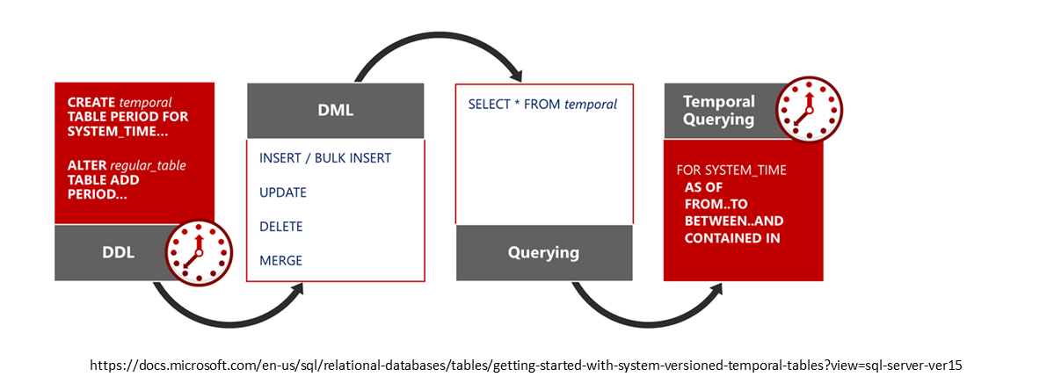
Use Case
Full Table Data Auditing
Notes:
Use temporal system-versioning on tables that store critical information for which you need to keep track of what has changed and when, and to perform data forensics at any point in time.

Slide 7
Getting Started
Can be applied to new or existing tables
Create Table x .. With (System_Versioning = ON (HISTORY_TABLE = History.x));
Alter Table x .. SET (SYSTEM_VERSIONING = ON (HISTORY_TABLE = History.x));
History Table can be
Anonymous (named and schema by system)
Default (you provide name, schema by system)
User Defined (you provide name and schema)
Notes:
https://docs.microsoft.com/en-us/sql/relational-databases/tables/creating-a-system-versioned-temporal-table?view=sql-server-ver15
Create Default:
CREATE TABLE Department
(
DeptID INT NOT NULL PRIMARY KEY CLUSTERED ,
DeptName VARCHAR(50) NOT NULL ,
ManagerID INT NULL ,
ParentDeptID INT NULL ,
SysStartTime DATETIME2 GENERATED ALWAYS AS ROW START NOT NULL ,
SysEndTime DATETIME2 GENERATED ALWAYS AS ROW END NOT NULL ,
PERIOD FOR SYSTEM_TIME (SysStartTime, SysEndTime)
)
WITH (SYSTEM_VERSIONING = ON (HISTORY_TABLE = dbo.DepartmentHistory));
Alter Default:
CREATE SCHEMA History;
GO
ALTER TABLE InsurancePolicy
ADD
SysStartTime DATETIME2 GENERATED ALWAYS AS ROW START HIDDEN CONSTRAINT DF_SysStart DEFAULT SYSUTCDATETIME() ,
SysEndTime DATETIME2 GENERATED ALWAYS AS ROW END HIDDEN CONSTRAINT DF_SysEnd DEFAULT CONVERT(DATETIME2, '9999-12-31 23:59:59.9999999’),
PERIOD FOR SYSTEM_TIME (SysStartTime, SysEndTime);
GO
ALTER TABLE InsurancePolicy SET (SYSTEM_VERSIONING = ON (HISTORY_TABLE = History.InsurancePolicy));

Slide 8
Code
Demo

Slide 9
Querying Data
Defaults to current data
Retrieve historical data using:
As Of <date time>
From <start date time> To <end date time>
Between <start date time> And <end date time>
Contained In (<start date time> ,<end date time>)
All
Can be specified for each table in a join
Notes:
https://docs.microsoft.com/en-us/sql/relational-databases/tables/querying-data-in-a-system-versioned-temporal-table?view=sql-server-ver15
/*State of entire table AS OF specific date in the past*/
SELECT [DeptID], [DeptName], [SysStartTime],[SysEndTime] FROM [dbo].[Department]
FOR SYSTEM_TIME AS OF '2015-09-01 T10:00:00.7230011’ ;
/* Query using BETWEEN...AND sub-clause*/
SELECT [DeptID] , [DeptName] , [SysStartTime] , [SysEndTime] , IIF (YEAR(SysEndTime) = 9999, 1, 0) AS IsActual
FROM [dbo].[Department]
FOR SYSTEM_TIME BETWEEN '2015-01-01' AND '2015-12-31’
WHERE DeptId = 1
ORDER BY SysStartTime DESC;
/* Query using ALL sub-clause */
SELECT [DeptID] , [DeptName] , [SysStartTime] , [SysEndTime] , IIF (YEAR(SysEndTime) = 9999, 1, 0) AS IsActual
FROM [dbo].[Department]
FOR SYSTEM_TIME ALL
ORDER BY [DeptID], [SysStartTime] Desc

Slide 10
Code
Demo

Slide 11
Changing Schema
Currently you must use ALTER Table query, no SMS Designer support
Can optionally turn on/off the SysTime column hidden status
Certain schema changes may require you to start/stop SYSTEM_VERSIONING

Slide 12
Additional Resources
https://docs.microsoft.com/en-us/sql/relational-databases/tables/temporal-tables?view=sql-server-ver15
https://github.com/TexasJetter/SQLTemporal

Slide 13

Q&A Contact us with questions!
CODE/EPS Contact:
www.codemag.com
info@codemag.com
facebook.com/codemagazine
twitter.com/codemagazine
Presenter Contact:
jetter@codemag.com
linkedin.com/in/TexasJetter
twitter.com/TexasJetter

