Slide 1

第9章 Applet小程序案例
Applet小程序类
Applet小程序工作原理
合并Application和Applet小程序
Applet小程序的应用

Slide 2
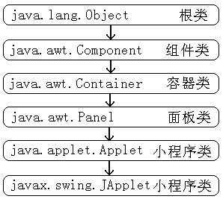
Applet小程序类

Slide 3
Applet小程序工作原理
Applet小程序编程框架
Applet小程序的运行过程

Slide 4
Applet小程序编程框架
package appletsample;
import java.awt.*;
import java.awt.event.*;
import java.applet.*;
public class AppletSample extends Applet {
boolean isStandalone = false;
String var0;
int var1;

Slide 5
Applet小程序编程框架
public String getParameter(String key, String def) {
return isStandalone ?
System.getProperty(key, def) :
(getParameter(key) !=
null ? getParameter(key) : def);
}
public AppletSample() {
}

Slide 6
Applet小程序编程框架
public void init() {
try {
var0 = this.getParameter("param0", "");
}
catch(Exception e) {
e.printStackTrace();
}
try {
var1 = Integer.parseInt(this.getParameter("param1", "0"));
}
catch(Exception e) {
e.printStackTrace();
}
try {
sampleInit();
}
catch(Exception e) {
e.printStackTrace();
}
}

Slide 7
Applet小程序编程框架
private void sampleInit() throws Exception {
}
public void start() {
}
public void stop() {
}
public void destroy() {
}
public void paint(Graphics g){
}

Slide 8
Applet小程序编程框架
public String getAppletInfo() {
return "Applet Information";
}
public String[][] getParameterInfo() {
String[][] pinfo = {
{"param0", "String", ""},
{"param1", "int", ""},
};
return pinfo;
}
}

Slide 9
启动Applet小程序的HTML
<html>
<head><title> appletsample.AppletSample</title></head>
<body>
<applet
codebase = "."
code = "appletsample.AppletSample.class"
name = "SampleAppletTest"
width = "400"
height = "300"
align = "top"
>
<param name = "param0" value = "AppletSample输入参数">
<param name = "param1" value = "0">
</applet>
</body>
</html>

Slide 10
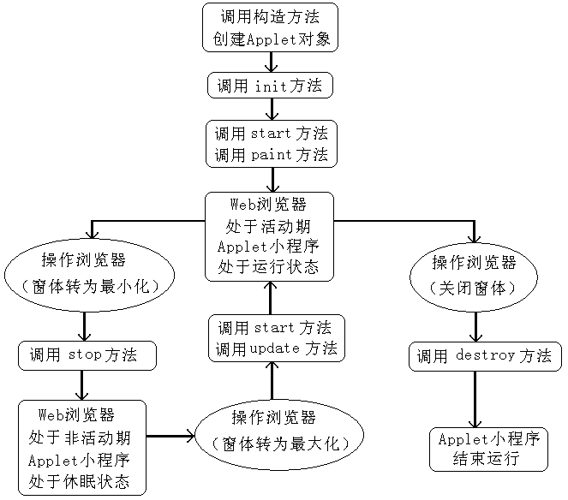
Applet小程序的运行过程

Slide 11
合并Application和Applet小程序
在图形界面基础上
在Applet中加入main方法
在main方法创建窗体
在窗体中加入Applet

Slide 12
Applet小程序的应用
显示外部参数Applet小程序
显示时间Applet小程序
播放声音Applet小程序

