Slide 1
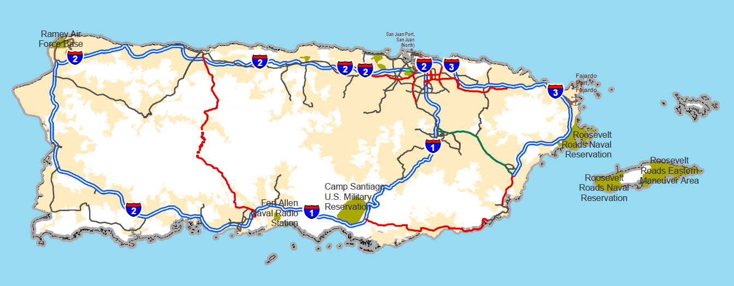
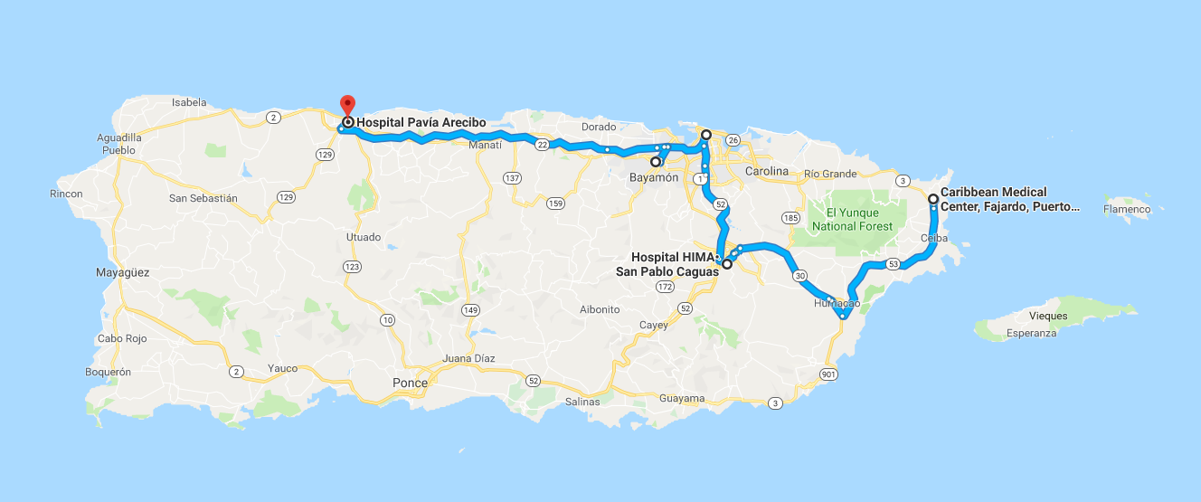

Slide 2
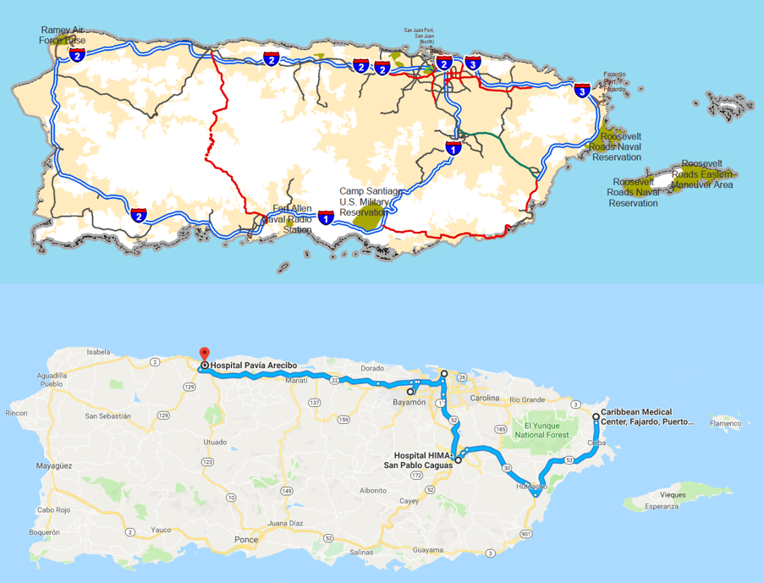

Slide 3
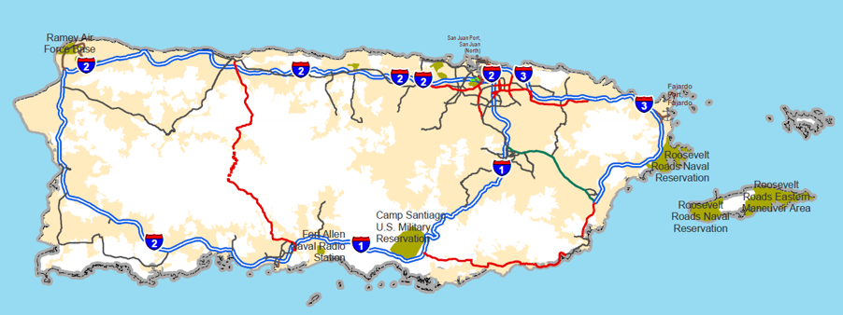
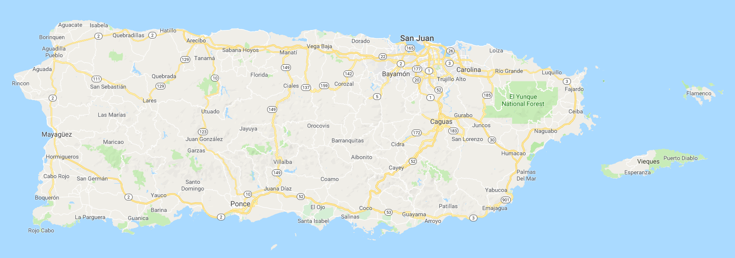
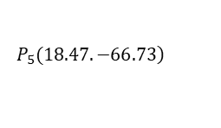

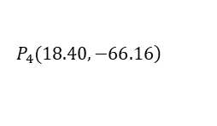

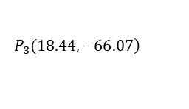

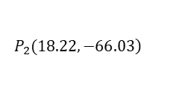

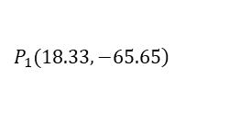


$$\left.P_{3}(18.44,−66.07\right)$$
$$60.63km$$
$$10.48km$$
$$\left.P_{5}(18.47.−66.73\right)$$
$$45.97km$$
$$\left.P_{1}(18.33,−65.65\right)$$
$$\left.P_{4}(18.40,−66.16\right)$$
$$24.82km$$
$$24.27km$$
$$41.94km$$
$$\left.P_{2}(18.22,−66.03\right)$$

Slide 4
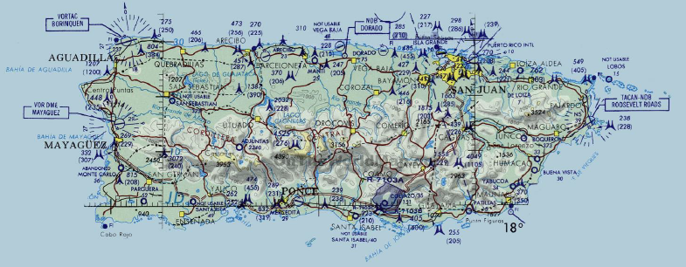
$$\left.P_{3}(18.44,−66.07\right)$$
$$60.63km$$
$$10.48km$$
$$\left.P_{5}(18.47.−66.73\right)$$
$$45.97km$$
$$\left.P_{1}(18.33,−65.65\right)$$
$$\left.P_{4}(18.40,−66.16\right)$$
$$24.82km$$
$$24.27km$$
$$41.94km$$
$$\left.P_{2}(18.22,−66.03\right)$$

Slide 5
$$\left.P_{3}(18.44,−66.07\right)$$
$$60.63km$$
$$10.48km$$
$$\left.P_{5}(18.47.−66.73\right)$$
$$45.97km$$
$$\left.P_{1}(18.33,−65.65\right)$$
$$\left.P_{4}(18.40,−66.16\right)$$
$$24.82km$$
$$24.27km$$
$$41.94km$$
$$\left.P_{2}(18.22,−66.03\right)$$

Slide 6
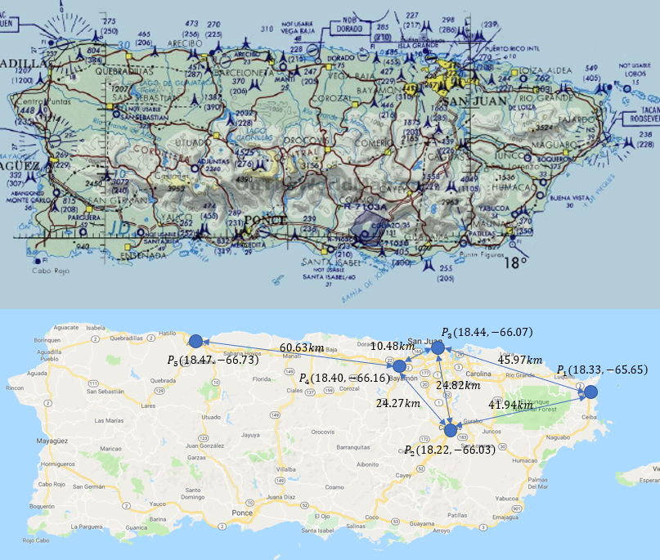
直线距离

Slide 7
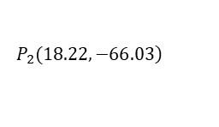

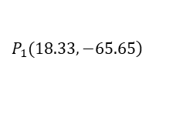

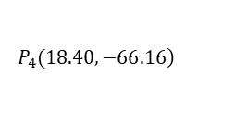

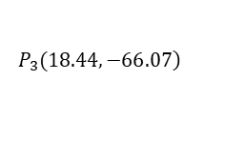
$$\left.P_{3}(18.44,−66.07\right)$$
$$60.63km$$
$$10.48km$$
$$\left.P_{5}(18.47.−66.73\right)$$
$$45.97km$$
$$\left.P_{1}(18.33,−65.65\right)$$
$$\left.P_{4}(18.40,−66.16\right)$$
$$24.82km$$
$$24.27km$$
$$41.94km$$
$$\left.P_{2}(18.22,−66.03\right)$$

Slide 8
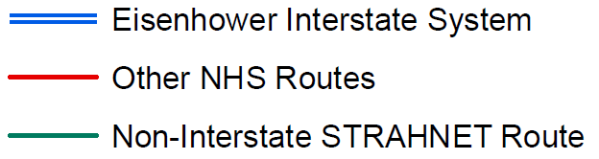








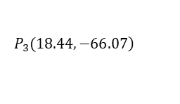





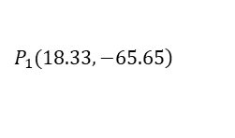




$$\left.P_{3}(18.44,−66.07\right)$$
$$\left.P_{5}(18.47.−66.73\right)$$
$$EIS_{4}$$
$$ONR_{4}$$
$$EIS_{2}$$
$$\left.P_{4}(18.40,−66.16\right)$$
$$\left.P_{1}(18.33,−65.65\right)$$
$$ONR_{2}$$
$$EIS_{3}$$
$$ONR_{1}$$
$$EIS_{7}$$
$$ONR_{3}$$
$$ONR_{6}$$
$$EIS_{1}$$
$$\left.P_{2}(18.22,−66.03\right)$$
$$NISR$$
$$EIS_{5}$$
$$P_{Humacao}$$
$$ONR_{5}$$
$$EIS_{6}$$
$$P_{Coco}$$
$$P_{Ponce}$$

Slide 9

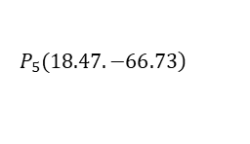





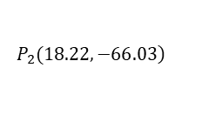

$$\left.P_{3}(18.44,−66.07\right)$$
$$\left.P_{5}(18.47.−66.73\right)$$
$$EIS_{4}$$
$$ONR_{4}$$
$$EIS_{2}$$
$$\left.P_{4}(18.40,−66.16\right)$$
$$\left.P_{1}(18.33,−65.65\right)$$
$$ONR_{2}$$
$$EIS_{3}$$
$$ONR_{1}$$
$$EIS_{7}$$
$$ONR_{3}$$
$$ONR_{6}$$
$$EIS_{1}$$
$$\left.P_{2}(18.22,−66.03\right)$$
$$NISR$$
$$EIS_{5}$$
$$P_{Humacao}$$
$$ONR_{5}$$
$$EIS_{6}$$
$$P_{Coco}$$
$$P_{Ponce}$$

Slide 10





















$$79.6\text{km}$$
$$P_{3}$$
$$P_{5}$$
$$\text{1}2.9\text{km}$$
$$\text{5}\text{1.9}\text{km}$$
$$P_{4}$$
$$\text{5}\text{7.1}\text{km}$$
$$P_{1}$$
$$\text{3}1.2\text{km}$$
$$\text{1}56.0\text{km}$$
$$\text{3}2.4\text{km}$$
$$\text{3}0.2\text{km}$$
$$\text{7}2.6\text{km}$$
$$\text{3}\text{6.5}\text{km}$$
$$P_{2}$$
$$\text{2}9.7\text{km}$$
$$\text{4}3.0\text{km}$$
$$P_{Humacao}$$
$$\text{4}5.2\text{km}$$
$$P_{Coco}$$
$$\text{7}1\text{.1}\text{km}$$
$$P_{Ponce}$$

Slide 11












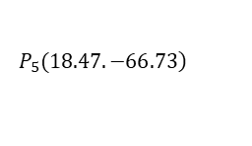




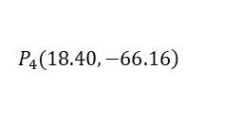







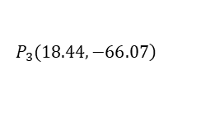





$$\left.P_{3}(18.44,−66.07\right)$$
$$\left.P_{5}(18.47.−66.73\right)$$
$$EIS_{4}$$
$$ONR_{4}$$
$$EIS_{2}$$
$$\left.P_{4}(18.40,−66.16\right)$$
$$ONR_{1}$$
$$\left.P_{1}(18.33,−65.65\right)$$
$$ONR_{2}$$
$$EIS_{3}$$
$$EIS_{7}$$
$$ONR_{3}$$
$$ONR_{6}$$
$$EIS_{1}$$
$$\left.P_{2}(18.22,−66.03\right)$$
$$NISR$$
$$EIS_{5}$$
$$P_{Humacao}$$
$$ONR_{5}$$
$$EIS_{6}$$
$$P_{Coco}$$
$$P_{Ponce}$$
$$79.6\text{km}$$
$$P_{3}$$
$$P_{5}$$
$$\text{1}2.9\text{km}$$
$$\text{5}\text{1.9}\text{km}$$
$$P_{4}$$
$$\text{5}\text{7.1}\text{km}$$
$$P_{1}$$
$$\text{3}1.2\text{km}$$
$$\text{1}56.0\text{km}$$
$$\text{3}2.4\text{km}$$
$$\text{3}0.2\text{km}$$
$$\text{7}2.6\text{km}$$
$$\text{3}\text{6.5}\text{km}$$
$$P_{2}$$
$$\text{2}9.7\text{km}$$
$$\text{4}3.0\text{km}$$
$$P_{Humacao}$$
$$\text{4}5.2\text{km}$$
$$P_{Coco}$$
$$\text{7}1\text{.1}\text{km}$$
$$P_{Ponce}$$

Slide 12
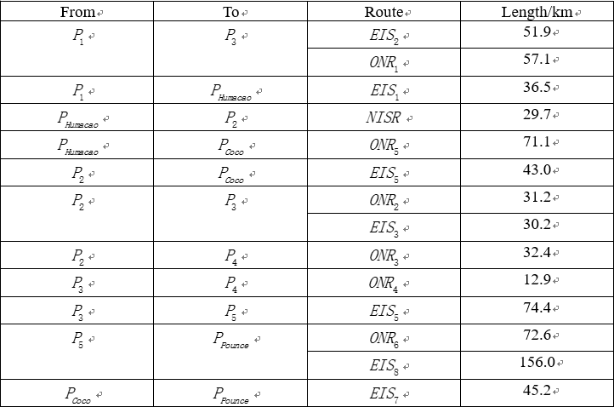

Slide 13
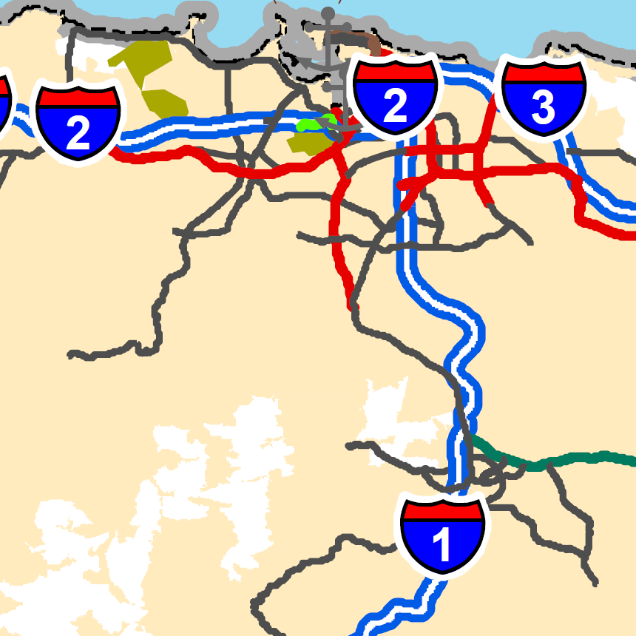
$$P_{2}$$

Slide 14
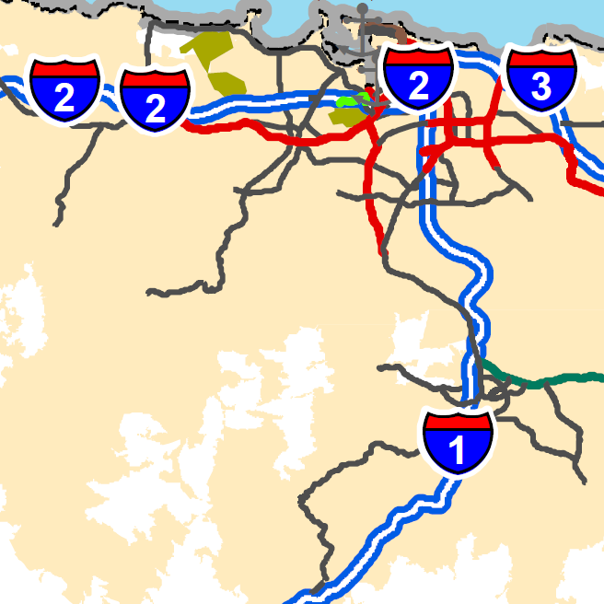
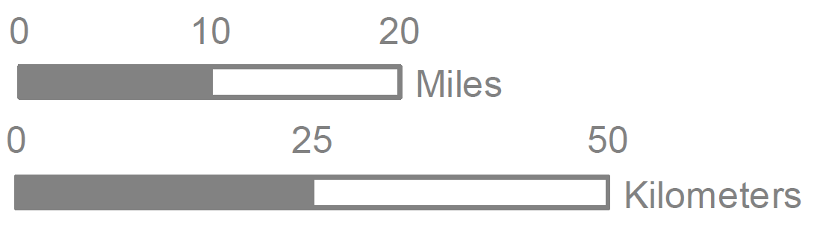

Slide 15
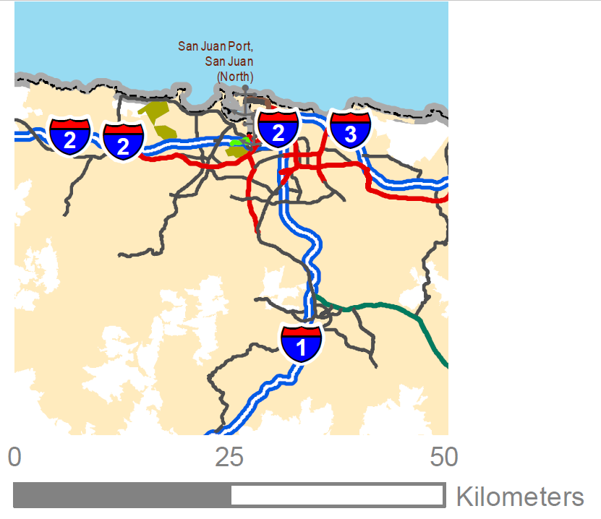

Slide 16
 |  |  |  |  |  |  |  |  |  |  |  |  | s11122

Slide 18
