Slide 1
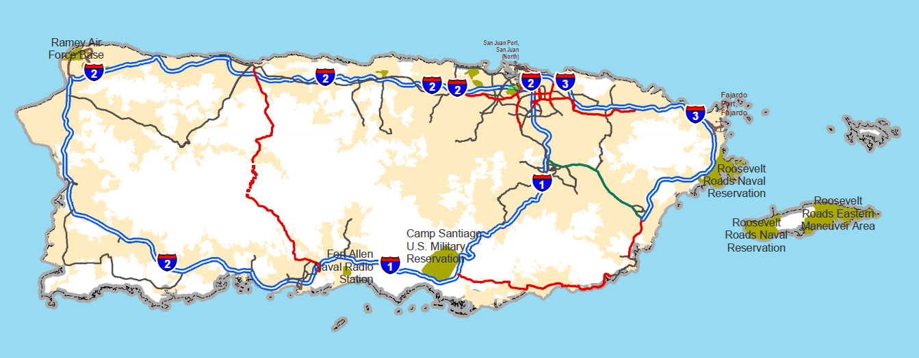
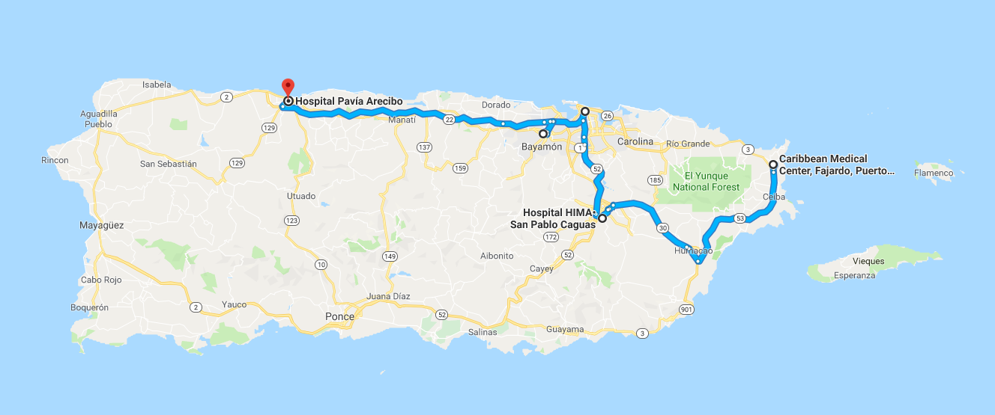

Slide 2
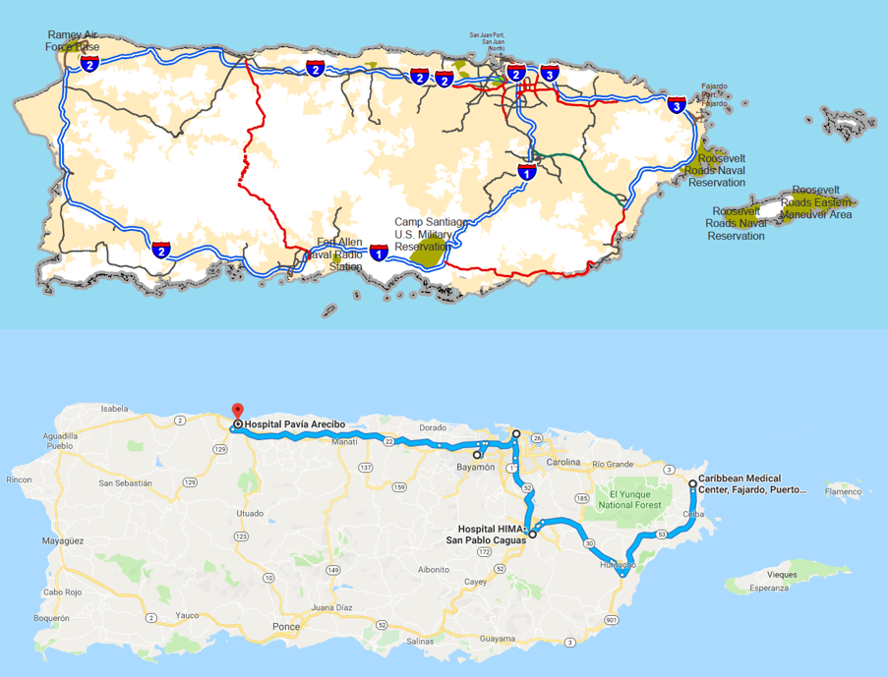

Slide 3
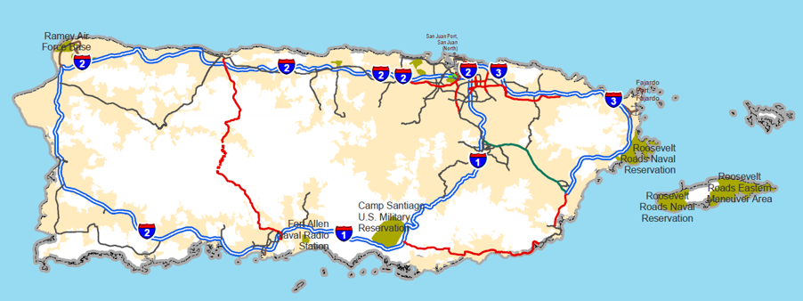
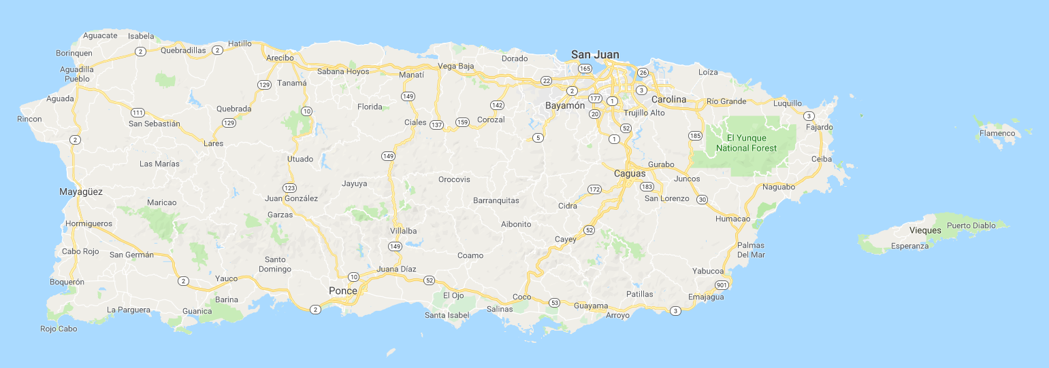
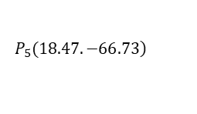

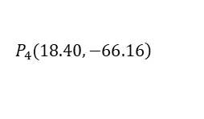

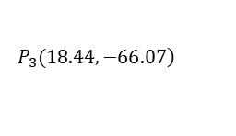

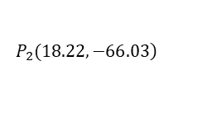

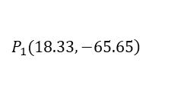


$$\left.P_{3}(18.44,−66.07\right)$$
$$60.63km$$
$$10.48km$$
$$\left.P_{5}(18.47.−66.73\right)$$
$$45.97km$$
$$\left.P_{1}(18.33,−65.65\right)$$
$$\left.P_{4}(18.40,−66.16\right)$$
$$24.82km$$
$$24.27km$$
$$41.94km$$
$$\left.P_{2}(18.22,−66.03\right)$$

Slide 4
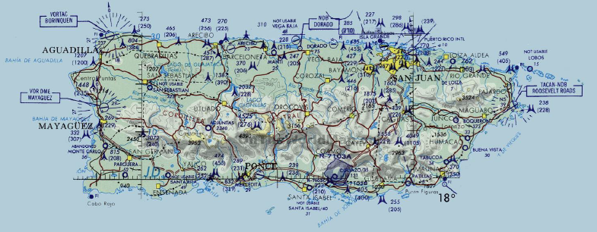
$$\left.P_{3}(18.44,−66.07\right)$$
$$60.63km$$
$$10.48km$$
$$\left.P_{5}(18.47.−66.73\right)$$
$$45.97km$$
$$\left.P_{1}(18.33,−65.65\right)$$
$$\left.P_{4}(18.40,−66.16\right)$$
$$24.82km$$
$$24.27km$$
$$41.94km$$
$$\left.P_{2}(18.22,−66.03\right)$$

Slide 5
$$\left.P_{3}(18.44,−66.07\right)$$
$$60.63km$$
$$10.48km$$
$$\left.P_{5}(18.47.−66.73\right)$$
$$45.97km$$
$$\left.P_{1}(18.33,−65.65\right)$$
$$\left.P_{4}(18.40,−66.16\right)$$
$$24.82km$$
$$24.27km$$
$$41.94km$$
$$\left.P_{2}(18.22,−66.03\right)$$

Slide 6
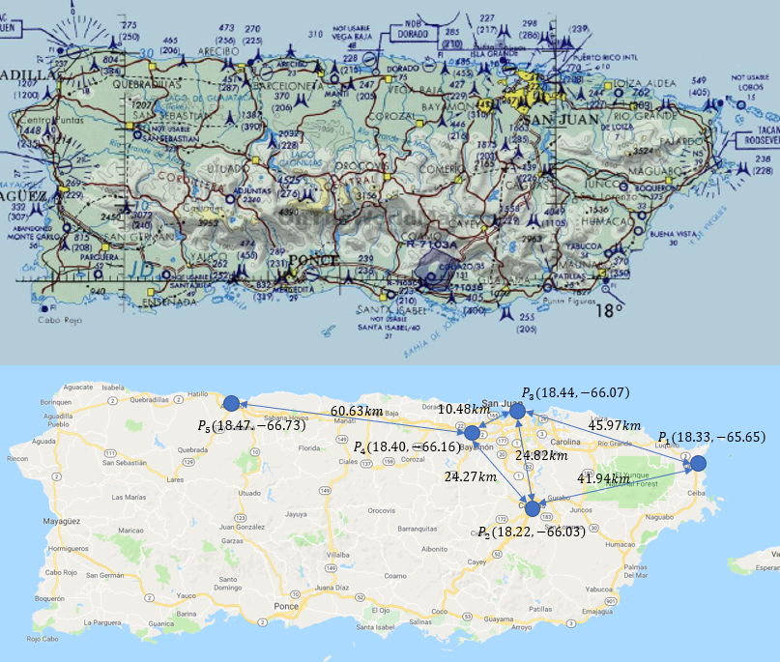
直线距离

Slide 7

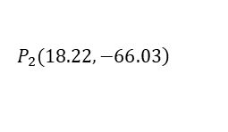

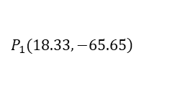

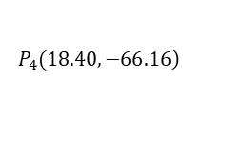

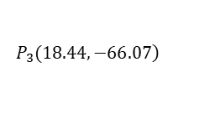
$$\left.P_{3}(18.44,−66.07\right)$$
$$60.63km$$
$$10.48km$$
$$\left.P_{5}(18.47.−66.73\right)$$
$$45.97km$$
$$\left.P_{1}(18.33,−65.65\right)$$
$$\left.P_{4}(18.40,−66.16\right)$$
$$24.82km$$
$$24.27km$$
$$41.94km$$
$$\left.P_{2}(18.22,−66.03\right)$$

Slide 8











$$(1, 0, 0)$$
$$P_{3}$$
$$(1, 1, 0)$$
$$(0, 0, 0)$$
$$P_{5}$$
$$(5, 2, 3)$$
$$P_{4}$$
$$P_{1}$$
$$(1, 0, 1)$$
$$(2, 0, 1)$$
$$(0, 0, 0)$$
$$P_{2}$$

Slide 9
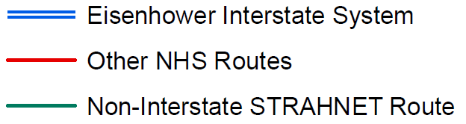









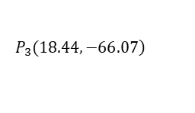





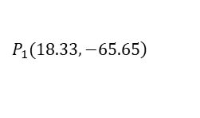




$$\left.P_{3}(18.44,−66.07\right)$$
$$\left.P_{5}(18.47.−66.73\right)$$
$$EIS_{5}$$
$$ONR_{4}$$
$$EIS_{2}$$
$$EIS_{4}$$
$$\left.P_{1}(18.33,−65.65\right)$$
$$\left.P_{4}(18.40,−66.16\right)$$
$$ONR_{1}$$
$$ONR_{2}$$
$$EIS_{3}$$
$$EIS_{8}$$
$$ONR_{3}$$
$$ONR_{6}$$
$$EIS_{1}$$
$$\left.P_{2}(18.22,−66.03\right)$$
$$NISR$$
$$EIS_{6}$$
$$P_{Humacao}$$
$$ONR_{5}$$
$$EIS_{7}$$
$$P_{Coco}$$
$$P_{Ponce}$$

Slide 10
$$\left.P_{3}(18.44,−66.07\right)$$
$$\left.P_{5}(18.47.−66.73\right)$$
$$EIS_{5}$$
$$ONR_{4}$$
$$EIS_{2}$$
$$EIS_{4}$$
$$\left.P_{1}(18.33,−65.65\right)$$
$$\left.P_{4}(18.40,−66.16\right)$$
$$ONR_{1}$$
$$ONR_{2}$$
$$EIS_{3}$$
$$EIS_{8}$$
$$ONR_{3}$$
$$ONR_{6}$$
$$EIS_{1}$$
$$\left.P_{2}(18.22,−66.03\right)$$
$$NISR$$
$$EIS_{6}$$
$$P_{Humacao}$$
$$ONR_{5}$$
$$EIS_{7}$$
$$P_{Coco}$$
$$P_{Ponce}$$

