Slide 1

Team-Name:VIJAY04 Track-2:Gaming-DiceRollingGame
Gaming
Design a game or gaming platform on Tezos that leverages the benefits of Web3

Slide 2
Objectives:
A group of people (invite only) can join only by Using Unique Game Code Set By the Admin
All winners receive prizes(Based on Their Bet Amount)
The Winner with high bet amount receives the highest share
For Example:
Bob(winner,bet_amount=10xtz)
Alice(winner,bet_amount=20xtz),
ack(Runner,bet_amount=10xtz)
Winners_total_bet=(10+20)xtz=30xtz
Total Pool=(10+20+10)xtz=40xtz
Bob_share=(bob’s bet_amount/winners_total_bet)*total_pool=(10/30)*40= 13.33xtz(3.33xtz profit)
alice_share=(alice’s bet_amount/winners_total_bet)*total_pool=(20/30)*40= 26.66xtz(6.66xtz profit)

Slide 3
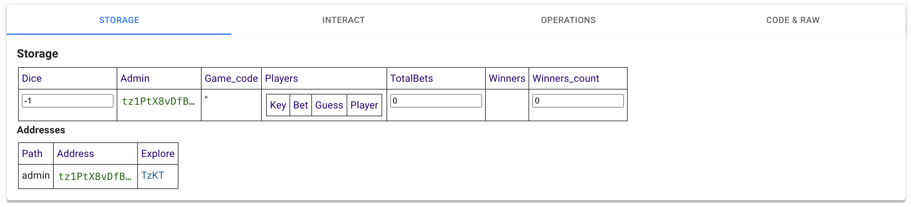

At_initiation:
Dice->-1 (To represent Dice Not Set By the User Yet )
Initial setup

Slide 4
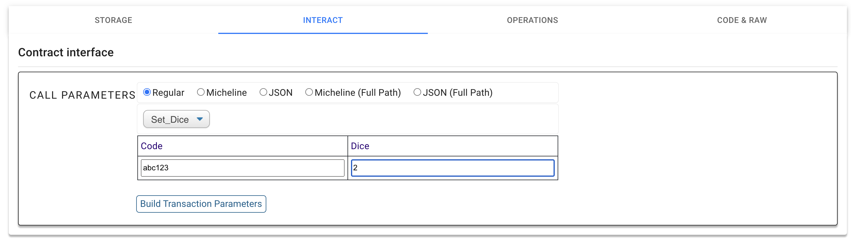

Game Initiated By the admin:
Note:
1) Code and Dice Can only be Set By the Admin(Using Set_Dice()EntryPoint)
2)Here admin is already set to (“tz1PtX8vDfBFsD5GJEmrCdXiqabETCvLVaYp”)

Slide 5
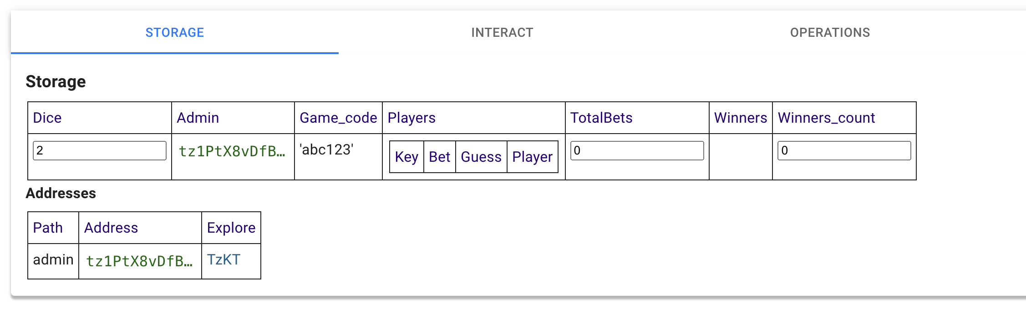


After Game initiated By the admin:
Note:
1)Dice was Set and Game_Code Is created
2)Players can only join with the game code or else Exception reported.
Null because players didn’t yet joined

Slide 6
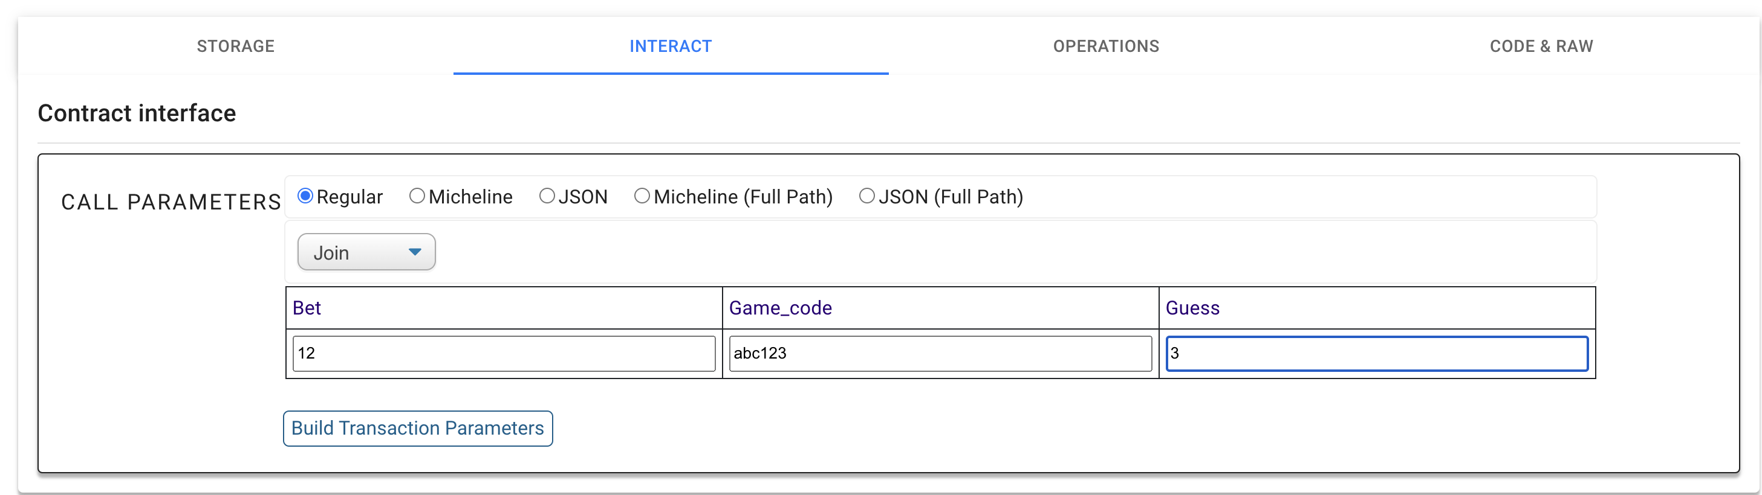

Adding Players:
Note:
1)Bet Amount is in Tez Type(xtz).
2)Game_code Must be valid or else not executed.
3)Guess is set by the player.

Slide 7
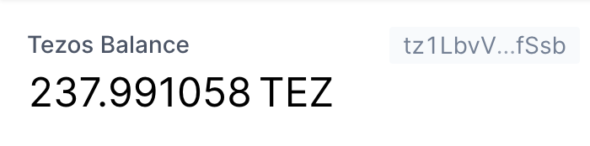
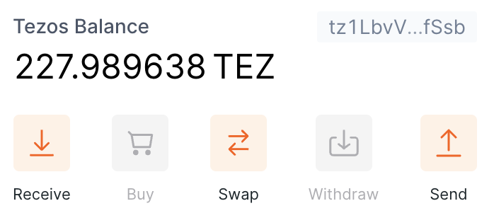
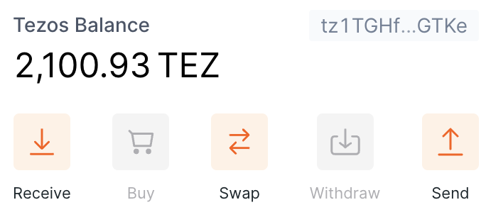
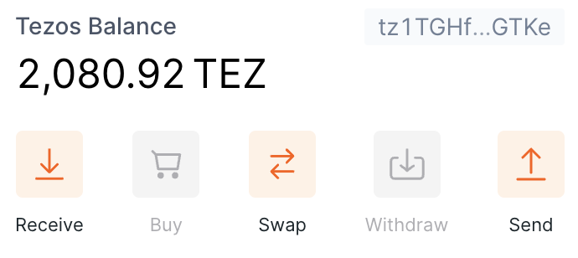
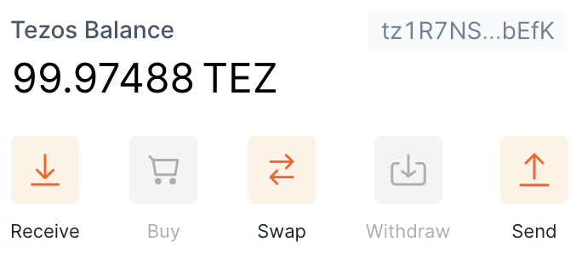
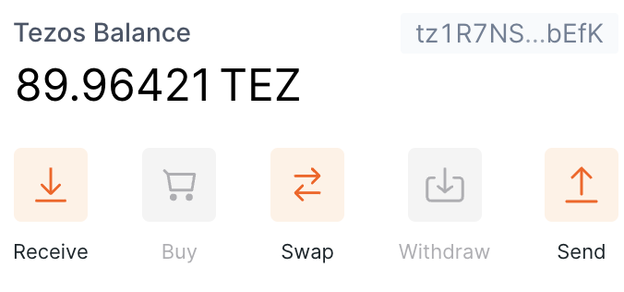




Adding Players:(Added 3 Players)
Before
After
1)
-10xtz
-20xtz
-10xtz
(With
Gas
Price)
2)
3)

Slide 8
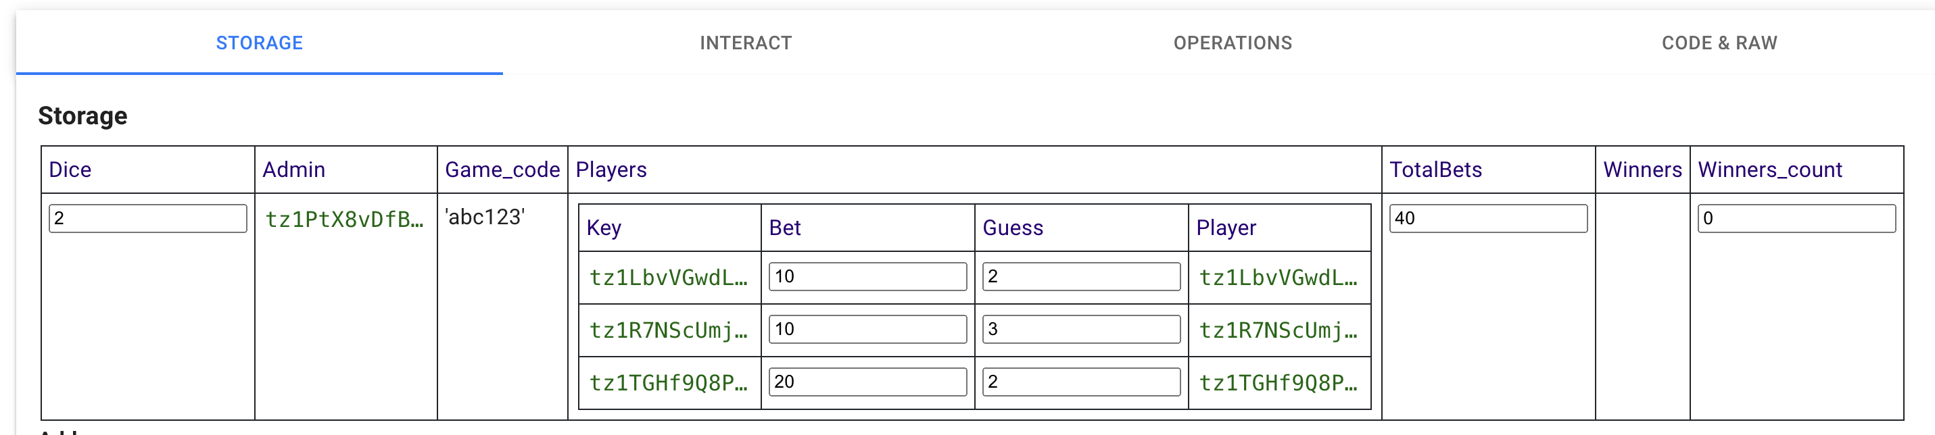

Storage, After Adding Players:
Available only
After revealing
Result(at slide 10)

Slide 9
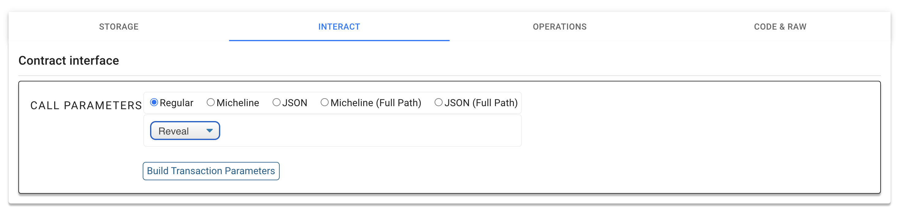

Revealing Results:For all Players

Slide 10
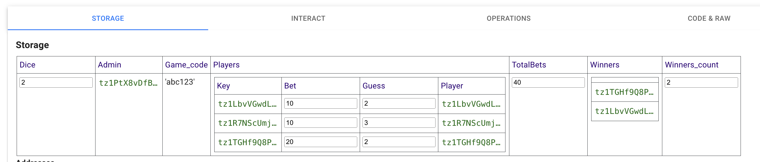
Storage, After Reavealing Results:
Now,
1)Winners list is assigned
2)Totalbets is Calculated
3)Winners count also calculated
Note:
!)Prizes are Only distributed to the winners ,when admin initialte(Distribute())->On Next Slide

Slide 11
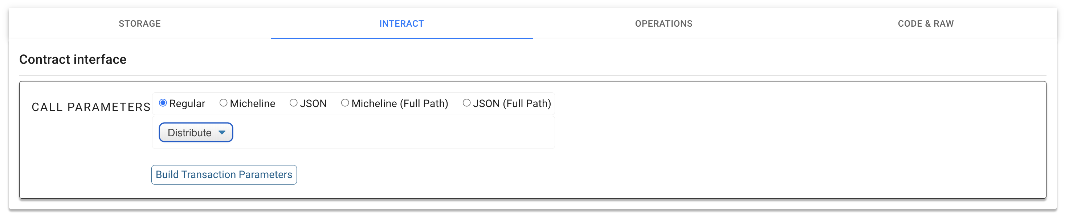

Distribution Of Prizes:

Slide 12
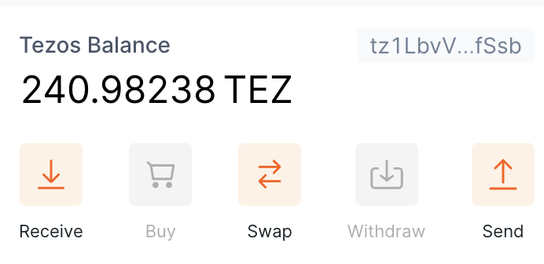
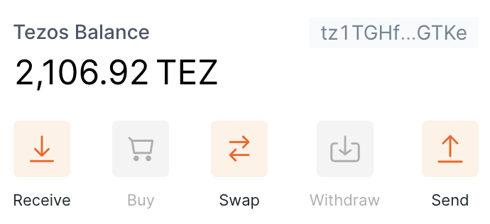
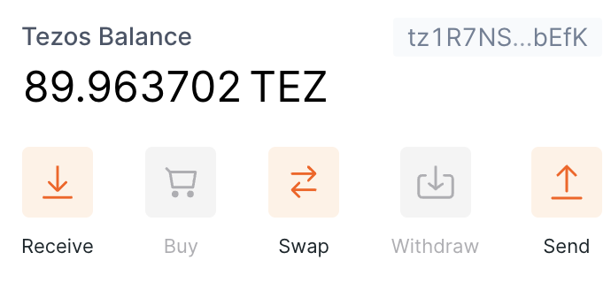
Balance After Result:
1)
Bob’s_Profit:
3.33 Xtz
Alice’s_Profit:
6.66 xtz
Jack’s_Profit:
-10 xtz(loss)
Refer:silde-2,7 For Better Understanding.
2)
3)

Slide 13
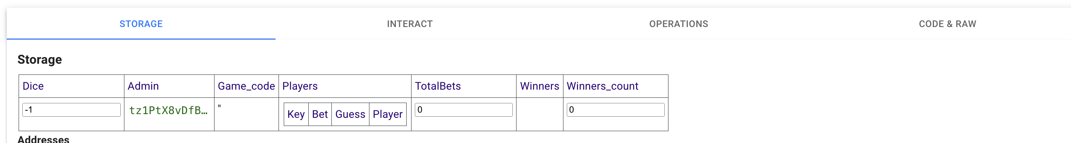
After Game Over Storage Set To default:
After Prize-distribution:
Storage->

Slide 14
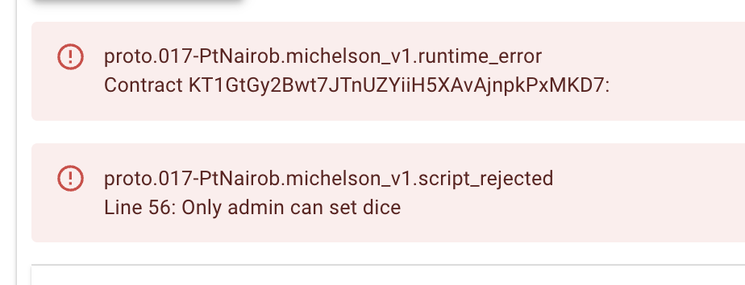
Errors handled:Un-authorized game Creation

Slide 15
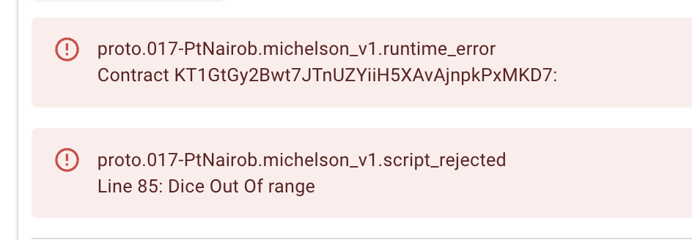
Errors handled:Dice out of range

Slide 16
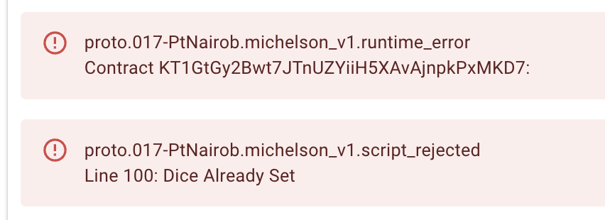
Errors handled:Try to update dice at middle of the game

Slide 17
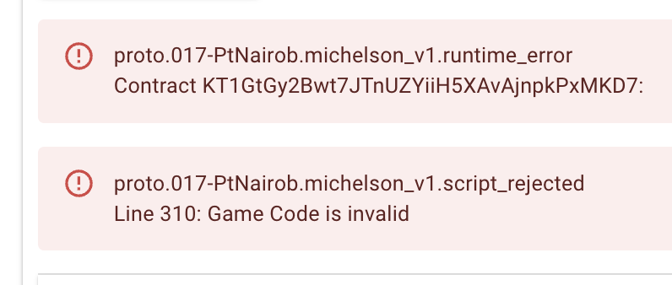
Errors handled:Invalid Game Code

Slide 18
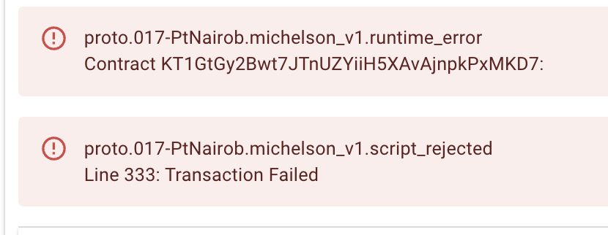
Errors handled:Transaction failure on Low balance

Slide 19
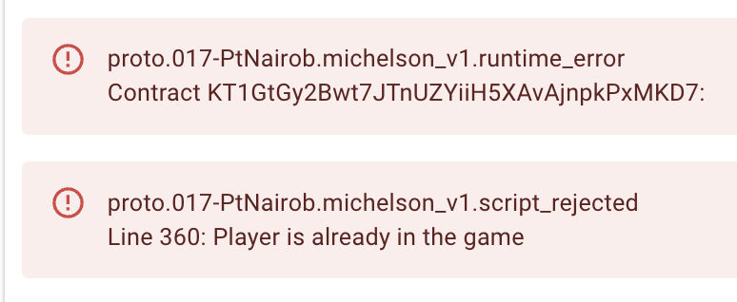
Errors handled:No Duplicate Player

Slide 20
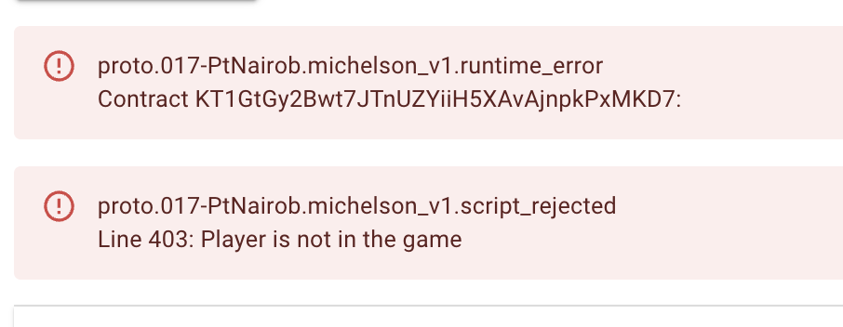
Errors handled:Player Not in game

Slide 21
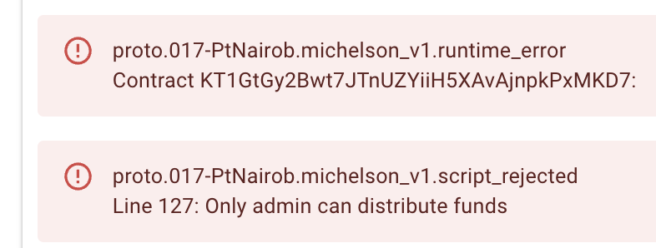
Errors handled:Only admin can distribute prizes

Slide 22
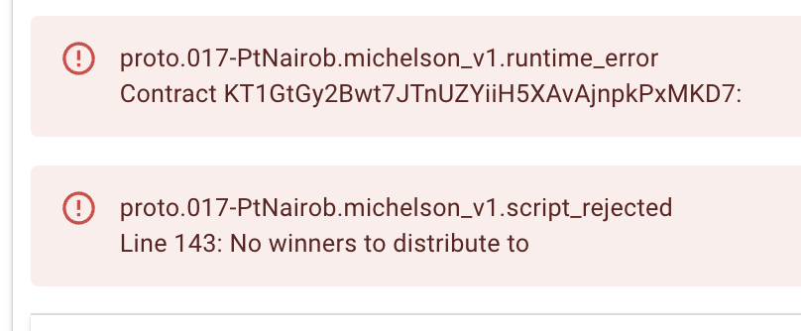
Errors handled:Trying to distribute prizes before result

