Slide 1

Oilfield Calculations
The Coding Bootcamp
April 29, 2017
Notes:
1

Slide 2

The Problem
Notes:
Oilfield personnel need a quick and easy way to do calculations to answer customer questions on an oil rig.
2

Slide 3
The Current Solutions
Notes:
They are distracting and full of ads
They don’t save your data
They are a dime/dozen – it’s hard to tell which are reliable
The reliable ones are hard to use
Current solutions can be hacked (DillingFormulas.com spreadsheet)
3

Slide 4
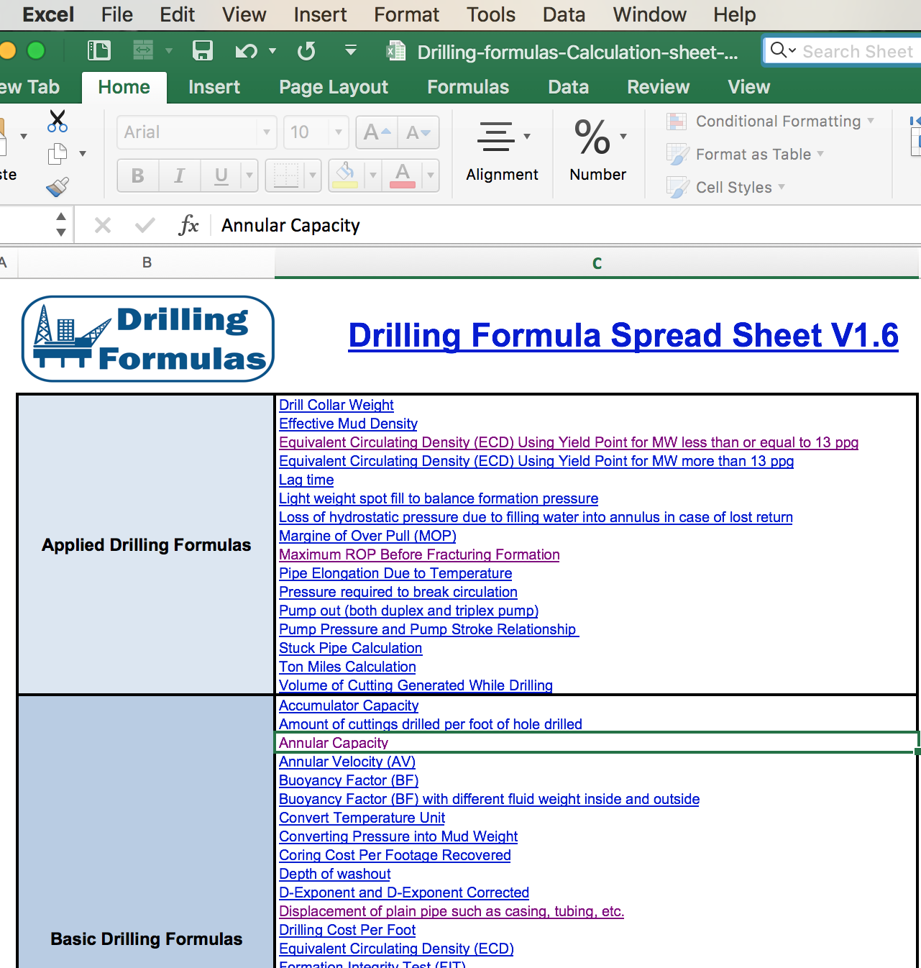
Drilling
Formulas
www.DrillingFormulas.com
Notes:
Example of “The reliable ones are hard to use”
4

Slide 5
The Tomagocha Solution
Notes:
Saves your data (using Firebase and cookies)
Clean and professional with no ads (woohoo!)
Can’t be hacked (because we use Sheetsu to access DrillingFormulas.com’s calculations)
Based on a reliable solution but made FAR easier
5

Slide 6
Front End
mth4.co/oilfield-calc
Clean and professional
No ads
Clear prompts
Input validation
Recent calculations
Local weather
Notes:
https://mathfour.github.io/Oilfield-Calculations/

Slide 7
Back End
Google Sheets
Firebase
GitHub Pages

Slide 8
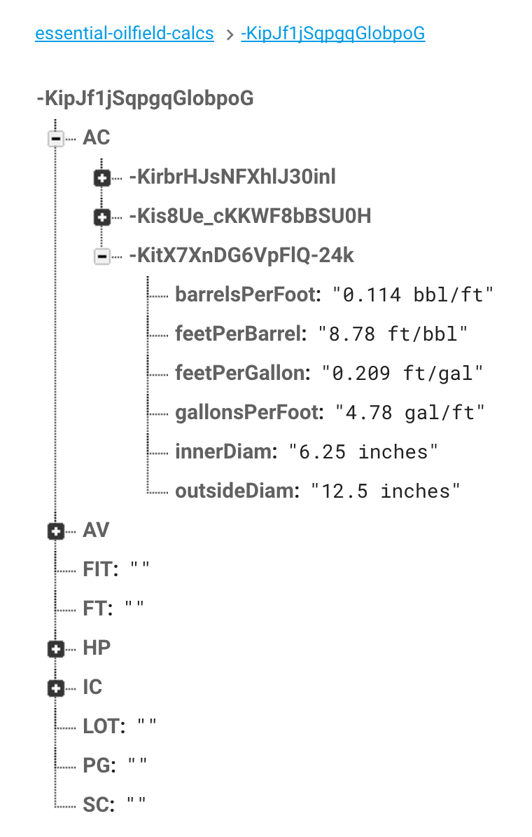
Notes:
Example of Firebase database layout

Slide 9
Under the Hood
API for Google Sheets
Sheetsu
AJAX
Push to one sheet
Get from many sheets
Persistent Data
Firebase generated cookies

Slide 10
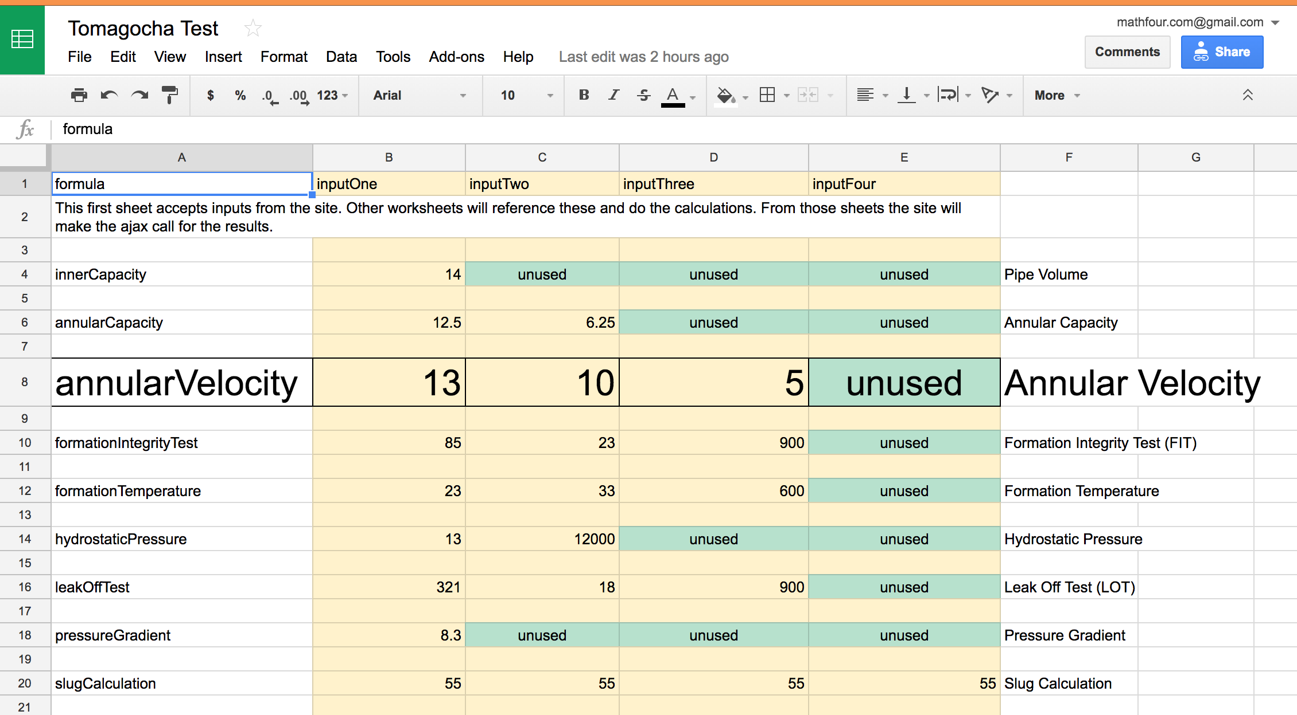
Notes:
Example of how the inputs are passed into a single spreadsheet. (text enlarged for ease of reading)

Slide 11
Next Steps
Notes:
11

Slide 12
Improvements and Coming Features
Mobile responsive
Premium service
Evernote/OneNote integration
All formulas
Improve code

Slide 13
Participate
https://github.com/mathfour/
Oilfield-Calculations
Quality coding standards
GitHub Issues up to date
Fork or request access today!

Slide 14
Questions

Slide 15
Tomagocha
Oilfield Calculations
April 29, 2017
Notes:
15

