Slide 1
Kinetic simulation of disease transmission
Max Curie

Slide 2
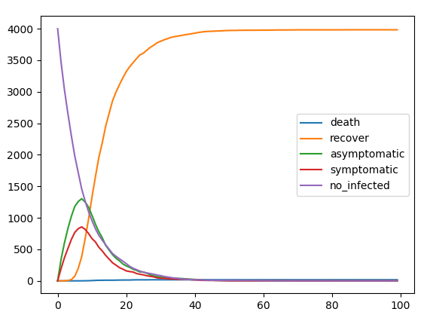
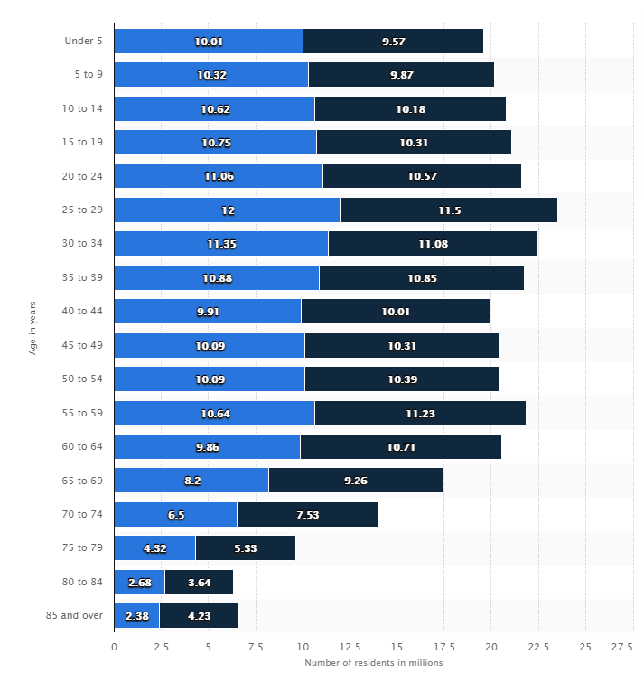
Kinetic simulation

Slide 3
Work during the Hackathon
Analyze data set from CDC for age distribution of the disease
Analyze data for indirect impact of COVID
Traveling(mobility)
Mental health
Physical health not related to COVID
Propose strategy for future plague
And more!

Slide 4
