Slide 2
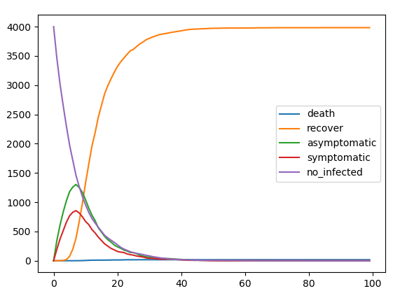
Non kinetic simulation
Kinetic simulation

Slide 3
