Slide 2
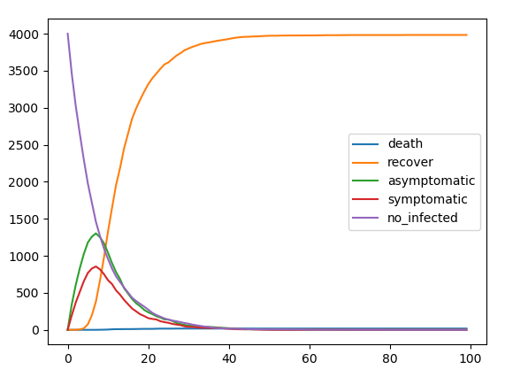
Non kinetic simulation

