Slide 1
DDP – Final Presentation – Group 31
A co-design approach for implementing the RSA algorithm

Slide 2
Our implementation
~22 millions of CPU cycles for decrypting
33.61 % LUTs usage
19.85 % of Registers
Optimizing Area impacts positively
The speed
FLEXIBILITY
AREA
TIME
Fig.1 : Performance triangle
Notes:
I am positioning the point following the average

Slide 3
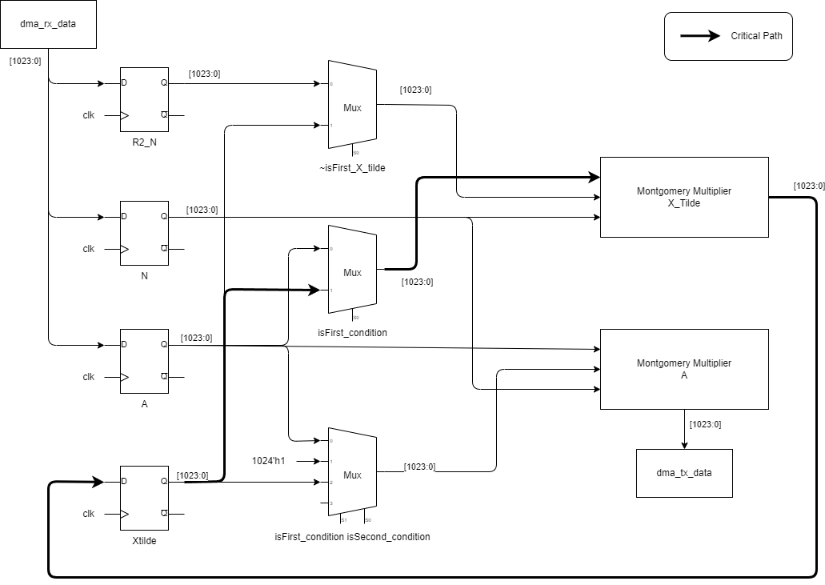
HW/SW boundaries
Loading phase for R2_N and N
Power Ladder Algorithm 4 possible stages
First X_tilde
Bit = 1
Bit = 0
Mont(A,1,N)
Fig.2 : Hardware of the Power Ladder implementation

Slide 4
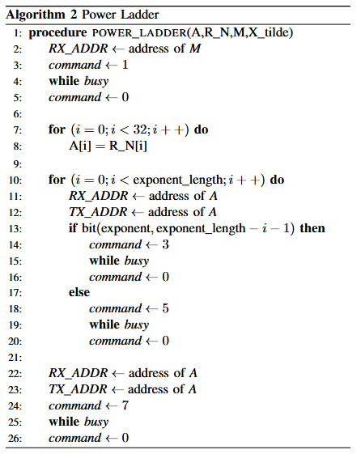
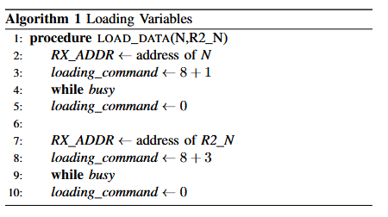
HW/SW interface
Fig.3 : Loading stage
+ 2 distinctive stages : added modularity
- Hard coding the algorithm : reduces flexibility
Fig.4 : Power Ladder stage

Slide 5
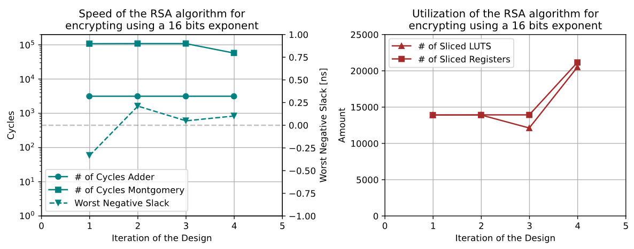
Results
Hardware
CPU Cycles : 381 100
LUTs : 17 614
REGs : 21 123
WNS : 0.102 ns
Software
Works with all test vectors
Fig.5 : Performance throughout the iterations

Slide 6
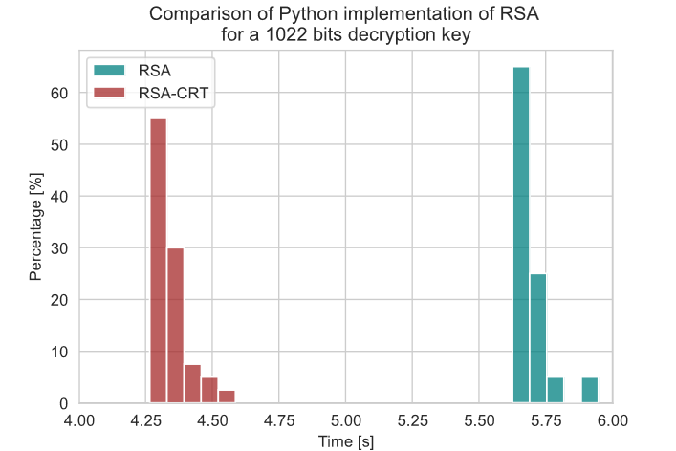
Going Beyond
Better User Experience
Can encrypt user provided string of text
Small library of functions to add layer of abstraction
Chinese Remainder Theorem [1]
Decrypting is expensive → reduce computation time
Divide and Conquer approach
Fig.6 : Speed up of RSA decryption using the CRT
[1] : Special thanks to Artur Folwarczny for introducing us this piece of mathematics

Slide 7
Thank you
Any Questions ?

