Slide 1


Project :
CAFE VINE
Guiding faculty: Mr. Nguyen Duc Thao
Members:
    - Nguyen Viet Huynh
    - Nguyen Anh Tan
    - Nguyen Van Trong
Da nang, 19 th September 2017

Slide 2

Content
1. Introduction
2. Introduce the software
3. software interface
4. Advantages & disadvantages
5. Development

Slide 3
I.Introduction
In the field of business, the need for commodity management is very necessary. In addition, you need to manage the staff well to ensure that you are doing well
And, workloads are getting bigger with the change and development of technology and the economy is booming.
So our team has built such management software to meet the management needs of the goods, which is the main idea of this project.

Slide 4
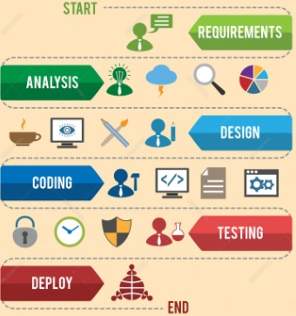
II. Introduce the software
* Software Development Overview:

Slide 5

II. Introduce the software
* Software overview includes:
Login, Log off
A User Management
Administrator interface and User interface
Product Functions
Order Functions

Slide 6
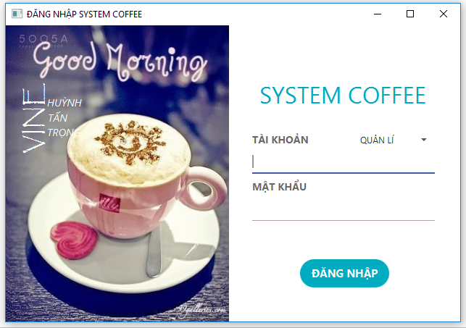
III. Software interface
login interface

Slide 7
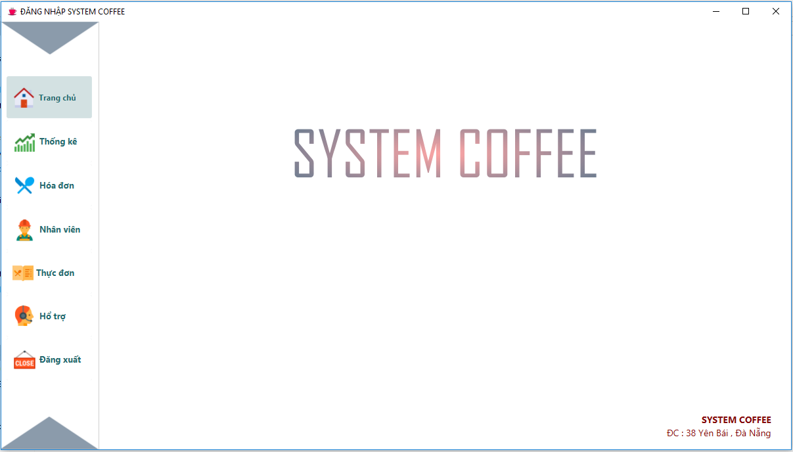
Home

Slide 8
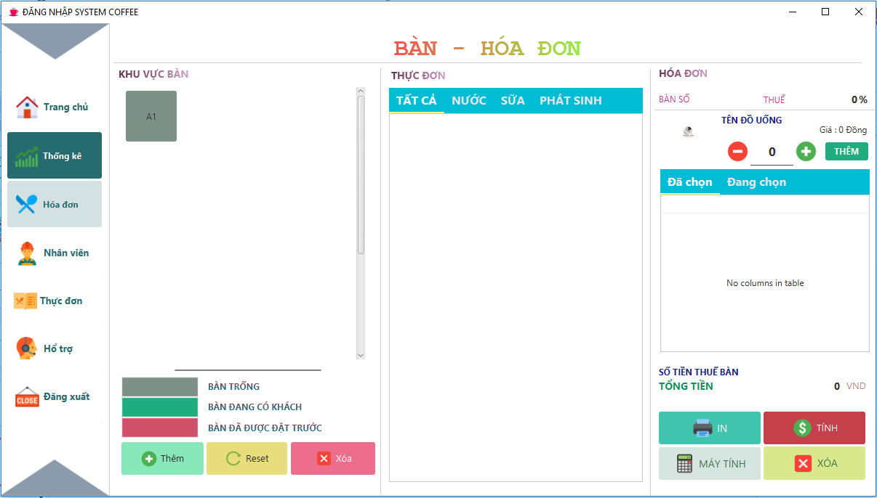
Tables and bills

Slide 9
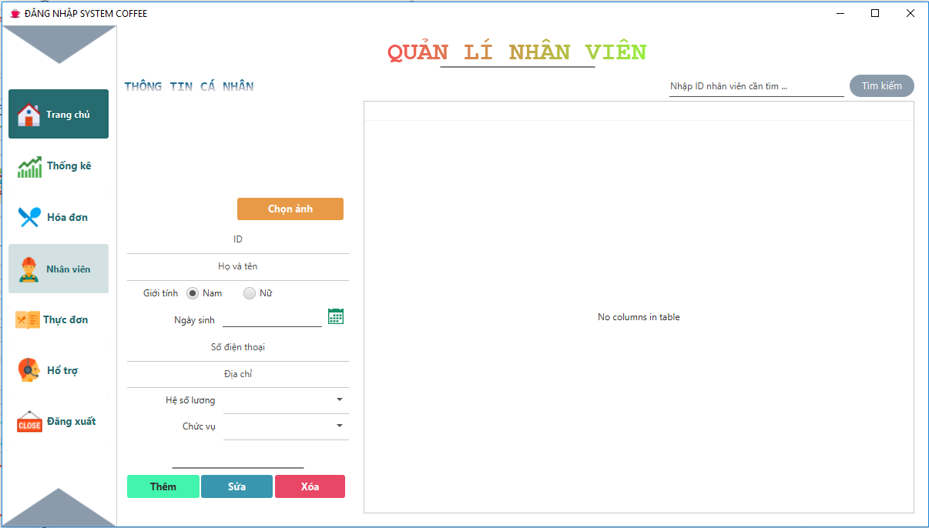
Employee management

Slide 10
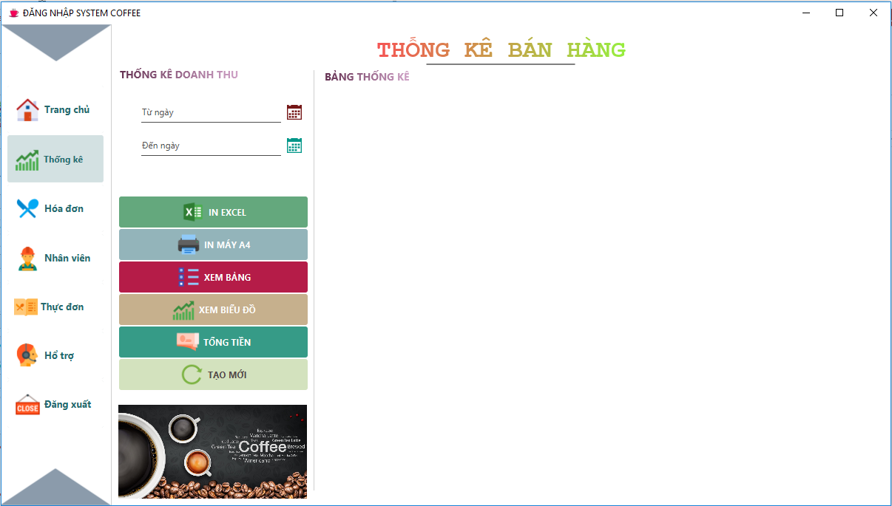
Sales statistics

Slide 11
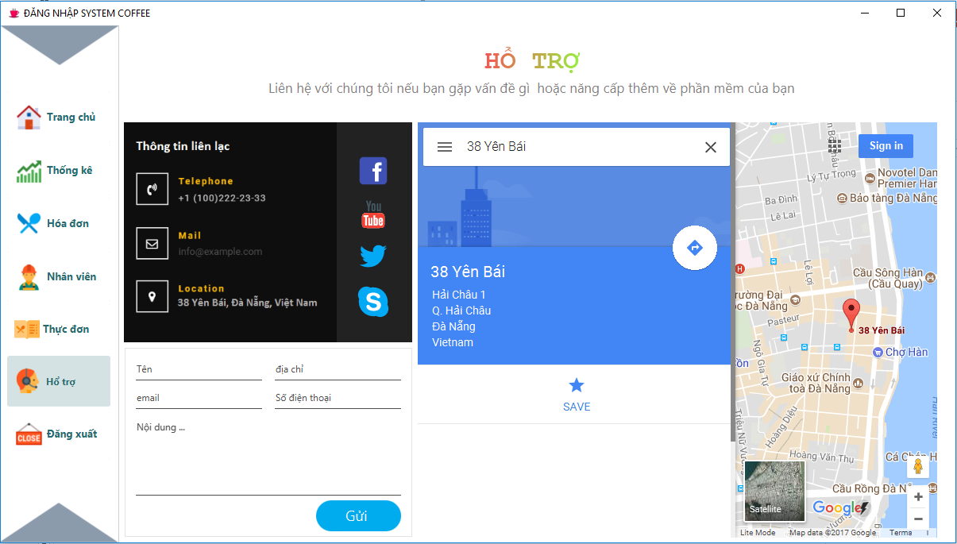
Contact support

Slide 12




IV.Advantages & disadvantages
$∎$ Easy to use, easy to manage
$∎$Some functions are incomplete
$∎$Saves times

Slide 13

V. Development

Slide 14


