Slide 1
Fake Review Detection in the Education Sector
Machine Learning, NLP, and Power BI Dashboard
Tushar Goswami

Slide 2
Project Overview
Online reviews strongly influence students when selecting educational institutions.
Fake or manipulated reviews can mislead prospective students.
Most fake review datasets exist for hotels, restaurants, and e‑commerce.
There is limited labeled data available for the education sector.

Slide 3
Project Objectives
Develop a machine learning model to detect deceptive reviews.
Apply Natural Language Processing (NLP) techniques to analyze review sentiment.
Create interactive Power BI dashboards to visualize insights.
Generate strategic insights and recommendations for institutions.

Slide 4
Data Collection
Fake review datasets collected from Kaggle and HuggingFace.
These datasets were used to train the machine learning model.
Education reviews were scraped from educational institution review platforms.
Final dataset analyzed: 350+ education-related reviews.

Slide 5
Machine Learning & NLP Workflow
Data Cleaning and Preprocessing
Education domain keyword filtering
TF‑IDF Feature Extraction
Logistic Regression Fake Review Detection Model
Sentiment Analysis using VADER (NLTK)

Slide 6
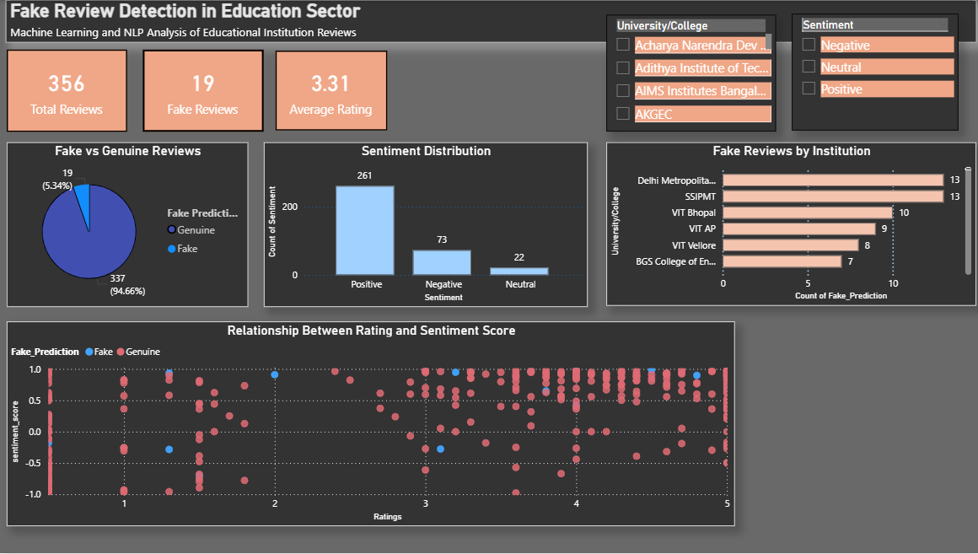
Power BI Dashboard Overview

Slide 7
Key Insights
Around 5% of reviews were predicted as potentially deceptive.
Most reviews show positive sentiment.
Certain institutions show higher concentrations of fake reviews.
Fake reviews often have very high sentiment scores and ratings.

Slide 8
Recommendations
Implement automated fake review detection systems using AI.
Encourage verified student reviews for authenticity.
Monitor unusual spikes in positive or negative sentiment.
Introduce review credibility indicators for transparency.

Slide 9
Conclusion
Machine Learning and NLP techniques can help detect deceptive reviews.
Combining cross-domain fake review datasets with scraped education reviews enables meaningful analysis.
Power BI dashboards help visualize review authenticity and sentiment trends.

